Slide 1
Welcome!
We would like to know who attends the training today so please sign in via chat:
Name
Email address
In order for us to be able to verify your attendance at today’s training, we need the above information which we will report to CASAS. You will then be able to request an attendance certificate from CASAS.
If you are having difficulty with the program, please chat to:
Marty Olsen
Stacy Everding
Materials for today’s training:
https://tinyurl.com/yyk8n8d7
CASAS IT PPT for today’s training:
https://tinyurl.com/y38tce68
M

Slide 2


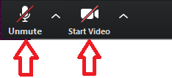
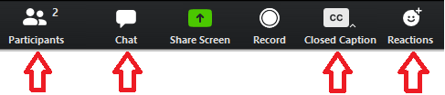
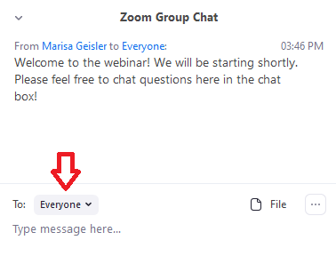
For tech help, private chat to Linda Keller
In the upper right corner – choose view
At the bottom (hover your mouse to reveal)
Keep mic and video off (looks like this – red line)

Slide 3

Administering
CASAS Life & Work and CASAS GOALS
Marty Olsen Stacy Everding
martha.olsen@gmail.com stacy.everding@isd518.net
Notes:
NOTE:
To change the image on this slide, select the picture and delete it. Then click the Pictures icon in the placeholder to insert your own image.

Slide 4
Agenda
CASAS Overview
NRS-approved CASAS tests for ESL and ABE learners
Review – Standardized Testing Process
Reading GOALS Overview, Blueprints
Math GOALS Overview, Blueprints
Resources
CASAS eTests
Questions
S

Slide 5

Implementation Modules training.casas.org
LINK
Module 1: Implementation Basics
Module 2: CASAS eTests Implementation
Module 3: Paper Test Implementation
Module 4: Interpreting Test Results and Reports
:
User Role* | Module 1 | Module 2 | Module 3 | Module 4
Tester – Administer eTests only | x | x |  | Optional
Tester – Administer Paper only | x |  | x | Optional
Tester – Administer eTests & Paper | x | x | x | Optional
Teachers | x |  |  | x
  *Testers must complete at least two modules, including Module 1.

Slide 6
Getting to Know You - Poll
What is your role in ABE?
Program Support Staff (Intake, Assessment, Data Management
ESL Instructor
GED Instructor
Program Manager
Other

Slide 7
Getting to Know You - Poll
What is your level of experience with CASAS?
Less the 3 months
3 months to 1 year
1 to 5 years
5 to 10 years
More than 10 years

Slide 8
About CASAS
Comprehensive Adult Student Assessment System
Non-profit organization started in 1980 to develop basic skills assessments for adult education programs
National leader in adult basic education and adult ESL assessment
Approved by the U.S. Department of Education for NRS Reporting for ABE and ESL
Used in 36 states and internationally

Slide 9

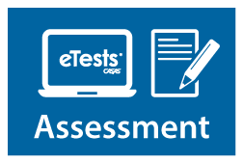


Integrated System Approach
Basic Skills Content Standards and
CASAS Competencies
Reading, Listening, Math Assessments
Paper or computer-based testing (eTests)
QuickSearch Online – free resource to find instructional material titles
TOPSpro Enterprise (TE) – data accountability software to score and track student test scores and generate reports

Slide 10
Tests Overview
M – Sign in reminder

Slide 11




How the System Works
Use CASAS Locator or Appraisal to find appropriate pretests and place students in program.
Use CASAS post-tests to measure learning gains and document completion of NRS EFLs.
Use CASAS pretests to place students into NRS Educational Functioning Levels (EFLs) and identify instructional needs.
Use pretest results to guide teaching.
Use QuickSearch Online to find curriculum resources.
Notes:
1. Placement:
The Locator available only for computer-based testing (CASAS eTests).
The locator test takes up to 15 minutes. An Appraisal test is typically 30-40 minutes.
2. Pretest:
Be sure to assess students in the same assessment series for their pretest and subsequent post-tests.
3. Instruct:
CASAS offers an online tool, QuickSearch Online, to locate instructor-recommended resources for classroom teachers.
4. Post-test:
CASAS recommends post-testing students after 70-100 instructional hours (or a minimum of 40 hours).

Slide 12








Uses of Test Results
CASAS progress tests (pretests and post-tests) have four principal uses:
  to identify a student’s skill level
  to guide instruction
  to measure learning progress
  for accountability reporting
Level A
Level B
Level C
Level D

Slide 13








CASAS Assessments for ESL
**Now approved through February 2, 2023:
Life and Work Reading (80 Series)
Beginning Literacy (Forms 27 and 28)
Life and Work Listening (980 Series)
Reading GOALS and Listening GOALS
Final form studies in progress
To be submitted for NRS approval in 2022

Slide 14

CASAS Assessments for ABE
CASAS Reading GOALS (900 Series) –
  Greater Opportunities for Adult Learning Success
  Approved through February 5, 2025
CASAS Math GOALS –
  **Now approved through March 7, 2023
Strongly aligned with College and Career Readiness Standards
Reading – assesses higher order thinking skills (Depth of Knowledge), complex informational text, and vocabulary, including academic language
Math – math concepts assessed in common life and work applications

Slide 15
Test Timing
To test in two modalities, it takes 2.5 – 3 hours
Intake
  Locator (eTests only) – 15 minutes or
  Appraisal (paper) – 30 minutes
Pre- and post-tests
  ABE
      Reading GOALS – 60 or 75 minutes
      Math GOALS – 60 or 75 minutes
      ESL
      Life and Work Reading – 60 minutes
      Life and Work Listening – 49 to 52 minutes

Slide 16
About CASAS Assessments
Measure academic skills in context of common life and work scenarios
Group or individual administration – practical for large or small groups
Re-usable paper test booklets – cost effective
Sample Test Items for test preparation available at no cost on the CASAS website
eTests (computer-delivered):
  Improves quality of assessment
  Reduces staff time
  Affordable ($1.75 to $2.85 per test)

Slide 17
Check for Understanding
Which test series is most appropriate for English language learners?
  Life & Work
  GOALS
Which test series is appropriate for ABE learners?
  Life & Work
  GOALS
Which Math test is approved for NRS reporting?
  Life Skills
  GOALS

Slide 18
CASAS Assessment Process
S

Slide 19
Accommodations in
Test Administration Procedures
Link
You may provide these accommodations in testing conditions for documented disabilities without contacting CASAS:
  allowing extended time
  giving supervised breaks
  providing a sign language interpreter (for test administration directions only)
  testing in an alternate room
It is not an appropriate accommodation to read a CASAS test or to allow use of a vocabulary pen, dictionaries, calculators or other electronic devices.
Refer to CASAS Assessment Accommodations at CASAS.org for more information
MN Disabilities Website: https://pandamn.org/accommodations/casas-comprehensive-adult-student-assessment-system/ Details specific accommodations that may be used that will not decrease the validity of the test.
Notes:
The latest information CASAS Policies on Accommodations is posted on the CASAS website.
There are many different types of accommodations. If the information you need on the accommodations is not on the website, contact CASAS.
Point out that the MN Disabilities website has specific details about accommodations.

Slide 20
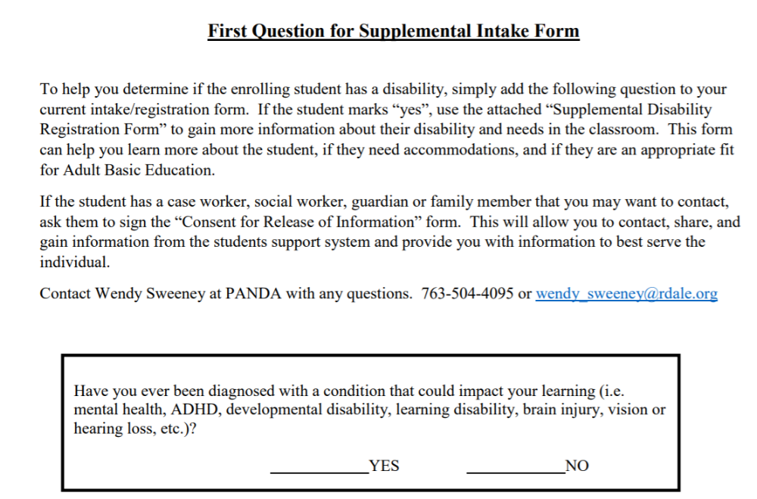
Supplemental Intake Form – Question 1
Link

Slide 21
Check for Understanding
Local agencies are responsible for providing accommodations for learners who have documented disabilities. Indicate whether or not each accommodation below is allowed for students with special needs.
Allowing a student extended time for the test.
Giving the student a supervised break.
Using a sign language interpreter for test directions.
Allowing a student to take the test in an alternate room.
Leaving a student alone to take a test.
Translating unfamiliar words in test items.
Allowed
Allowed
Allowed
Allowed
Not Allowed
Not Allowed

Slide 22
The Assessment Process
Place (Appraisal)
Pre-Test
Informal Assessment
Post-Test
Identifies the pretest the student should take
Establishes a baseline score and diagnoses learning needs
Includes targeted instruction based on information from tests
Given after 70-100 hours of instruction. Results compared to previous test to determine progress

Slide 23
Intake Screening
LINK
An Intake Screening process is crucial to identify test takers who should NOT be automatically administered a Locator or Appraisal because they have very low (pre-beginning level) basic skills.
Some test takers should be administered a Level A test.
Some test takers should be administered a Beginning Literacy test

Slide 24
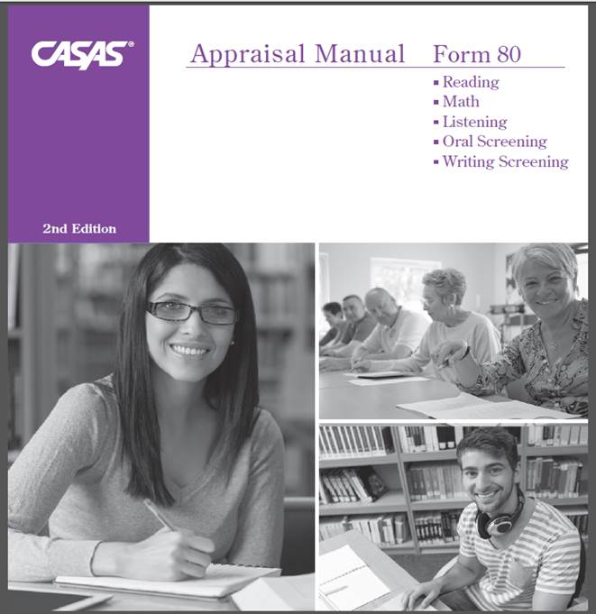
Oral and Writing Screening for ELLs
The Oral Screening is an optional one-on-one oral interview used to screen ESL/ELL learners for taking listening and reading locators or appraisal tests.
  six questions
  5 minutes
The Writing Screening is an additional optional tool to screen ESL/ELL learners for taking reading and listening locators or appraisals.
Examinees write
  two sentences that are dictated
  5 minutes

Slide 25
Question | Response
What’s your name? | This question is not scored. It may be omitted if the tester knows the examinee.
How long have you been in the United States? To clarify, ask: When did you come to the United States? | Some possible responses: Four years; 1987; etc.
Tell me why you want to learn English. To clarify, ask: Why do you want to study English? | Any appropriate reason may be acceptable.
Do you read in your native language? If Yes, ask: What do you like to read? If No, ask: Why not? | Yes. Some possible responses: names of books, types of books, subjects No. Some possible responses: I didn’t go to school in my country; I can’t read; I have no time to read; etc.
4. What work did you do in your home country? Or What work are you doing now? | Any appropriate response is acceptable. If the person has not worked, expressing that fact is also correct.
5. How many years did you go to school in your country? To clarify ask: How long did you go to school in your country? | Any appropriate response is acceptable.
Administering the
Oral Screening
Administer
one-on-one
Introduce yourself
Ask the questions
  Repeat the question once, if needed
  Use the clarification questions,
  if needed
Form 80 Appraisal TAM, pages 14 & 15

Slide 26
Scoring Rubric – Oral Screening
Form 80 Appraisal TAM pg. 14
Points | Guidelines
0 | No answer, incomprehensible, or does not answer the question. Note: If the examinee responds, “I don’t know,” it is up to the administrator to determine whether this answer represents an appropriate response or lack of comprehension.
1 | Comprehensible but not grammatically correct. Note: Comprehensible = understandable and relevant
2 | Comprehensible and grammatically correct. Note: Answers that are appropriate and represent what a native speaker would provide would be given 2 points; therefore, some one-word answers would be given 2 points.

Slide 27
Using Oral Screening results to select pretest for Beginning Level ELLs
Score of 7 or more:
  Give the Locator online or the Appraisal
  for Reading and/or Listening
Score of 6 or less:
  Do not give the Locator or Appraisal
  Give the Beginning Literacy Screening
  These items are found on the Form 27 or Form 28 Practice Items

Slide 28
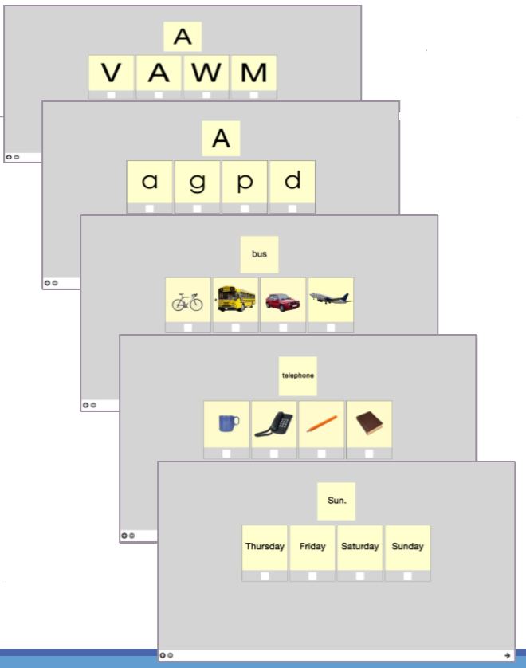
Beginning Literacy Screening
Administer 5 reading questions from Form 27 one-on-one
If some difficulty, administer Literacy Form 27 or Form 28
If little or no difficulty, administer Reading Form 81R or 82R

Slide 29
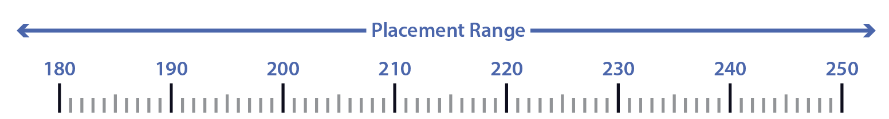
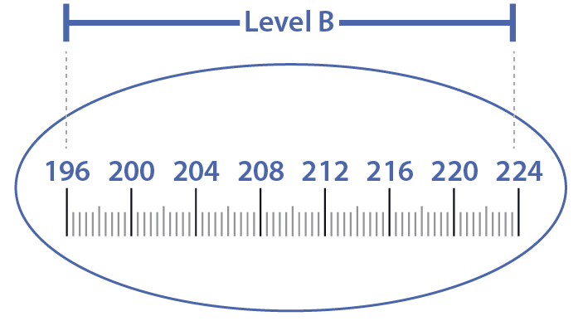
What’s the difference between Locators/ Appraisals and Pretests?
Locators & Appraisals
  Placement Tests
  Test items are widely distributed along the CASAS scale and range from very easy items to difficult items.
  These scores cannot be reported for pre- and post-testing.
Pre and Post-Tests
  Progress Tests
  Progress test items are clustered at a specific level.

Slide 30
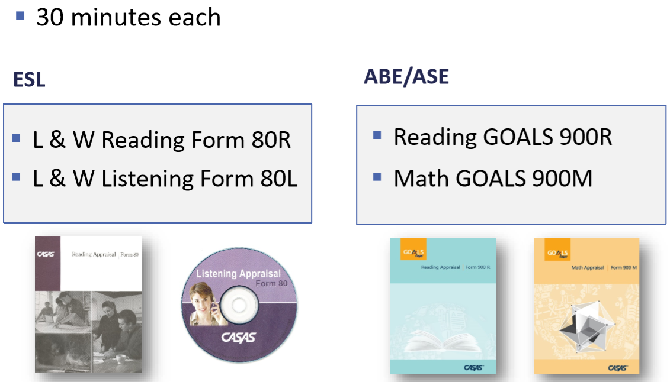
Next step after screening – Appraisals (Paper-based)
Notes:
Form 80 Appraisal – for learners whom you have determined to be English Language Learners
Form 900 Reading – for learners whom you have determined to be above 236 (ELL) or ALL English as a first language learners
Form 900 Math – ALL learners that need a math test need to use this form

Slide 31
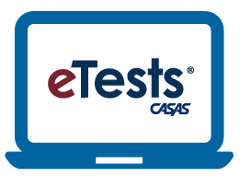
Next step after screening – Locators (Computer-Based)
ESL
ABE
L&W Reading 102R
L&W Listening 89L
10-14 minutes
Leads students seamlessly into the appropriate pretest.
Reading GOALS 104R
Math GOALS 104M
10-14 minutes
Leads students seamlessly into the appropriate pretest.
Notes:
Form 80 Appraisal – for learners whom you have determined to be English Language Learners
Form 900 Reading – for learners whom you have determined to be above 236 (ELL) or ALL English as a first language learners
Form 900 Math – ALL learners that need a math test need to use this form

Slide 32
CASAS tests are standardized tests.
What does that mean?
A standardized test is a test that is administered, scored, and interpreted in the same way for all test-takers.
Each student that takes the test should receive the same instructions
Each time a student takes the test, they should receive the same instructions.

Slide 33
Standardized Testing Guidelines – ESL and ABE
Ask students to turn off and put away their cell phones.
All personal items must be off the tables.
Tell students not to talk or get help from other students during the test.
Scratch paper is allowed for math tests, but not for reading or listening tests. All scratch paper must be collected and shredded after the test.
No cell phones, dictionaries, translators, or any other items allowed.
Allow adequate space between students.
Notes:
Ask participants – What do you remember about taking standardized tests in school?
Remind them that CASAS tests are standardized, government approved with strict testing policies.

Slide 34

Standardized Test Administration Guidelines
LINK
Appropriate
Inappropriate
Reviewing practice questions together
Providing start and end times on the board
Providing a relaxed, unhurried atmosphere.
Providing scratch paper (for math tests only) and pencils
Reading questions to students
Translation devices
Allowing cell phones

Slide 35
Administer the Appraisal
Have examinees open their test booklets to the test directions and practice items. Read the directions aloud.
Point out the location of the box on the answer sheet for answering the practice items.
Take the time to have everyone answer the practice items, then discuss and help as needed.
Advise students to do their best but not to spend more than a few minutes on any one question.
  Don’t guess.
  Stop when you can’t answer any more questions.
  Walk around the room to check students’ work.
Notes:
Ask participants “Why?” to most of these instructions – don’t assume they know or understand the importance of each

Slide 36
Appraisal Instructions Script – Part 1
Open your test booklet to page 1. Find the directions at the top of the page. Look at the directions as I read them. [Read directions.]
Look at the practice questions. Find the box on your answer sheet for answering the practice questions. Go ahead and read practice 1 and 2 and mark your answers.
What’s the answer to the first practice question? The answer is _. Did you mark _? [Explain.] The answer to the second practice item is _. [Explain and help any students that need assistance.]
We're ready to begin the test. You will mark your answer for the first question on line 1 of your answer sheet. Do not write in the test booklet.
Notes:
Remind participants that standardized tests means standardized administration of tests, too.

Slide 37
Appraisal Instructions Script – Part 2
There are ___ items on the test . You have ___ minutes.
If you don’t know the answer, that’s OK. You don’t have to mark an answer. Just go to the next question. Stop when the questions get too difficult.
Do your own test; don’t get help from other people. No dictionaries.
When you’re finished, or if you can’t answer any more questions, put your pencil down and wait and I will take your test. Any questions?
Turn the page and begin the test.
[After __ minutes] Who is not finished? You can take a little extra time to answer the question you are working on if you need it.
Notes:
Remind participants that standardized tests means standardized administration of tests, too.

Slide 38
During the Test
Post start and end times.
Circulate to make sure that everyone is working individually.
Circulate to make sure examinees are marking answers at the correct number on the answer sheet.
At the end of the allowed testing time, if a student is answering a question, the student can finish working on that question.
Students are not allowed to stop testing and continue at another time.
Notes:
When paper-testing different levels at the same time, start with the highest level.
For example, hand out booklets for students taking the D Level, go over practice items and then have them start. Then do the same with each level.
This will allow you to give more time to help beginning level test takers without holding up the more advanced test takers.
Some students may finish before time is up.

Slide 39
Finishing the Test
As examinees finish, have them put their answer sheet inside their test booklet and wait.
Announce when time is up. Allow examinees who are not finished to answer the question they are working on.
Notes:
Some students may finish before time is up.

Slide 40
After the Test
Pick up all test booklets and answer sheets and any scratch paper (math tests).
Check answer sheets to see that answers are clearly marked and that changed answers are completely erased.
Check that the correct test form is on the answer sheet.
Check the test booklets and erase any pencil marks.
Shred all scratch paper.
Return all test booklets and answer sheets to a secure location. Test administrators are responsible for the security of all test materials in their possession.
Score the tests
Notes:
Paper-based tests

Slide 41
Check for Understanding
What is the purpose of the Intake Screening?
It determines if an appraisal is suitable for a student.
It determines which pretest to give student with beginning skills.
It can provide valuable information about a student’s speaking and writing skills and previous education.
All of the above.

Slide 42
Break
Take a 10-minute break

Slide 43
Scoring the Appraisal
and
Determining the Pretest
(Using Next Assigned Test Charts)
M
Notes:
Paper-based tests

Slide 44
What is the Purpose of the Appraisal?
The purpose of the Appraisal is to determine the appropriate pretest to administer.
The Appraisal cannot be used to assign an Educational Functioning Level.

Slide 45
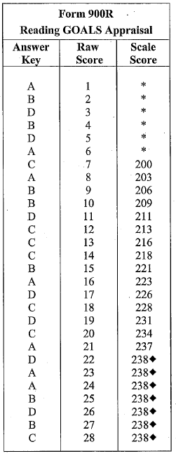
Raw Scores and
Scale Scores
Raw Score: the number of questions a
student answers correctly
Scale Score: converts a student's raw score on a test to a common scale that allows for comparison between students.
Each test form has its own Raw to Scale Score chart.
Be sure to use the correct chart to convert the raw score to the scale score.
For example, if the raw score is 13, then the scale score is 216.
Notes:
Converting the Raw Score
Remember, the raw score is the number correct on the test. But this is not the score you will use. You will use a “scale score”. Convert the raw score to a scale score using a chart like this one.
NOTE – eTests automatically scores each test and calculates the raw and scale score.
This is a key training point.

Slide 46
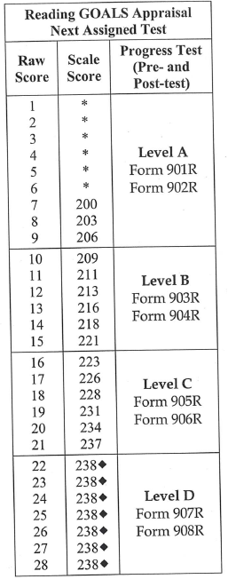
Determining the Pretest
Using the Raw to Scale Score Chart and the Next Assigned Test Level Chart, what pretest form should this student take, if they got 13 correct on the Appraisal?
GOALS Reading Series
Level | Form
A | 901R, 902R
B | 903R, 904R
C | 905R, 906R
D | 907R, 908R

Slide 47
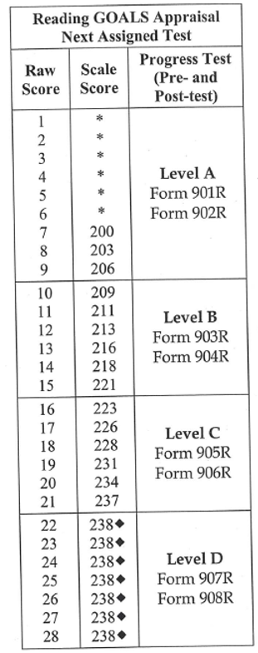
Appraisal Activity
Malia Sanchez got 9 correct on her GOALS 900 appraisal. What is her scale score? _________
What pretest form should she take? _________
Moo Htoo’s appraisal raw score was 14. What is his scaled score? __________
What pretest form could he take? ______________
Sarah Jones’ appraisal raw score was 19. What is her scaled score? __________
What pretest form could she take? ______________
206
901 or 902
218
903 or 904
231
905 or 906
Notes:
See page 4 in the Activity Packet for an appraisal activity.
ANSWERS
1. Malia Sanchez got 9 correct on her GOALS 900 appraisal. What is her scale score? 206
2. What pretest form should she take? 901 or 902
3. Moo Htoo’s appraisal raw score was 14. What is his scaled score? 218
4. What pretest form could he take? 903 or 904
5. Sarah Jones’ appraisal raw score was 19. What is her scaled score? 231
6. What pretest form could she take? 905 or 906

Slide 48
Pre- and Post Tests
Valid Scores
S

Slide 49







Valid Scale Scores – Life & Work
Inaccurate Scale Scores
Re-test immediately
Cannot be reported in SiD
Valid Scale Scores
  If pre-test score is in the conservative estimate range (high end or  score), retest at a higher level.
  If a learner receives a conservative estimate score on a post-test, the highest valid score can be reported. (229 on 83R)
Conservative Estimate Scale Scores

Slide 50
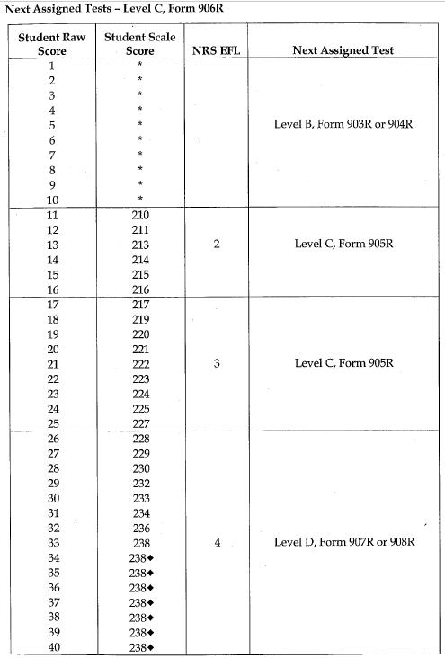
Valid Scale Scores - GOALS
Inaccurate Scale Scores
Re-test immediately
Cannot be reported in SiD
Valid Scale Scores
  If pre-test score is in the conservative estimate range (high end or  score), retest at a higher level.
  If a learner receives a conservative estimate score on a post-test, the highest valid score can be reported. (238 on 906)
Conservative Estimate Scale Scores

Slide 51
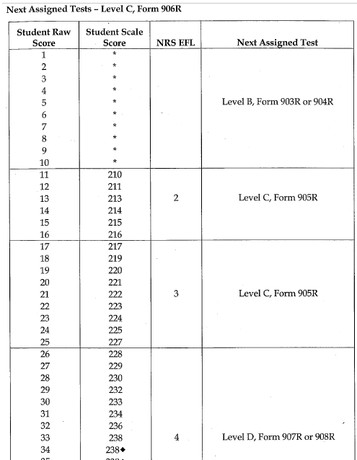
Valid Score Activity
Use the Form 906 Next Assigned Test chart to answer the following questions.
Maria received a raw score of 13 on her Form 906 pretest. What is her scale score? __________ Is this a valid score? ________
Sandra received a raw score of 6 on her Form 906 assessment. What is her Scale Score? _________ Is this a valid score? _______ What would you suggest as a next step? _____________________
Andre took Form 906 as a pretest and got a raw score of 27. What is his scale score? __________ What posttest should be given? ______________
Allison took form 906 as a posttest and got a raw score of 34. What is her scale score? __________ Is this a valid score? __________
213
Yes
--
No
Retest with 903 or 904
229
907 or 908
238
Yes
Notes:
See page 5 in the Activity Packet for this activity.
ANSWERS
1. 213; Yes
2. --; No; Retest with 903 or 904
3. 229; 907 or 908
4. 238; Yes

Slide 52
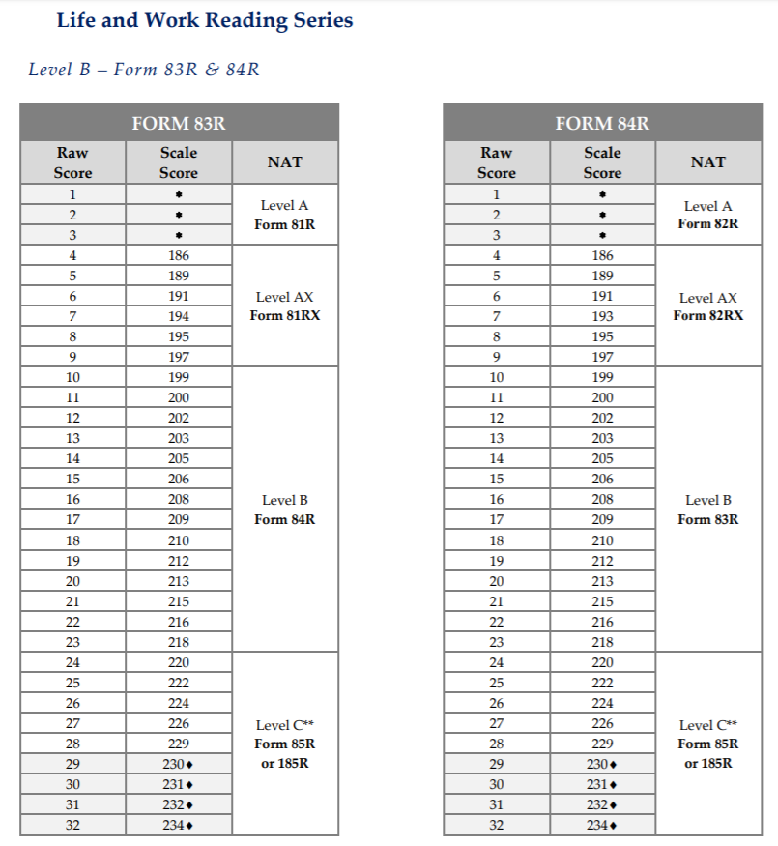
What Do You Need to Know About Post-testing?
Only after 40 or more hours of instruction.
Use the Next Assigned Test chart found in the Test Administration Manual (TAM) to determine the appropriate post-test.
  Paired tests must always be in the same modality.
  You must always give a different form than the previous test administered (even if it’s been years).
Ask “Can the learner get a level gain with the same level test as the pretest?”
  If not, it is best to administer a test from the next higher level

Slide 53
What is a Level Gain?
A level gain is earned by a student when they move from one educational functioning level to a higher educational functioning level.
Why are level gains important?
  Federal targets have been negotiated, and each program, and ultimately the state results, are judged based on attainment of targets.
  See 2019-2020 targets on next slide.

Slide 54
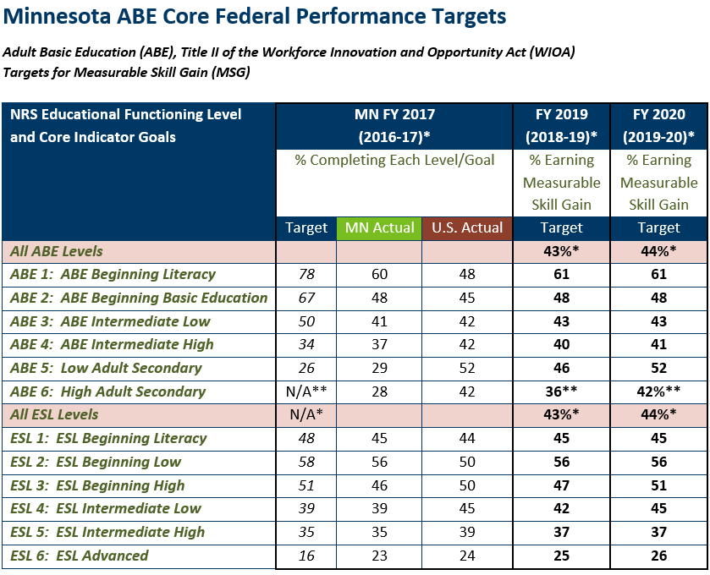
**For ABE 6, the only way to earn a measurable skill gain is through completion of a high school or equivalency diploma, or to exit ABE and enter postsecondary education and training.

Slide 55
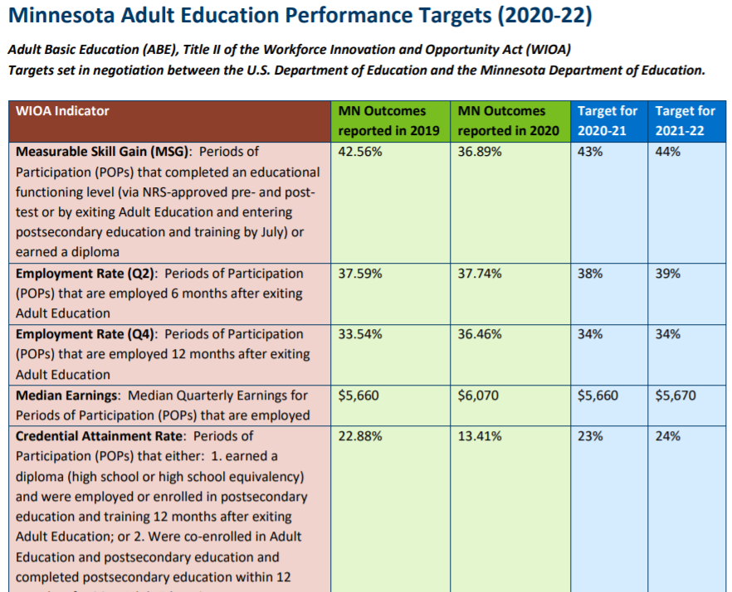

Slide 56
Important Considerations: Level Gains
Consider your program’s level gains!
  Make sure all Advanced ESL students pre-tested on the Life & Work have the opportunity to post-test on the Life & Work.
  Advanced ESL students can continue to test in Life & Work until a score of 236 has been achieved.
  Check SiD to ensure that all students have an Educational Functioning Level in FY 2021. If they don’t, they may have a pretest that is too old (prior to July 1, 2019), or they may need to be tested immediately with CASAS GOALS.
  SiD Testing Strategies – December 2019 Webinar https://mnabe.zendesk.com/hc/en-us/articles/360037200072-SiD-Testing-Strategies-Dec-2019-webinar

Slide 57
Testing Transitions Scenario #1
Student A, an English language learner, registered for your program on May 1st. They were given a CASAS Life & Work, Level C, and scored 228. They attended for 26 hours in May and June.
The student returned in September and after 15 additional hours of instruction, the student is given a CASAS GOALS, Level C, and scores 236.
  Is this a level gain?
  How could this student show a level gain?
Answers:
  This is not a level gain because it was two different test series.
  Since the learner is an English language learner, the appropriate post-test would be a CASAS Life & Work, level D. If the learner scored 236 on that test, they would earn a level completion.
Notes:
Answers:
This is not a level gain because it was two different test series.
Since the learner is an English language learner, the appropriate post-test would be a CASAS Life & Work, Level D. If the learner score 236 on that test, they would earn a level completion.

Slide 58
Testing Transitions Scenario #2
A student is given a Life & Work posttest in November and scores 236, earning them a level completion. They continue to attend class.
Later in November, as you are entering hours, you get an error message that indicates that you can’t enter any additional hours for this student.
Q: What happened? And how can this be avoided?
Answer: Even though the student achieved a level completion the new level they entered was low adult secondary, based on the Life & Work series, which, as of July 1, 2019, is no longer approved for ABE learners. Therefore, they no longer have a valid Educational Functioning Level. Only 12 hours of attendance can be entered.
To avoid this, when an ESL student completes level 6, you should immediately administer a CASAS GOALS appraisal and pretest – no need to wait 40 hours.
Notes:
Answer:
Even though the student achieved a level completion the new level they entered was low adult secondary, based on the Life & Work series, which, as of July 1, 2019, is no longer approved for ABE learners. Therefore, they no longer have a valid Edudational Functioning Level. Only 12 hours of attendance can be entered.
To avoid this, when an ESL student completed level 6, you should immediately do a CASAS GOALS appraisal and pretest – no need to wait 40 hours. Also, test all ABE students on CASAS GOALS by July 1.

Slide 59
Testing Decisions
What test series would you start with for the following students? Life & Work or GOALS? What additional information do you need to make the decision?
Estela arrived in the U.S. from Nicaragua 5 weeks ago.
Sandra was born in Minnesota, attended through grade 11 there, and needs a GED.
Solomon was born in Ethiopia, attended high school in the U.S., and wants a GED.
Fernando was born in California, attended school in San Diego, and dropped out of high school at age 17.
Thelma came to the U.S. at age 15. She attended school until age 17, and now would like to work on a GED in Spanish.
Martin has been in the U.S. for 20 years, but has only a 3rd grade education.
ADDITIONAL INFORMATION THAT YOU SHOULD CONSIDER:
Time in U.S.; First language literacy level; Education in home country
Notes:
Estela – Life & Work (unless she is proficient in English)
Sandra – GOALS
Solomon – Possibly GOALS (How is his English? How many years in U.S. high school? If English skills are lacking, might recommend English before studying for GED.)
Fernando – Probably GOALS (assuming he is wanting to earn a GED)
Thelma – Probably Life & Work (needs to build English skills, but wants Spanish GED right now)
Martin – Probably Life & Work (speaking and listening skills may be good, but not having formal education, reading skills may still merit ESL instruction)

Slide 60
NRS EFLs and Reading GOALS Scale Score Ranges
NRS Level | ABE/ASE Levels | Reading GOALS Scale Score Ranges | Life and Work Reading Scale Score Ranges
1 | Beginning ABE Literacy | 203 and below | 200 and below
2 | Beginning Basic Education | 204-216 | 201-210
3 | Low Intermediate Basic Education | 217-227 | 211-220
4 | High Intermediate Basic Education | 228-238 | 221-235
5 | Low Adult Secondary Education | 239-248 | 236-245
6 | High Adult Secondary Education | 249 and above | 245 and above
*LINK

Slide 61
CASAS GOALS – Instructional Considerations
Greater Opportunities for Adult Learning Success
M

Slide 62
Reading GOALS incorporates:
*LINK
CASAS Competencies
Content Standards
  CASAS Content Standards
  College and Career Readiness Standards
    Reading
    Reading Foundations
Reading Task Areas (Display – form, chart, table, text)
Depth of Knowledge (DOK)

Slide 63
Reading GOALS Item Types
Multiple Choice – All levels
Comprehension (in existing CASAS tests)
Sentence Completion
New Text and Item Features – Levels B, C, and D
Numbered lines in text passages
Underlined words embedded in passages
Level A only
Photo prompts and distractors in beginning items
Item Families
Multiple items related to one reading passage makes efficient use of test time
Notes:
One way CASAS was able to maintain the shorter time frame and still have complexity was to have multiple questions/items for one passage (time is required for reading additional passages). CASAS has noted that students take the most time on the first item of any reading passage – reading the passage takes that extra time. So by having fewer passages, but more questions on each passage, they were able to address the rigor necessary without making the assessment time extended.

Slide 64
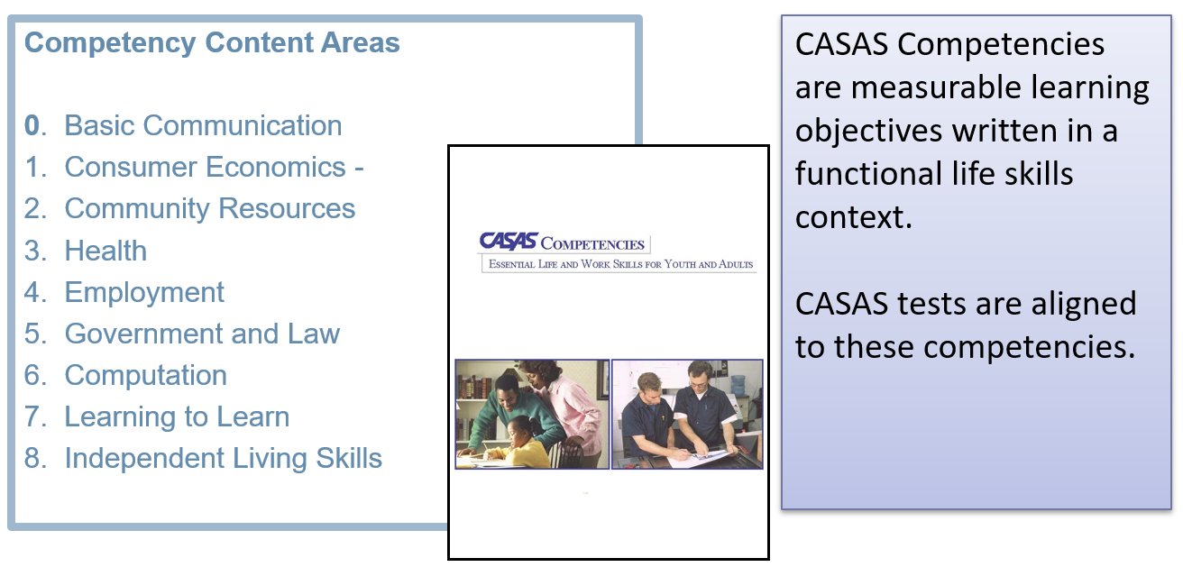
CASAS Competencies

Slide 65
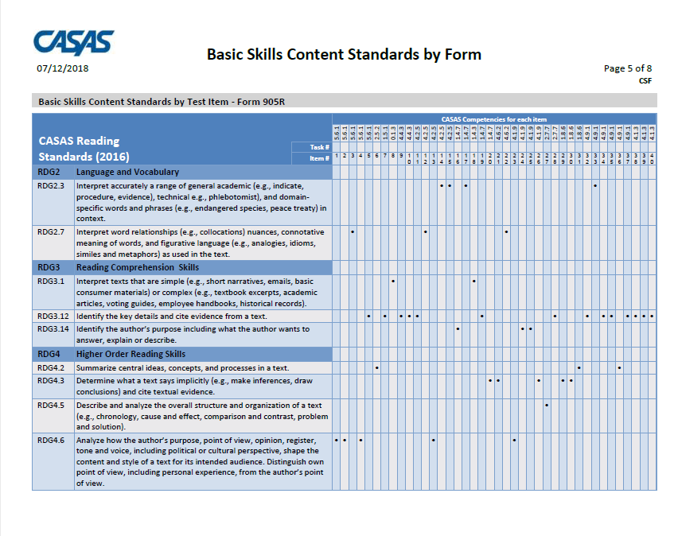
*LINK
CASAS Competencies tied to each test item
https://www.casas.org/product-overviews/assessments/reading-goals
Compare to CCRS
RDG2.3 – Interpret accurately a range of general academic (e.g., indicate, procedure, evidence), technical (e.g., phlebotomist), and domain-specific words and phrases (e.g., endangered species, peace treaty) in context. (CCR Anchor 4)
RDG3.12 – Identify the key details and cite evidence from a text. (CCR Anchor 1 and Anchor 2)
RDG4.2 – Summarize central ideas, concepts, and process in a text. (CCR Anchor 2)
RDG4.3 – Determine what a text says implicitly (e.g., make inferences, draw conclusions) and cite textual evidence. (CCR Anchor 1)
RDG4.5 – Describe and analyze the overall structure and organization of a text (e.g., chronology, cause and effect, comparison and contrast, problem and solution. (CCR Anchor 5)

Slide 66
Depth of Knowledge (DOK)
Describes levels of cognitive processing and higher-order thinking required in the College and Career Readiness Standards
Four DOK levels:
Recall, Reproduction, Recitation
Application of Skill/Concept
Strategic Thinking
Extended Thinking
Notes:
Not able to assess DOK 4 in a multiple choice test, but the other 3 levels are assessed

Slide 67
Reading CASAS GOALS Sample Test Items
Available at no cost at https://www.casas.org/product-overviews/curriculum-management-instruction/sample-test-items/reading-goals
Use these Sample Test Items to:
  Familiarize students with CASAS test items
  Give students practice in taking a CASAS test
  Make future testing go more smoothly
  Help reduce student test-taking anxiety

Slide 68
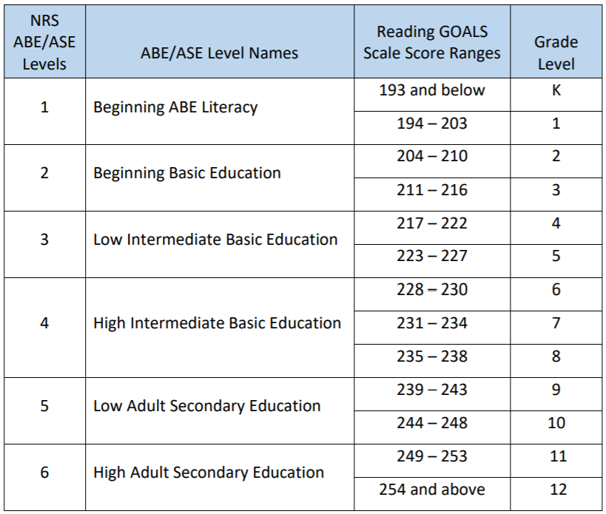
Reading GOALS
Grade Level Equivalents

Slide 69
CASAS Math GOALS includes:
*LINK
CASAS Competencies
  Skills used in academic and employment settings, as well as everyday life skills
Content Standards
  CASAS Math Content Standards
  CCR Standards for Adult Education
    Number Sense
    Algebra
    Geometry
    Measurement
    Statistical Reasoning
NRS Educational Functioning Levels (EFL) Descriptors for Math

Slide 70
Math GOALS - Features
A range of item types is provided, including:
  Word problems (reading complexity and cognitive load are consistent with level-specific expectations
  Simple to advanced calculation
  Traditional academic contexts
  Situational scenarios that reflect real-world applications
Two forms at each level
  A/B level (40 items on each form) – covers CCR levels A-C
  C/D level (38 items on each form) – covers CCR levels C-E
Formulae are provided within the item presentation so that focus is on math concepts and skills, not memorization
Time to complete: Level A/B – 60 minutes; Level C/D – 75 minutes

Slide 71
Calculators in Math GOALS
Students may use a calculator throughout the entire math test.
If using CASAS eTests, an on-screen calculator is provided, but students may use hand-held calculators while testing, if preferred.
Students may not use a personal calculator nor their cell phone calculator.
Examples of appropriate calculators are Texas Instruments TI-30XS, TI-108 and TI 503SV, Casio SL-300SV, and other approved calculators for use on high school equivalency exams.

Slide 72
Math CASAS GOALS Sample Test Items
*LINK
Available at no cost at https://www.casas.org/product-overviews/curriculum-management-instruction/sample-test-items/math-goals
Use these Sample Test Items to:
  Familiarize students with CASAS test items
  Give students practice in taking a CASAS test
  Make future testing go more smoothly
  Help reduce student test-taking anxiety

Slide 73
Grade Level Equivalents for CASAS Math GOALS Score Ranges
NRS ABE/ASE Levels | NRS ABE/ASE EFLs for Mathematics | CASAS Math GOALS Score Ranges | Grade Level
1 | Beginning ABE Literacy | 193 and below | 1
2 | Beginning Basic Education | 194 – 203 | 2
3 | Low Intermediate | 204 – 209 210 – 214 | 3 4
4 | Middle Intermediate | 215 – 220 221 – 225 | 5 6
5 | High Intermediate | 226 – 230 231 – 235 | 7 8
6 | Adult Secondary Education | 236 – 240 241 – 244 245 – 248 249 and above | 9 10 11 12

Slide 74
WHERE TO FIND LEVELED MATERIALS
https://www.commonlit.org/
https://www.readworks.org/
https://newsela.org
https://www.readtheory.org
https://www.activelylearn.com/
https://www.crowdedlearning.org/skillblox
https://www.crowdedlearning.org/learn/projects

Slide 75
Break
Take a 10-minute break

Slide 76

Going live! Checklist
*LINK
First Steps
M

Slide 77
Going Live! Checklist - First Steps
1. Confirm system requirements for each online application
      CASAS eTests Online System Requirements
      TOPSpro Enterprise Online System Requirements
At least one person per agency/site must complete the following:
2. Complete training, agency agreement, and certifications
      Module 1: Implementation Basics
      Module 2: CASAS eTests Implementation
      New Agency Online Implementation Agreement
      eTests Coordinator Certification
      eTests Proctor Certification
Notes:
Steps 1 – 4 are prerequisites that agencies complete before access is granted to an online account.
Steps 1 – 3 may be coordinated simultaneously. They are not sequential prerequisites.
Step 4 is what alerts CASAS that your agency is ready to access an online account and complete remaining prerequisites to Going Live! with eTests Online.

Slide 78
Preparation for Administering eTests
Poll – Has anyone in your program completed steps 1 and 2 in preparation for receiving your TEUs?

Slide 79


Step 1. System Requirements
CASAS eTests Online
Used to administer to tests.
TOPSpro Enterprise
Used to manage data and user access, retrieve test results and generate reports.
Notes:
The CASAS Online System uses two applications sharing the same database.
You will be using both online applications.
CASAS eTests Online presents appropriate level tests to each learner automatically, with option to collect demographic data.
TOPSpro Enterprise Online scores eTests, records results, tracks progress, and reports outcomes for local, state, and federal accountability.

Slide 80
Step 2. Agreement & Certifications
CASAS Implementation Agreement for New Agencies
  15 minutes
  Submitted by Program Director/Administrator who becomes the Main Point-of-Contact (MPOC) for your agency
  MPOC identifies the Data Manager (DM) for your online account
eTests Coordinator Certification
  30-45 min
  Completed by anyone coordinating online testing at one or multiple site locations
eTests Proctor Certification
  30-45 min
  Completed by anyone administering online tests
Notes:
The CASAS Implementation Agreement is for New Agencies and agencies transitioning from CASAS paper tests to CASAS eTests.
The agreement provides the information CASAS needs to set up your online account.
If ever there is a need to change the MPOC or DM at your agency, please submit a TOPSpro Enterprise Online - Change Request.
The next slides will help your agency identify staff to fulfill responsibilities for these key roles:
Data Manager
eTests Coordinator
eTests Proctor

Slide 81
Step 2. Data Manager Responsibilities
The Data Manager
  Manages your online account data
  Adds users, sites, teachers and classes
  Manages user access to TE and/or eTests
  Reports outcomes
Notes:
The Data Manager –
may grant any person Access to TE Online as appropriate without eTests certification, or any other required CASAS training.
may only grant Access to eTests Online upon confirmation of eTests coordinator and / or proctor certification. Retain copies of certificates for your records.
eTests Coordinators – responsible for online testing management
eTests Proctors – responsible for administering online tests
*Data Exchange Options
Import data to your online account from a 3rd-Party System or other external database for quick setup/ongoing data management
Export student and test data from TE to a 3rd-Party System or other external database for local, state, or federal accountability

Slide 82
Step 2. eTests Coordinator Responsibilities
Coordinates station registration
      Identifies computers to register for eTesting in each lab at each site
      Coordinates station registration by two certified eTests users
Customizes default testing session templates
      Ensures test series comply with local or state Assessment Policy
      Confirms data collection needs for local, state, or federal accountability
Selects sets of testing sessions per program
      Replicates sessions to each site for proctors to administer tests
      Assigns sets of sessions per lab at each site location
Coordinates a trial run in each lab at each site
      Ensures staff are appropriately trained
      Confirms successful test delivery before going live
Coordinates ongoing testing at one or multiple sites
      Ensures all proctors are certified eTests proctors
      Ensures adherence to test security & testing code of ethics
Notes:
eTests Coordinators have 5 primary duties to fulfill.
1 – 3 must be completed prior to going live. These steps may be coordinated simultaneously.
4 is strongly recommended prior to going live to begin testing.
5 is an ongoing responsibility of an eTests Coordinator.

Slide 83
Step 2. eTests Proctor Responsibilities
Prepare to Test
  SIGNS IN & STARTS testing sessions at proctor station
  OPENS eTests application at testing stations
  ADDS stations to sessions matching testing purpose
Begin to Test
  Assists examinees entering demographics
  Helps examinees understand test delivery
  Directs examinees to begin the test
During the Test
  Supervises examinees at each station
  Maintains test security and examinee confidentiality
  Adheres to testing code of ethics
After the Test
  EXITS eTests application at testing stations
  STOPS testing sessions at proctor station
  LOGS OUT & EXITS eTests application at proctor station
Notes:
eTests Proctors have 4 primary duties to fulfill.
1 – 4 must be completed every time a proctor administers tests.
Proctors will use the same testing sessions whenever testing is needed throughout the program year (July 1 – June 30).
Proctors must START testing sessions to administer tests.
Proctors must always STOP testing sessions when they are finished administering tests.

Slide 84

Step 3. Order Your eTests
If you do not already have them, you should order Test Administration Manuals (TAMs) for each test series and modality that you intend to administer via eTests – at least one per site.

Slide 85
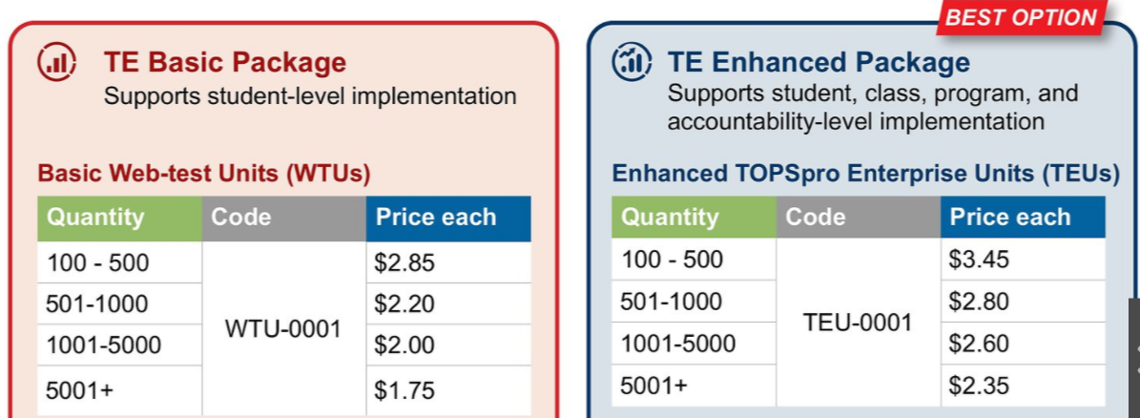
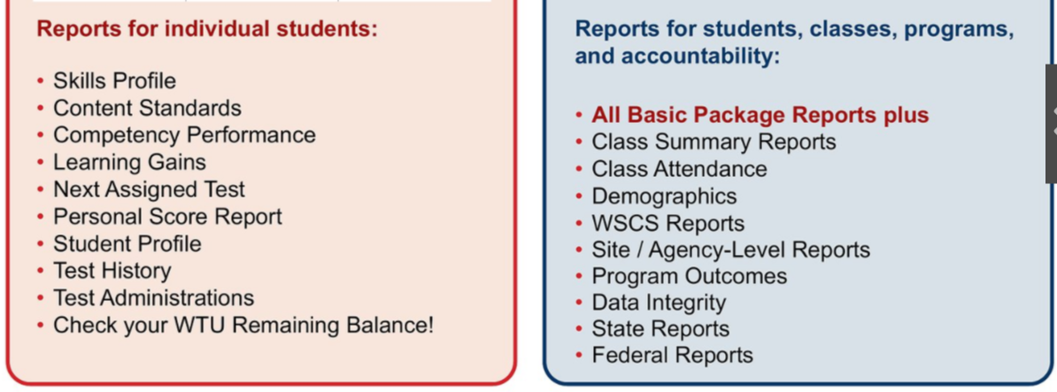
eTest Software includes:

Slide 86
Step 4. Online Account Setup and Access
When you complete initial prerequisites for eTests implementation (Steps 1 – 3),
  Send an email to golive@casas.org and request CASAS to set up your online account.
CASAS will set up your online account with the following:
  TEU purchase record
  One eTests site
  Default testing session templates and sessions at the eTests site
  Default set of TE access groups for the DM to add and manage users
CASAS will send an email:
  In 2-3 business days, the MPOC and DM will receive an email from CASAS with access information.

Slide 87
Going Live! Checklist – Next steps
(All steps have live links to instructions)
*LINK
5. Connect to your online account
6. Add Sites
7. Add Users
8. Register testing stations
9. Replicate testing sessions
10. Conduct a trial run
11. Go live! and begin testing
12. Retrieve results and generate reports
Notes:
Steps 5 – 10 are remaining prerequisites necessary to complete after access to your online account and before Going Live! with eTests Online.
Step 6 applies if you have more than one site where you plan to use eTests.
Step 7 is necessary to add certified eTests users who will assist with Step 8 and also participate in Steps 10 & 11.
Steps 6 & 7 combined give you the option of adding users at the site level otherwise, the recommendation is adding all users at the agency level for maximum flexibility with managing user access to TE and / or eTests.
Steps 8 & 9 may be completed in any order.
Step 10 is strongly recommended prior to going live in Step 11.
Step 12 applies any time after Going Live!

Slide 88
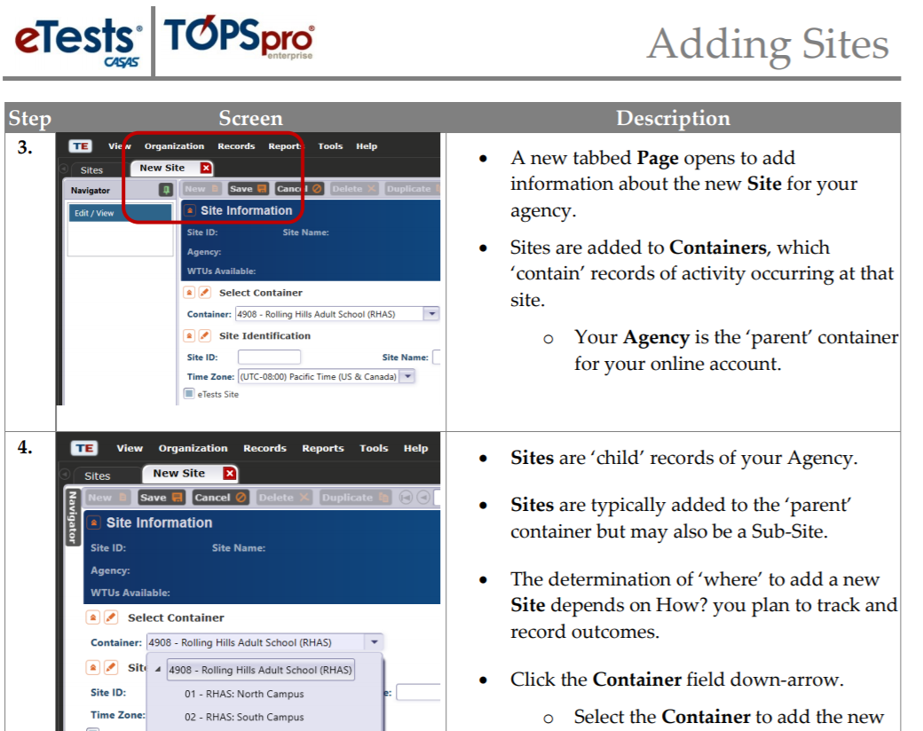
All steps are linked to pictorial instructions

Slide 89
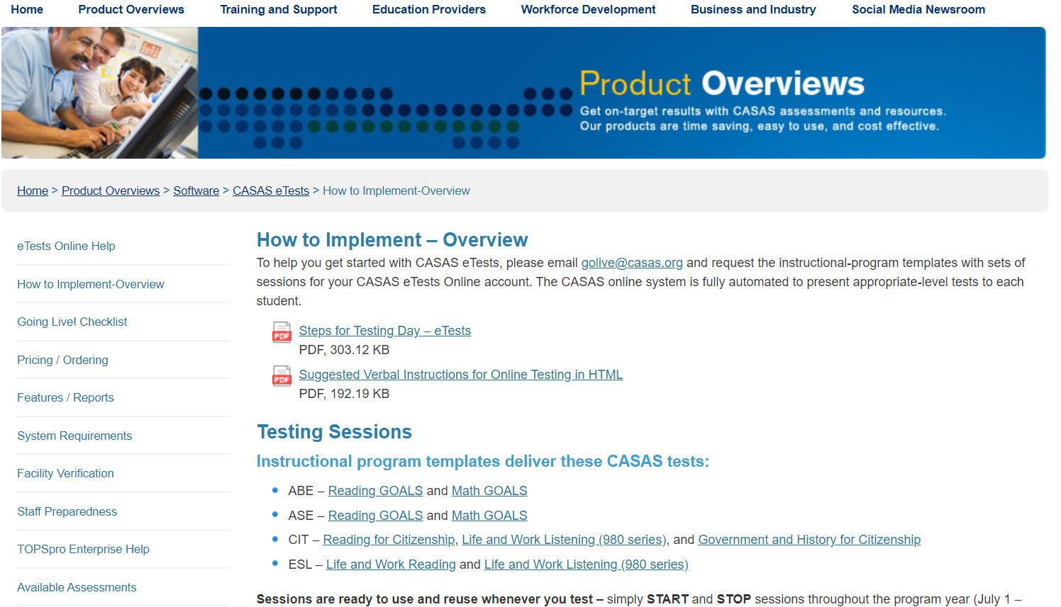
How to Implement - Overview
*LINK

Slide 90
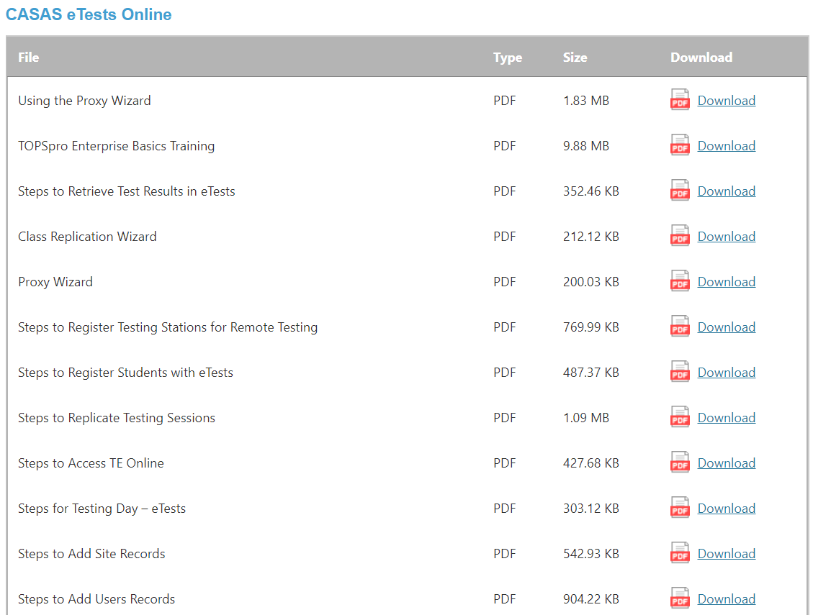
Steps 5 – 12: CASAS Online Help Documents
*LINK
This is just a small part of a long list of help documents that can be accessed.
The documents are step-by-step and many include pictorial directions.
Included in the list of documents are instructions as to how to generate student reports.

Slide 91
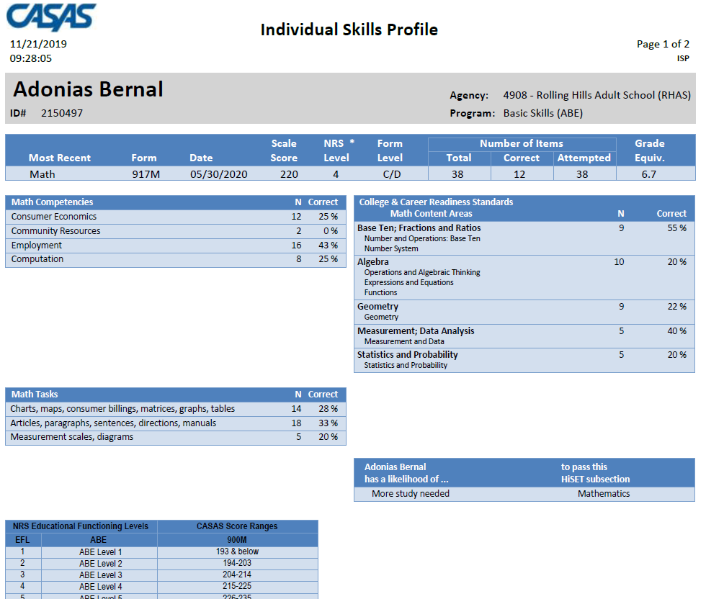
CASAS eTESTS – Reports – Individual Skills Profile

Slide 92
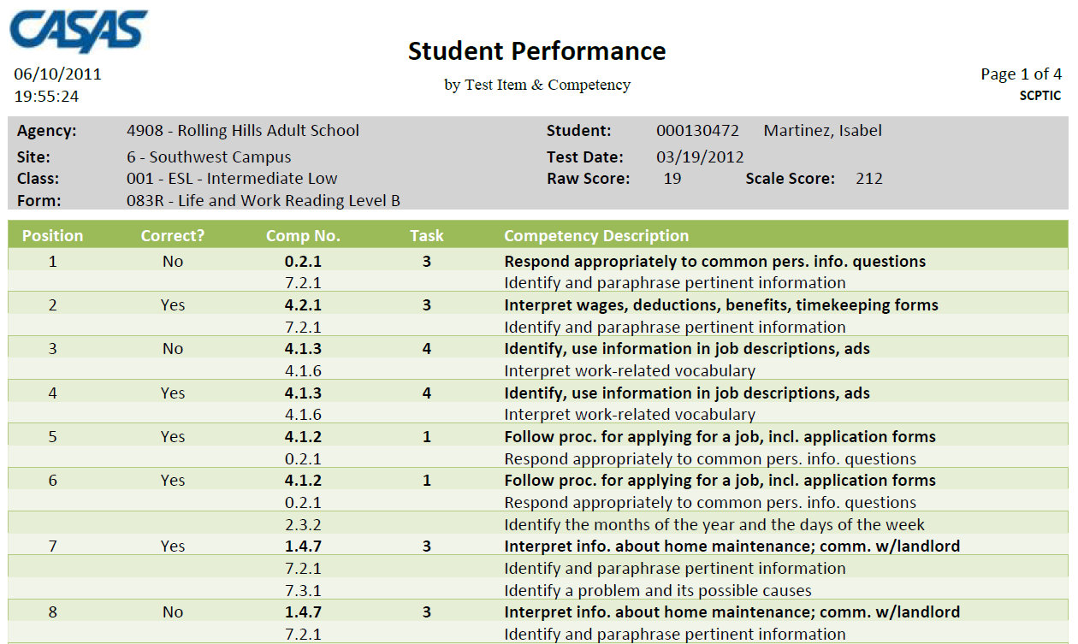
CASAS eTESTS – Reports – Student Performance
Articulates specifics regarding the content standards that student needs to focus on.
Note:
**Number of items
**Percent correct
**Content Standard
Description

Slide 93
Remote Testing
*LINK
https://www.casas.org/product-overviews/remote-testing
Remote testing updates
Proctor remote testing certification
Remote testing webinar
Remote testing demonstration video
Remote testing documents

Slide 94
QUESTIONS?

Slide 95

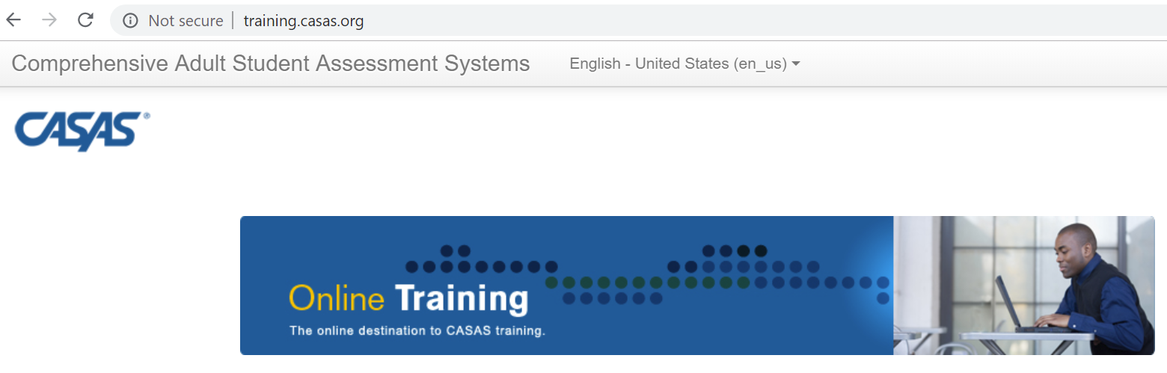
Time to complete your training!
Training Passcode:
___7742_______
Complete the following online:
  Submit your Test Security Agreement
  Get your Certificate
This key step verifies your attendance!
S
Notes:
Option: Model going to the website so participants see the Training landing page.
Remind all attendees to set up their account on the CASAS website – which can be done on any device. It’s key they choose their agency in the drop-down menu when asked for .
Go to http://training.casas.org

Slide 96
Steps to Complete Your Certification
Go to training.casas.org
Click: In-Person Training Completion Certificates
Click: the State for your training completion portal
Click: the portal for the Date of your training
Log in
  OR Click on the Create a new account button and activate your account
Enter: the Training Passcode given to you by your trainer
Click: Enroll Me
Click: Test Security Agreement and submit
Click: ‘Get your certificate’
Notes:
Walk training participants through the process. On step 8: “Get your certificate”, advance to the next slide.

Slide 97
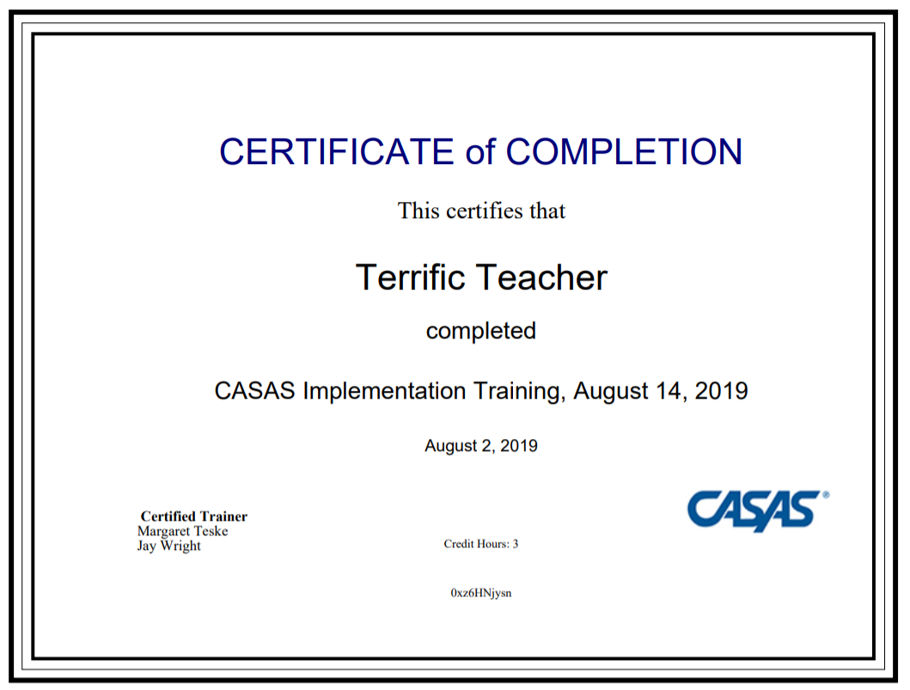
When you click “Get your certificate”...
This certificate is automatically sent to the email used to register your CASAS account.
Notes:
Participants can download the certificate immediately. Remind participants they should also get an email with the certification, and they should check their spam folder if for some reason they do not receive the auto-generated email.

Slide 98
Congratulations!
If you need further assistance with training completion, contact training@casas.org
Additional E-Mail Contact Groups
CASAS eTests Online Implementation: golive@casas.org
CA WIOA, Title II Accountability: capm@casas.org
CA AEP: caep@casas.org
CIT: citcertification@casas.org
FIELD TESTING: fieldtesting@casas.org
GENERAL QUESTIONS: casas@casas.org
NEDP: nedp@casas.org
ORDERING: orders@casas.org
TECHNICAL SUPPORT: techsupport@casas.org
TRAINING: training@casas.org
WSCS: wscs@casas.org
Notes:
If participants have any problems with certification, have them contact training@casas.org.
TRAINER NOTE: Please feel free to add your local contact information to this slide. Thank you!

