Slide 1

CASAS and TABE
Side by Side
Marty Olsen
Minnesota Lead Trainer

Slide 2
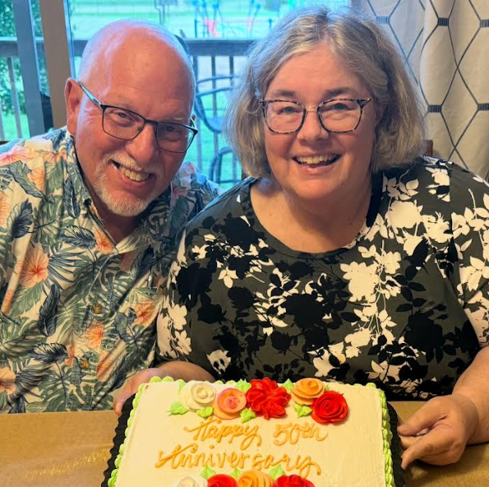
30 years in ABE
CASAS Trainer for 20 years
TABE Trainer for 17 years
ABE Teacher for 20 years
*ESL
*GED
*Work Readiness
*Computer Skills
*Corrections and Community
Program Coordinator for 10 years
Marty Olsen
Minnesota Lead Trainer

Slide 3

Getting to Know You
Name
Role at your agency
Agency size and population served
eTests, paper tests, or both
Testing environment

Slide 4

Training Agenda / Topics
Compare and contrast CASAS and TABE
Understand NRS-approved test series designed for ABE and ESL
Identify benefits of both assessment systems

Slide 5

What do you want to know?
Tell us!
Notes:
[Note: Before beginning, use a Parking Lot/WANT TO KNOW (virtual or flip chart) to capture questions participants have. Be sure to revisit these during and at the end of the training.]
[Possible online tools – Mural (https://www.mural.co/) , Mentimeter (https://www.mentimeter.com/), Miro (https://miro.com/)]
Before we begin, we want to know what you know about CASAS, and what you want to know by the time we finish this overview of CASAAS and how to get started with either eTests or paper-based tests.

Slide 6
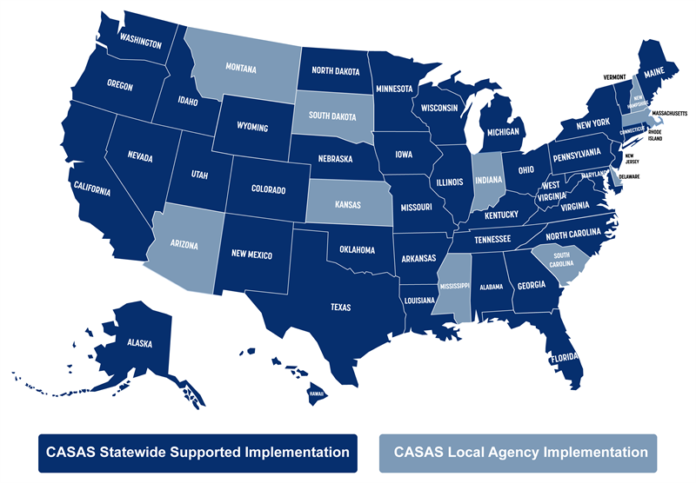
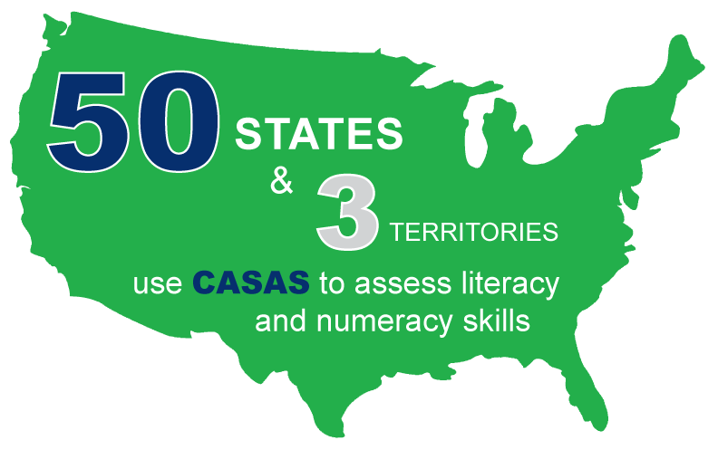


CASAS Celebrates 45 Years – now in all 50 States!
Non-profit
established in 1980
Notes:
CASAS celebrates a 45-year anniversary this year! Through changing times and administrations, CASAS has been a constant, national leader in adult education.
50 States – and 3 territories.
CASAS is looked to as a National Leader in Adult Ed – We specialize in assessing adult learners – always have, always will.
Fully integrated assessment and data management system use to assess functional literacy and numeracy skills
As a non-profit organization, CASAS is committed to helping you help your learners achieve their educational and workplace goals.
We are adult educators focused on adult learners’ needs – that’s what sets up apart!

Slide 7
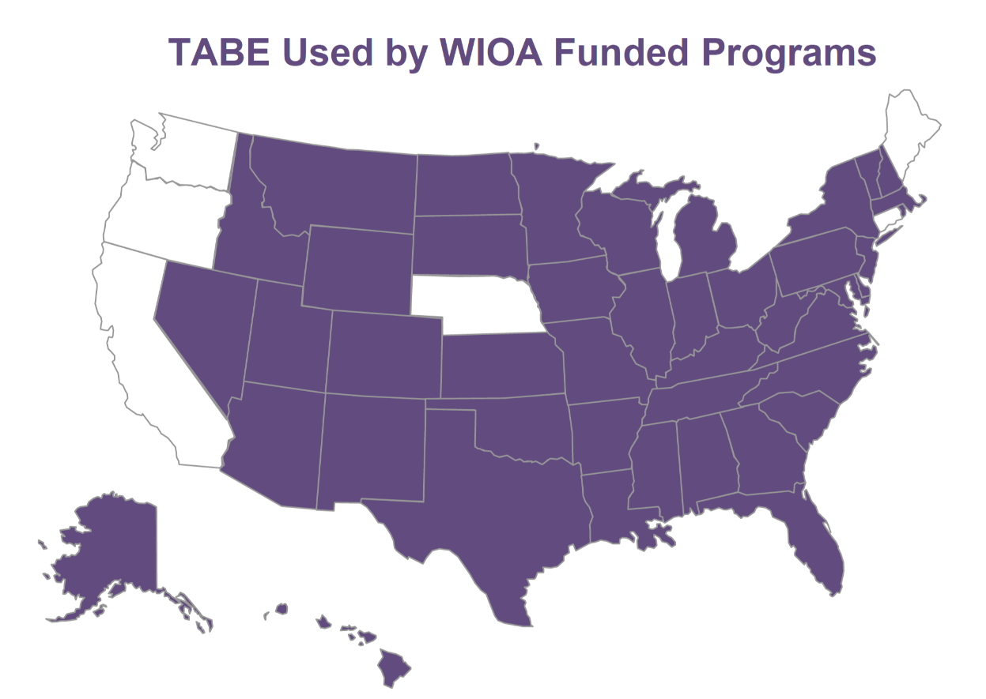
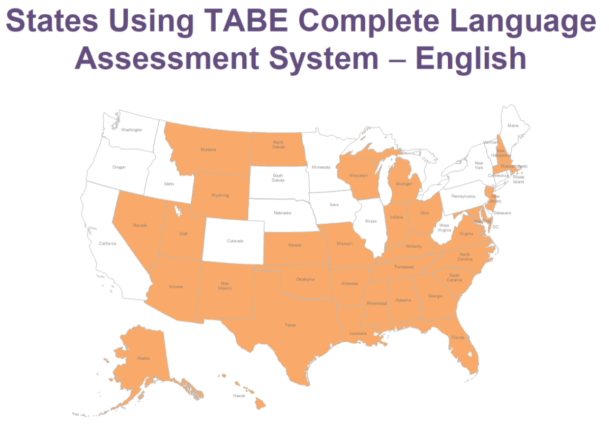
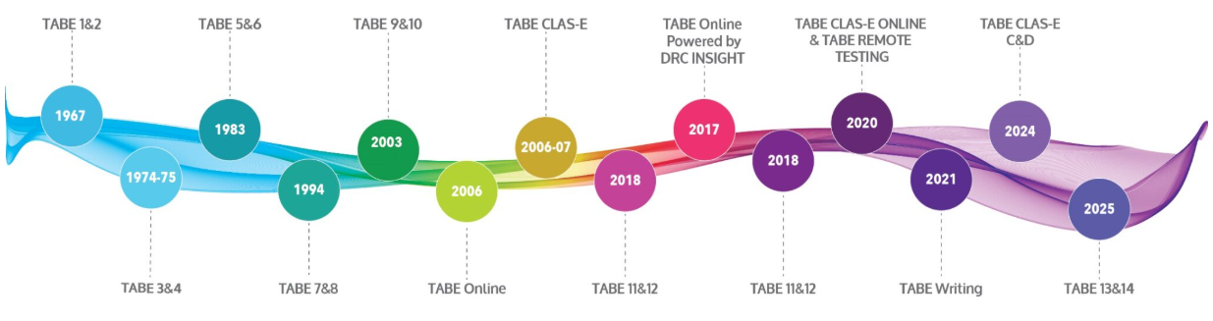
TABE Celebrates 58 Years !
Notes:
CASAS celebrates a 45-year anniversary this year! Through changing times and administrations, CASAS has been a constant, national leader in adult education.
49 States – and 3 territories.
CASAS is looked to as a National Leader in Adult Ed – We specialize in assessing adult learners – always have, always will.
Fully integrated assessment and data management system use to assess functional literacy and numeracy skills
As a non-profit organization, CASAS is committed to helping you help your learners achieve their educational and workplace goals.
We are adult educators focused on adult learners’ needs – that’s what sets up apart!

Slide 8
Why do we administer these assessments?
CASAS
TABE
Obtain basic information as to student's current skills
Establish best class placement
Provide instructional guidance
Baseline for post-testing
Ascertain information regarding progress
Accountability
Obtain basic information as to student's current skills
Establish best class placement
Provide instructional guidance
Baseline for post-testing
Ascertain information regarding progress
Accountability

Slide 9
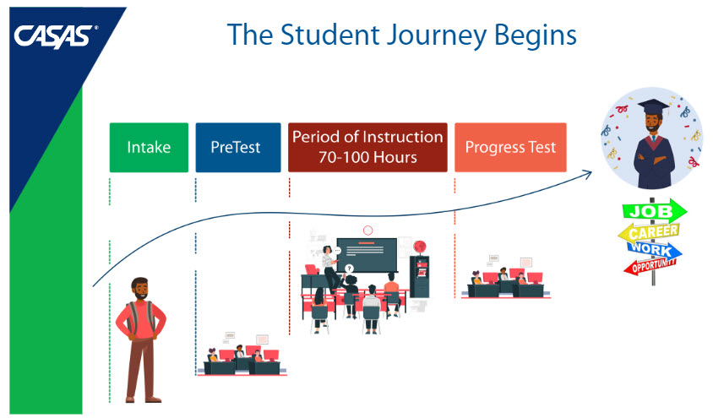

Notes:
The CASAS journey begins with Intake Screening.
Intake and orientation is your opportunity to welcome students to your program. With an effective intake and orientation process, programs can create a learning environment that works to determine students’ needs, goals, skill levels, and education and work backgrounds. When we engage students at the beginning, they are more likely to have higher retention and completion rates, improved learning gains, and overall program success.
The next step is administering a Locator or Appraisal and Pre-Test to determine the test taker’s basic functional level. Students should be pre-tested as soon as is feasible upon entry into the program or before any substantial instructional intervention has occurred.
Post-testing - Research indicates that the more time allowed for instruction and learning between pre- and post-testing, the higher the probability of increased learning gains and other learning outcomes. Agencies should administer post-tests, using alternate forms, at the end of a semester, term, quarter, or other substantial block of instruction to document learning gains. Typically programs assess after approximately 70-100 hours of instruction. However, testing should not occur before at least 40 hours of instruction.
Programs offering high intensity courses (e.g., class meets more than 15 hours per week) may choose to test at the end of a semester, term, quarter, or other substantial block of instruction, even though the instructional intervention is more than 100 hours of instruction. While this is CASAS’s research-based guidance, state and agency policy determines how many hours an at what frequences students should be take a Progress or Post-test.
Programs may choose to assess students who indicate they are leaving the program before the scheduled post-test time, to maximize collection of paired test data.

Slide 10
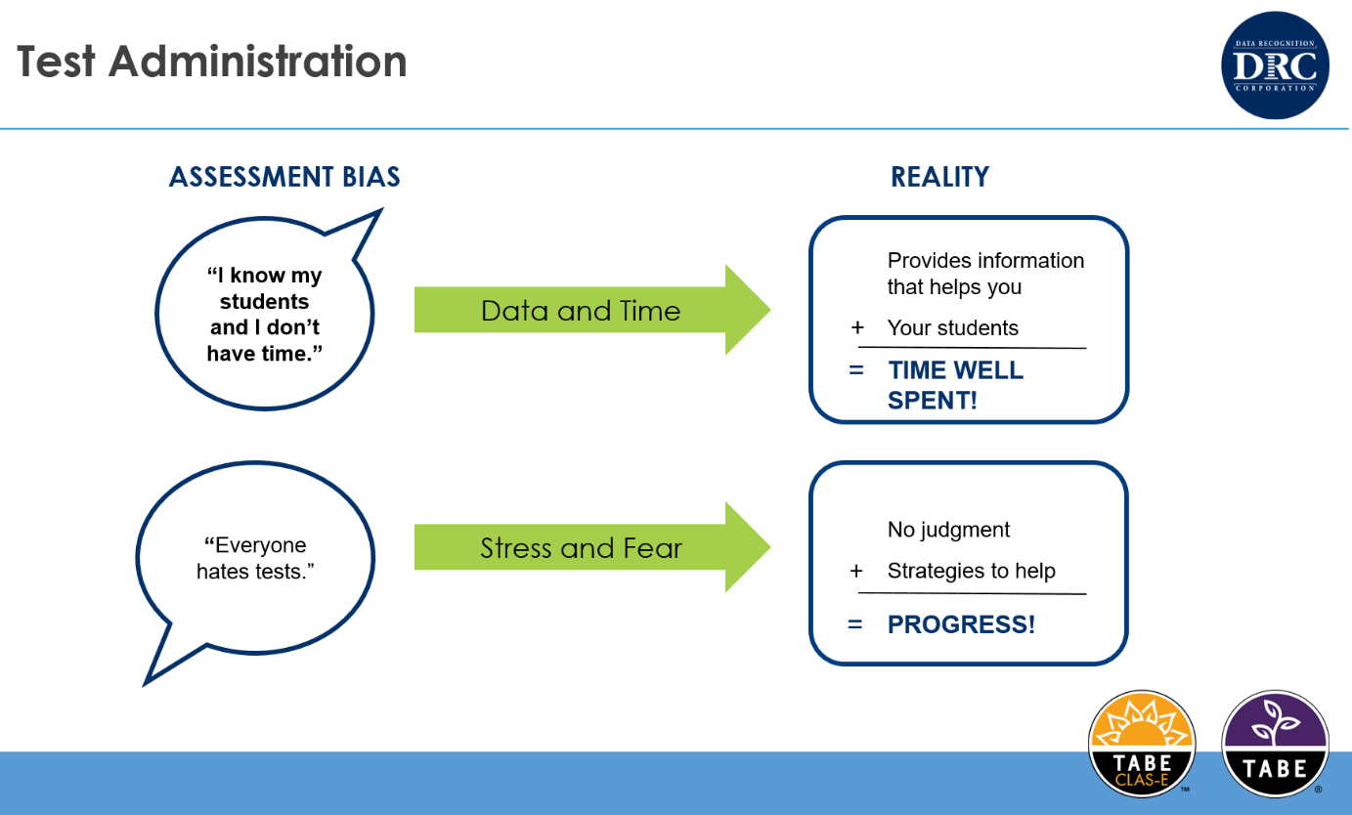
Notes:
The CASAS journey begins with Intake Screening.
Intake and orientation is your opportunity to welcome students to your program. With an effective intake and orientation process, programs can create a learning environment that works to determine students’ needs, goals, skill levels, and education and work backgrounds. When we engage students at the beginning, they are more likely to have higher retention and completion rates, improved learning gains, and overall program success.
The next step is administering a Locator or Appraisal and Pre-Test to determine the test taker’s basic functional level. Students should be pre-tested as soon as is feasible upon entry into the program or before any substantial instructional intervention has occurred.
Post-testing - Research indicates that the more time allowed for instruction and learning between pre- and post-testing, the higher the probability of increased learning gains and other learning outcomes. Agencies should administer post-tests, using alternate forms, at the end of a semester, term, quarter, or other substantial block of instruction to document learning gains. Typically programs assess after approximately 70-100 hours of instruction. However, testing should not occur before at least 40 hours of instruction.
Programs offering high intensity courses (e.g., class meets more than 15 hours per week) may choose to test at the end of a semester, term, quarter, or other substantial block of instruction, even though the instructional intervention is more than 100 hours of instruction. While this is CASAS’s research-based guidance, state and agency policy determines how many hours an at what frequences students should be take a Progress or Post-test.
Programs may choose to assess students who indicate they are leaving the program before the scheduled post-test time, to maximize collection of paired test data.

Slide 11






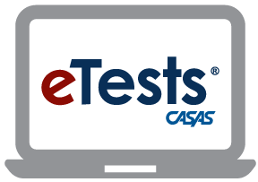

CASAS Assessments: Essential Skills Compass Points
High School Diploma
Work Readiness Tools
Other Tools
Reading and Listening for ESL
CASAS
Tests
  Spanish Reading Comprehension
  Writing & Language
Reading and Math for ABE

Slide 12



TABE Assessments for Student Success
TABE CLAS-E for ELL
Reading, Writing, Listening, Speaking
High School Diploma
WorkForce
Other
TABE Tests
TABE 13&14 for ABE
Reading, Math, Language
TABE Online
Notes:
The CASAS journey begins with Intake Screening.
Intake and orientation is your opportunity to welcome students to your program. With an effective intake and orientation process, programs can create a learning environment that works to determine students’ needs, goals, skill levels, and education and work backgrounds. When we engage students at the beginning, they are more likely to have higher retention and completion rates, improved learning gains, and overall program success.
The next step is administering a Locator or Appraisal and Pre-Test to determine the test taker’s basic functional level. Students should be pre-tested as soon as is feasible upon entry into the program or before any substantial instructional intervention has occurred.
Post-testing - Research indicates that the more time allowed for instruction and learning between pre- and post-testing, the higher the probability of increased learning gains and other learning outcomes. Agencies should administer post-tests, using alternate forms, at the end of a semester, term, quarter, or other substantial block of instruction to document learning gains. Typically programs assess after approximately 70-100 hours of instruction. However, testing should not occur before at least 40 hours of instruction.
Programs offering high intensity courses (e.g., class meets more than 15 hours per week) may choose to test at the end of a semester, term, quarter, or other substantial block of instruction, even though the instructional intervention is more than 100 hours of instruction. While this is CASAS’s research-based guidance, state and agency policy determines how many hours an at what frequences students should be take a Progress or Post-test.
Programs may choose to assess students who indicate they are leaving the program before the scheduled post-test time, to maximize collection of paired test data.

Slide 13
NRS-approved tests and length of approval
CASAS
TABE
ESL–7 years
  Reading STEPS (July 13, 2030)
  Listening STEPS (July 13, 2030)
ABE/ASE–7 years
  Reading GOALS 2 (May 8, 2032)
  Math GOALS 2 (July 13, 2030)
  Reading GOALS (June 30, 2026)
  Writing, Language, Spanish Reading Comprehension available – not reportable
ESL–3 yrs through June 20, 2027
  Reading - CLAS-E
  Listening - CLAS-E
  Writing - CLAS-E
  Speaking - CLAS-E
ABE/ASE–3 yrs through June 20, 2027
  Reading – 13&14
  Math – 13&14
  Language – 13&14
  TABE 11&12 (June 30, 2026)
Notes:
Maybe make the point that NRS only allows states/agencies to report an MSG in ONE test modality.

Slide 14
Alignment of the assessments
CASAS
TABE
Aligned to standards
  ESL – English Language Proficiency Standards
  ABE – College and Career Readiness Standards
Aligned to the NRS Educational Functioning Levels
Incorporates identified adult competencies
Identifies task areas to assist in instruction
Designed using Universal Design elements and Webb's Depth of Knowledge
Aligned to standards
  ESL – English Language Proficiency Standards
  ABE – College and Career Readiness Standards
Aligned to the NRS Educational Functional Level Descriptors
Meets Universal Design requirements

Slide 15




CASAS STEPS Reading and Listening and CASAS GOALS 2 Reading and Math
Aligned to ELP and CCR Standards and NRS EFLs
Academic focus
Meet the demands of the changing workforce
Relevant questions designed for adults

Slide 16


CASAS Test Series Design – What’s in a test item?
STANDARDS
CASAS COMPETENCIES
TASK/ITEM TYPES
Notes:
Now that we’ve looked at some of the sample test items, What’s in a test item?
Each Test Item is designed to measure 3 things at the same time – Content Standards, CASAS Competencies, and a Task/Item Type. These new test series – STEPS and GOALS 2, are more rigorous. Our field studies show that they are more accurate than ever. The NRS approval of 7 years is a vote of confidence in the test series design!

Slide 17
CASAS Competencies – 9 Content Areas
Basic Communication
Community Resources
Consumer Economics
Health
Employment
Government and Law
Math
Learning and Thinking Skills
Independent Living
360 essential, functional life and workplace skills
Used to measure what a learner is expected to know in everyday situations
Community, family, and workforce context
Notes:
The CASAS Competencies along with the ELPS and CCRS Standards, form the basis of the CASAS integrated assessment and curriculum management system. The CASAS Competencies identify more than 360 essential life skills that youth and adults need to be functionally competent members of their community, their family, and the workforce.
The competencies are relevant across the full range of instructional levels, from beginning literacy through high school completion including transition to postsecondary education and training. They cover nine broad content areas.
These critical competencies provide instructional objectives for curriculum, direct links to test content for monitoring student learning, criteria for program evaluation, and a referencing system for instructional materials. Based on field research – which began in 1980 – and recommendations from education providers, learners, business and industry representatives, and community-based agencies, the competencies have been regularly updated and validated at state and national levels

Slide 18
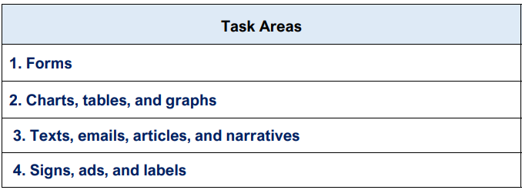

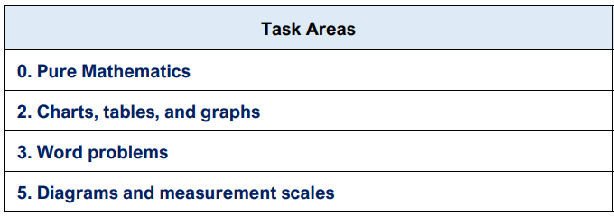
CASAS Task Areas
Reading
Reading
Math
Math
Notes:
The CASAS Competencies along with the ELPS and CCRS Standards, form the basis of the CASAS integrated assessment and curriculum management system. The CASAS Competencies identify more than 360 essential life skills that youth and adults need to be functionally competent members of their community, their family, and the workforce.
The competencies are relevant across the full range of instructional levels, from beginning literacy through high school completion including transition to postsecondary education and training. They cover nine broad content areas.
These critical competencies provide instructional objectives for curriculum, direct links to test content for monitoring student learning, criteria for program evaluation, and a referencing system for instructional materials. Based on field research – which began in 1980 – and recommendations from education providers, learners, business and industry representatives, and community-based agencies, the competencies have been regularly updated and validated at state and national levels

Slide 19
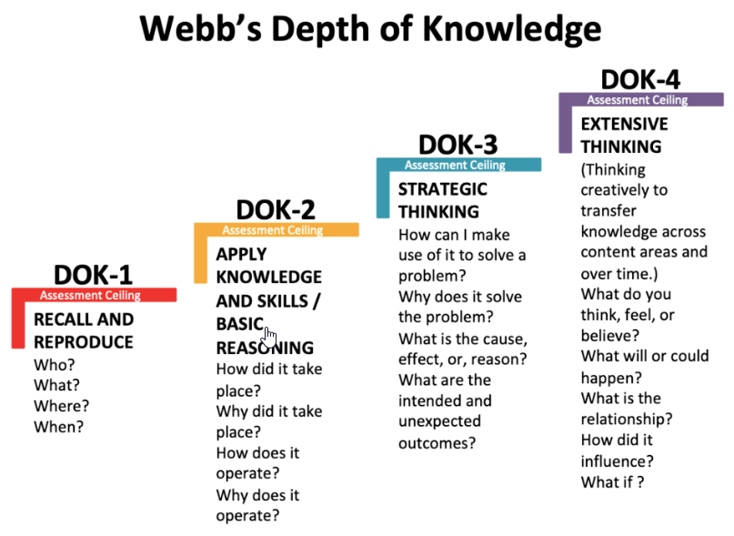
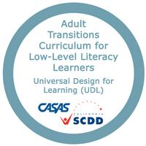
All CASAS test series design
Universal Design for Learning
Webb’s Depth of Knowledge
https://www.casas.org/product-overviews/curriculum-management-instruction/low-level-literacy-curriculum-modules
https://www.structural-learning.com/post/webbs-depth-of-knowledge

Slide 20


TABE 13&14 and TABE CLAS-E
Aligned to ELP and CCR Standards
along with the NRS Educational Functioning Level Descriptors
Contemporary and relevant content designed to test the academic skills of adults in everyday contexts
Content was selected to provide valid assessment aligned to the CCR standards
Motivates students to succeed
Notes:
The CASAS Competencies along with the ELPS and CCRS Standards, form the basis of the CASAS integrated assessment and curriculum management system. The CASAS Competencies identify more than 360 essential life skills that youth and adults need to be functionally competent members of their community, their family, and the workforce.
The competencies are relevant across the full range of instructional levels, from beginning literacy through high school completion including transition to postsecondary education and training. They cover nine broad content areas.
These critical competencies provide instructional objectives for curriculum, direct links to test content for monitoring student learning, criteria for program evaluation, and a referencing system for instructional materials. Based on field research – which began in 1980 – and recommendations from education providers, learners, business and industry representatives, and community-based agencies, the competencies have been regularly updated and validated at state and national levels

Slide 21

TABE 13&14 and TABE CLAS-E
Developed to meet Universal Design requirements – Considerations for adult learners
  Accessibility
  Clarity
  Equity
  Appropriateness
Notes:
The CASAS Competencies along with the ELPS and CCRS Standards, form the basis of the CASAS integrated assessment and curriculum management system. The CASAS Competencies identify more than 360 essential life skills that youth and adults need to be functionally competent members of their community, their family, and the workforce.
The competencies are relevant across the full range of instructional levels, from beginning literacy through high school completion including transition to postsecondary education and training. They cover nine broad content areas.
These critical competencies provide instructional objectives for curriculum, direct links to test content for monitoring student learning, criteria for program evaluation, and a referencing system for instructional materials. Based on field research – which began in 1980 – and recommendations from education providers, learners, business and industry representatives, and community-based agencies, the competencies have been regularly updated and validated at state and national levels

Slide 22
Which series should be administered?
CASAS
TABE
CASAS STEPS Reading and STEPS Listening
  Designed for learners for whom English is not their first language
  Transition to CASAS GOALS 2 when score reaches NRS Level 6
CASAS Reading GOALS 2
  Designed for learners for whom English is their first language
  Designed for ELLs who have reached an NRS Level 6 in STEPS
CASAS Math GOALS 2
  Only CASAS Math test that is NRS-approved, so can be administered to all learners if Math will be part of instruction
TABE CLAS-E (Reading, Listening, Speaking, Writing)
  Designed for adult ELLs whose primary language is not English
  Transition to TABE 13&14 when score reaches NRS Level 6
TABE 13&14 (Reading, Math, Language)
  Adult learners in a variety of programs including ABE, high school equivalency, vocational training, welfare-to-work
  Administer to ELLs who have reached an NRS Level 6 in ESL series

Slide 23
Where do we start?
CASAS
TABE
Oral Screening (ESL)
  Interview, Reading and Writing
Appraisal – paper or CASAS eTests
  Results indicate student pretest level
  Not computer adaptive
Locator
  CASAS eTests only
  Not computer adaptive
  Moves student directly into appropriate level pretest
Initial interview
Locator – Same paper or online
  Results indicate student pretest level
  Not computer-adaptive
  If the test session is set up with Locator + subject (Reading, Math or Language), the same test ticket can be used for each test desired
Notes:
Hi Marty – The CASAS Locator is not computer adaptive, FYI, but does automatically move student directly into the appropriate leveled based on the student’s answers on the locator. ☺ Thanks.

Slide 24
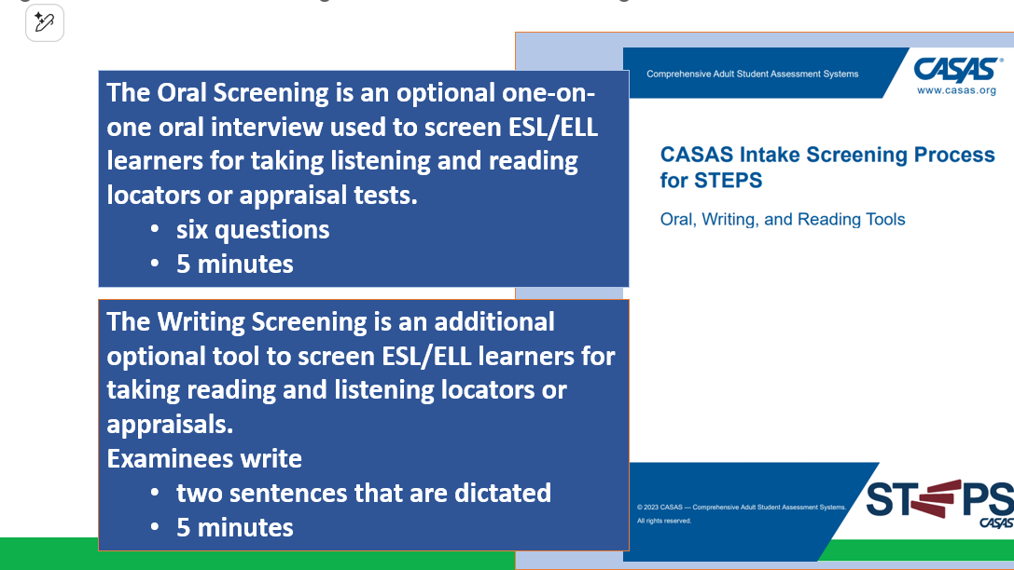
CASAS Intake Screening for Oral, Writing, and Reading
Intake Screening Tool (Oral, Writing, and Reading)

Slide 25
CASAS GOALS 2 (Reading and Math) CASAS STEPS (Reading and Listening)
CASAS GOALS 2
Test | Total Items | Testing Time (Minutes)
Reading and Math Appraisal | 28 | 30
Reading Locator (eTests only) | 14 | 15
Math Locator (eTests only) | 15 | 15
CASAS STEPS
Test | Total Items | Testing Time (Minutes)
Reading Appraisal | 28 | 30
Listening Appraisal | 28 | 35
Reading Locator (eTests only) | 14 | 15
Listening Locator (eTests only) | 15 | 20
Notes:
The CASAS Competencies along with the ELPS and CCRS Standards, form the basis of the CASAS integrated assessment and curriculum management system. The CASAS Competencies identify more than 360 essential life skills that youth and adults need to be functionally competent members of their community, their family, and the workforce.
The competencies are relevant across the full range of instructional levels, from beginning literacy through high school completion including transition to postsecondary education and training. They cover nine broad content areas.
These critical competencies provide instructional objectives for curriculum, direct links to test content for monitoring student learning, criteria for program evaluation, and a referencing system for instructional materials. Based on field research – which began in 1980 – and recommendations from education providers, learners, business and industry representatives, and community-based agencies, the competencies have been regularly updated and validated at state and national levels

Slide 26
Reading STEPS for ESL – Test Time is Student Centered!
CASAS Level | Form Number | Number of Test Items | Test Time (minutes) | Average Test Time (minutes) | Scale Score Ranges
Appraisal | 619R | 28 | 30 | --
Locator | 620R | 14 | 15 | --
A | 621R – 622R | 33 | 30 | 15 | 160 - 196
B | 623R – 624R | 36 | 50 | 30 | 184 - 206
C | 625R – 626R | 36 | 75 | 45 | 197 - 216
D | 627R – 628R | 36 | 75 | 51 | 207 - 227
E | 629R – 630R | 36 | 75 | 56 | 217 - 251
Notes:
Pt. Although the test time allowed for a locator and pre-test is 45 minutes…Our field studies show that the average test time to complete a Reading Locator + Pre-Test Online for a beginning ESL students at Level A /NRS Level 1 or 2 is about 30 minutes.

Slide 27
Listening STEPS Test Specifics
CASAS Level | Form Number | Number of Test Items | Test Time (minutes) | Average Test Time (minutes) | Scale Score Ranges
Appraisal | 619L | 28 | 30 | --
Locator | 620L | 14 | 15 | --
A | 621L – 622L | 33 | 28 | 16 | 158 - 191
B | 623L – 624L | 36 | 45 | 29 | 182 - 201
C | 625L – 626L | 39 | 52 | 35 | 192 - 211
D | 627L – 628L | 39 | 56 | 40 | 202 - 221
E | 629L – 630L | 39 | 38 | 31 | 212 - 235

Slide 28
Reading GOALS 2 Test Specifics
CASAS Level | Form Number | Number of Test Items | Test Time (minutes) | Average Time (minutes) | Scale Score Ranges
Appraisal | 919R | 28 | 30 | - | -
Locator | 920R | 14 | 20 | - | -
A | 921R – 922R | 33 | 35 | 20 | 178 – 216
B | 923R – 924R | 36 | 60 | 34 | 204 – 227
C | 925R – 926R | 36 | 70 | 43 | 217 - 238
D | 927R – 928R | 36 | 70 | 39 | 228 - 248
E | 929R – 930R | 33 | 70 | 46 | 239 - 266

Slide 29
Math GOALS 2 Test Specifics
CASAS Level | Form Number | Number of Test Items | Test Time (minutes) | Average Test Time (minutes) | Scale Score Ranges
Appraisal | 919M | 28 | 30 | --
Locator | 920M | 14 | 15 | --
A | 921M – 622M | 33 | 50 | 32 | 171 - 203
B | 923M – 924M | 36 | 65 | 38 | 193 - 213
C | 925M – 926M | 36 | 75 | 44 | 204 - 224
D | 927M – 628M | 36 | 75 | 47 | 214 - 235
E | 929M – 930M | 36 | 90 | 58 | 225 - 255

Slide 30
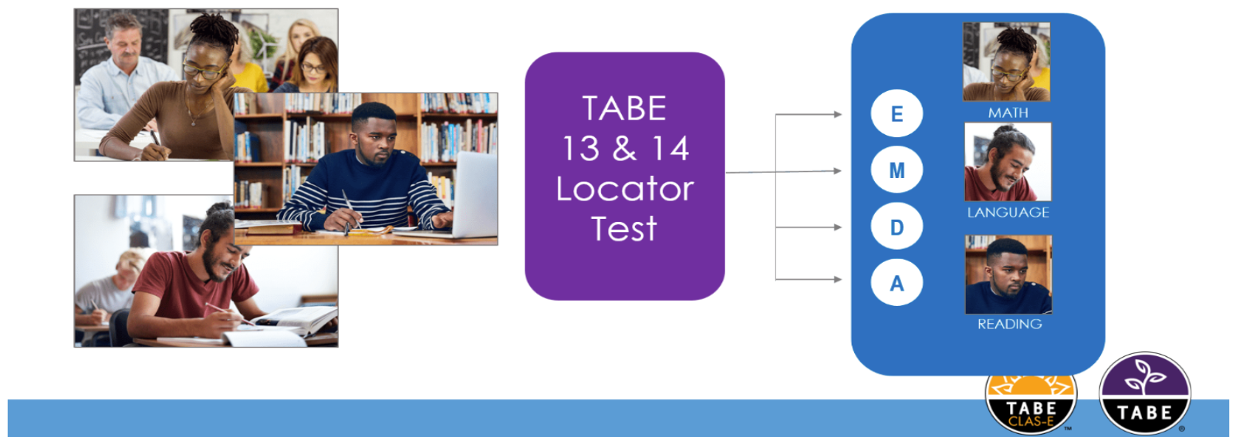
TABE 13&14 and TABE CLAS-E Locators
Incoming students should take the Locator Test for program placement decisions.
Notes:
The CASAS Competencies along with the ELPS and CCRS Standards, form the basis of the CASAS integrated assessment and curriculum management system. The CASAS Competencies identify more than 360 essential life skills that youth and adults need to be functionally competent members of their community, their family, and the workforce.
The competencies are relevant across the full range of instructional levels, from beginning literacy through high school completion including transition to postsecondary education and training. They cover nine broad content areas.
These critical competencies provide instructional objectives for curriculum, direct links to test content for monitoring student learning, criteria for program evaluation, and a referencing system for instructional materials. Based on field research – which began in 1980 – and recommendations from education providers, learners, business and industry representatives, and community-based agencies, the competencies have been regularly updated and validated at state and national levels

Slide 31
TABE 13&14 and TABE CLAS-E Locator
TABE 13&14 LOCATOR TEST
Subtest | Total Items | Testing Times
Reading | 16 | 35 minutes
Language | 16 | 20 minutes
Mathematics | 16 | 10 minutes (Part 1) 10 minutes (Part 2)
TABE CLAS-E (Forms C & D) LOCATOR TEST
Locator Test | Total Items | Testing Time (Minutes)
Reading & Writing (Part 1) | 15 | 20
Listening & Speaking (Part 2) | 15 | 25
Notes:
The CASAS Competencies along with the ELPS and CCRS Standards, form the basis of the CASAS integrated assessment and curriculum management system. The CASAS Competencies identify more than 360 essential life skills that youth and adults need to be functionally competent members of their community, their family, and the workforce.
The competencies are relevant across the full range of instructional levels, from beginning literacy through high school completion including transition to postsecondary education and training. They cover nine broad content areas.
These critical competencies provide instructional objectives for curriculum, direct links to test content for monitoring student learning, criteria for program evaluation, and a referencing system for instructional materials. Based on field research – which began in 1980 – and recommendations from education providers, learners, business and industry representatives, and community-based agencies, the competencies have been regularly updated and validated at state and national levels

Slide 32
Pre/Post-tests and Test Levels
CASAS
TABE
There are 5 levels of pre/post-tests available in CASAS STEPS and CASAS GOALS 2
  Levels A, B, C, D, E
Each test level covers two NRS levels
Encourages scaffolding in instruction
There are 5 levels of pre/post-tests in TABE 13&14
  E, M, D, A
  (still in development, TABE Level L)
There are 4 levels of pre/post-tests in TABE CLAS-E
  Levels 1, 2, 3, and 4

Slide 33
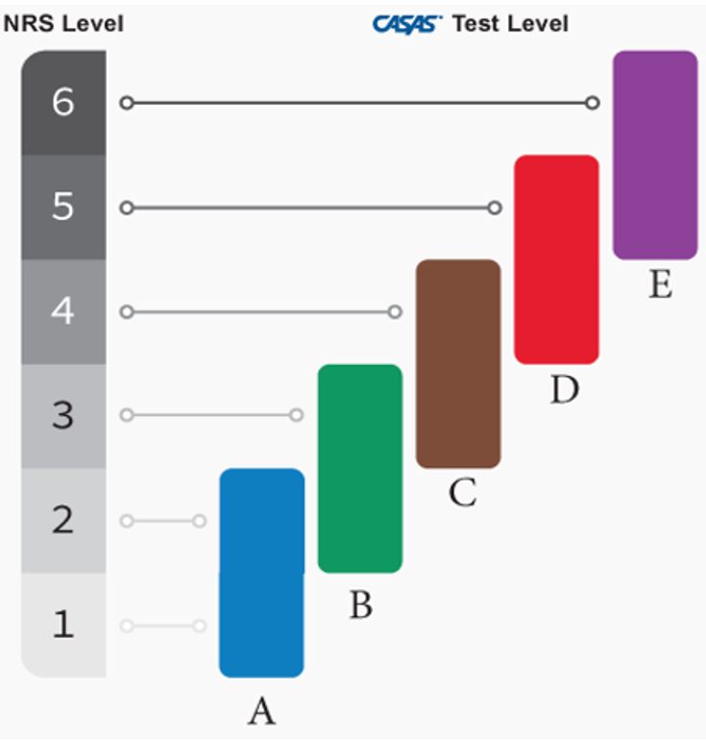
CASAS Test Levels each cover two NRS levels
CASAS STEPS and GOALS 2
Level A (Beginning Literacy/Beginning): Focuses on understanding basic words and phrases.
Level B (Beginning/Intermediate): Assesses fundamental communication and simple life-skill tasks.
Level C (Advanced ELL/Advanced Basic): Introduces more complex tasks, such as managing health and finances.
Level D (Adult Secondary): Evaluates readiness for situations requiring critical thinking and independence.
Level E (Proficient/Advanced Adult Secondary): The highest level, assessing sophisticated skills for complex real-world scenarios.
Pre/Post-test Levels
Notes:
The CASAS Competencies along with the ELPS and CCRS Standards, form the basis of the CASAS integrated assessment and curriculum management system. The CASAS Competencies identify more than 360 essential life skills that youth and adults need to be functionally competent members of their community, their family, and the workforce.
The competencies are relevant across the full range of instructional levels, from beginning literacy through high school completion including transition to postsecondary education and training. They cover nine broad content areas.
These critical competencies provide instructional objectives for curriculum, direct links to test content for monitoring student learning, criteria for program evaluation, and a referencing system for instructional materials. Based on field research – which began in 1980 – and recommendations from education providers, learners, business and industry representatives, and community-based agencies, the competencies have been regularly updated and validated at state and national levels

Slide 34

TABE Level Content
Level L (Literacy): Assesses skills at a K-1st grade level
Level E (Easy): Assesses skills at a 2nd-3rd grade level
Level M (Medium): Assesses skills at a 4th-6th grade level
Level D (Difficult): Assesses skills at a 7th-8th grade level
Level A (Advanced): Assesses skills at a 9th-12th grade level
Pre/Post-test Levels
What These Levels Measure
Reading: Assesses understanding of texts, including word meaning, comprehension, and literary analysis
Language: Assesses grammar, mechanics, sentence structure, and writing
Mathematics: Assesses foundational mathematical skills, including arithmetic, number sense, and problem-solving
Notes:
The CASAS Competencies along with the ELPS and CCRS Standards, form the basis of the CASAS integrated assessment and curriculum management system. The CASAS Competencies identify more than 360 essential life skills that youth and adults need to be functionally competent members of their community, their family, and the workforce.
The competencies are relevant across the full range of instructional levels, from beginning literacy through high school completion including transition to postsecondary education and training. They cover nine broad content areas.
These critical competencies provide instructional objectives for curriculum, direct links to test content for monitoring student learning, criteria for program evaluation, and a referencing system for instructional materials. Based on field research – which began in 1980 – and recommendations from education providers, learners, business and industry representatives, and community-based agencies, the competencies have been regularly updated and validated at state and national levels

Slide 35
Test Timing
CASAS
TABE
STEPS AND GOALS 2 timing varies by subject and by functioning level.
Follow Test Administration Manual to ensure correct times.
If student is not finished with the test, CASAS suggests allowing students a minute or two to finish the question they are on.
TABE 13 &14 has been shortened to allow students to finish faster.
All subtests have consistent test administration times across levels.

Slide 36
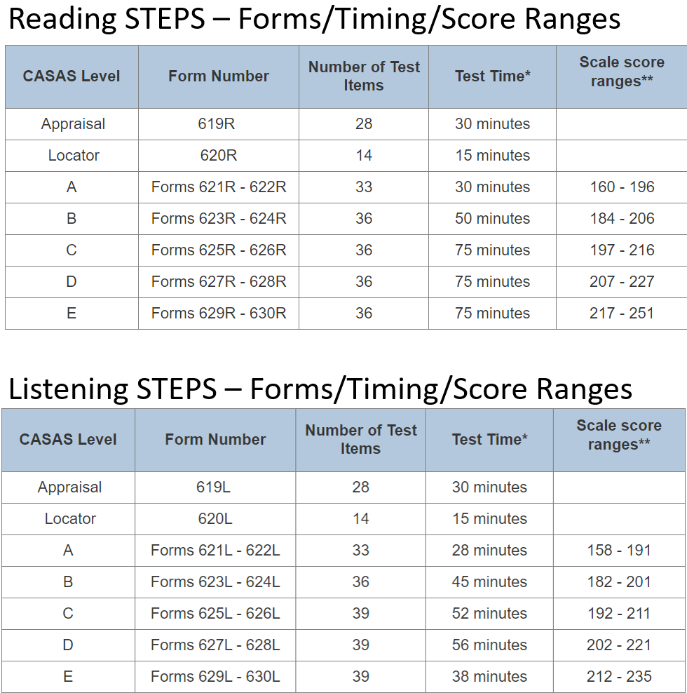
CASAS STEPS (Reading and Listening)
Notes:
The CASAS Competencies along with the ELPS and CCRS Standards, form the basis of the CASAS integrated assessment and curriculum management system. The CASAS Competencies identify more than 360 essential life skills that youth and adults need to be functionally competent members of their community, their family, and the workforce.
The competencies are relevant across the full range of instructional levels, from beginning literacy through high school completion including transition to postsecondary education and training. They cover nine broad content areas.
These critical competencies provide instructional objectives for curriculum, direct links to test content for monitoring student learning, criteria for program evaluation, and a referencing system for instructional materials. Based on field research – which began in 1980 – and recommendations from education providers, learners, business and industry representatives, and community-based agencies, the competencies have been regularly updated and validated at state and national levels

Slide 37
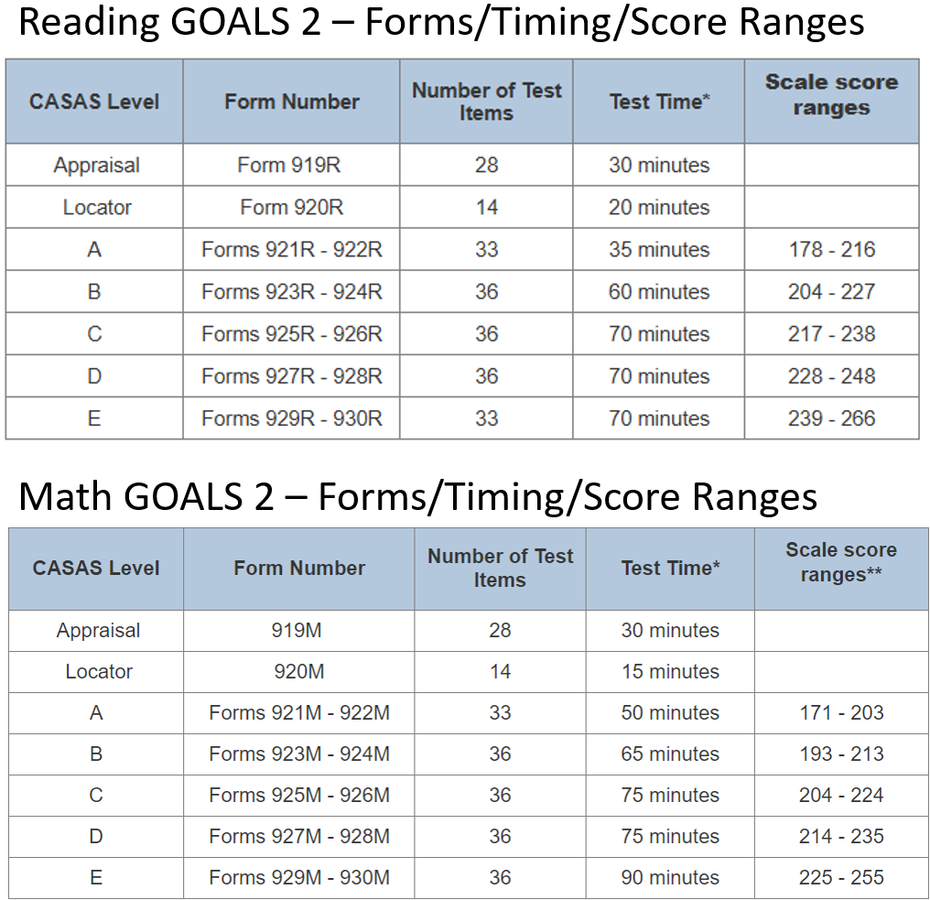
CASAS GOALS 2 (Reading and Math )
Notes:
The CASAS Competencies along with the ELPS and CCRS Standards, form the basis of the CASAS integrated assessment and curriculum management system. The CASAS Competencies identify more than 360 essential life skills that youth and adults need to be functionally competent members of their community, their family, and the workforce.
The competencies are relevant across the full range of instructional levels, from beginning literacy through high school completion including transition to postsecondary education and training. They cover nine broad content areas.
These critical competencies provide instructional objectives for curriculum, direct links to test content for monitoring student learning, criteria for program evaluation, and a referencing system for instructional materials. Based on field research – which began in 1980 – and recommendations from education providers, learners, business and industry representatives, and community-based agencies, the competencies have been regularly updated and validated at state and national levels

Slide 38
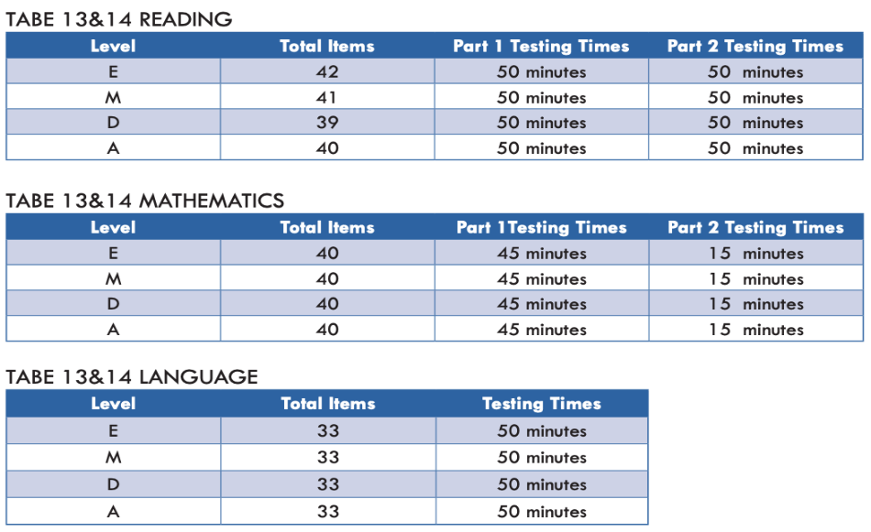
TABE 13&14 Maximum Allowable Testing Times
Notes:
The CASAS Competencies along with the ELPS and CCRS Standards, form the basis of the CASAS integrated assessment and curriculum management system. The CASAS Competencies identify more than 360 essential life skills that youth and adults need to be functionally competent members of their community, their family, and the workforce.
The competencies are relevant across the full range of instructional levels, from beginning literacy through high school completion including transition to postsecondary education and training. They cover nine broad content areas.
These critical competencies provide instructional objectives for curriculum, direct links to test content for monitoring student learning, criteria for program evaluation, and a referencing system for instructional materials. Based on field research – which began in 1980 – and recommendations from education providers, learners, business and industry representatives, and community-based agencies, the competencies have been regularly updated and validated at state and national levels

Slide 39
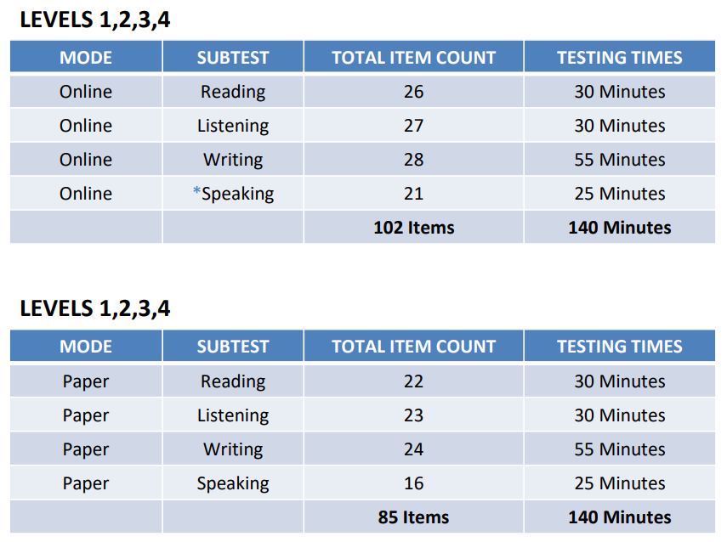
TABE CLAS-E Testing Times
Notes:
The CASAS Competencies along with the ELPS and CCRS Standards, form the basis of the CASAS integrated assessment and curriculum management system. The CASAS Competencies identify more than 360 essential life skills that youth and adults need to be functionally competent members of their community, their family, and the workforce.
The competencies are relevant across the full range of instructional levels, from beginning literacy through high school completion including transition to postsecondary education and training. They cover nine broad content areas.
These critical competencies provide instructional objectives for curriculum, direct links to test content for monitoring student learning, criteria for program evaluation, and a referencing system for instructional materials. Based on field research – which began in 1980 – and recommendations from education providers, learners, business and industry representatives, and community-based agencies, the competencies have been regularly updated and validated at state and national levels

Slide 40
Tools to help students become familiar with tests
CASAS
TABE
Sample Test Items
  Familiarize decision-makers, teachers, and students with CASAS items
  Give students practice in taking a CASAS test
  CASAS eTests Sampler builds familiarity with online testing platform – point and click only required skill
  Help reduce student test-taking anxiety
  Make future testing go more smoothly
  Not predictors of class placement
Online Tools Training
  Familiarize staff and examinees with online testing environment
  Practice in using the online tools available to testers
  Reduce anxiety of online testing
TABE 11&12 Sample Test Items
  Not yet available for TABE 13&14

Slide 41
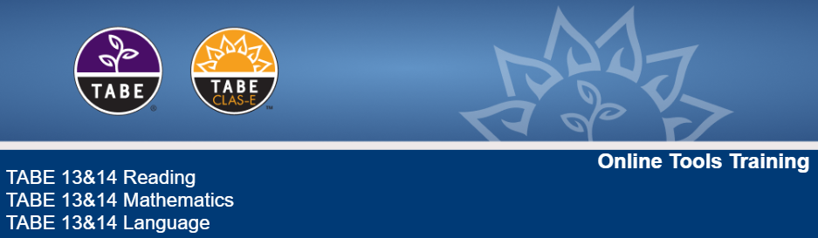
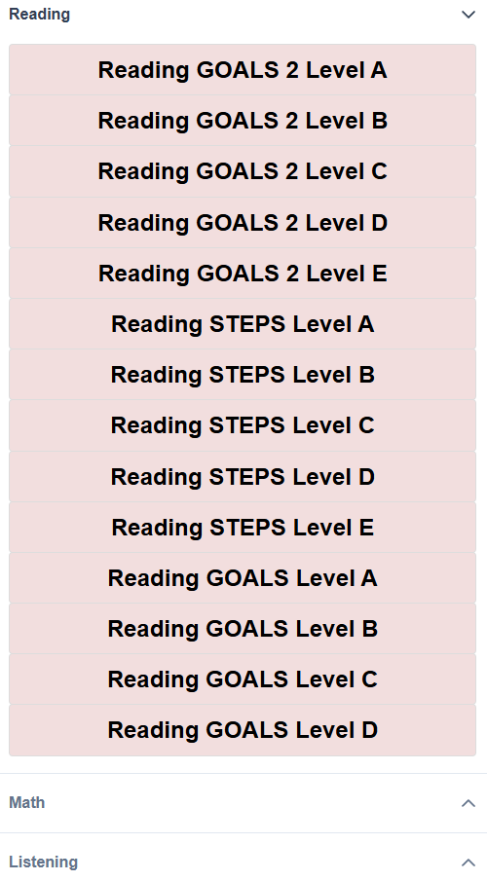


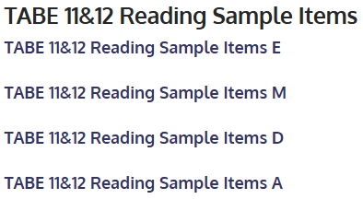
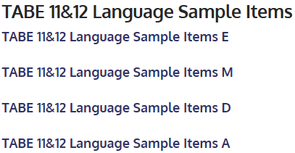
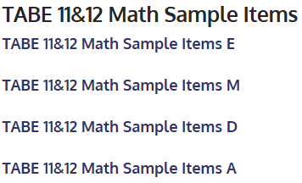
Tools to help students become familiar with tests
CASAS - Sample Test Items
TABE
Online – eTests Sampler
Printable Paper Test Items
T
T
T
T
T
T
T
T
T
T
T
T
T
T
t
Notes:
CASAS eTests Sampler

Slide 42
What scoring options are available?
CASAS
TABE
CASAS eTests – online testing automatically scored, test results/reports are immediately available in TOPSpro Enterprise (TE)
Scan official answer sheets using OMR scanner
Manually enter student answers into TE
Hand score using answer keys found in TAM
TABE Online – online tests automatically scored, reports available in DRC Insight portal
Scan official answer sheets using TWAIN compliant scanner
Scoreze answer sheets
No key for hand-scoring

Slide 43
Testing Accommodations
CASAS
TABE
CASAS eTests Enhanced Accessibility features
Partners with American Printing House for the Blind (APH)
Alt text for display images and answer options
Large print options and tactile graphics booklets
Color combinations of background and text colors
Default Text size options that illustrate the differences in text size
A Preview Area that shows the text size and color combinations together
All accessibility features can be modified at the testing station, or in the Management Console ahead of time
A new CASAS eTests Accommodations session- “untimed” for test takers with appropriate documentation
3 Categories of Accommodations:
Category 1 – Does not affect the interpretation of the scores
  "take the test alone or in a study carrel"
Category 2 – May have an effect on student performance and should be considered when interpreting individual test scores
  "use extra time for a timed test"
Category 3 – Likely to change what is being measured and have an effect that alters the interpretation of individual scores.
  "use a calculator for a mathematics computation test"

Slide 44
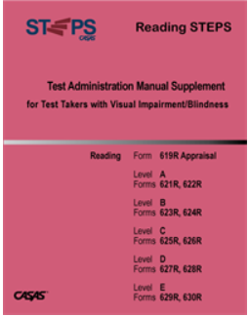
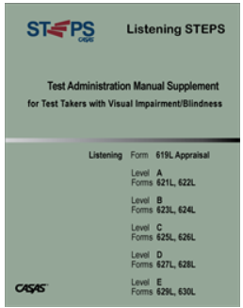
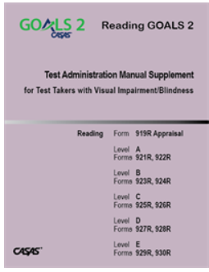
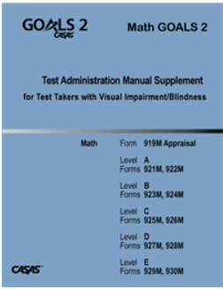

CASAS Accommodations Materials for Test Takers with Visual Impairment/Blindness
Product | For use with CASAS Forms | Description
Screen Reader Software - CASAS eTests are compatible with screen reader software | All STEPS and GOALS 2 | Test takers with visual impairment/blindness can listen to test directions, a description of prompts, test questions, and answer options
Reading STEPS TAM Supplement for Test Takers with Visual Impairment/Blindness | Forms 619R and 621R-630R | Includes specific administration guidelines and materials for administration. Test form scripts for prompts, test questions, and answer options are included for Reader/Scribe.
Listening STEPS TAM Supplement | Forms 619L and 621L-630L | Same as above
Reading GOALS 2 TAM Supplement | Forms 919R and 921R-930R | Same as above
Math GOALS 2 TAM Supplement | Forms 919M and 921M-930M | Same as above
Math GOALS 2 Tactile Graphics/Braille Supplement | Sold together as a package with Math GOALS 2 TAM Supplement above | Includes tactile graphics for prompts and test question in braille for items that can be accessed for test takers. Conveys non-textual information such as maps, graphs, and diagrams.

Slide 45
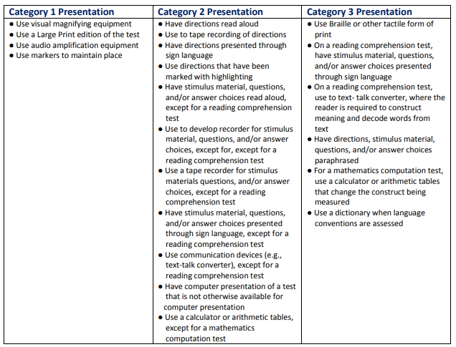
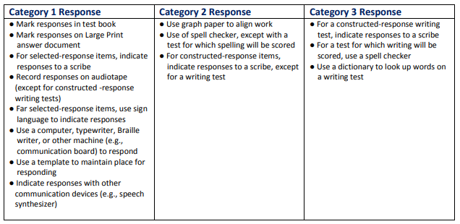
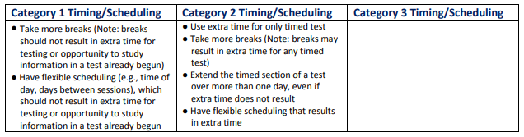
TABE Accommodations Materials and Classifying Table
TABE is available in:
Large-print test booklets/Large-print answer documents | Audio CD format (SPRING 2025)
Braille (SPRING 2025) | Text-to-Speech tool available in DRC INSIGHT/CBT

Slide 46
Test Administration Training Online
CASAS
TABE
Complimentary Online Training
  Training modules organized based on responsibilities
  Organized by test administration type – Paper, CASAS eTests, Remote
  Administrators, coordinators, data managers, proctors, remote testing, educators, workforce partners, business and industry, citizenship
  Certificates available
Complimentary TABE Administration Certification
  Certification Part 1: TABE 13&14 Overview
  Certification Part 2: Common Security and Administration Guidelines for TABE 13&14 and CLAS-E C&D
  Certification Part 3: TABE CLAS-E C&D Overview
  Certificates available with 80% correct on certification test

Slide 47
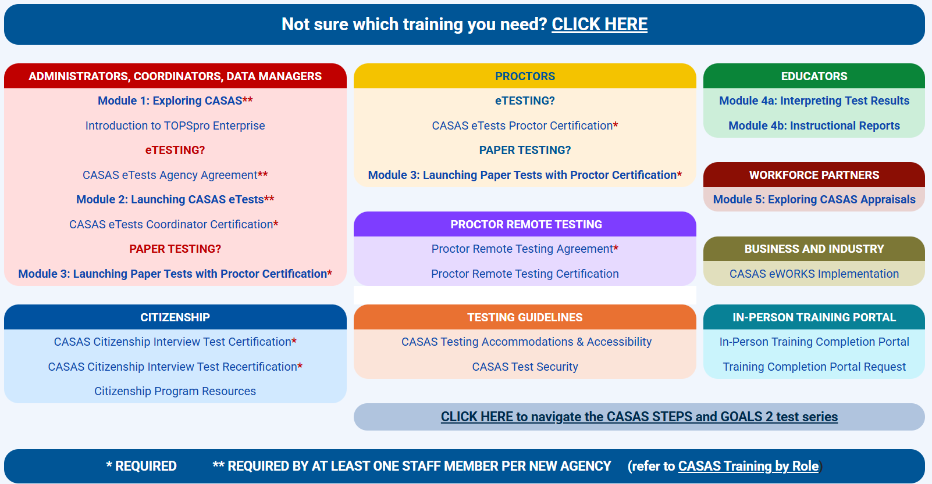
CASAS Administration Training Online

Slide 48
TABE Administrator Certification
TABE Administrator Certification is a free online training for programs interested in having their staff certified as TABE Test Administrators. TABE Certification consists of three unique, hour-long presentations, each of which is followed by a test. Upon successfully completing the training and passing the tests participants will be certified to handle, score, and proctor TABE and TABE CLAS-E tests. Participants can elect to print their Certificate of Completion, save it for late use, or have it emailed to them.
Upon completion certificate holders can:
Understand and follow general TABE and TABE CLAS-E best practices
Implement correct forms and levels
Securely administer and handle test resources
Follow student privacy protocols
Score and interpret the TABE and TABE CLAS-E test results
To access the Training modules please click on the separate links below:
Certification Part 1: TABE 13&14 Overview
Certification Part 2: Common Security and Administration Guidelines for TABE 13&14 and CLAS-E C&D
Certification Part 3: TABE CLAS-E C&D Overview
TABE Administration Training Online

Slide 49
Blueprints
CASAS – Content Standards, Competencies, and Task Area
TABE – Content Standards
GOALS 2 Reading – Vocabulary, Details, Main Idea, Inference and Point of View
GOALS 2 Math - Number Sense and Operations, Algebraic Thinking, Geometry and Measurement, and Data Analysis, Statistics and Probability
STEPS Reading – High-frequency Vocabulary (Pictures), High-frequency Vocabulary (Text), Numbers, Vocabulary, Details, Main Idea, Inference, and Point of View
STEPS Listening – Dialogue, Vocabulary, Details, Main Idea, and Summary
Reading – Reading Foundational Skills, Key Ideas and Details, Craft and Structure, Vocabulary Acquisition and Use, Integration of Knowledge and Ideas
Math – Numbers and Operations, Algebraic Concepts, Geometry, Measurement, Data and Probability
Language – Conventions of Standard English, Text Types and Purposes, Knowledge of Language and Vocabulary
Notes:
NRS-Approved Tests for both

Slide 50
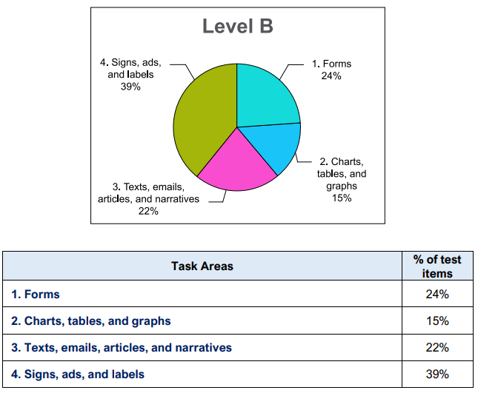
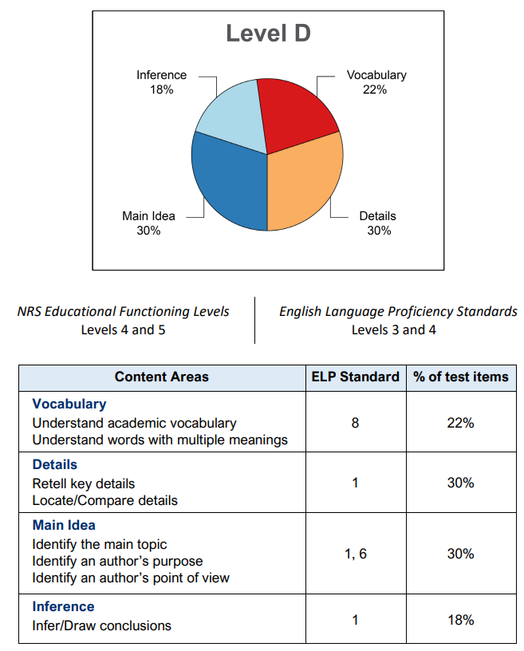
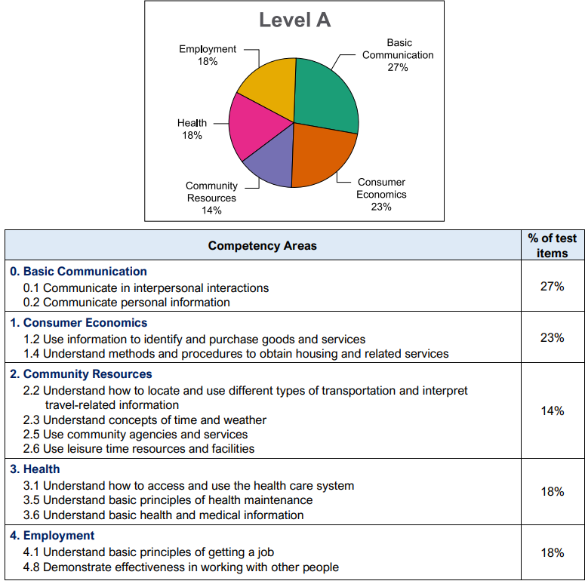
CASAS Blueprints* – Show content coverage at various levels
*Available for both
and
STEPS Reading Task Areas
STEPS Reading Content Standards
STEPS Listening Competencies

Slide 51
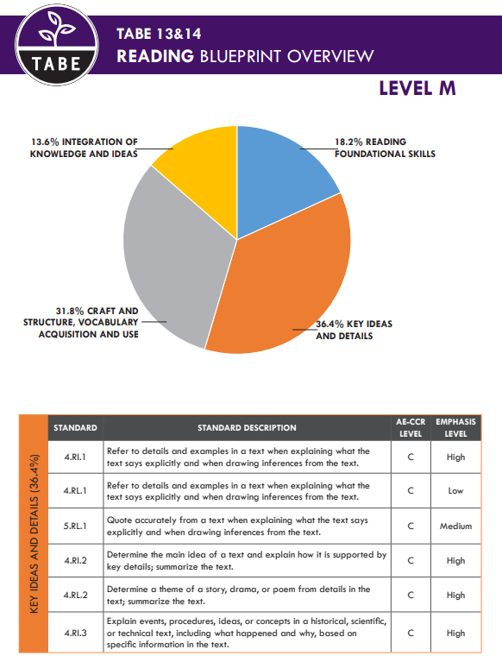
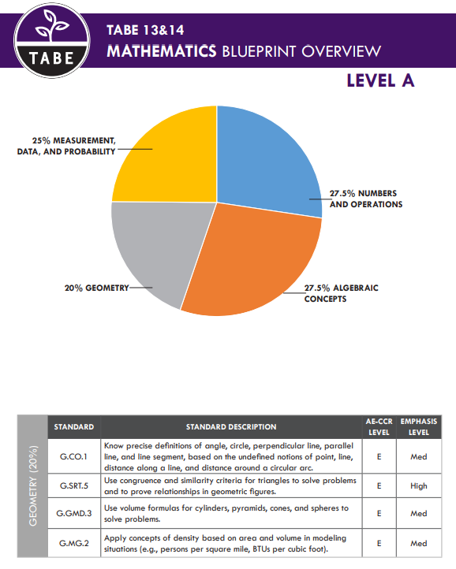
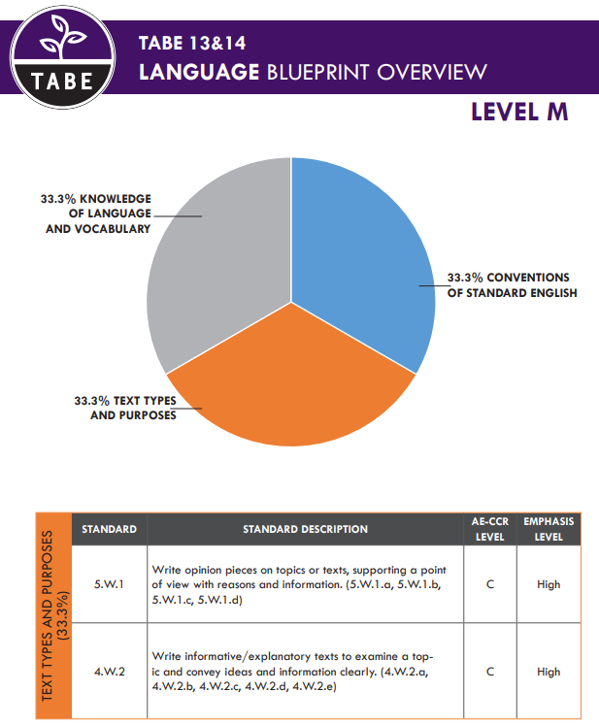
TABE Blueprints – Show content coverage at various levels

Slide 52
Reports
CASAS
TABE
Generate reports using TOPSpro Enterprise
Track student progress, including learner assessment scores and learner performance.
Next Assigned Test and Student Test History reports are available.
Generate individual student or class reports.
Generate reports using DRC Insight
Track test results with detailed skill analysis.
NRS level reports for accountability.
Includes Next Recommended Level for post-testing.
Optional Workforce reports that align with career clusters.

Slide 53
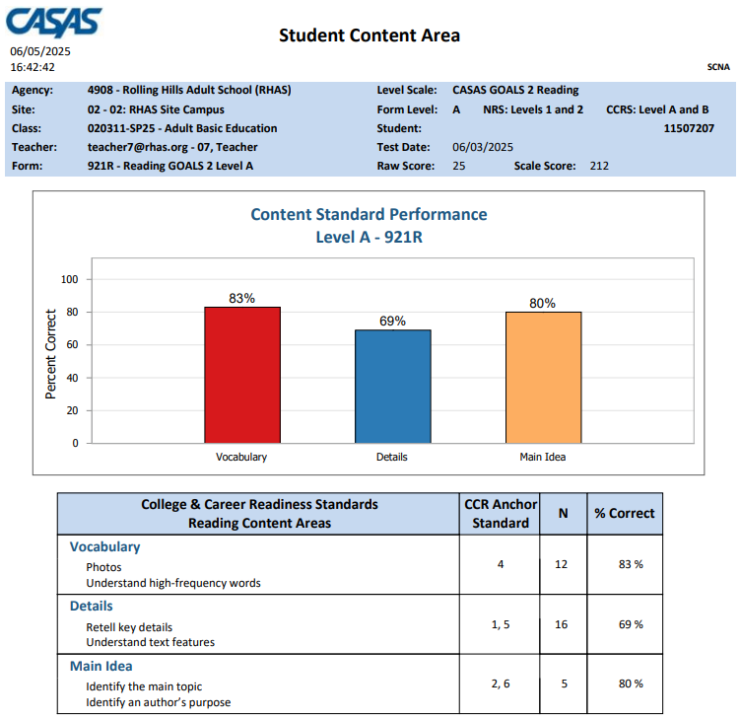
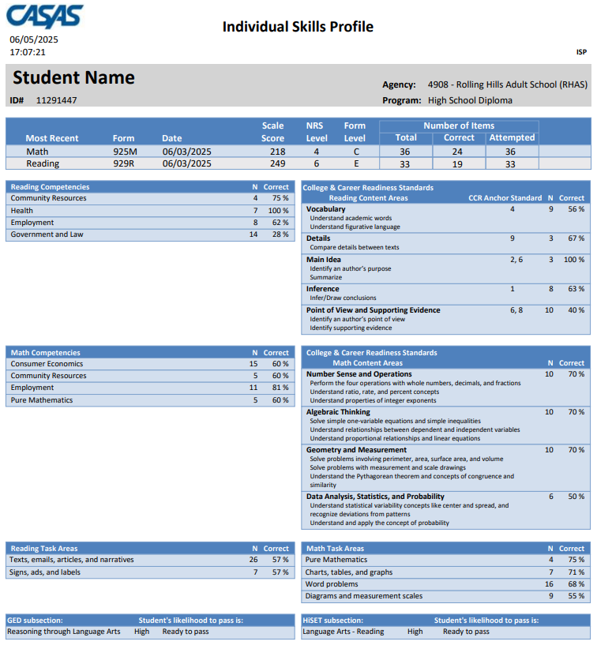
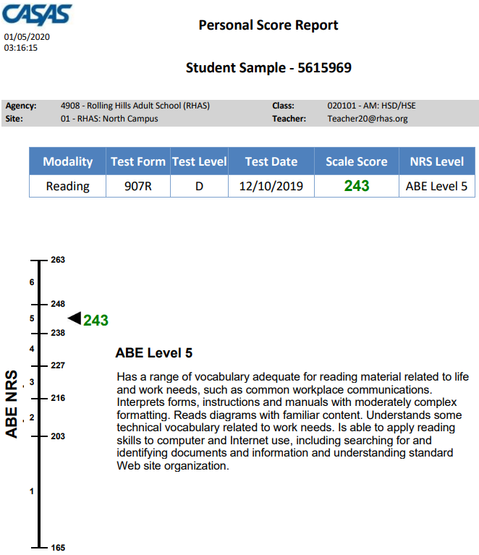
CASAS Reports – Show content coverage at various levels

Slide 54
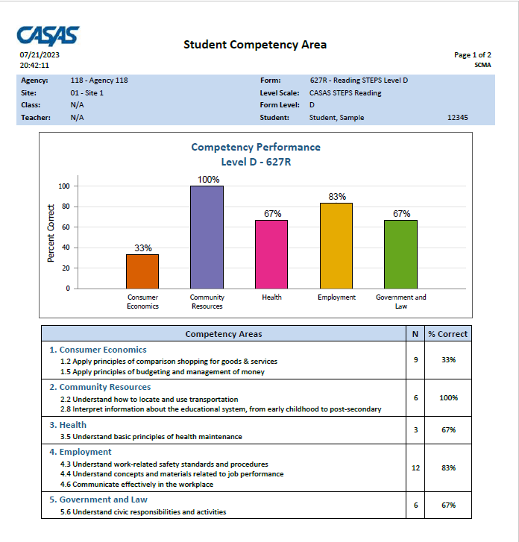
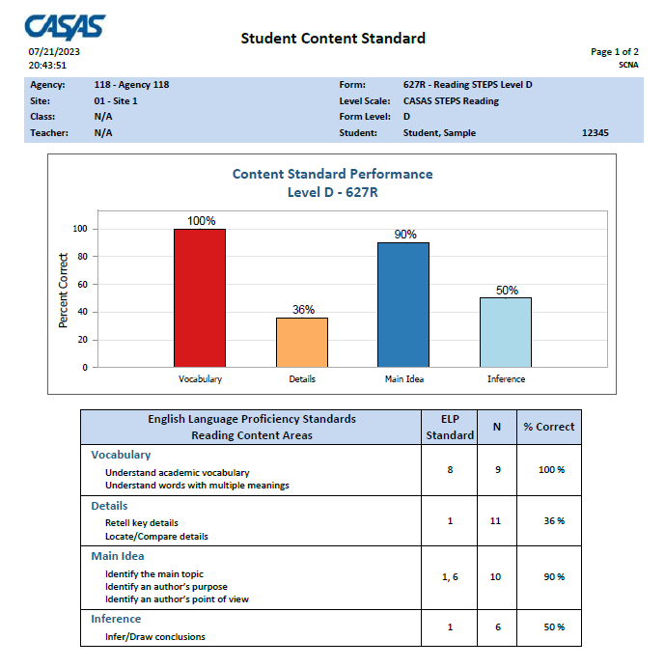
Class Report Samples
Notes:
This an example of the NEWEST Competency and Content Standard Reports. You can learn more about how to read and interpret the CASAS Test Results and reports in Module 4 (4 a & 4b Online Training).

Slide 55
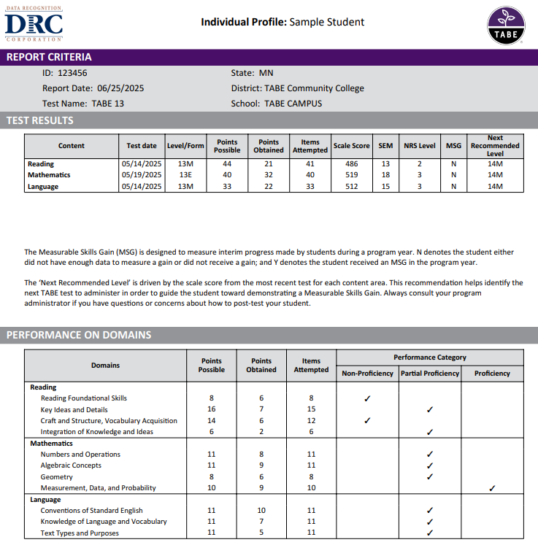
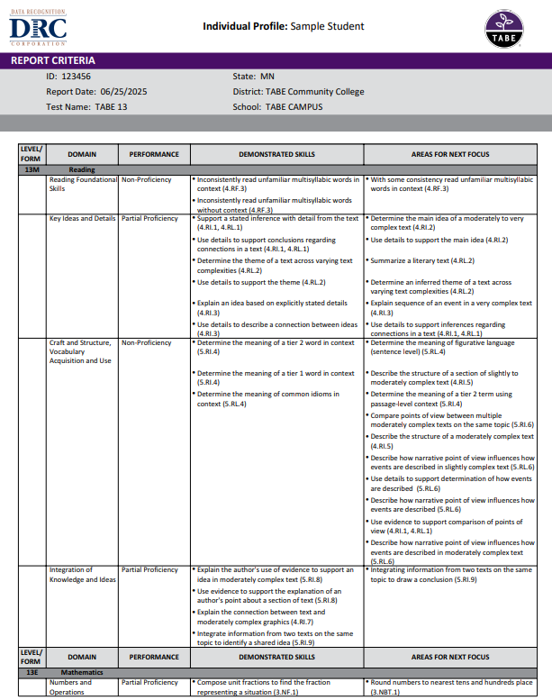
TABE Reports – Show Test Results, Proficiency, and Areas for Next Focus

Slide 56
High School Equivalency
CASAS
TABE
Transitioning Learners/ High School Equivalency Tests
TABE to High School Equivalency (HSE) Test Concordance

Slide 57

CASAS and HSE Readiness
Each examinee is classified into one of the following categories which corresponds to an NRS level.
Likelihood of Passing | NRS EFL based on Math or Reading GOALS 2
High – Ready to Pass | 6+
Medium – May Pass, more study may be needed | 5
Low – More Study Needed | 4 or below
In the excerpt below from a hypothetical student's Individual Skills Profile Report this student's likelihood is High for GED Reasoning through Language Arts and HiSET Language Arts-Reading and Medium for GED Mathematical Reasoning or HiSET Mathematics.
GED subsection |  | So Min Lee's likelihood to pass is:
Reasoning through Language Arts | High | Ready to pass
Mathematical Reasoning | Medium | May pass – more study may be needed
HiSET subsection |  | So Min Lee's likelihood to pass is:
Language Arts - Reading | High | Ready to pass
Mathematics | Medium | May pass – more study may be needed
Notes:
This an example of the NEWEST Competency and Content Standard Reports. You can learn more about how to read and interpret the CASAS Test Results and reports in Module 4 (4 a & 4b Online Training).

Slide 58

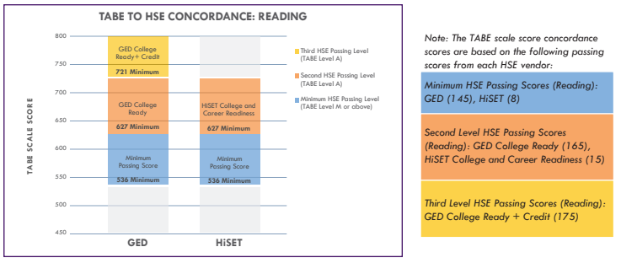
TABE to High School Equivalency (HSE) Concordance
Helps program administrators, instructors, and students understand the relationship between TABE and HSE (GED and HiSET)
Helps the decision-making process by providing a statistical view of how TABE results can provide a readiness predictor to each of the HSE tests.
Shows how TABE results for Reading and Mathematics are related to the RLA and Mathematics passing criteria for each HSE test.

Slide 59

Workforce Skills Alignment
CASAS
TABE
Assess, Profile and Certify a person's existing Skills - Create a Workforce Skills Profile that certifies current skills .
Develop Skills - Use easy-to-read learner-level reports to focus on work-related academic skills, soft skills, and competencies employers look for.
Certify Improved Skills – Award a certificate to document that the candidate has the high-level skills needed to succeed.
Search the TABE Workforce Portal for in-demand careers linked to TABE scores.
View national comparisons and career information by state, including the median pay and projected career growth for selected occupations.
Each career listing also includes information on key job tasks, technical skills, and related occupations.

Slide 60
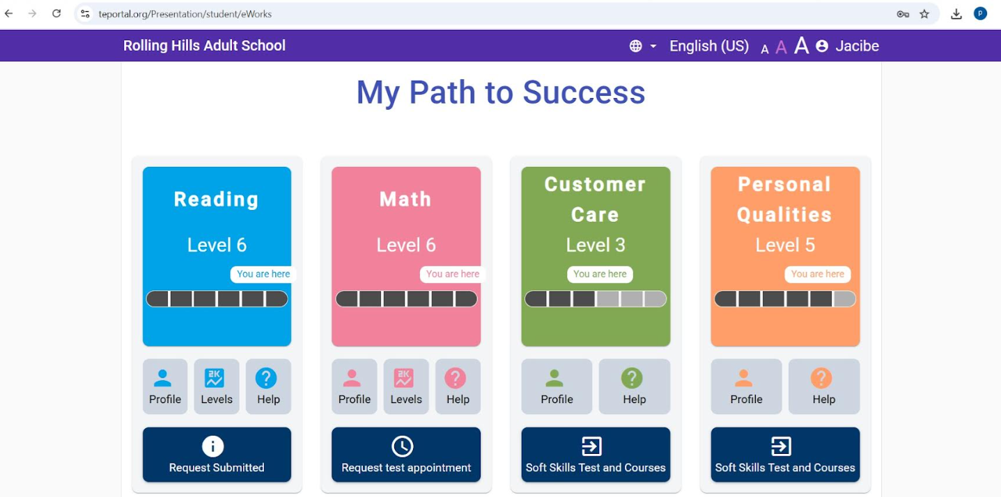
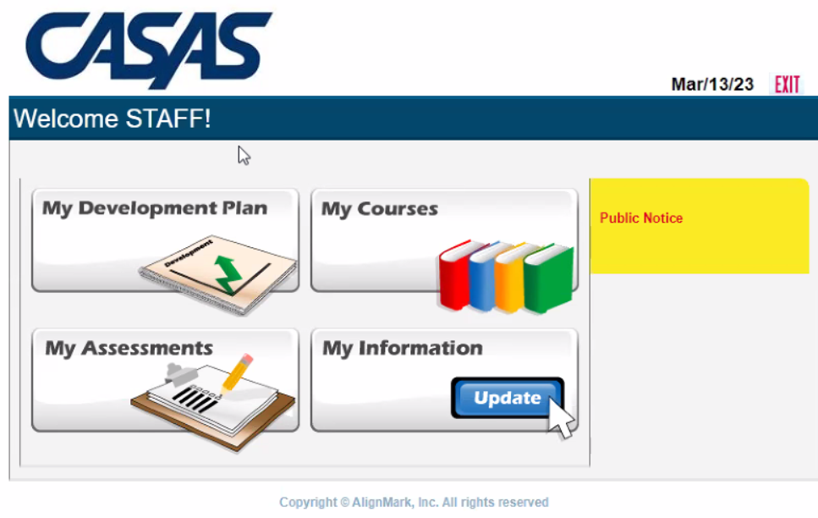
CASAS eWorks
CASAS eWORKs is a credentialing product that uses work-related academic and soft skills assessments to create a Workforce Skills Profile.
Certify Job-Seekers' soft skills with video-based scenarios:
* Integrity
* Self-management
* Customer Relations
* Decision-making
* Commitment to Quality
Job Seeker Benefits:
* Certify Job Readiness Skills
* Identify work-related competencies
* Identify skills that need to be strengthened
Notes:
CASAS eWORKs Document and develop employer-validated academic and soft skills and facilitate transition to the workforce using CASAS eTests, Teacher Portal and Student Portal.
CASAS eWorks Creates an individual profile of skills, including:
Employer validated academic skills
– Reading and Math ‘essential academic foundational skills’ needed for the workplace
Soft Skills (Workplace Behaviors) Video-based Assessments
– Personal Qualities & Customer Care
Includes an Individualized Learning Plan Tool for Counselors & Career Navigators
And… includes scenario-based Curriculum
– Use with Individuals or Group

Slide 61
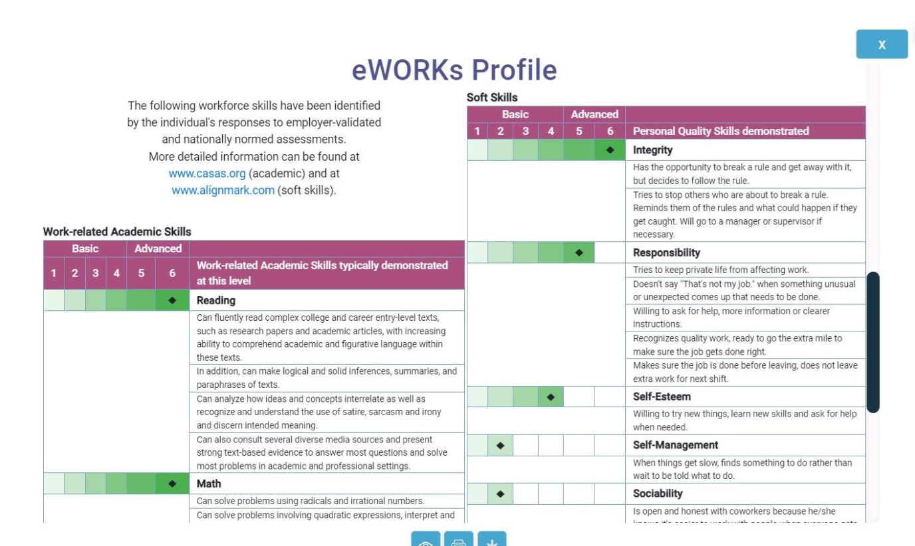
CASAS eWorks
**eWORKs Profile as shown on the back of the eWORKs certificate.

Slide 62



TABE Workforce Portal
Leveraging TABE Test Data to Inform Career Paths and Goals​

Slide 63
Getting Started with Online Testing
CASAS
TABE
Going Live Checklist
Complete required training
Submit eTests Agency Agreement
Choose Basic or Enhanced package
Minimum order of 100 WTUs or TEUs required (no expiration date)
Universal test units – can be used for any test series ESL or ABE
CASAS will verify training and create account
Order Forms
Minimum purchase of $500.00
All purchases are valid for one year from the date of purchase
ESL and ABE test units are specific to TABE CLAS-E and TABE 13/14 (or TABE 11/12)
Sign license agreement agreeing to terms of use

Slide 64

CASAS eTests Software Options​
CASAS eTests
DO NOT expire!
CASAS Help Documentation​
CASAS System Requirements​
Available Assessments in CASAS eTests

Slide 65
TABE Online Cost​
TABE 13&14 Online
TABE CLAS-E C&D Online
Number of Sub-Test Administrations | Price
1-1,500 | $4.45/each
1,501-3,000 | $4.15/each
3,001-6,000 | $3.65/each
6,000-10,000 | $3.30/each
10,000-30,000 | $3.05/each
30,0001+ | $2.90/each
Number of Sub-Test Administrations | Price
1-1,500 | $3.00/each
1,501-3,000 | $2.85/each
3,001-6,000 | $2.70/each
6,000-10,000 | $2.55/each
10,000+ | $2.25/each
Test administrations have a one-year expiration, beginning when tests are disbursed to program.

Slide 66
Remote Testing
CASAS
TABE
Remote Testing for CASAS eTests
  CASAS Remote Testing Policy
  Remote Testing Rules for Students
  Remote Testing Links for eTests2
  Remote Test Directions for Students using Zoom
  Remote Test Directions for Proctors using Zoom
Remote Testing Hub
  CASAS Remote Testing Hub Rules for Students
  Remote Testing Directions for Students using Zoom
TABE Remote Proctoring
  TABE Remote Testing FAQs
  TABE Examiner Instructions for Remote Testing
  TABE Student Instructions for Remote Testing
  DRC DEVICE Check for Remote Testing

Slide 67

What’s your takeaway?
This Photo by Unknown Author is licensed under CC BY-ND

Slide 68

Questions?
Notes:
MENTI meter with question bubbles?

Slide 69

Thank you!
Marty Olsen
martha.olsen@gmail.com

