Slide 1
Critical issues in assessment –
Casas goals and tabe 11 & 12
Support Services Conference
MN Department of Education
November 9, 2018
Linda Keller – lindam.keller@ahschools.us
Marty Olsen – martha.olsen@gmail.com

Slide 2


Slide 3


Slide 4

What is the timeline for CASAS GOALS assessments to be used for reporting?
Greater Opportunities for Adult Learning Success
CASAS GOALS Reading assessment was approved for NRS reporting for 7 years beginning February 5, 2018.
CASAS GOALS was approved for use by programs in Minnesota in September 2018, and the scores are available in SiD (on SiD Dashboard, click on “Select Displayed Tests” to add tests to choice).

Slide 5
What do we know about the CASAS GOALS Reading assessment?
The assessment is designed to assess the Reading skills of Adult Basic Education (ABE) and Adult Secondary Education (ASE) learners.
The test items are aligned to the College and Career Readiness Standards (CCRS) and the new NRS ABE/ASE level descriptors.
The new CASAS tests are available in both paper and eTesting versions.

Slide 6
Test Content Areas and CCRS
CASAS Reading GOALS Content Areas | CCRS Reading Anchor*
Vocabulary | R4
Reading Comprehension Skills | R1, R2
Locate information/detail; cite evidence
Identify main idea and details
Higher Order Thinking Skills
Cite evidence; infer; draw conclusions; summarize | R1, R2
Text structures and features | R5
Author’s purpose and point of view | R6
Analyze claim/argument | R8
*CCRS Reading Standards R7, R9, and R10 are measured across content areas

Slide 7
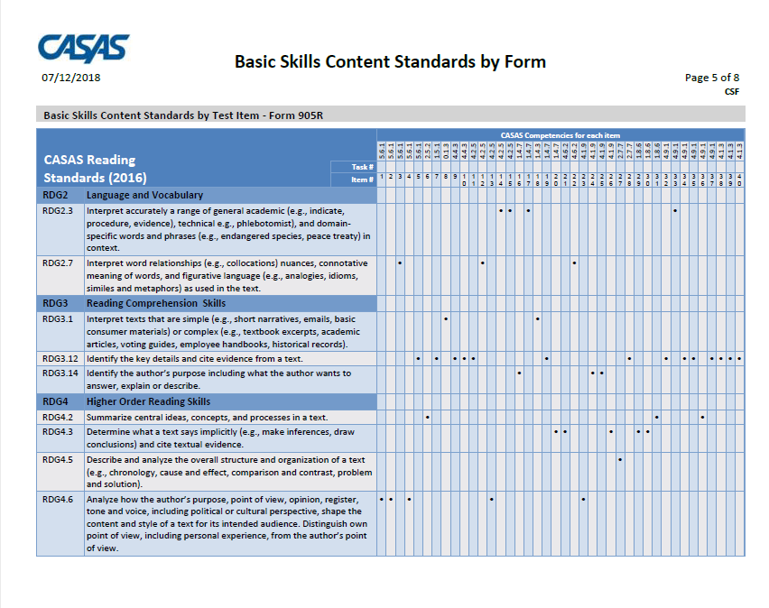
CASAS Competencies tied to each test item
https://www.casas.org/product-overviews/assessments/reading-goals
Compare to CCRS
RDG2.3 – Interpret accurately a range of general academic (e.g., indicate, procedure, evidence), technical (e.g., phlebotomist), and domain-specific words and phrases (e.g., endangered species, peach treaty) in context. (CCR Anchor 4)
RDG3.12 – Identify the key details and cite evidence from a text. (CCR Anchor 1 and Anchor 2)
RDG4.2 – Summarize central ideas, concepts, and process in a text. (CCR Anchor 2)
RDG4.3 – Determine what a text says implicitly (e.g., make inferences, draw conclusions) and cite textual evidence. (CCR Anchor 1)
RDG4.5 – Describe and analyze the overall structure and organization of a text (e.g., chronology, cause and effect, comparison and contrast, problem and solution. (CCR Anchor 5)

Slide 8
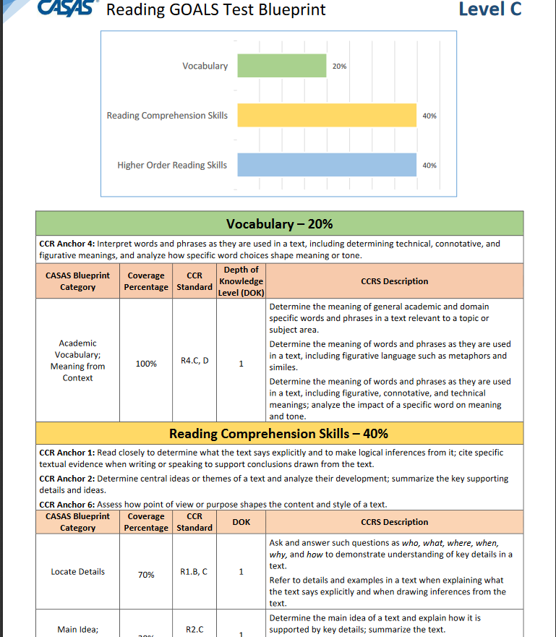
CASAS Reading GOALS Test Blueprint – Level C

Slide 9
What do we know about the CASAS GOALS Reading assessment?
Intake
eTests – Short locator – 10 to 15 minutes
Appraisal Form 900R (paper & eTests) – must be used to place learners in the appropriate GOALS level pre-test.
This appraisal is 28 questions, and 30 minutes long.
Pretests and Posttests (Maximum time allowed)
Level A test forms – 60 minutes each
Levels B, C, and D – 75 minutes in length

Slide 10
Test Times and Item Count
Reading GOALS |  |  | Timing
CASAS Level | Form Number | Number of Test Items | Students have up to
A | Form 901 | 39 | 60 minutes
A | Form 902 | 39 | 60 minutes
B | Form 903 | 40 | 75 minutes
B | Form 904 | 40 | 75 minutes
C | Form 905 | 40 | 75 minutes
C | Form 906 | 40 | 75 minutes
D | Form 907 | 40 | 75 minutes
D | Form 908 | 40 | 75 minutes

Slide 11
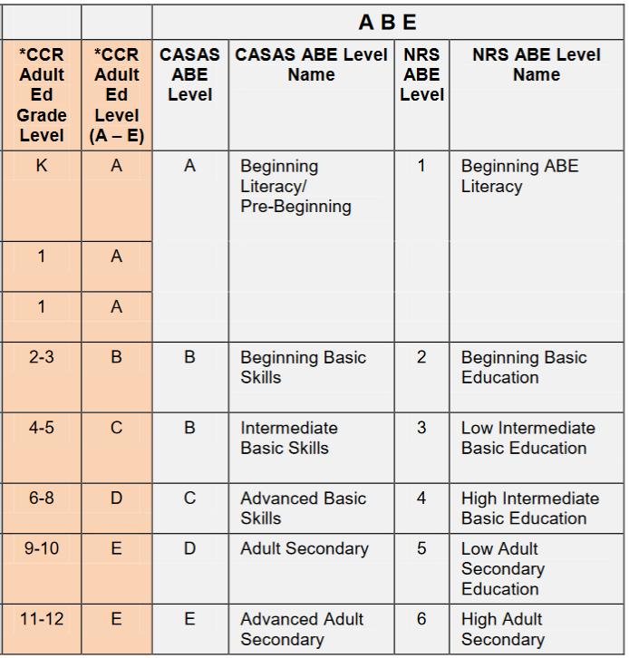
Alignment of CASAS ABE Levels with NRS and CCR Adult Education Levels

Slide 12
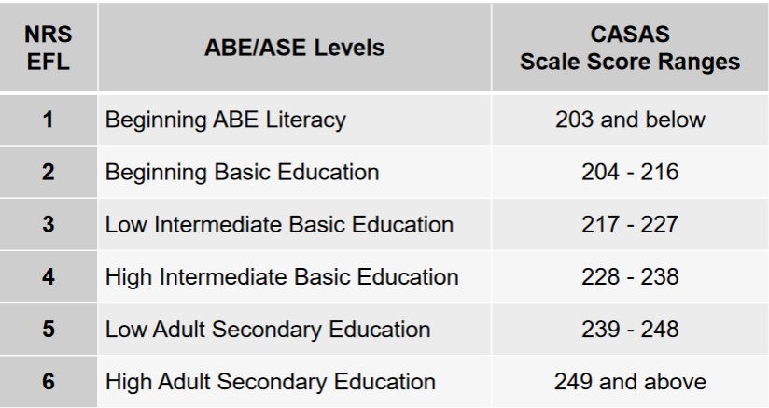
CASAS GOALS Scale Score Ranges

Slide 13
CASAS GOALS Sample Test Items
Level A – Beginning Basic Education
Level B – Low Intermediate Basic Education
Level C – High Intermediate Basic Education
Level D – Low Adult Education
**Activity – Look at the Sample Test Items. How do these compare to CASAS Life & Work?

Slide 14
What do we know about the CASAS GOALS Math assessment?
CASAS submitted these assessments to the NRS in March. They hope to hear something by the end of the year.
Assess math concepts via common life and work applications. A range of item types will include word problems, simple to advanced calculation, and situational scenarios that reflect real-world applications.
The new math tests will allow use of a calculator.
Formulae will be provided within the test item to keep assessment focused on math concepts and skills, not memorization.

Slide 15
How can English Language Learners be assessed?
The revised NRS ELL descriptors were published at the end of 2017.
CASAS has aligned the GOALS assessments to the ELL descriptors and submitted them to the NRS in October, 2018.
Listening GOALS is being field-tested. CASAS plans to submit it to the NRS in October 2019.
Forms 27 and 28 are being revised. CASAS plans to submit them to the NRS in October 2020. (ELL use only after June 30, 2019)
Continue to use Life & Work Reading and Listening, for ELL, through February 2, 2021.

Slide 16
Assessment policy http://www.mnabe.org/sites/default/files/mnabe_assessment_policy_2018-19_revised_9-25-18.docx
For Levels: ABE 1-6
**Approved by OCTAE and the Minnesota Department of Education for NRS purposes for ABE levels through June 30, 2019.
Name/Series | Content | Format | Forms/Levels
GOALS (New for 2018) | Reading | Paper-based, Computer-based | 901R-908R
Life Skills | Math** | Computer-based, Paper-based | 31-38, 505, 506

Slide 17
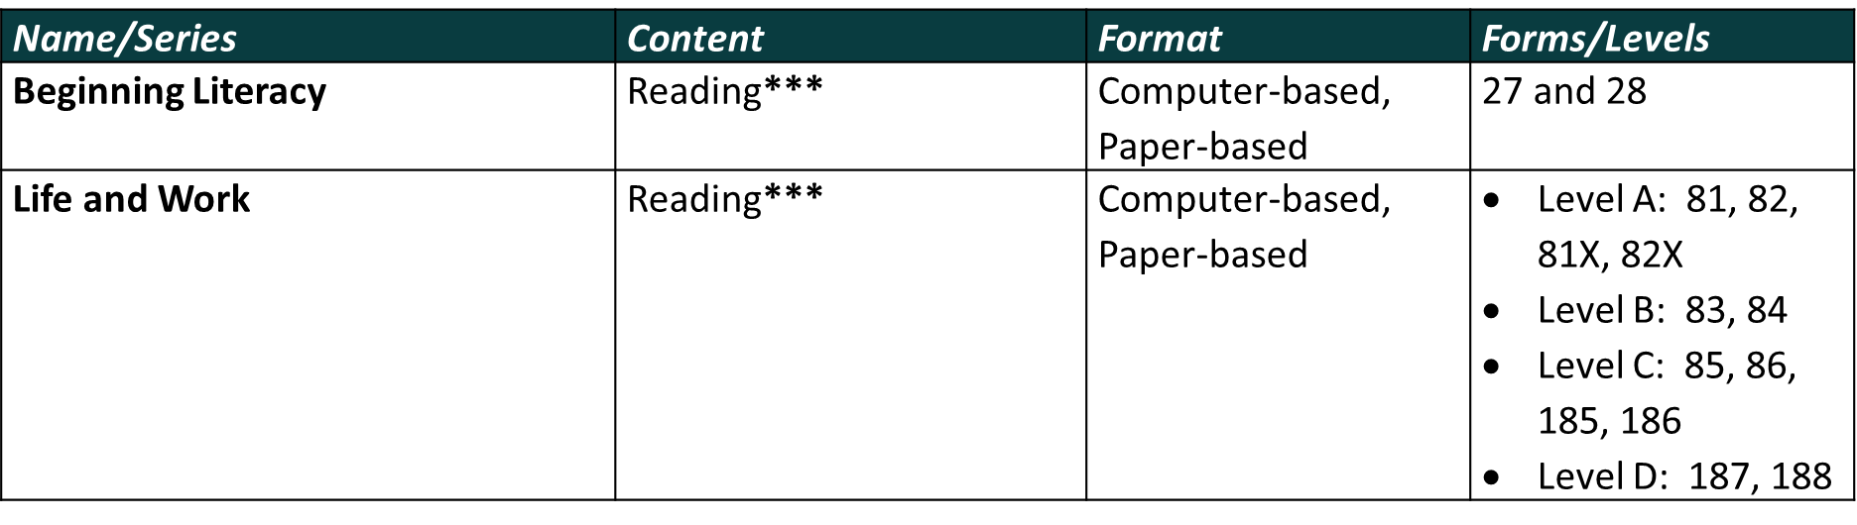
Assessment policy http://www.mnabe.org/sites/default/files/mnabe_assessment_policy_2018-19_revised_9-25-18.docx
For Levels: ABE 1-6 and ESL 1-6
***Approved by OCTAE and the Minnesota Department of Education for NRS purposes for ESL Levels through February 2, 2021. Approved by OCTAE and the Minnesota Department of Education for NRS purposes for ABE Levels through June 30, 2019.

Slide 18
Assessment policy http://www.mnabe.org/sites/default/files/mnabe_assessment_policy_2018-19_revised_9-25-18.docx
For Levels: ESL 1-6
Name/Series | Content | Format | Forms/Levels
Life and Work | Listening**** | Computer-based, Paper-based | 981L-986L
****Approved by OCTAE and the Minnesota Department of Education for NRS purposes for ESL Levels through February 2, 2021.

Slide 19
Purchase CASAS GOALS Tests
Paper-based tests-Reading GOALS
Computer-delivered tests
Item | Price Each
Test Adm Manual | $40
Appraisal Booklets | $100/25
Test Forms (4 levels/2 forms each level) | $100/each set of 25
Pkg. of 5 each level | $190
Pkg. of 10 each level | $350
Answer Sheets (100) | $63/set
Test Administrations | Price Each
100-500 | $2.85
501-1000 | $2.20
1001-5000 | $2.00
5001+ | $1.75
*Each pretest and each posttest in each modality is one test administration.

Slide 20
CASAS GOALS Links
Https://www.Casas.Org/product-overviews/assessments/reading-goals
Reading GOALS overview
Reading GOALS for ABE/ASE FAQs
Reading GOALS Test Blueprint
Sample test items
Reading GOALS – Basic Skills Content Standards by form

Slide 21
Training Options
Face-to-face with state certified trainer (summer institute, support staff conference, regionals)
Local trainings by request (martha.olsen@gmail.com) – need 8 to 10 participants to schedule
Online at: training.casas.org

Slide 22
Transitioning to CASAS GOALS
Currently GOALS can only be used with ABE learners (not ELL).
Test proctors should read through the test directions.
Teachers should become familiar with some of the new items types and practice them with students.
After 40 hours of instruction, returning students should be posttested with CASAS Life & Work – and then pretested with GOALS.
New students can be tested with GOALS.
Final transition for ABE learners must be complete by June 30, 2019.

Slide 23
Remember!
CASAS Life & Work, Reading and Listening, is still approved through February 2, 2021. If you use CASAS for your EL learners, that is still an option. You are not being forced to move to TABE 11&12.

Slide 24
QUESTIONS about CASAS GOALS?

Slide 25


Slide 26
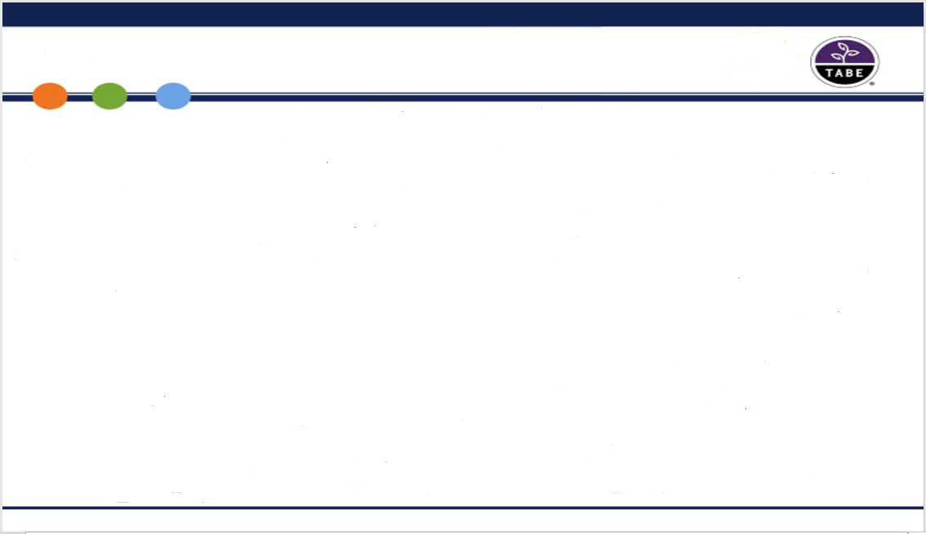
TABE 11&12 – Quick Facts
  New standards
    Aligned to College and Career Readiness (CCR) standards
  New test length
    Only one test length; no survey and complete battery
  Improved locator design
    Longer locator test provides a stronger prediction to TABE
  Aligned to all three HSE exams
  Recommended for ABE learners and ELLs who have earned a 236+ on CASAS

Slide 27
Comparing TABE 9&10 to 11&12
 | TABE 9&10 | TABE 11&12
Versions | Two versions of each test – version 9 and version 10 | Two versions of each test – version 11 and version 12
Levels | L (Literacy), E (Easy), M (Medium), D (Difficult), A (Advanced) | No Change
Locator | 12 questions in Language and Reading, 16 questions in Math | 16 questions in all subjects, with three two-part questions in Reading (for 19 answers)
Subject Tests | Reading, Mathematics Computation, Applied Mathematics, Language, Vocabulary, Language Mechanics, Spelling | Reading, Mathematics, and Language
Test Length | Long Form (Complete Battery) and Short Form (Survey) | Only one test length, approximately 40 questions in each subject area
Question Types | Multiple Choice | Multiple choice with some technology-enhanced questions on the computer version of the test, such as drag and drop and multiple select
Test Time | 10 to 50 minutes depending on the test; approximately 1 minute per question (less on Mathematics Computation) | Mathematics – 75 minutes Reading – 120 minutes Language – 60 minutes Approximately 2-3 minutes per question

Slide 28
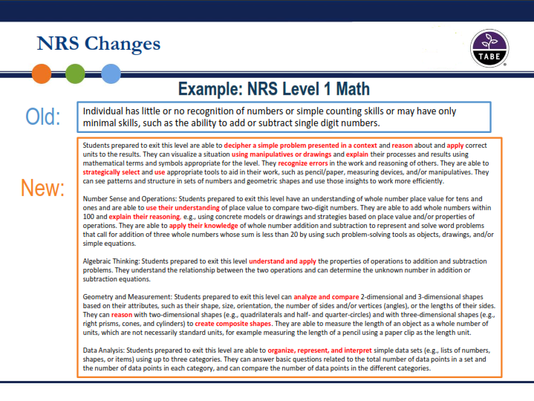
Notes:
TABE 11&12 is longer in order to address the new NRS standards as evidenced by this example.

Slide 29
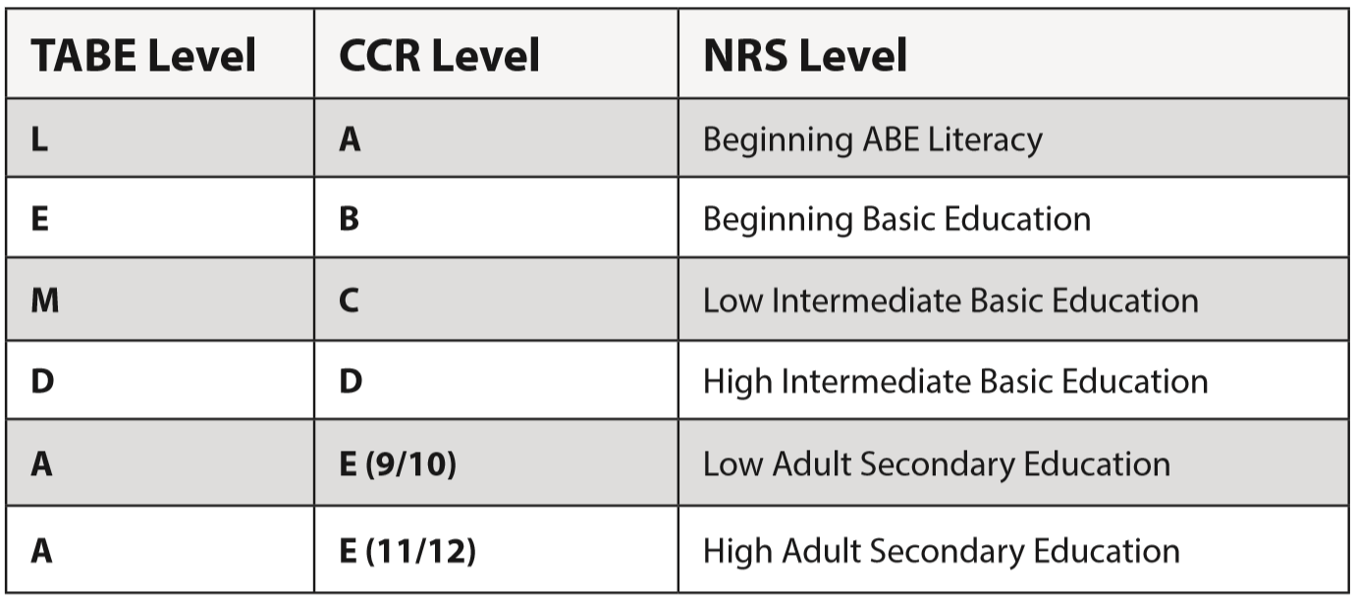
TABE 11&12 Level/ CCR Level/NRS Level
(0-1.9)
(2-3.9)
(4-5.9)
(6-8.9)
(9-12.9)
(9-12.9)

Slide 30
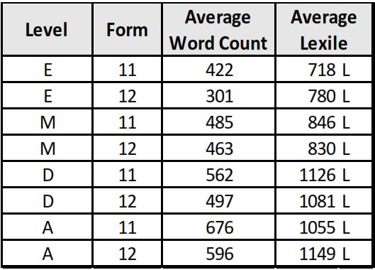
TABE 11&12 Word Count and Average Lexile
Grade | Lexile Range
1 | Up to 400 L
2 | 140 L to 500 L
3 | 330 L to 700 L
4 | 445 L to 850 L
5 | 565 L to 950 L
6 | 665 L to 1050 L
7 | 735 L to 1075 L
8 | 805 L to 1100 L
9 | 855 L to 1165 L
10 | 905 L to 1200 L
11&12 | 840 L to 1300 L

Slide 31
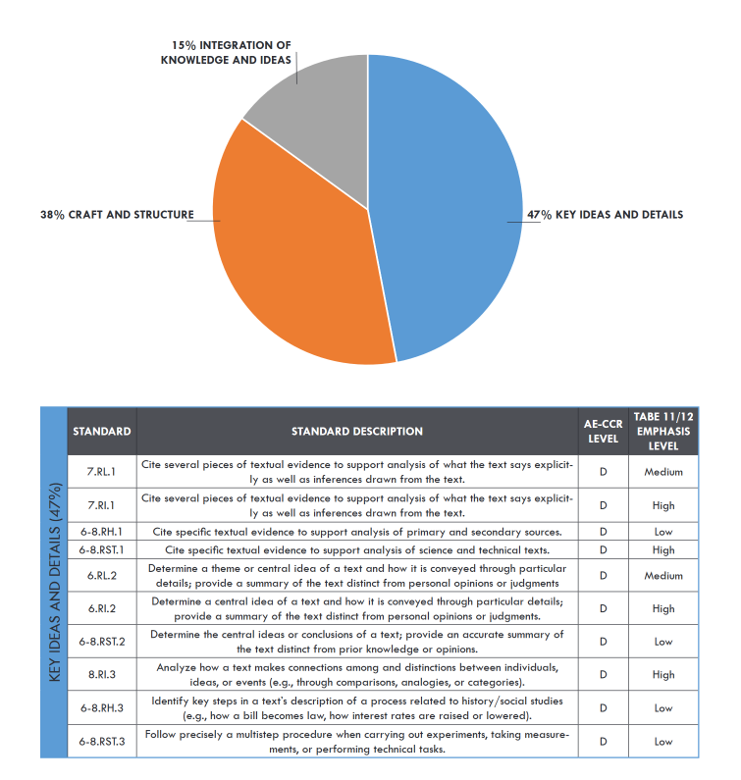
Blueprint Level D - Reading
Cite specific textual evidence to support analysis of primary and secondary sources (CCR Anchor 1)
Determine a central idea of a text and how it is conveyed through particular details: provide a summary of the text distinct from personal opinions or judgments. (CCR Anchor 2)
Analyze how a text makes connections among and distinctions between individuals, ideas, or events. (CCR Anchor 3)

Slide 32
Preparing for Testing – TABE 11&12
Each Examiner needs:
  Test Directions
  TABE test book
  Answer Key
Each Examinee needs:
  TABE test book
  Answer document
Additional Materials needed for each examinee:
  Pencils
  Scratch paper for Math
  Protractor for Math, Level M only
  Basic 4-function calculator for Math – Part 2 Level M only
  Scientific calculator for Math – Part 2 Levels D and A only

Slide 33
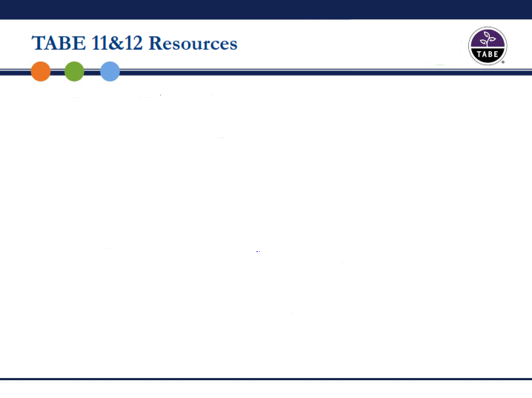
Total Test Items and Time Allowed
LEVEL | EBSR (Evidence-Based Selected Response) | TOTAL NUMBER OF ITEMS | MAXIMUM AMOUNT OF TESTING TIME ALLOWED
Mathematics (Total for Calculator and Non-Calculator Sections)
L | 0 | 40 items | 75 minutes
E | 0 | 40 items | 75 minutes
M | 0 | 40 items | 75 minutes
D | 0 | 40 items | 75 minutes
A | 0 | 40 items | 75 minutes
**Reading (Total for Part 1 and Part 2)
L | 0 | 47 items | 95 minutes
E | 3 | 47 items | 120 minutes
M | 7 | 47 items | 120 minutes
D | 9 | 47 items | 120 minutes
A | 15 | 47 items | 120 minutes
Language
L | 0 | 40 items | 60 minutes
E | 0 | 40 items | 60 minutes
M | 0 | 40 items | 60 minutes
D | 0 | 40 items | 60 minutes
A | 0 | 40 items | 60 minutes
Notes:
TABE 11/12 contains about half the number of items as the TABE 9/10 Complete Battery. However, the testing time has clearly increased. Students will not yet be familiar with CCR-based high stakes assessment, and we therefore chose these times to give students the best chance at completing their test with the least amount of pressure. Most students will finish their test well before the time is up.
Due to the potential for longer testing times, Reading – which relies heavily on passages – was divided into two parts. You may give both to your students at one sitting, or you may set them up as separate tests.
Mathematics has two sections: A non-calculator section and a calculator section. Online students will have access to an online calculator, and paper/pencil students can use a manual calculator. These two sections of the test are distinct, however, and test takers should not have access to a calculator when taking the non-calculator section. Note that once the non-calculator section is complete in the online test, students cannot return to it.
EBSR stands for “Evidence Based Selected Response” which means that a question requires the test-taker to choose the evidence that supports their answer in the previous question.

Slide 34
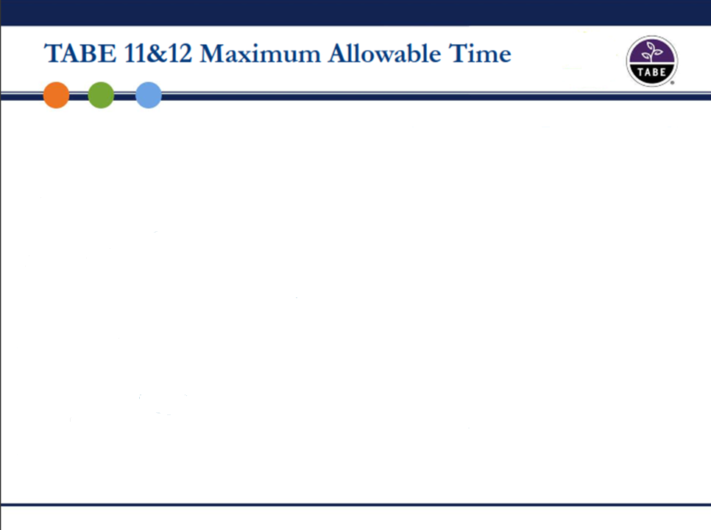
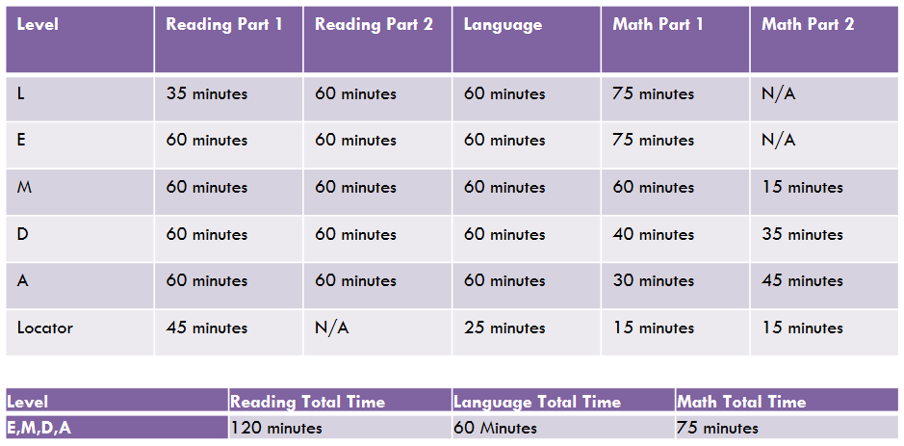
**Maximum allowable testing times have been revised to reflect actual time needed to complete the assessments.

Slide 35
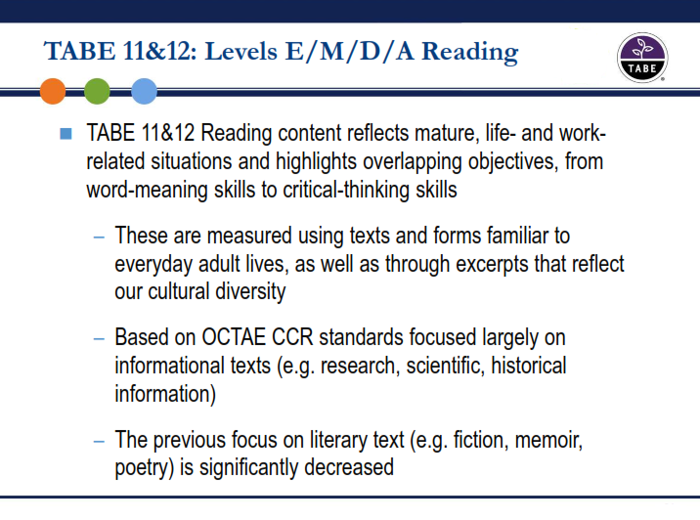

Slide 36
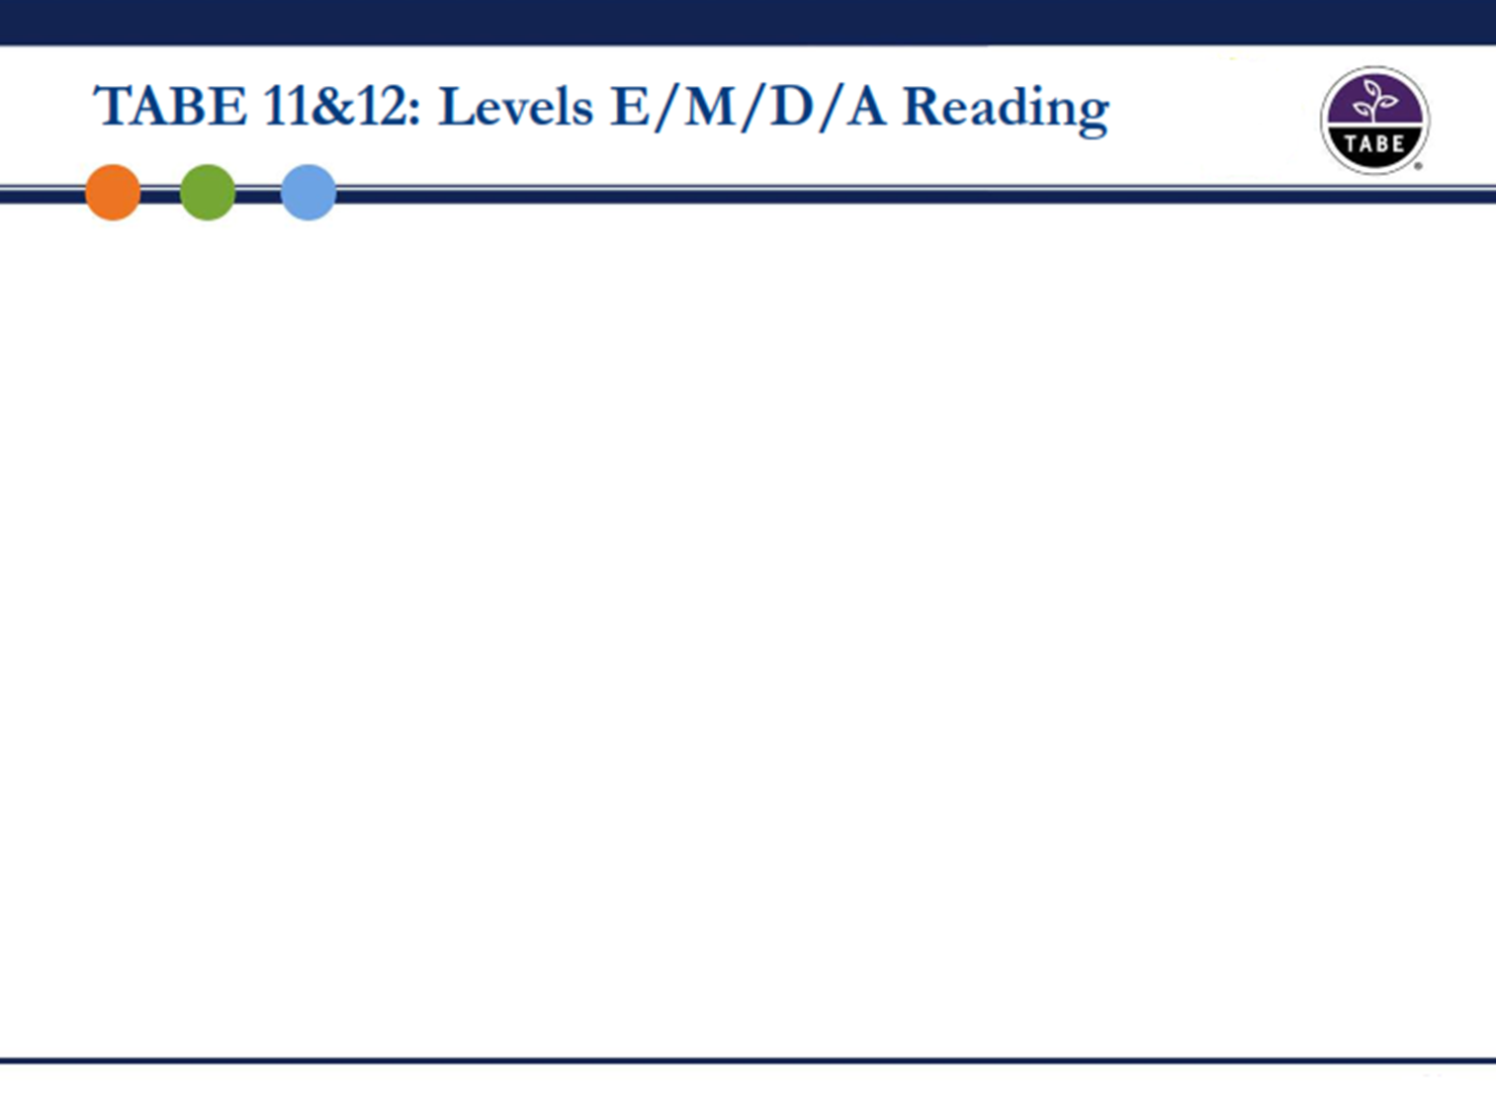
Reading Level E (Easy)
Reading Level M (Medium)
Reading Level D (Difficult)
Reading Level A (Advanced)

Slide 37
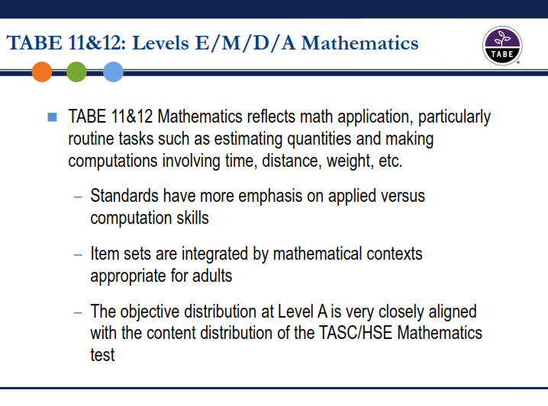

Slide 38
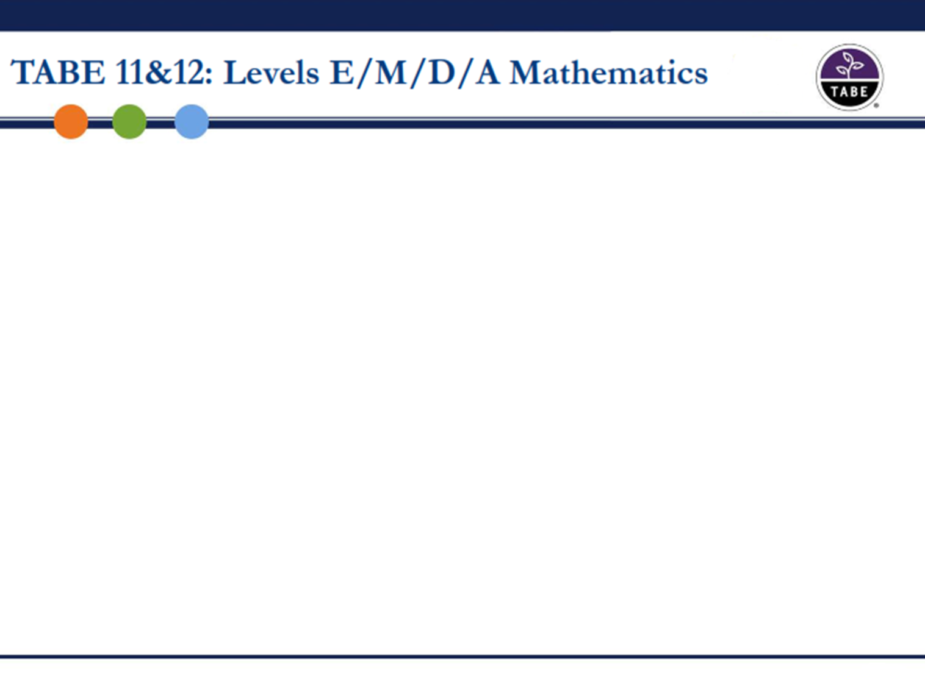
MATH LEVEL E (EASY)
MATH LEVEL M (MEDIUM)
MATH LEVEL D (DIFFICULT)
MATH LEVEL A (ADVANCED)

Slide 39
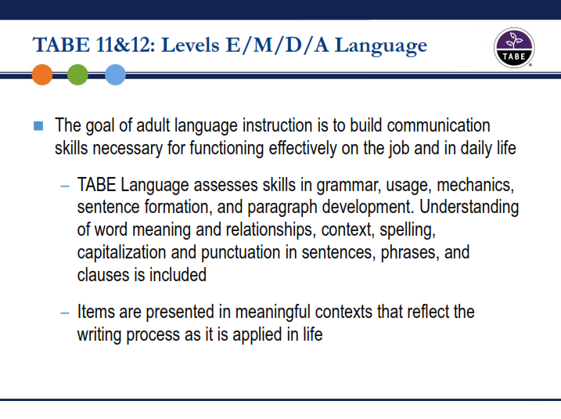

Slide 40
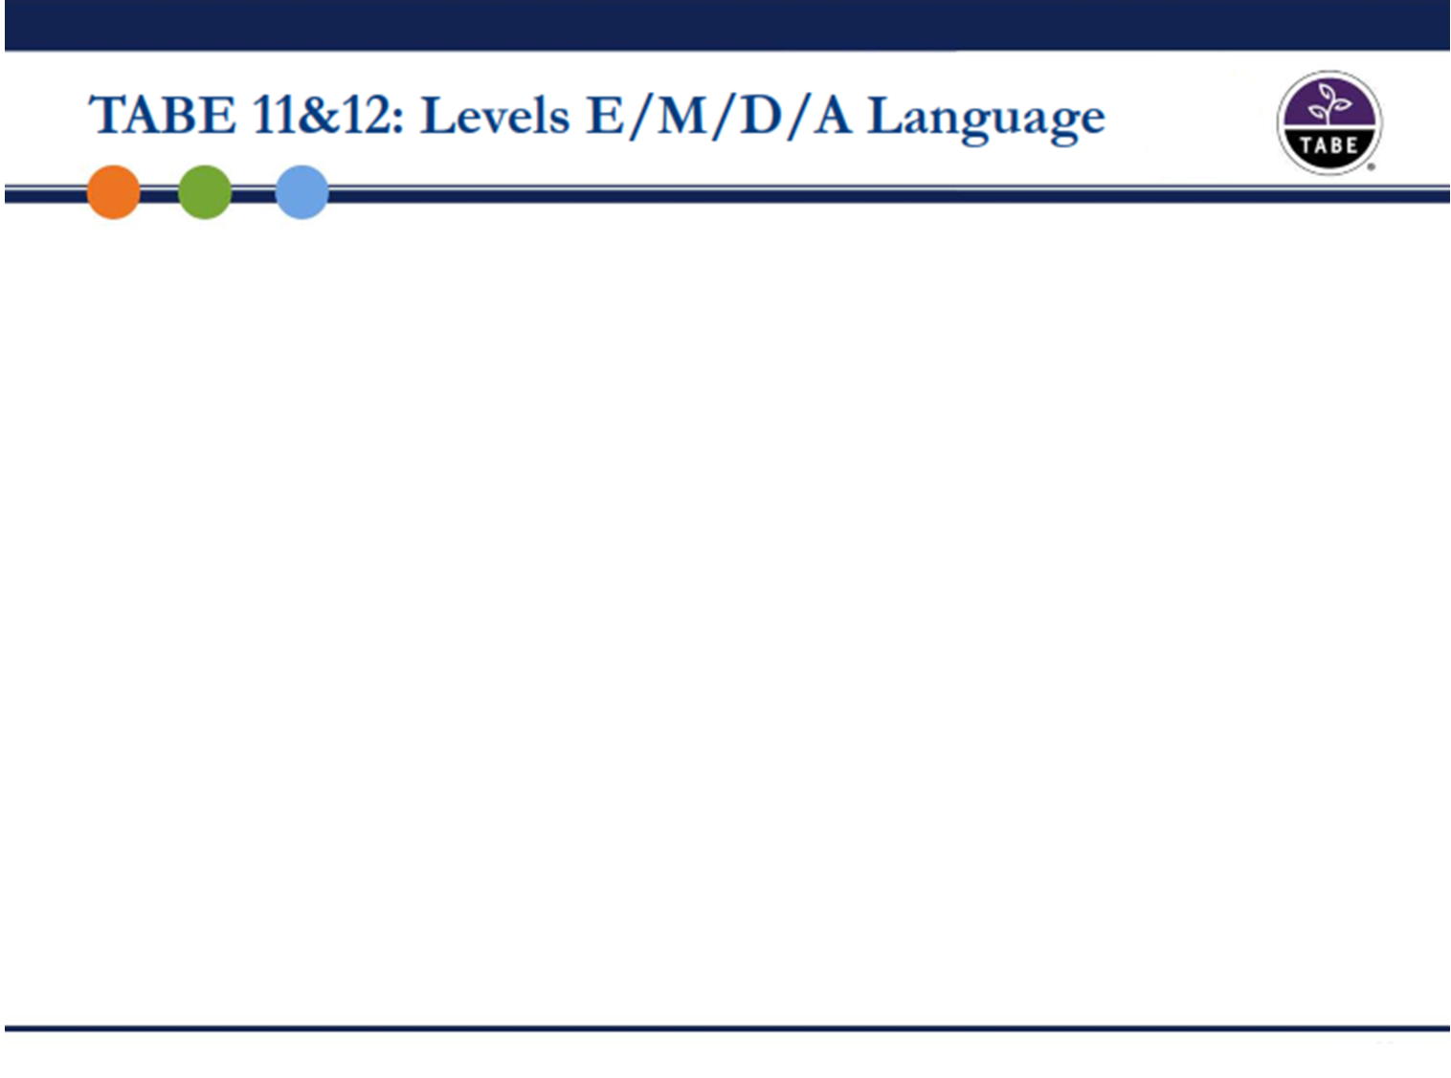
LANGUAGE LEVEL E (EASY)
LANGUAGE LEVEL M (MEDIUM)
LANGUAGE LEVEL D (DIFFICULT)
LANGUAGE LEVEL A (ADVANCED)
Activity: Look at test samples and compare to TABE 9&10.

Slide 41
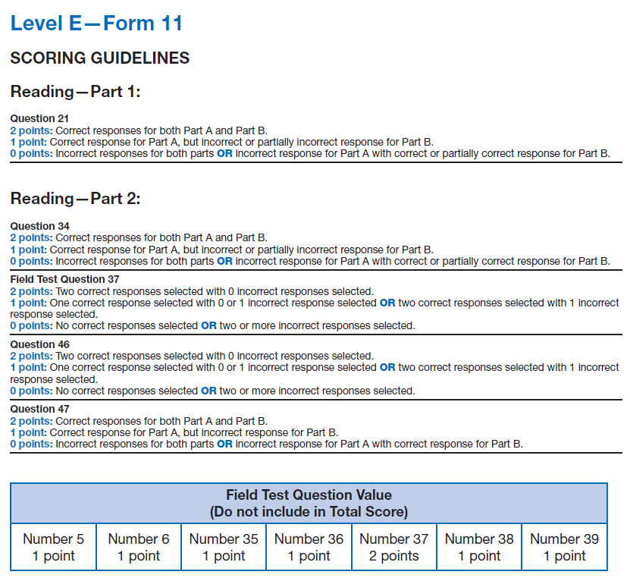
Hand-Scoring TABE 11&12
*Note scoring for 2-part questions
*Note: Field test questions don’t count in the total score.

Slide 42
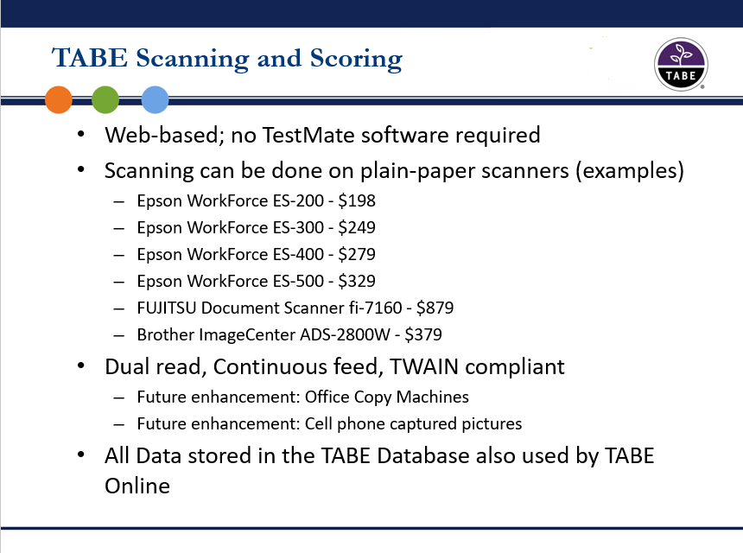

Slide 43
TABE 11&12 Scale Score and NRS Levels
Reading
 | NRS Level 1 | NRS Level 2 | NRS Level 3 | NRS Level 4 | NRS Level 5 | NRS Level 6
TABE L | 300-441 | 442-541 | n/a | n/a | n/a | n/a
TABE E | 310-441 | 442-500 | 501-535 | n/a | n/a | n/a
TABE M | n/a | 442-500 | 501-535 | 536-575 | n/a | n/a
TABE D | n/a | n/a | 501-535 | 536-575 | 576-616 | n/a
TABE A | n/a | n/a | n/a | 536-575 | 576-616 | 617-800
The scores on these charts reflect the valid scores found in SiD.
Mathematics
 | NRS Level 1 | NRS Level 2 | NRS Level 3 | NRS Level 4 | NRS Level 5 | NRS Level 6
TABE L | 300-448 | 448-485 | n/a | n/a | n/a | n/a
TABE E | 310-448 | 449-495 | 496-536 | n/a | n/a | n/a
TABE M | n/a | 454-495 | 496-536 | 537-595 | n/a | n/a
TABE D | n/a | n/a | 501-536 | 537-595 | 596-656 | n/a
TABE A | n/a | n/a | n/a | 537-595 | 596-656 | 657-800
**Note: n/a is denoted for those NRS levels that are higher or lower than allowed for a given TABE level.
Language
 | NRS Level 1 | NRS Level 2 | NRS Level 3 | NRS Level 4 | NRS Level 5 | NRS Level 6
TABE L | 300-457 | 458-510 | n/a | n/a | n/a | n/a
TABE E | 310-457 | 458-510 | 511-546 | n/a | n/a | n/a
TABE M | n/a | 459-510 | 511-546 | 547-583 | n/a | n/a
TABE D | n/a | n/a | 513-546 | 547-583 | 584-630 | n/a
TABE A | n/a | n/a | n/a | 549-583 | 584-630 | 531-800

Slide 44
TABE 11 & 12 Grade Ranges
READING
NRS Level | Grade Range Guideline | Grade | Scale Score Range
1 | K-1 | K | 300-371
 |  | 1 | 372-441
2 | 2-3 | 2 | 442-471
 |  | 3 | 472-500
3 | 4-5 | 4 | 501-518
 |  | 5 | 519-535
4 | 6-8 | 6 | 536-549
 |  | 7 | 550-562
 |  | 8 | 563-575
5 | 9-10 | 9 | 576-596
 |  | 10 | 597-616
6 | 11-12 | 11 | 617-709
 |  | 12 | 710-800
To help programs transition from grade equivalents to scale scores, DRC has provided these grade range tables.
This information is intended to help programs that have used grade equivalents to identify the appropriate scale score ranges.
Notes:
These Grade Ranges were determined using:
NRS Implementation Guidelines
TABE Performance Level Descriptors
College and Career Readiness Standards for Adult Basic Education
Adult Basic Education Levels
TABE cut scores

Slide 45
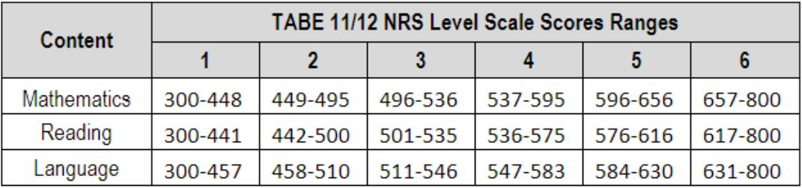
NRS Level Scale Score Ranges

Slide 46
Assessment policy http://www.mnabe.org/sites/default/files/mnabe_assessment_policy_2018-19_revised_9-25-18.docx
For Levels: ABE 1-6
Name/Series | Content | Format | Forms/Levels
9 and 10 Survey and Complete Battery versions | Reading** Complete Math** (2 tests: Math Computation and Applied Mathematics) Language** | Computer-based Paper-based | L: Literacy E: Easy M: Medium D: Difficult A: Advanced
11 and 12 (New for 2018) | Reading Math Language | Computer-based Paper-based | L: Literacy E: Easy M: Medium D: Difficult A: Advanced
**Approved by OCTAE and the Minnesota Department of Education for NRS purposes for ABE Levels through June 30, 2019.

Slide 47
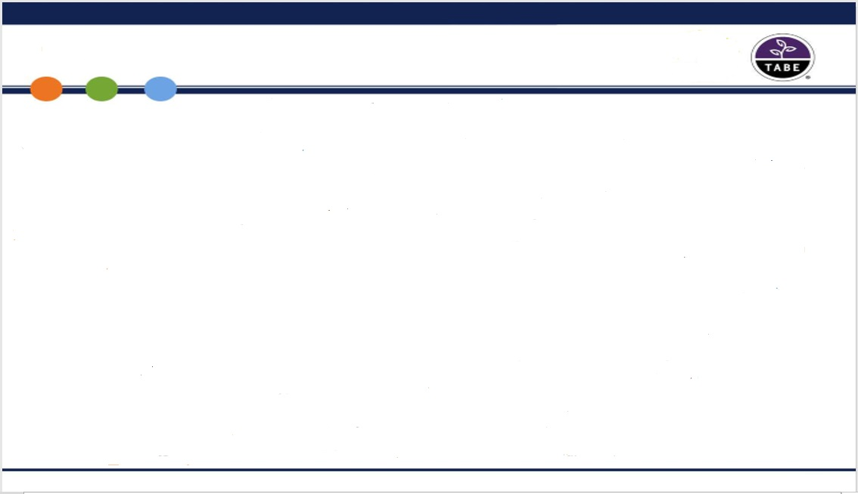
Purchasing TABE 11&12
TABE 11&12 Online Testing
TABE 11&12 Paper-Based Testing
Item | Price Each
500 – 1,500 | 3.40
1501 – 3,000 | 3.20
3,001 – 6,000 | 2.87
6,001 – 10,000 | 2.57
10,001 – 30,000 | 2.32
30,000+ | 2.17
Item | Price Each
Test Adm Manual | 25.00
Test Directions (11&12) | 32.50
Scoring Guide | 30.50
Locator Test Booklets | 86.50/25
Form L Consumable Answer Booklets | 156.00/25
Test Booklets (E,M,D,A) | 156.00/25
Answer Booklets | 24.00/25

Slide 48
Now available at tabetest.com
TABE 11&12 Blueprints
www.tabetest.com/resources-2/testing-information/blue-prints
TABE 11&12 Sample Test Items
www.tabetest.com/resources-2/testing-information/tabe-1112-practice
TABE 11&12 Online Tools Training
www.tabetest.com/resources-2/testing-information/online-tools-training
TABE 11&12 Objective Structure
http://www.tabetest.com/PDFs/TABE_11_12_Objective_Structure_07_12_17.pdf

Slide 49
Training Options
Face-to-face with state certified trainer (summer institute, support staff conference, regionals)
Local trainings by request (martha.olsen@gmail.com) – need 8 to 10 participants to schedule
Online at https://www.brainshark.com/drc/TABE11_12CertificationPartI
Online at https://www.brainshark.com/drc/TABE11_12CertificationPartII
  (Password for both parts is tabecertdrc)

Slide 50
Transitioning to TABE 11&12
Programs have until June 30, 2019 to complete transition for ABE learners
Prior to administering TABE 11&12, test proctors should:
  Read through the test administration manual
  Read through the test directions for TABE 11 & 12
  Note the new maximum allowable testing times
  If hand-scoring, read through Answer Key to understand nuances
  Become familiar with the TABE 11&12 scoring guide
Returning students with a current 9&10 pretest – at 40 hours, posttest with 9&10, and then give the 11&12 locator and pretest as soon as possible (TABE 11&12 is a new test, no need to wait 40 hours.)
New students – 11&12 locator and pretest

Slide 51
QUESTIONS about TABE 11&12?

Slide 52
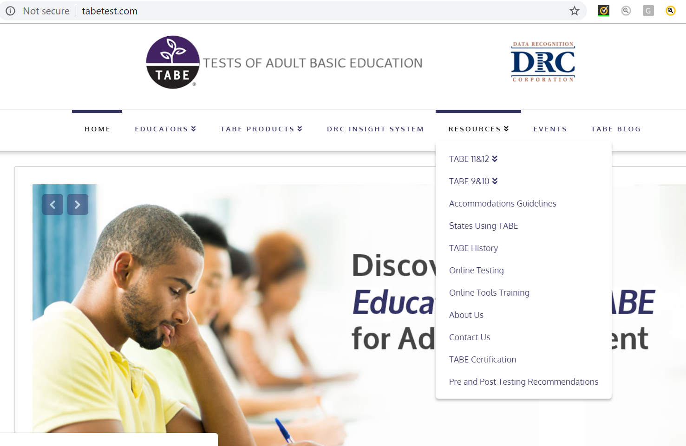
TABE ONLINE PLATFORM – tabetest.com

Slide 53
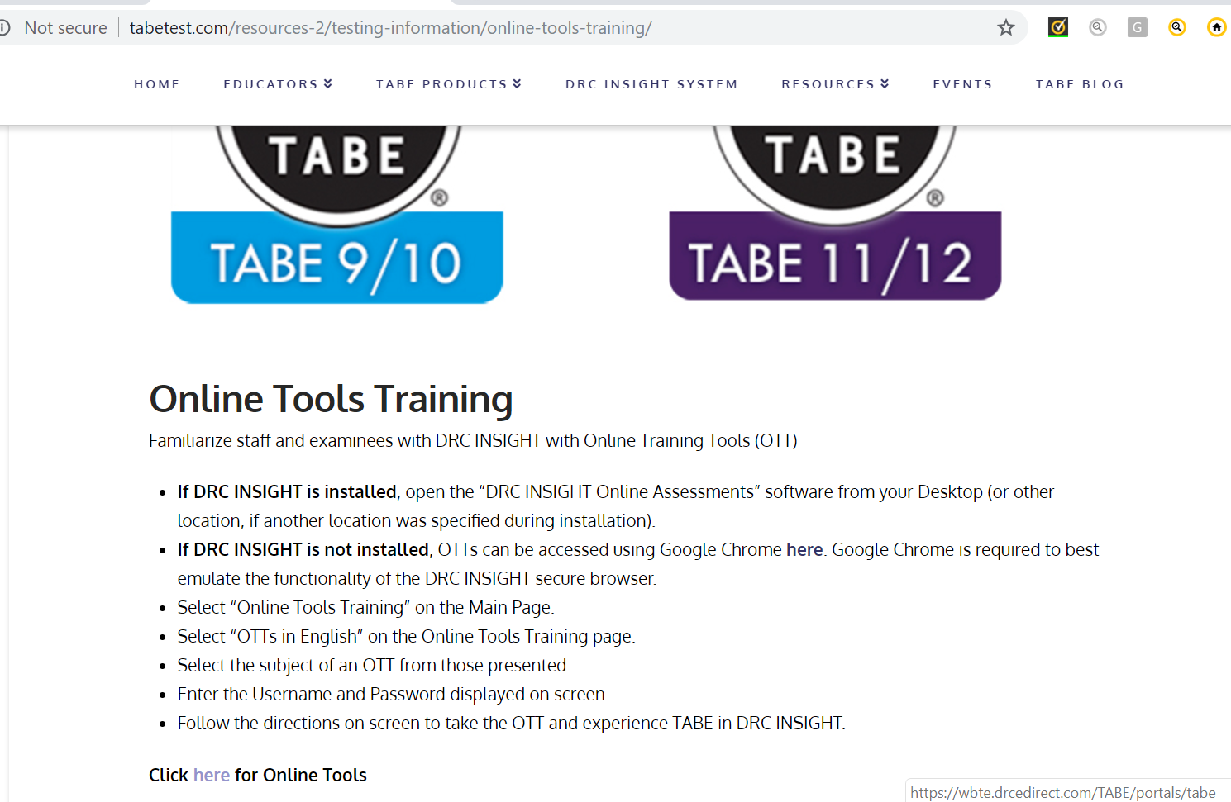
ONLINE TOOLS TRAINING

Slide 54
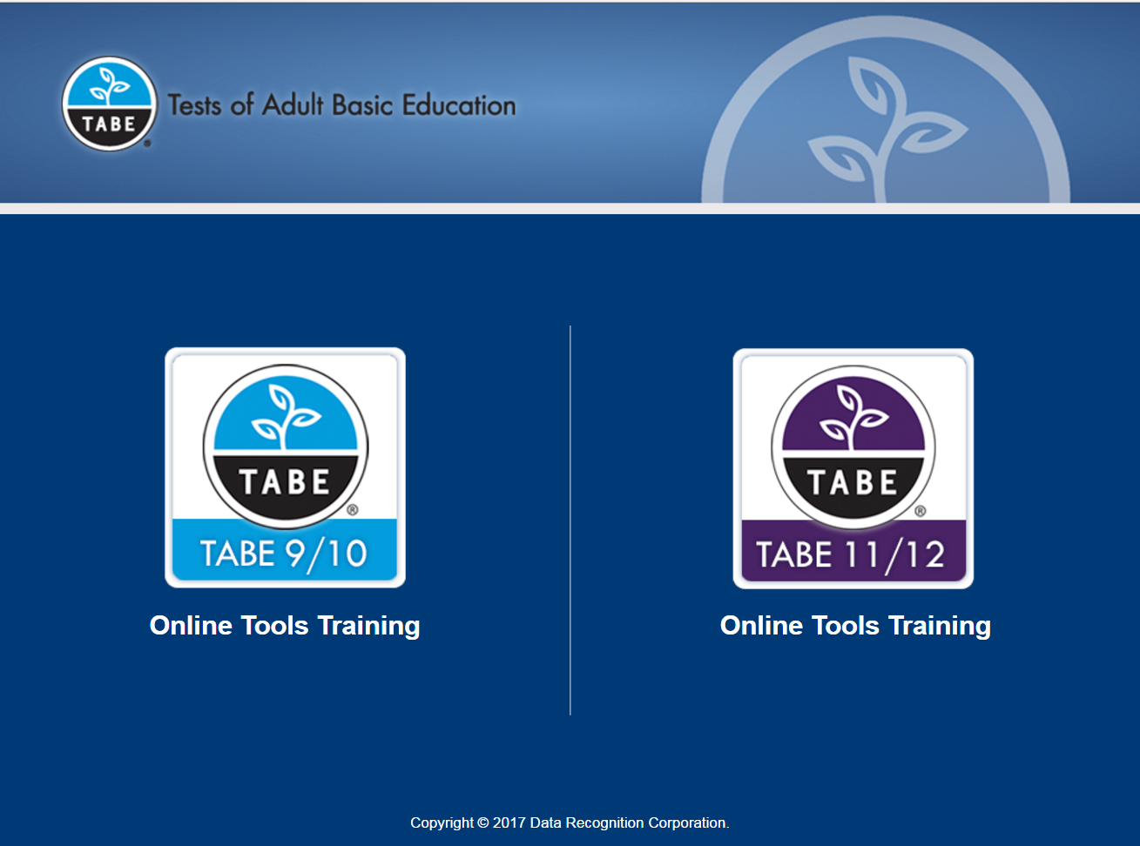

TABE Online Platform

Slide 55
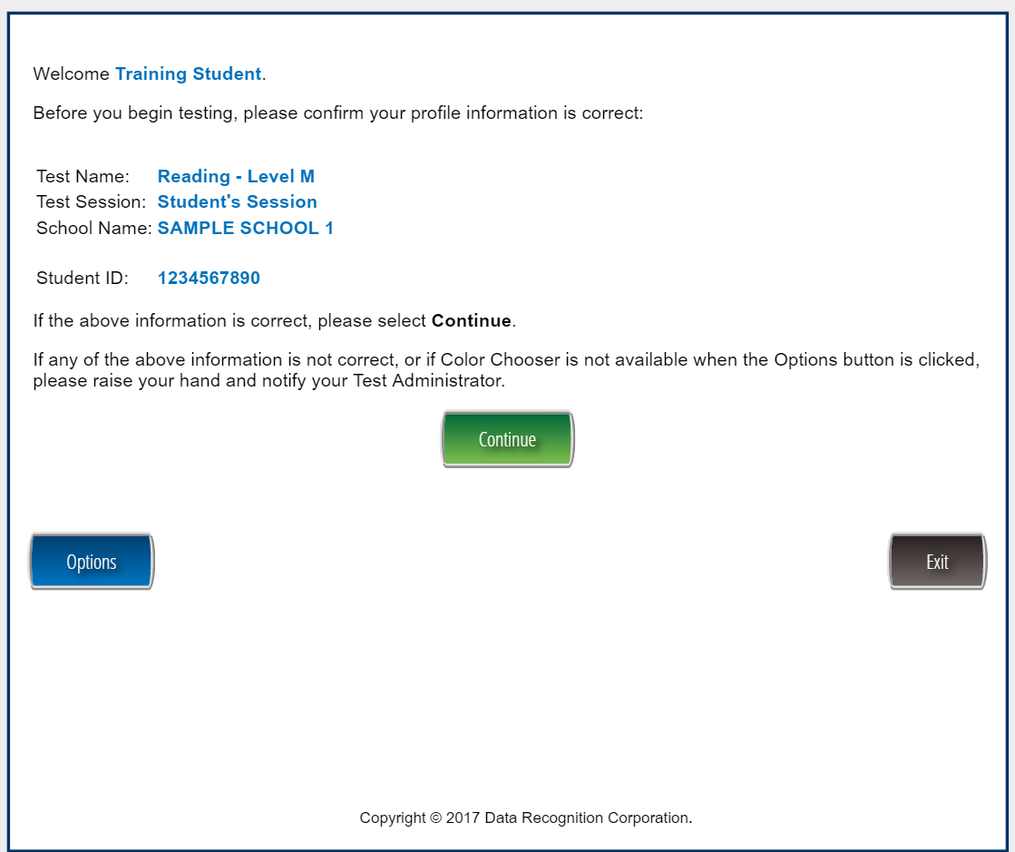
Examinee Confirmation
55
Notes:
New confirmation screen

Slide 56
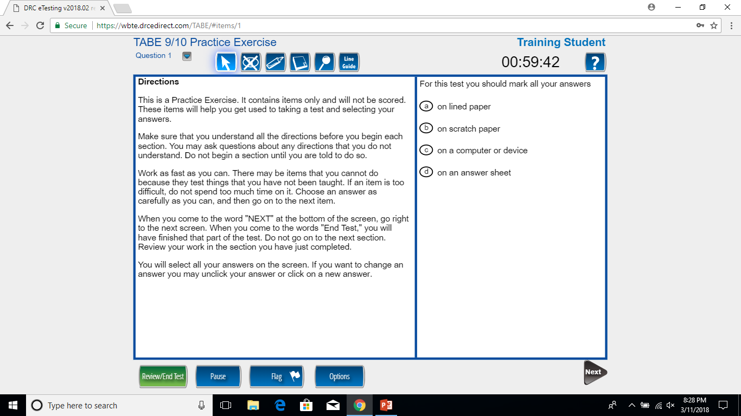
TABE Online Practice Portion

Slide 57
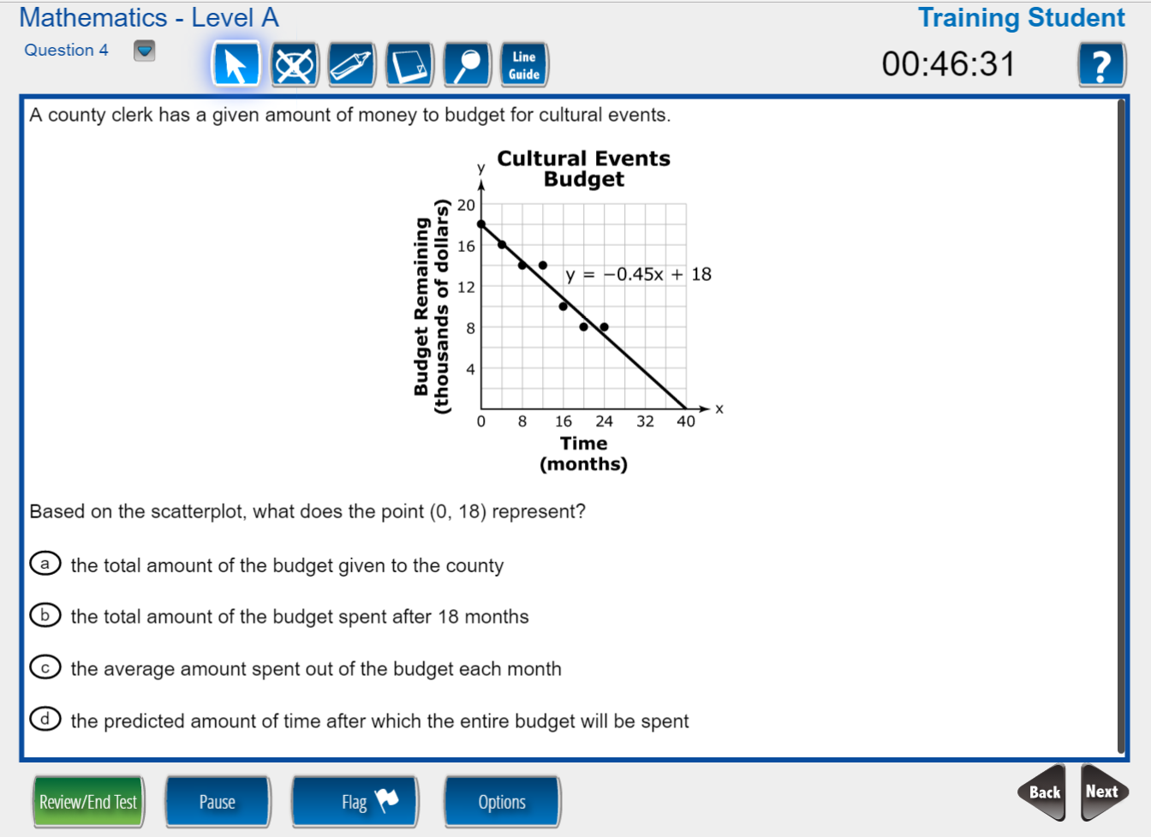
Testing Interface
57
Notes:
New testing interface provides more access to tools and resources.

Slide 58
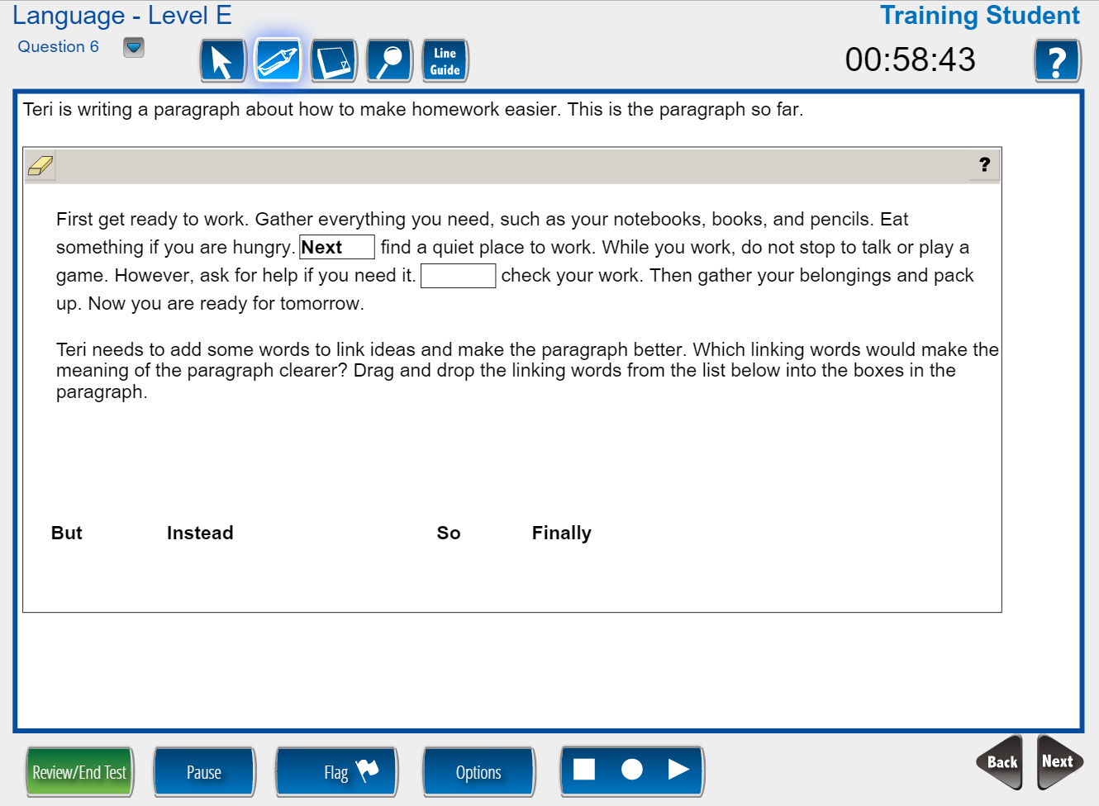
Technology-Enhanced Items
Drag and Drop
58
Notes:
Interface supports a variety of technology-enhanced interactions.
TABE 11/12 includes numerous TE item types: Hot Text, Drag and Drop, EBSR, Math Palette, and Multi-Select

Slide 59
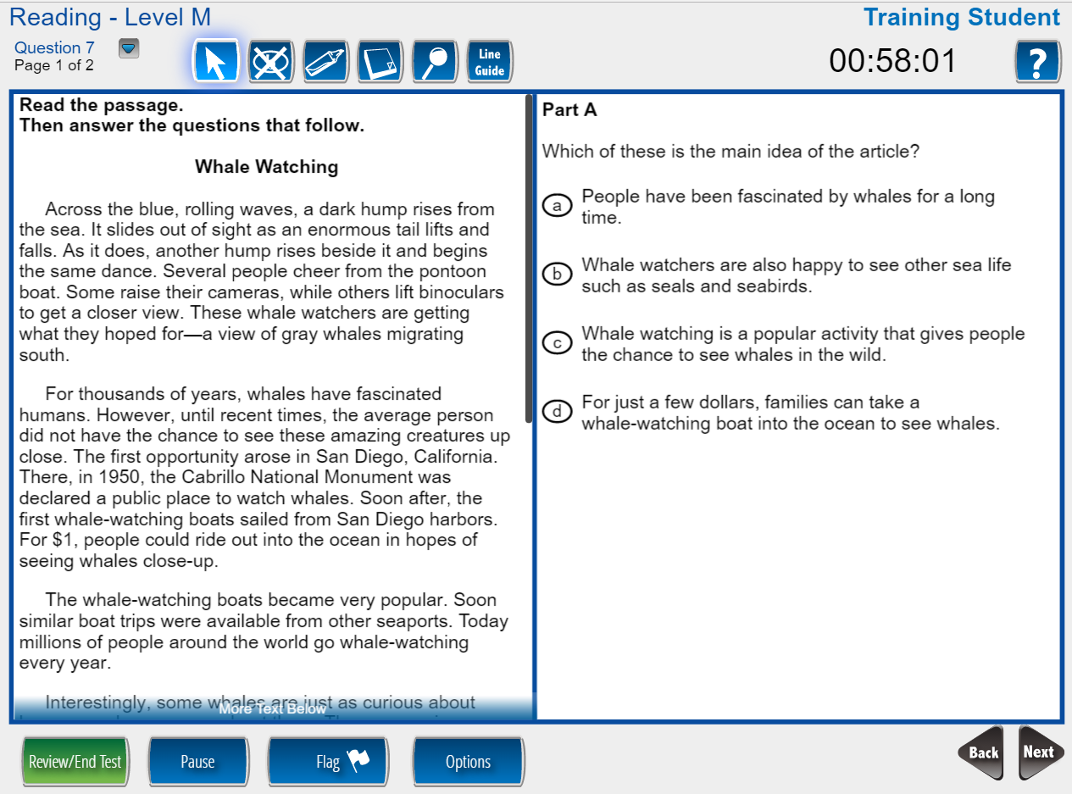
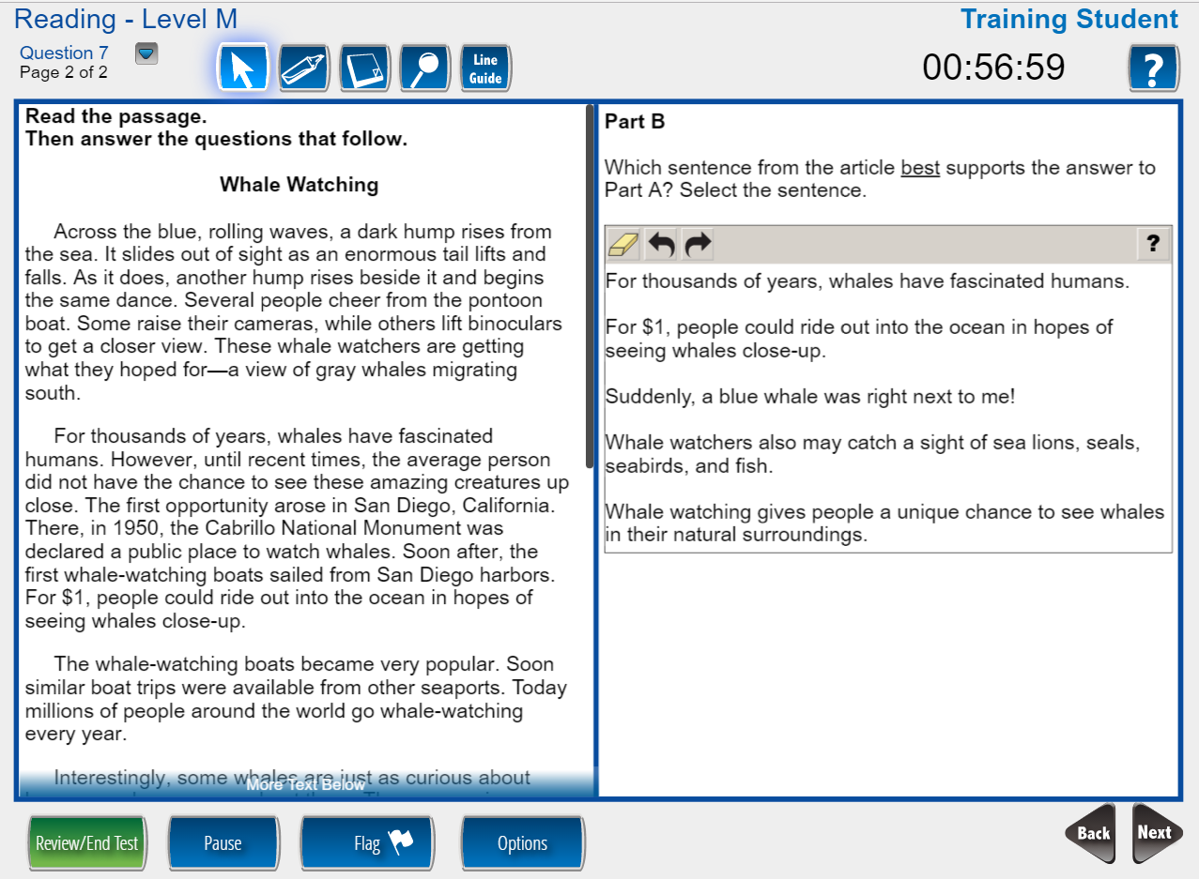
Technology-Enhanced Items
Evidence-Based Selected Response
Part A: Answer a question about the passage
Part B: Provide evidence to support your answer to Part A
59

Slide 60

Student Tools
TIMER
HELP TOOLS
QUICK NAVIGATION
Move to any item or passage with one click
TESTING TOOLS
Customized by item
REVIEW TEST PROGRESS
PAUSE TEST
FLAG ITEM FOR REVIEW
OPTIONS
Color Choices
Contrasting Color
Reverse Contrast
Masking
Audio Settings
BACK AND NEXT NAVIGATION
60
Notes:
New testing interface provides more access to tools and resources.

Slide 61
Student Tools (continued)
      Line Guide
      Highlighter
      Cross Off
      Magnifier/Zoom
      Sticky Notes
      Calculators
      Color Choices
      Contrasting Colors
      Reverse Contrast
      Masking
      Text-to-Speech (English)
      Online Large Print
      Mark for Review
      Pause Test
      Mathematics Formula Sheet
      Ruler (inches and centimeter)
      Protractor
61
Notes:
New testing interface provides more access to tools and resources.
If students are more comfortable with a handheld calculator, they may use one as long as it’s not programmable. Physical calculators should only be allowed with the student during the calculator section of the math test.

Slide 62
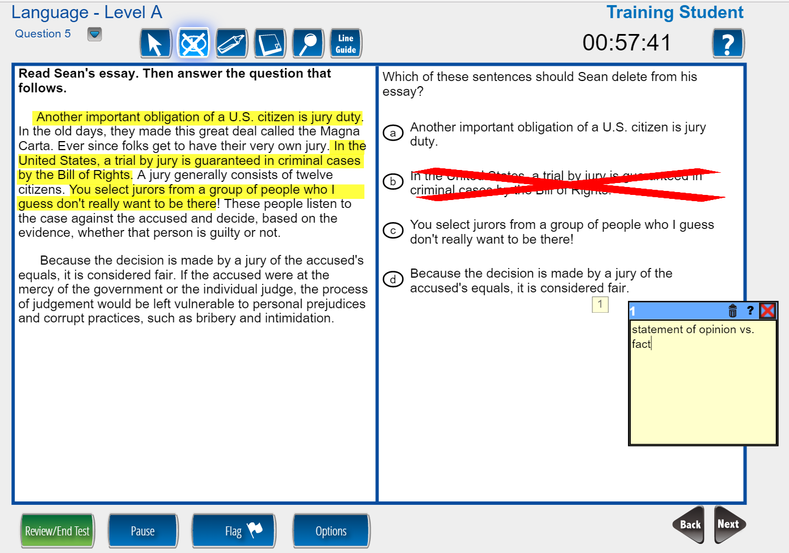
Student Tools: Highlighter, Cross Off, and Sticky Note
Multiple tools may be used simultaneously
62
Notes:
Examples of some of the tools

Slide 63
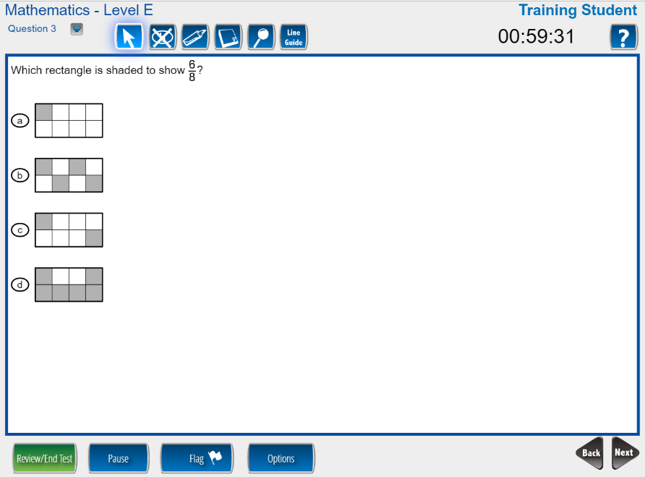
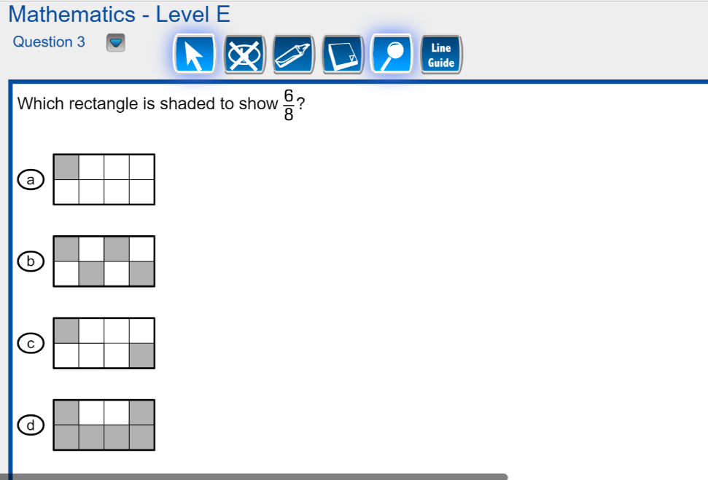
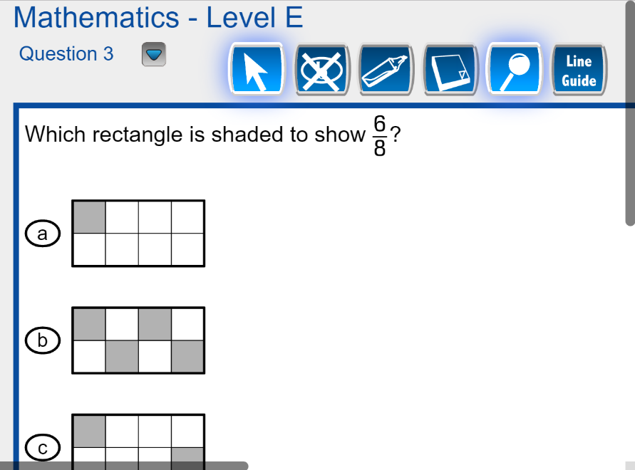
Magnifier
Standard View
1.5x Magnification
2x Magnification
63

Slide 64
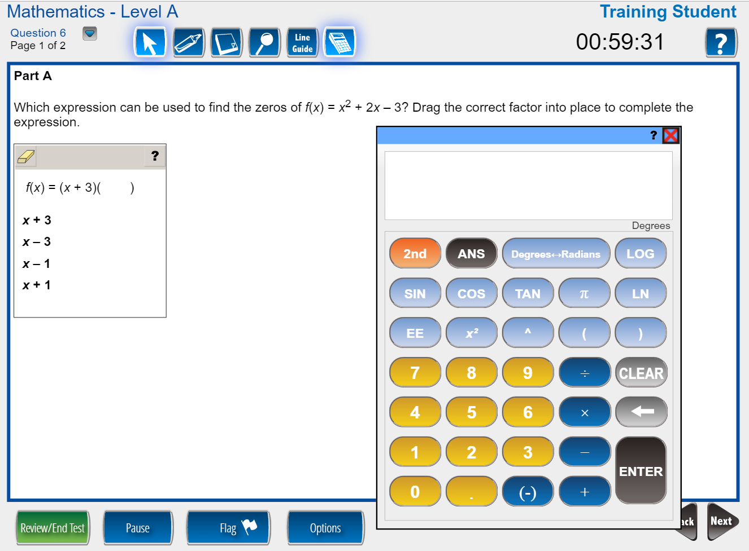
Scientific Calculator
64

Slide 65
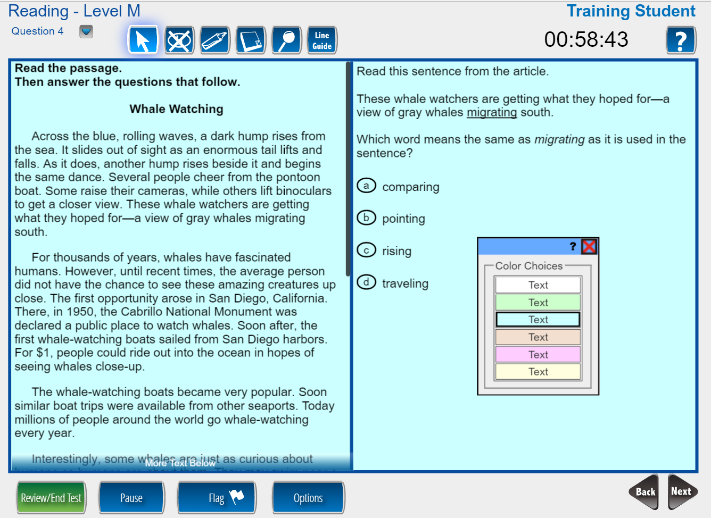
Color Choices (Overlays)
65

Slide 66
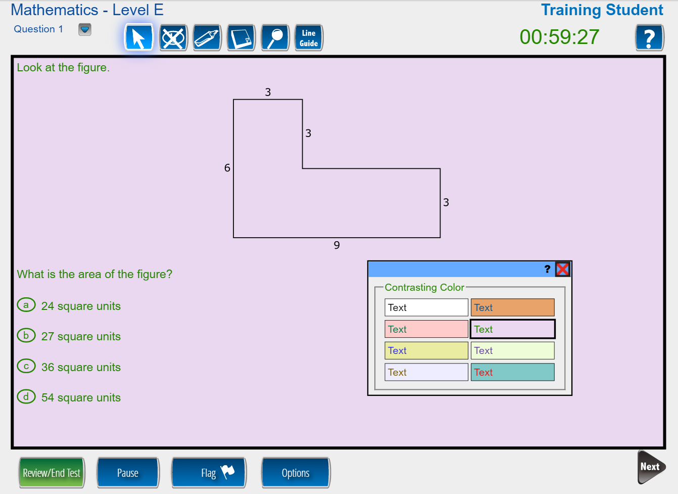
Contrasting Colors
(Font and Background Color Combinations)
66

Slide 67
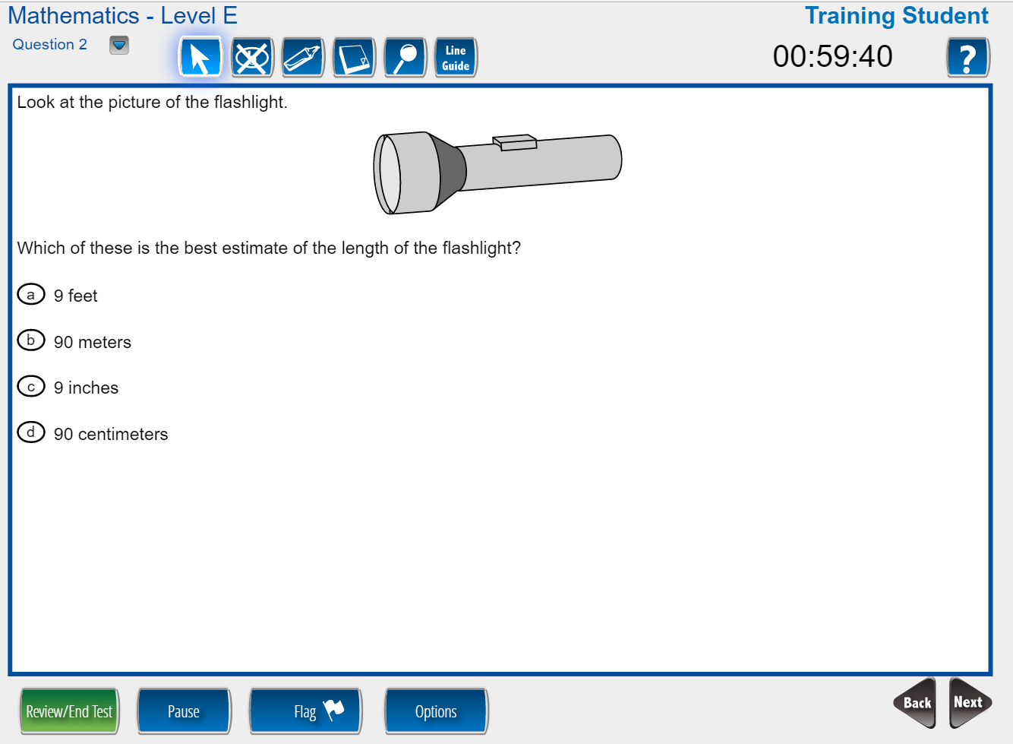
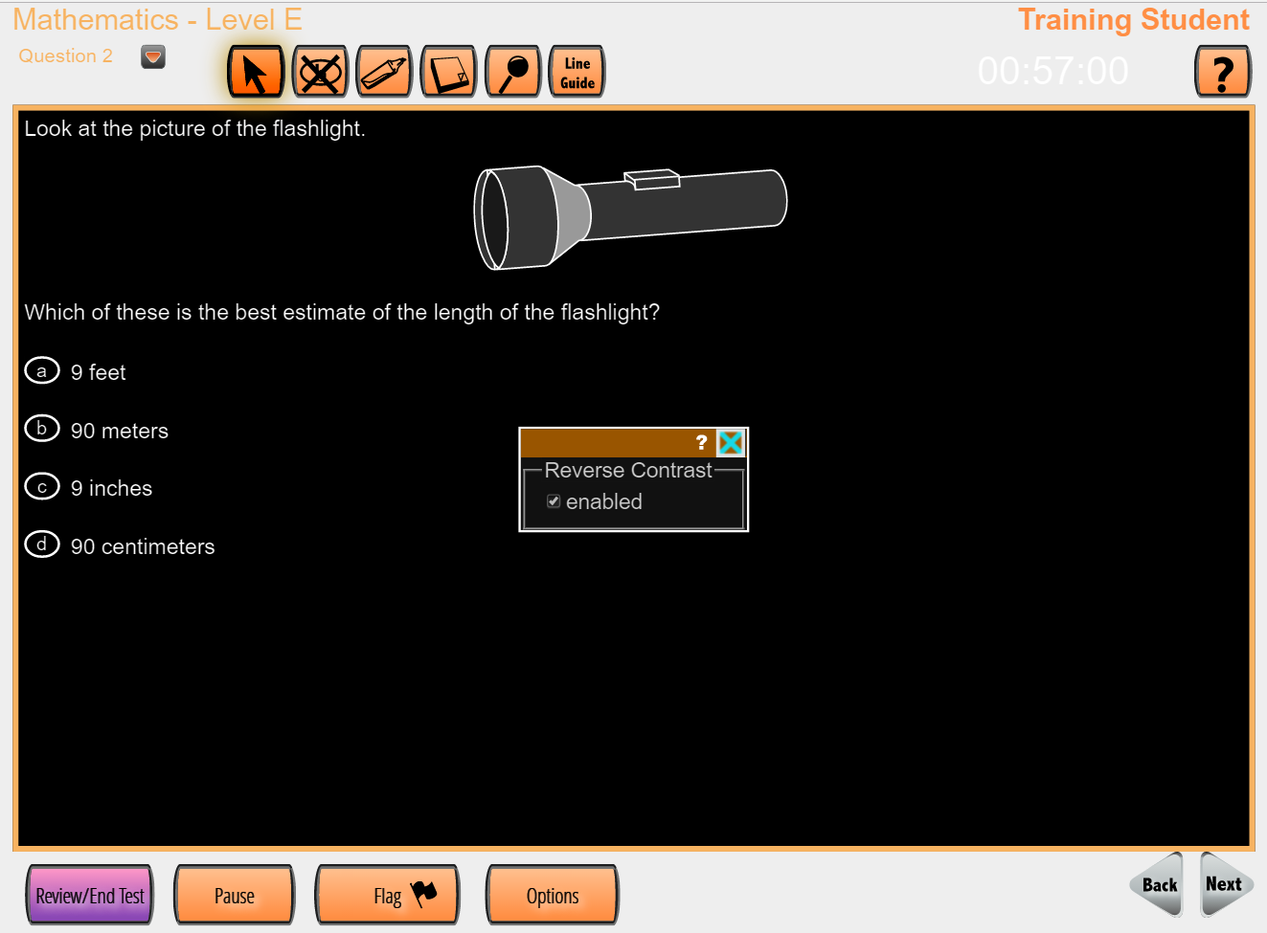
Reverse Contrast
Original Item
Item with Reverse Contrast
67

Slide 68
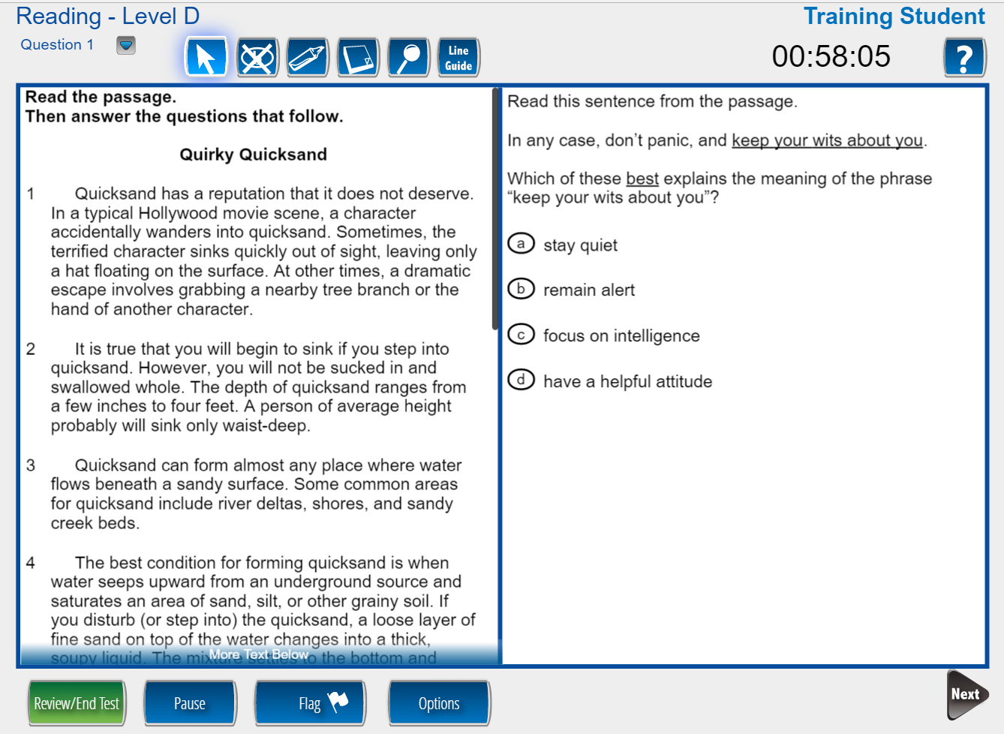
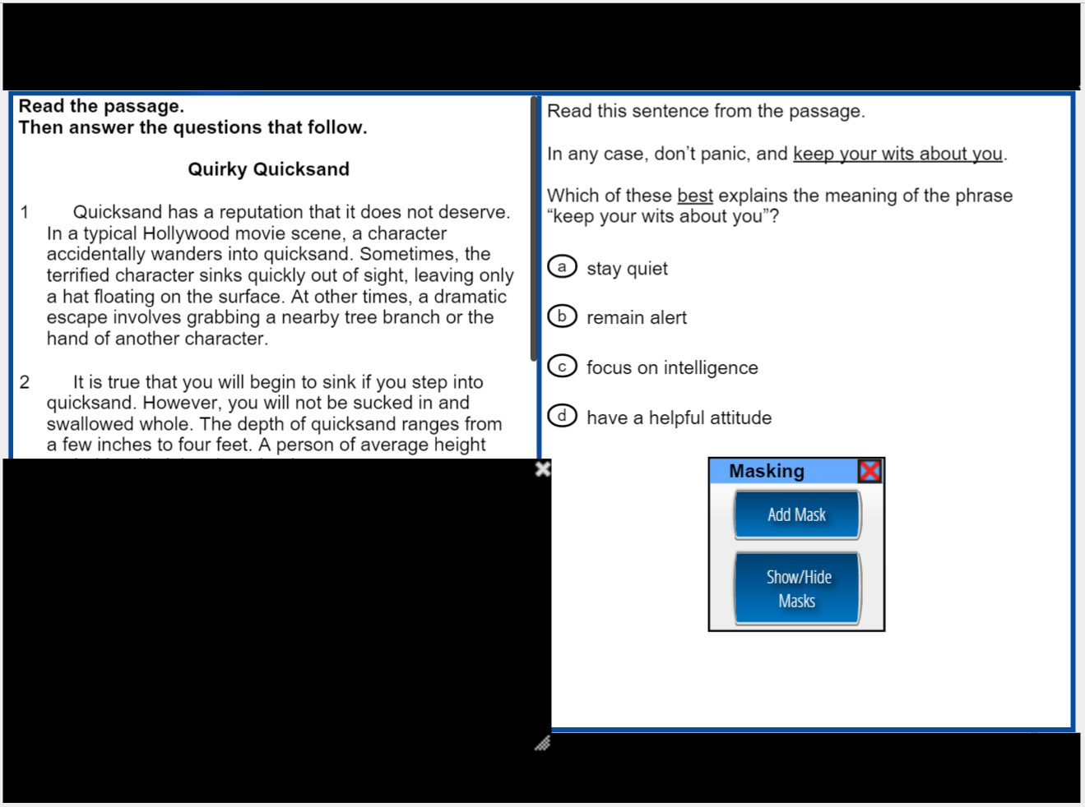
Masking
Original Item
Item with Masking
The test taker can place a mask over any portion of the screen. Multiple masks can be used simultaneously to customize the viewing area.
68

Slide 69
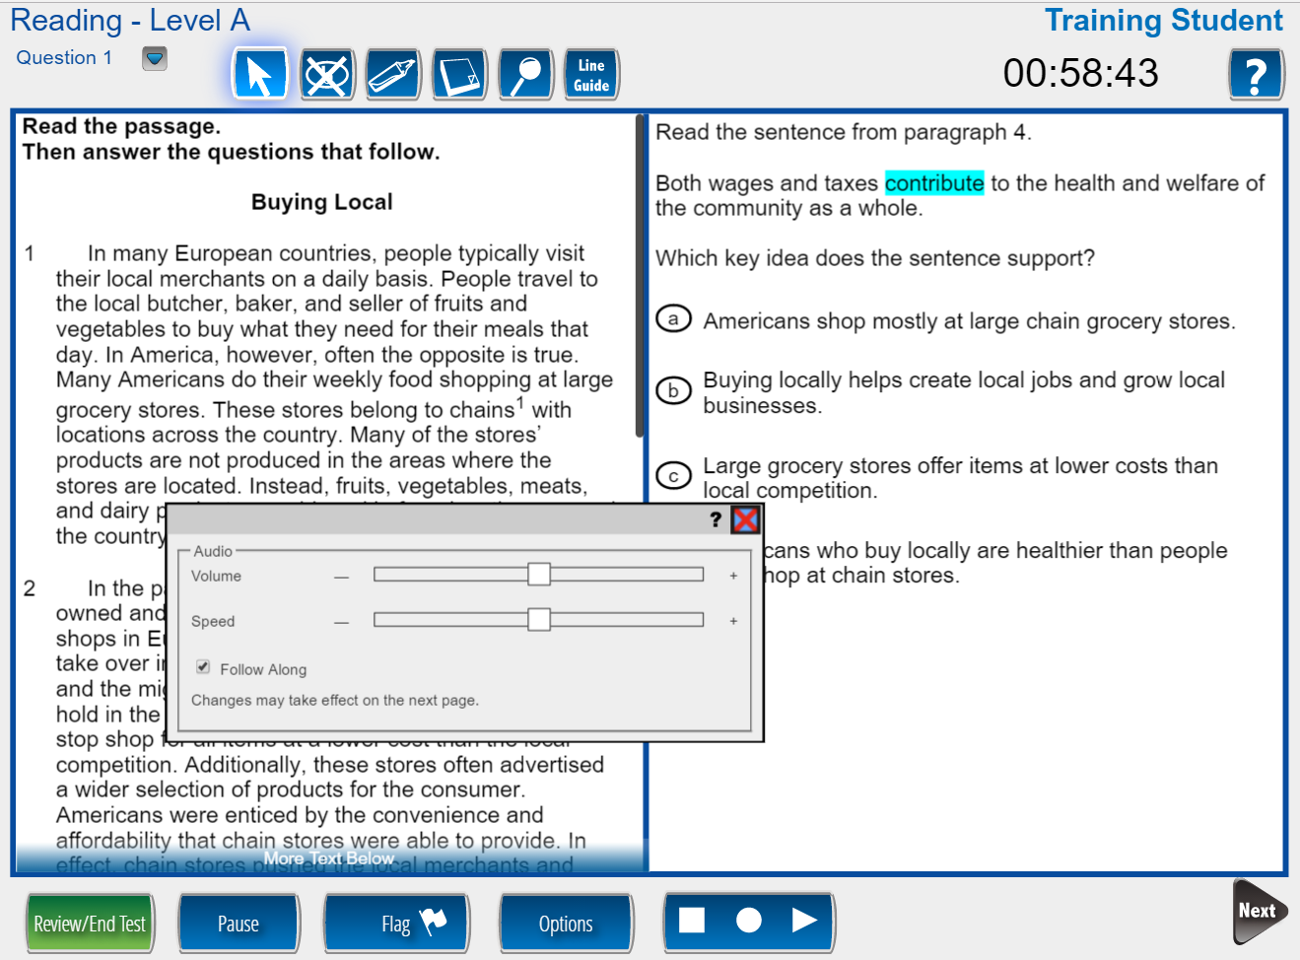
Text-to-Speech Audio
Follow along highlighting of words as they are spoken
Audio settings for Volume, Speed, and Follow Along
Stop, Starting Points, and Play/Pause controls
69

Slide 70
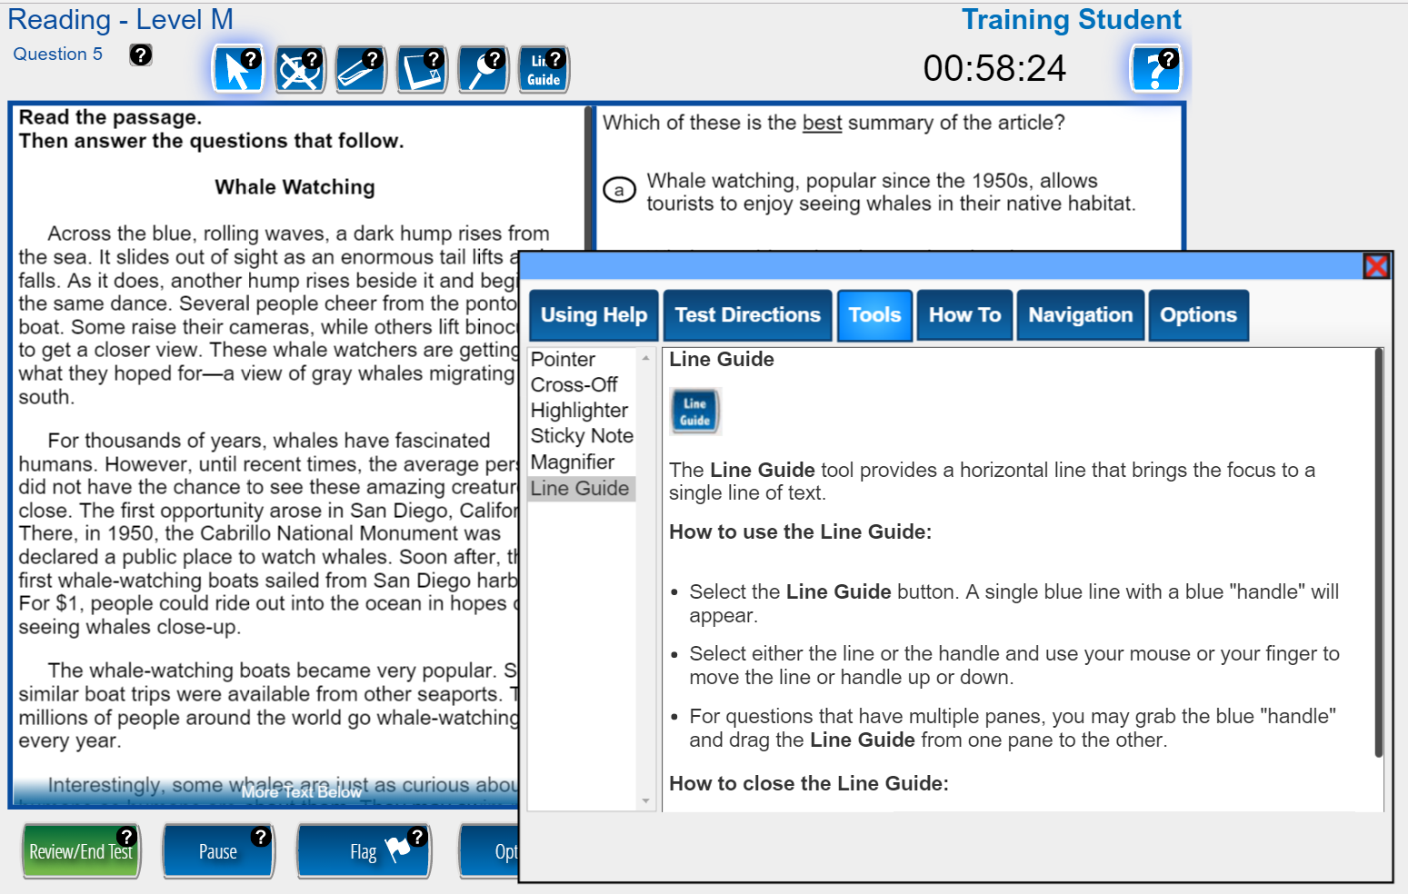
Context-Sensitive Help Screens
In Help mode, the test taker can click or tap on any object that has a question mark (e.g., Line Guide) to open contextual help for that object
70

Slide 71
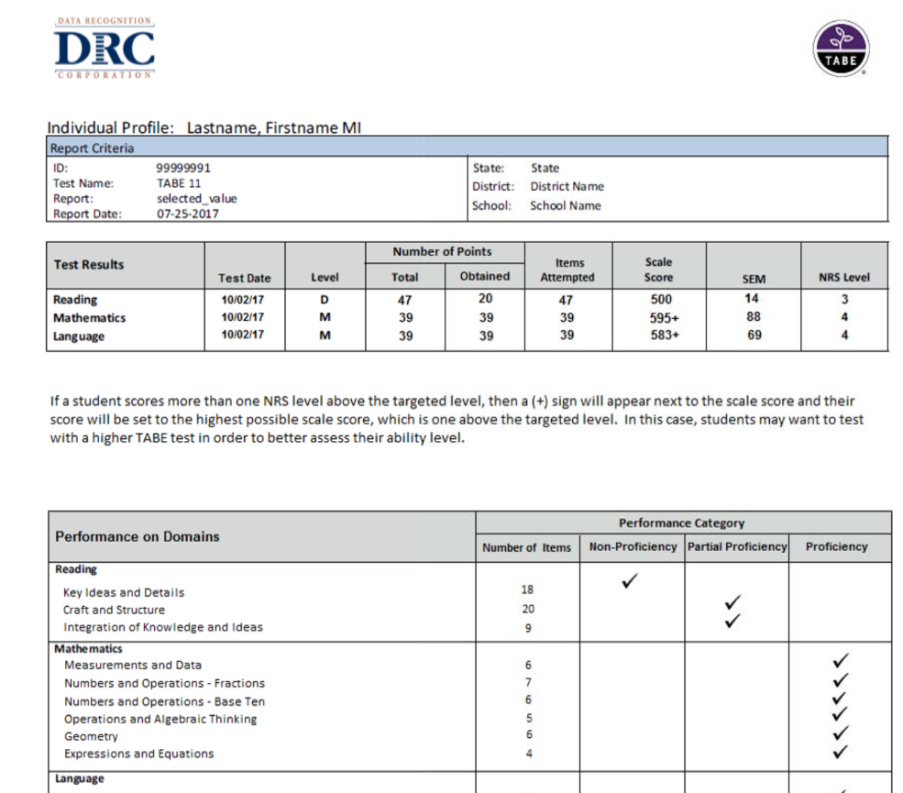
Online Individual Profile Report

Slide 72
Training Options – TABE online
Face-to-Face – contract with DRC
(on-site training-$3,715.00; web-based-$981.50)
Support Services Conference – DRC rep will be doing a session on Tabe Online
TABE Online On-Demand training videos (see next slide)

Slide 73
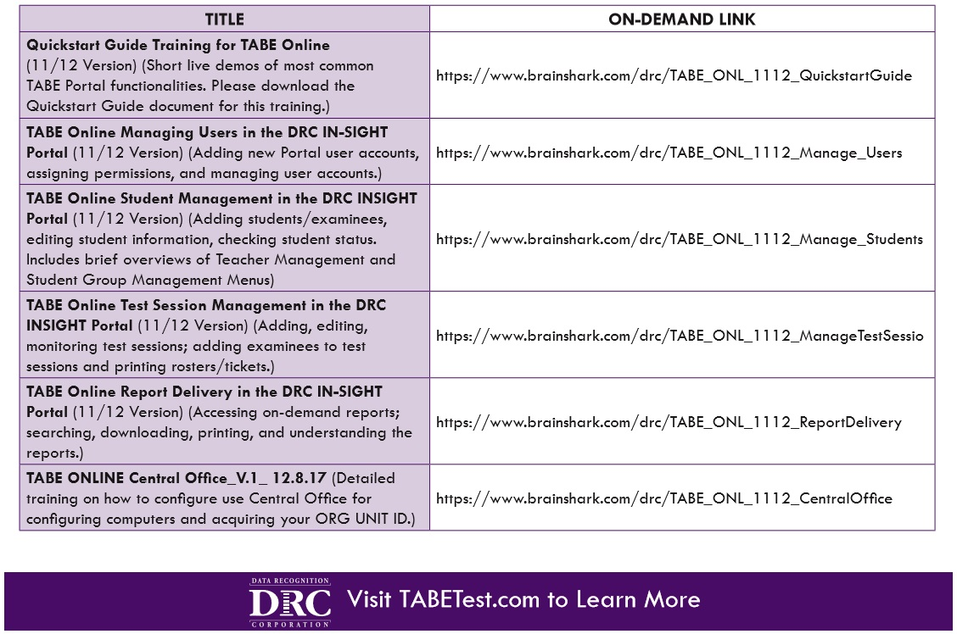
TABE Online on-demand training videos
These online videos have been updated for TABE 11&12

Slide 74
Table Discussion: Test Transition Planning with Local ABE Programs
Start thinking now about when you will transition testing:
When will you purchase tests? Which ones will you purchase?
  Which tests will you purchase for ABE students (TABE 11/12 or CASAS GOALS)?
  Will you purchase paper and/or computer tests?
How will you train yourself and your staff on the new tests?
  Which staff need certification and which staff just need new test info?
How will your program implement the new tests?
  Current students? New students?
  How will you adjust your program for the longer testing times?

Slide 75


