Slide 1


Welcome to the
ABE Support Services Conference!
November 30 –December 1, 2017
Minnesota Department of Education
Notes:
1 Min: Becca

Slide 2

Introductions
Dave Haugen
SPARC Committee and Conference Chair
Notes:
1 min: Becca

Slide 3
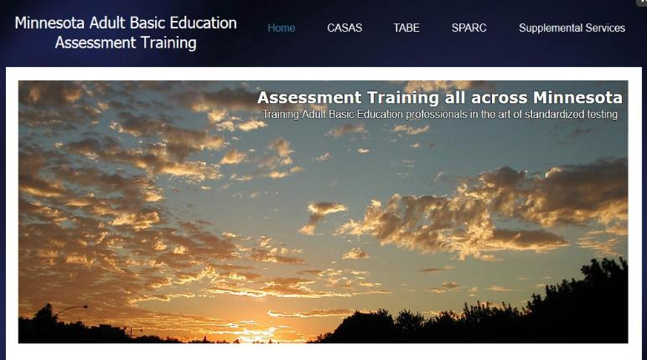
Your Statewide Supplemental Service Provider for Assessment Training
Marty Olsen
SW ABE and State Assessment Trainer
martha.olsen@gmail.com
Learn more/schedule a training:
www.mnabeassessment.com
Notes:
5 min: Marty

Slide 4


Todd Wagner, State ABE Director
Notes:
Todd

Slide 5

Thank You
SPARC Committee
  Conference Planners
  Dave Haugen, Chair
Sponsoring organization
  SW ABE’s Supplemental Service Grant
All the presenters
Everyone participating
Notes:
Todd

Slide 6
State Level Supports
We are here to support you!
Notes:
Todd

Slide 7
Supplemental Services
Minnesota Literacy Council
  technology, volunteer training
ATLAS
  professional development
Literacy Action Network
  program quality, administrator support
SW ABE
  assessment training
PANDA
  disability resources & assistance
MWCA
  transitions
Notes:
Todd

Slide 8
MNABE
Staff
From the Minnesota Department of Education
Todd Wagner, State ABE Director
Julie Dincau, Transitions Specialist
Cherie Eichinger, Administrative Support
Brad Hasskamp, Policy Specialist
Astrid Liden, Professional Development Specialist
Laurie Rheault, Grants Specialist
Alice Smith, Administrative Support/GED
Notes:
All introduce themselves

Slide 9
New Working/Advising Groups
Adult Diploma
  Working Group
  Consultation Team
Standards
  College and Career Ready Standards Implementation Team
Transitions
  Moving Pathways Forward grant
  Advising working group

Slide 10
Ongoing Working Groups
Support Professional Resource Advisory Committee (SPARC)
Distance Education Virtual Task Force
Disabilities Outreach Committee
PD Advisory Committee
Regional Transitions Coordinators

Slide 11

The Numbers
Indicators
State and Federal Funding
Enrollees and Participants
Contact Hours
Average Contact Hours
Level Change
GED

Slide 12
State Funding

Slide 13
Federal Funding

Slide 14
Enrollees and Participants

Slide 15
Hours

Slide 16
Average Hours

Slide 17
ABE Level Change

Slide 18
ESL Level Change

Slide 19
GED thru Summer 2015
Long term Trend

Slide 20
Numbers Lessons
Folks are working, which is good, but may be missing out on the current window of opportunity to skill up and move up.
ABE programs can support folks in skilling up by expanding both:
  partnerships with post-secondary education and training providers, i.e. career pathway models, and
  by supporting for incumbent workers, i.e. workplace programming.

Slide 21
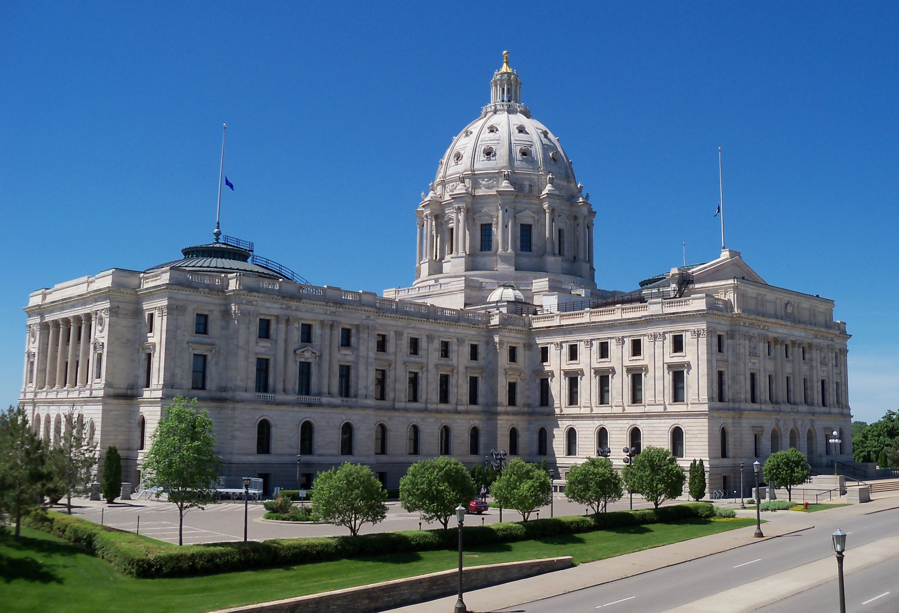
Law/Statute Updates
Adult Diploma
Pell Grants and Ability to Benefit
WIOA
  Adult Career Pathways
  College and Career Ready Standards

Slide 22

Standard Adult High School Diploma
19 and 20 year olds now eligible
Still in pilot phase
  Second pilot cohort to be announced early December
Awarding diplomas
  Accepted by employers, MnSCU & military
More info available at adult diploma pilot panel session

Slide 23
Ability to Benefit
Ability to Benefit restored for students in pathways that include integrated education and training (IET) support provided by ABE
That means:
  Students w/out a high school diploma or GED,
  Who score above Ability to Benefit Accuplacer cut score, and
  Enrolled in qualifying programs that include IET provided by ABE are Pell eligible
For more info, contact Julie Dincau

Slide 24

Workforce Innovation and Opportunity Act (WIOA)
2015-16 Transition Year
WIA Reporting Requirements
WIOA Implementation Requirements
  IEL/Civics (English, Civics, Work Prep, Work Training)
  Begin implementation of College and Career Ready Standards
  Develop state and local plans
2016-17 and beyond
WIOA Reporting Requirements
Changes to grant application process for 2017-18

Slide 25
Change

Slide 26
Some Sources
Expectations
Secondary Credential to Post-secondary and industry recognized credentials
Technology
Labs to online, distance ed, mobile
Professional practice
National Academy of Sciences Reading Panel 1998
Performance-based
Standardized testing, outcomes measures

Slide 27
MN ABE Adaptation
Collegial, collaborative culture
Economies of Scale
  Consortium Model
  Regional Transitions
  Supplemental Services System
    Which grew out of early MLC and Literacy Training Network activities

Slide 28
Program Standards
Citizen, Parent, Worker
Why
Diploma/GED, Career Pathway, College Transition
Goal (Context)
Supp Serv Prov
Mpls
MWCA
What
Standards
ATLAS
PANDA
STAR, MNI, Writing, Universal Design
MLC Tech
How
St Paul
SW ABE
Tools
Tech, Online, Distance, Assessment
MLC Volunteer
Program Structure
SPARC, LEA, Program Improvement, MABE/MARCS, Volunteer Coordination
LAN

Slide 29
WIOA and ABE
  Partner in providing:
    Local/regional workforce development systems that include an array of career pathways that:
    are responsive to both worker and employer needs;
    are labor market information (LMI) driven;
    align as many resources as possible, in a collaborative/coordinated/non-duplicative way, in support of folks traversing the career pathways.
Provide instruction and education services
  below the postsecondary level
  that increase individual’s attainment of the knowledge and skills articulated in state content standards.

Slide 30
Content Standards

Slide 31
Requirements
WIOA requires that:
  State ABE systems implement content standards that align to state K-12 academic standards (WIOA, Title I A Section 102(2)D(ii)).
  U.S. Department of Education revise the NRS level descriptors to align to the CCRS.
  the U.S. Department of Education have pre- and post-tests aligned to the CCRS in Language Arts and Math (scheduled for PY 2017-18

Slide 32
Purpose
Content standards:
  Describe what students should know and be able to do upon successful completion of an instructional program.
  Provide the foundation for designing curricula, instruction, and assessment.
Content do not:
  Dictate the types of lesson plans, activities, or teaching methods to be used in the classroom.

Slide 33
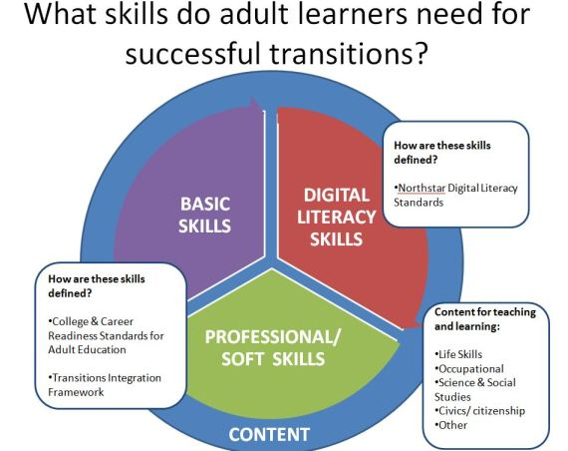

Slide 34
Benefits
Provide teachers and administrators with:
  a shared vision for adult education
  a common language for discussing outcomes, and
  guidelines for structuring curriculum, instruction, and assessment. Content standards.
Provide students:
  guideposts to follow as they make progress, giving them more responsibility for their learning and helping them design their own goals, and
  assure that high-mobility students and students who “stop out” have access to a logical, predictable set of skills all teachers/programs are working toward
Provide stakeholders (i.e., postsecondary institutions, vocational programs, employers)
  a description what adult education students know and are able to do which helps inform collaboration and coordination of services and employment decisions.

Slide 35
Citizen, Parent, Worker
Why
Diploma/GED, Career Pathway, College Transition
Goal (Context)
What
Standards
STAR, MNI, Writing, Universal Design
How
Tools
Tech, Online, Distance, Assessment
Program Structure
SPARC, LEA, Program Improvement, MABE/MARCS, Volunteer Coordination

Slide 36

Notes:
5 Min: Becca

Slide 37

4 Key Domains for
ABE Support Professionals
ABE Program and Policy Knowledge
Technology
Customer Service
Effective Work Culture
Notes:
5 Min: Becca

Slide 38

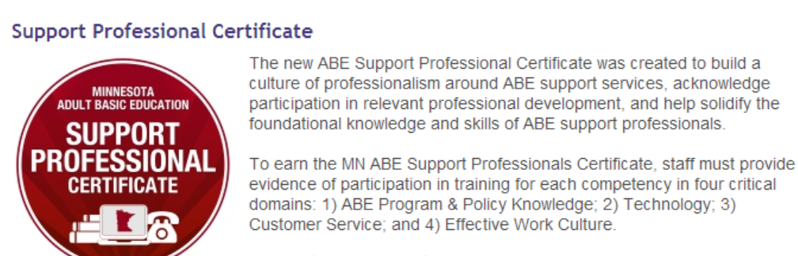
ABE Support
Professional Certificate
https://www.mnabeassessment.com/support-professionals-certificate
Notes:
5 Min:

Slide 39

SPARC Plug: Light that fire!
Support Professional Advisory and Resource Committee
Notes:
Becca

Slide 40
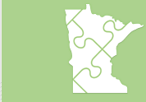

PD Newsletter & calendar
All PD information is now being distributed via the ABE PD E-Newsletter
Get on our distribution list by contacting Cherie.Eichinger@state.mn.us
Info and registration for all PD events can be found on our statewide PD calendar at www.atlasABE.org
Notes:
Todd

Slide 41



Enjoy the conference!
Use your action plan to mark down great ideas you want to try when after the conference!
Notes:
Becca

Slide 42
Break

