Slide 1
CASAS Tools to Aid Instruction – Low Intermediate Esl
Marty Olsen
June 11, 2010
martha.olsen@gmail.com
www.mnabeassessment.com

Slide 2
Objectives
Review tools CASAS provides to aid teachers in lesson-planning
Discuss specific skills that should be addressed at Low Intermediate ESL level
View sites online that provide lesson plans or other tools that can be used to address specific CASAS competencies
View sites online that students can use to build the skills they need for the CASAS tests

Slide 3
Quick review of CASAS tools
Class Profile by Competency
Basic Skills Content Standards by Test Item Correlations
Task Areas
Sample Test Items – Level B
Suggested Next Test charts

Slide 4
Other Curricula Suggestions
Curriculum adopted by your program (linked to CASAS competencies)
Scope and Sequence (found on www.marshalladulteducation.org website)

Slide 5
CASAS Competency items assessed in Forms 83R and 84R and found in Scope and Sequence
Communication
Answer questions regarding conversations
Consumer Economics
Read monetary amounts in numbers
Read sales ads
Identify types of housing
Communicate information about home repair
Health
Read information on a medicine label
Employment
Read simple want ads
Complete simple job application
Basic employment expectations
Describe personal work experience and skills
Government and Law
Understand basic government concepts
Learning to Learn
Read and comprehend silently
Answer comprehension questions
Read a simple table or chart
Learning to Read
Read maps
Reading various forms
Contextual clues
Formatting clues
Practice reading strategies

Slide 6
Questions for discussion:
How are the 83R/84R level tests different from the previous tests (81R, 82R, 81RX, 82RX)?
What does this mean for your instructional plans?

Slide 7
How to Use Competencies and Basic Skills Content Standards in the Classroom

Slide 8
Steps to integrate CASAS competencies and content standards in lesson planning:
Step 1: Administer appropriate CASAS pre-test
Step 2: Score the assessment
Step 3 : Identify priority competencies using the Class Performance by Competency report

Slide 9
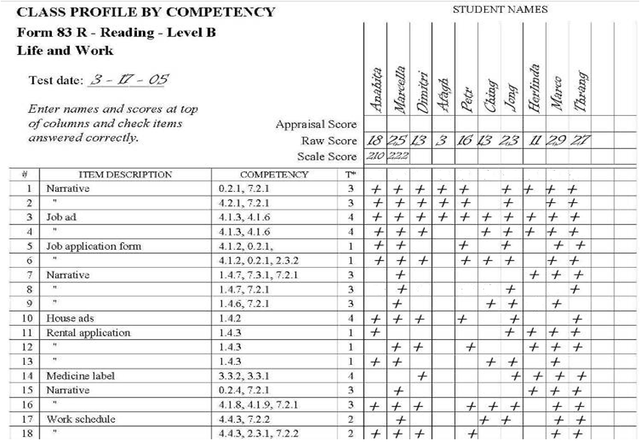
Life and Work Reading Form 83 Class Profile by Competency (Manual Report)
Step 3 – Identify priority competencies

Slide 10
“Steps” continued –
Step 4: Identify the basic skills content standards related to the priority competencies in Step 3
Step 5: Plan instruction around identified basic skills content standards and priority competencies using the WIPPEA lesson-planning method
Step 6: Administer the appropriate Post-test

Slide 11
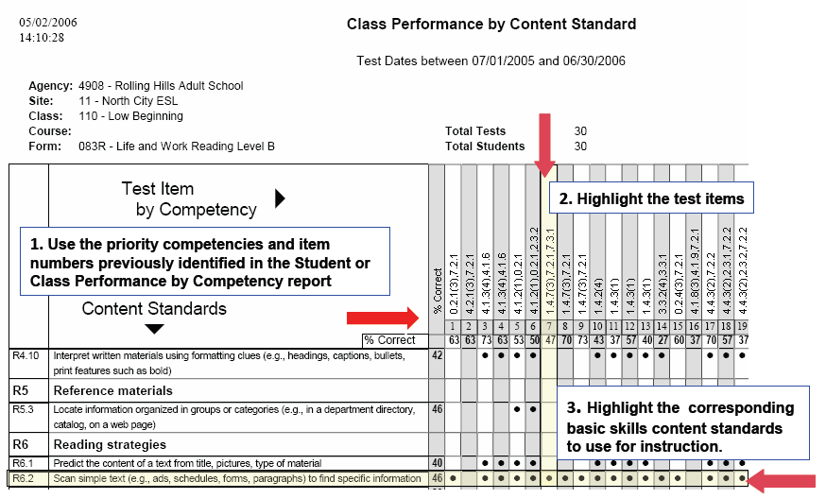
Reading Basic Skills Content Standards by Test Item
Step 4 – Identify Content Standards associated with priority competency

Slide 12
Planning a Reading Skills Lesson
R3.2
Read and understand simple sentences
R2.8
Interpret meaning from word formations
R3.8
Interpret basic sentence structure and grammar
CASAS Competency
1.4.7
Interpret information about home maintenance
R7.2
Identify main idea of a multi-paragraph text
R3.10
Follow pronoun references within a text
Instructional Program
ESL – Intermediate Low
CASAS Level: B
NRS Level: 4
R6.2
Scan simple text to find specific information

Slide 13
How to Develop a Competency-Based Lesson Plan (WIPPEA)
WIPPEA – Warm-up/Introduction
Presentation
Practice
Evaluation
Application
Warm-Up/Introduction:
Review of previously learned material. Prepare for new lesson. Establish purpose of lesson.

Slide 14
WIPPEA (continued)
Presentation:
Introduce new information and skills using a variety of activities and techniques. Use a variety of strategies: visuals, realia, lecture, demonstration.
Practice:
Provide the learners with the opportunity to practice the new information and skills by integrating the new information in a controlled context. Include Guided Practice (pair work, dictation, worksheets) and Communicative Practice (role play, team work, info exchange and problem-solving) when appropriate. During the practice, monitor learners and provide feedback.

Slide 15
WIPPEA (continued)
Evaluation/Assessment:
Assess the learners and provide feedback.
Application:
Learners apply new skills and knowledge in a functional context.

Slide 16
Sample Competency-Based Lesson Plan
1.4.7
Competency Objective(s): _________________________________
_________________________________________________________
__________________________________________________________
Level: ______________________ NRS Level: ____________
CASAS Level: ______ Scale Score Range: ________________
Primary Content Standard(s)
__________________________________________________________
__________________________________________________________
Content Standards covered in other lessons:
_____________________________________________________
_____________________________________________________
_____________________________________________________
Interpret information about home maintenance and communicate housing problems to landlord.
ESL Intermediate Low
4
B
201 - 210
R6.2 Scan simple text for information
R3.2 Read and understand simple sentences
R3.8 Interpret basic sentence structure and grammar
R3.10 Follow pronoun references within a text
R7.2 Identify main idea of a multi-paragraph text

Slide 17
Sample Competency-Based Lesson Plan
Warm-up/Introduction:
Review vocabulary about housing repair. Ask for examples of repair process for different problems.
Show pictures and write vocabulary on the board.

Slide 18
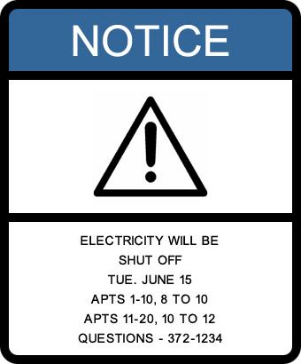
Presentation:
Using pictures, introduce a problem in an apartment complex where the electricity will be shut off.
Write Q (such as #1-what will happen?/#2-what day? etc.) on the board. Go over the questions with the students.
Show the notice on OH that has been posted on the apartment doors. Read each Q and explain that they must find the answer quickly. Ask for answers to each Q.
As students give answers, point to the answer in the text. Underline and mark answers with #1, 2, 3, etc. (corresponding to the questions) on the notice.
1
2
*Warning sign generated at:
http://www.warningsigngenerator.com/
**Reading Signs in English
(Photographs of many signs)
http://www.manythings.org/signs/

Slide 19
Practice:
Pass out a worksheet with 3-4 notices/signs/letters (about different repair work, fumigation, wet paint, etc.) with Qs under each. Tell the students to read the Qs silently as the Teacher reads them aloud. Then quickly find the answer.
Teacher reads Q aloud and students underline and write the Q number next to the answer in the text.
Students can work in pairs to check each other, and then individuals can mark on OH in front of class for feedback.

Slide 20
Sample Competency-Based Lesson Plan
Evaluation/Assessment:
Students will be given a worksheet with a new notice. Teacher will ask the group Qs such as what work will be done? What apartments will be without water? Who will you contact?
Students will mark answers in notice with 1, 2, 3, 4, etc.
Teacher can walk around to view student work and assess mastery.
Application:
Send small groups with Qs to answer, each to a different area of the school to read signs that have been posted there and report back to the class (e.g. “This stairway will be closed for repairs, Thursday between 8 and 5”).

Slide 21
Discussion of the Process
After doing this reading lesson:
How would you follow up on the lesson tomorrow?
How might you teach this reading skill in relation to another competency area? For example, in three weeks, when you move into a jobs unit:
How could you work to practice/and
review this reading skill?

Slide 22
Incorporating Graphic Organizers
Text Structure Table
Freeology
Oracle ThinkQuest
“Google” graphic organizers for many more choices

Slide 23
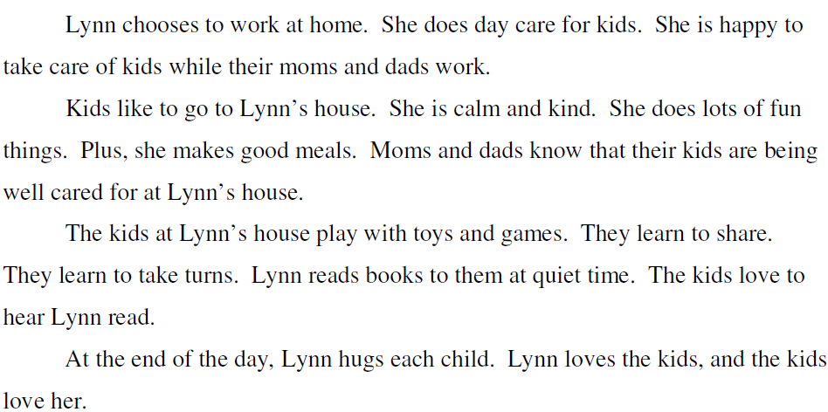
*Source: www.marshalladulteducation.org
kind
calm
does fun things
reads books at quiet time
Lynn
makes good meals
hugs each child

Slide 24
Sites for Reading Samples
Marshall Adult Education – Reading Skills for Today’s Adults
100 free Short English Stories for ESL Learners
EL Civics “Print & Go ESL Reading Worksheets”

Slide 25
Materials Online for Teacher Use
Lesson plans linked to competencies www.mnabeassessment.com/competency_links.html
CASAS Life & Work – Forms 83R and 84R – Linking documents www.mnabeassessment.com/competency_links.html

Slide 26
Materials Online for Teacher Use
Reading For Life http://www.mnliteracy.org/tools/reading-for-life
HUBBS EL Civics – “Food Safety” http://www.hubbs.spps.org/Food_Safety2.html
HUBBS EL Civics – “Construction” http://www.hubbs.spps.org/Construction_Skills.html

Slide 27
Targeted Online Activities for Student Use
Minneapolis ABE https://abeweb.mpls.k12.mn.us/
Marshall Adult Education http://www.marshalladulteducation.org/reading-skills-for-todays-adult
Adult and Family Education http://ww.web-esl.com/
johnmh.com – Form 83 Practice http://www.web-esl.com/ILA/ila83r.html
johnmh.com – Form 185 Practice http://www.web-esl.com/ILA/ila185.html
Learning Line www.rmpbs.org/resources/files/education/learningline
California Distance Learning Project http://www.cdlponline.org
GCFLearnFree www.gcflearnfree.org
English-On-The-Web www.english-on-the-web.yolasite.com

Slide 28
Questions?

