Slide 1


Welcome to the
ABE Support Services Conference!
November 20-21, 2014
Minnesota Department of Education
Notes:
1 Min: Abbey

Slide 2
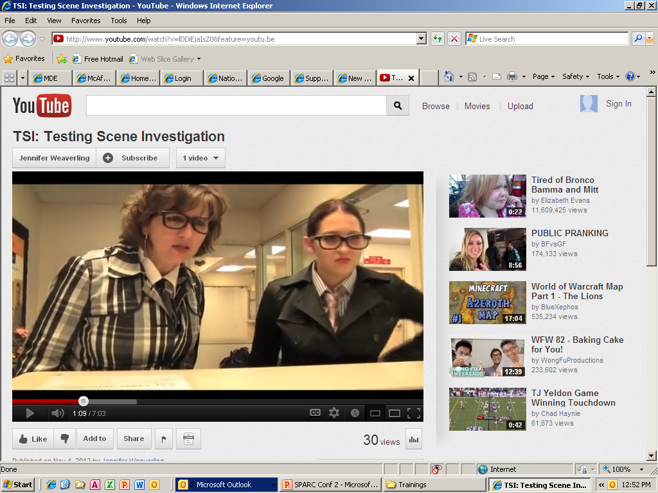

World Premiere!
What?! It’s time for another Support Services Conference!
But it is still amazing and still important. Some things never change!
Hunting season on ineffective testing is NEVER OVER!
And I did get married!
You mean, “TSI 2: Test This! (Miami Style)?” We ran out of money. ☹
So, when’s the TSI sequel?
It’s hard to believe we made this video two years ago!
That’s not true! New laws, new testing rules, new programs, new partners, everything changes.
That’s right! Hunting season is almost over.
At least people can still check us out on YouTube!
TSI: Testing Scene Investigation

Slide 3

Introductions
Athena Eleftheriou
SPARC Committee and Conference Chair
Notes:
1 min: Athena

Slide 4
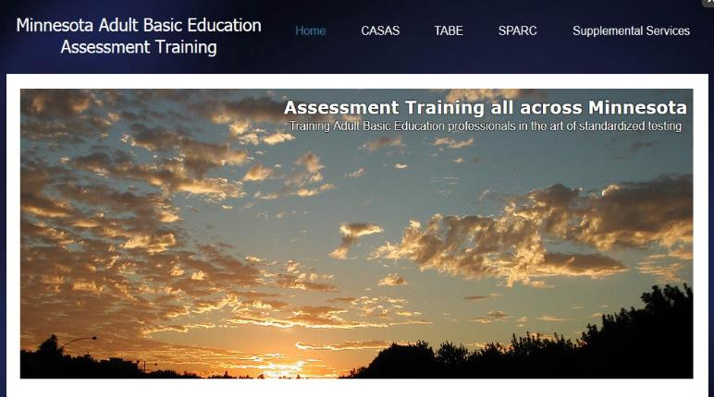
Your Statewide Supplemental Service Provider for Assessment Training
Marty Olsen
SW ABE and State Assessment Trainer
martha.olsen@gmail.com
Learn more/schedule a training:
www.mnabeassessment.com
Notes:
5 min: Marty

Slide 5
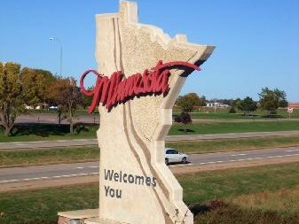
Todd Wagner
State ABE Director

Slide 6
State ABE Office Staff
Astrid Liden – Professional Development
Alice Smith – GED Records
Brad Hasskamp – Policy and Operations
Cherie Eichinger – Office Support
Jim Colwell – State GED Administrator
Julie Dincau – Transitions
Laurie Rheault - Grants
Todd Wagner – State Director
Notes:
Put out post it notes on tables for participants.
Provide handouts as participants walk in.
Show of hands to show reps, TEACHERS, Administrators, other….

Slide 7
Supplemental Services
Minnesota Literacy Council - technology, volunteer training, outreach
ATLAS – professional development
LAN - program quality, administrator support
St. Paul ABE – distance learning
Minneapolis ABE – GED 2014 resources
SW ABE – assessment training, SPARC
PANDA – disability resources & assistance
MWCA - transitions

Slide 8
The Numbers
Indicators
State and Federal Funding
Enrollees and Participants
Contact Hours
Average Contact Hours
Level Change

Slide 9
State Funding

Slide 10
Federal Funding

Slide 11
Enrollees and Participants

Slide 12
Hours

Slide 13
Average Hours

Slide 14
ABE Level Change

Slide 15
ESL Level Change

Slide 16

Looking into our future

Slide 17

Looking Ahead in ABE
Secondary Credential Testing
Collaborative Programming
WOIA
CCRS
New State Adult Diploma

Slide 18
GED
Vouchers: Extension of expiration date
Discounts:
  Promo Code (ABE only $40)
  Discount (All $40)
  Re-takes
Access to Test Taker Data
Accommodations: GED Ready™ - extended time

Slide 19
GED 2014
If you have additional questions, please ask us throughout the day or you can come to the GED concurrent session later today.
Notes:
Amy (and Jim?)

Slide 20

Collaborative Programming
More Adult Career Pathway Programming
Working with MnSCU on Developmental Education Programming Changes
Working with MFIP clients
Certificate Programs that align to workforce needs

Slide 21

Adult Career Pathways
FastTRAC
$1.5M per year
“Three Component Model”
Postsecondary Ready
College prep
Articulation
Co-Requisite programming
Occupational Certificates
Boiler License
Apprenticeships
Carpentry

Slide 22
Student Advising Committee
The Minnesota Workforce Council Association is convening a work group that explores advising models for ABE learners
Part of MWCA’s supplemental service grant
Collaborating with practitioners across the state
Connecting with FastTRAC, New State Adult Diploma Working Group and other Adult Career Pathway programming

Slide 23

WIOA
Workforce Innovation & Opportunity Act
Increased connections across systems leading to networked governance, including DEED, MnSCU, employers
Breaking down boundaries while keeping identities and articulating clear roles
Creates common measures

Slide 24
Workforce Innovation & Opportunity Act (WIOA)
Signed by President on July 22, 2014
Effective July 1, 2015
Implementation Timeline: 2014-2017
Authorized through 2020
Federal government developing guidance for states (Now-January 2015)
State Staff Training (Fall 2014-Spring 2015)

Slide 25
The Why and How of WIOA (1)
Seeks to ensure that job seekers receive training services that align with workforce needs
Encourages strategic alignment and coordination among workforce development, adult education, and vocational rehabilitation services

Slide 26
The Why and How of WIOA (2)
Uniform performance measures across all WIOA programs
Emphasizes indicators and targets for employment entry, job retention, postsecondary entry, and credential attainment
Replaces incentive funding with penalties for states missing targets

Slide 27



The Why and How of WIOA (3)
Alignment to the College and Career Readiness Standards and state K-12 standards
Federal regulatory power = greater control by OCTAE
Keeps federal ABE funding level with some growth over time

Slide 28
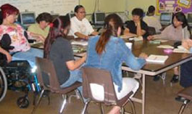



Defining Adult Education
Academic instruction and education services below the postsecondary level that increase an individual’s ability to:
Read, write, and speak in English and perform mathematics or other activities necessary for the attainment of a secondary school diploma or its recognized equivalent;
Transition to postsecondary education and training; AND
Obtain employment.
Source: Workforce Innovation & Opportunity Act, Sec. 203

Slide 29


For More Info on WIOA
U.S. Dept of Education
www.ed.gov/AEFLA
U.S. Dept of Labor
www.doleta.gov/wioa
More information available at the 2015 Spring Grant Application Meetings
Many Details Still in Development

Slide 30

Federal Monitoring
Federal Visit: June 9-13, 2014
Official federal report expected fall 2014
No Federal Report Yet

Slide 31
CCRS
College & Career Readiness Standards for Adult Education
Standards-Based Education
Articulating objectives and aligning curriculum to the standards
Changing our assessments
Standards in:
English Language Arts
Math

Slide 32
Becoming a Standards-Based System
ACES Transitions Integration Framework – Academic, Career and Employability Skills
College and Career Readiness Standards (CCRS)
North Star Digital Literacy Standards

Slide 33

New State Adult Diploma
Embeds K-12, CCRS, ACES TIF, and Northstar Standards
Requires ongoing advising
Gives students multiple options
Piloting January-June 2015
Pilot applications due 12/2

Slide 34

New State Adult Diploma
Five Competency Areas:
English Language Arts,
Math,
Science,
Social Studies,
Employability & Career Development
Notes:
Brad

Slide 35

40-Hour
Post-Testing
Increasing student persistence and program intensity
More efficient data entry and monitoring
Increased program communication and coordination

Slide 36

40-Hour Post-Testing
Consider:
Program intensity
Policies
Data tracking
Staff training

Slide 37
40-Hour
Post-Testing
How is your program adjusting its policies with the 40-hour rule?
What challenges is your program facing with it?
What questions do you have?

Slide 38
Assessment Training
Check out the assessment training concurrent sessions available today!
Attend certification training (every 5 years at least!)
www.mnabeassessment.com
Notes:
Marty

Slide 39

State Overview
If you have additional questions, please ask any of the state ABE staff throughout the day or you can come to Todd’s and Brad’s concurrent session later today.
Notes:
Todd

Slide 40

The NEW ABE Support Professional Certificate!
Available starting today!
Check out the information packet at the registration table
Submit online to Cherie at cherie.eichinger@state.mn.us
Notes:
5 Min: Brad

Slide 41
4 Key Domains for ABE Support Professionals
ABE Program and Policy Knowledge
Technology
Customer Service
Effective Work Culture
Notes:
5 Min: Brad

Slide 42

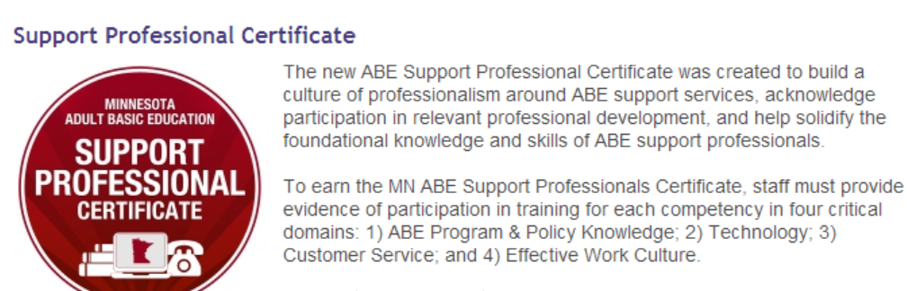
ABE Support Professional Certificate
www.atlasabe.org
Click on Professional Development
Click on Support Services
Notes:
5 Min: Brad

Slide 43
Congratulations!
Jennifer Gibson
Carolina Salazar
Notes:
5 Min: Brad

Slide 44

SPARC Plug: Light that fire!
Support Professional Advisory and Resource Committee
Notes:
3 min: Athena

Slide 45
Mark Your Calendars!
2015 Support Professional Conference
November 19-20, 2015
Notes:
Athena

Slide 46
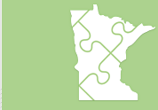

PD Newsletter & calendar
All PD information is now being distributed via the ABE PD E-Newsletter
Get on our distribution list by contacting Cherie.Eichinger@state.mn.us
Info and registration for all PD events can be found on our statewide PD calendar at www.atlasABE.org
Notes:
Astrid

Slide 47



Enjoy the conference!
Use your action plan to mark down great ideas you want to try when after the conference!
Notes:
Athena

Slide 48
World Premiere!
What?! It’s time for another Support Services Conference!
That’s right! Hunting season is almost over.
Hunting season on ineffective testing is NEVER OVER!
It’s hard to believe we made this video two years ago!
But it is still amazing and still important. Some things never change!
That’s not true! New laws, new testing rules, new programs, new partners, everything changes.
And I did get married!
So, when’s the TSI sequel?
TSI: Testing Scene Investigation
You mean, “TSI 2: Test This! (Miami Style)?” We ran out of money. ☹

