Slide 1


Welcome to the ABE Support Services Conference!
November 17-18, 2016
Minnesota Department of Education
Notes:
1 Min: Becca

Slide 2


Introductions
Becca Bair
SPARC Committee and Conference Chair
Notes:
1 min: Becca

Slide 3
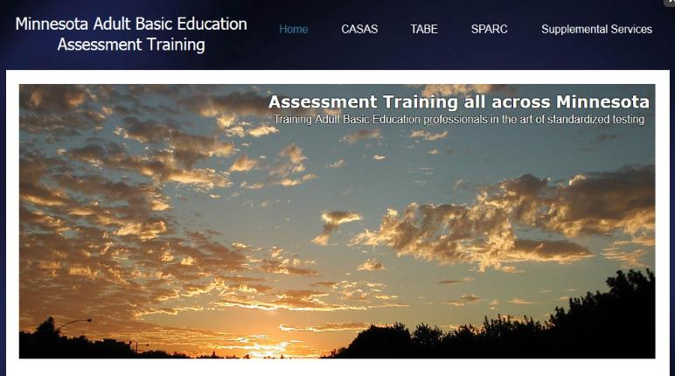
Your Statewide Supplemental Service Provider for Assessment Training
Marty Olsen
SW ABE and State Assessment Trainer
martha.olsen@gmail.com
Learn more/schedule a training:
www.mnabeassessment.com
Notes:
5 min: Marty

Slide 4


Todd Wagner, State ABE Director
Notes:
Todd

Slide 5

Thank You
SPARC Committee
Conference Planners
Becca Bair, Chair
Sponsoring organization
SW ABE’s Supplemental Service Grant
All the presenters
Everyone participating
Notes:
Todd

Slide 6
State Level Supports
We are here to support you!
Notes:
Todd

Slide 7
MNABE Staff
From the Minnesota Department of Education
Todd Wagner, State ABE Director
Julie Dincau, Transitions Specialist
Cherie Eichinger, Administrative Support
Brad Hasskamp, Policy Specialist
Astrid Liden, Professional Development Specialist
Laurie Rheault, Grants Specialist
Alice Smith, Administrative Support/GED
Jodi Versaw, Program Quality
Notes:
All introduce themselves

Slide 8
Supplemental Services
Minnesota Literacy Council
technology, volunteer training
ATLAS
professional development
Literacy Action Network
program quality, administrator support
Minneapolis ABE
GED 2014 resources
SW ABE
assessment training
PANDA
disability resources & assistance
MWCA
transitions
Notes:
Todd

Slide 9
Supplemental Services
ABE Supplemental Service Activities | Provider for 2016-17
Professional development (PD) services: Regional PD activities PD and resources on: writing, evidence-based reading instruction (EBRI), including STAR adult numeracy instruction (MNI – MN Numeracy Initiative), including language and math integrating transitions skills into ABE instruction (ACES) career-focused contextualized basic skills instruction and programming ESL instruction, including ESL Study Circles (low-literacy, pronunciation) implementation of College & Career Readiness Standards (CCRS) for Adult Education Coordination of MN ABE Calendar of Events and MN ABE Connect e-newsletter | ATLAS www.atlasABE.org Patsy Egan Vinogradov, Director (ESL, Contextualized Instruction, Transitions) Kristine Kelly (ELA, CCRS) Marn Frank (literacy, EBRI, STAR) Amber Delliger (Numeracy) Liz Andress (career pathway programming) Marisa Geisler (Communications & Finances)

Slide 10
Supplemental Services
ABE Supplemental Service Activities | Provider for 2016-17
Volunteer and outreach services: Adult Literacy Hotline Volunteer training, outreach and recruitment Volunteer management support | Minnesota Literacy Council (www.mnliteracy.org) Rob Podlasek (Volunteer training) Ellie Purdy (Volunteer management)
Technology integration services: PD on educational technology Online orientation to distance learning PD on distance learning best practices Administration and training for state-supported distance learning platforms Facilitation of assessment of curricula for inclusion under distance learning policy Communication of distance learning information and resources to the ABE field Training on integrating digital literacy skills into instruction Online course development and delivery Online learning resources, including OERs | Minnesota Literacy Council (www.mnliteracy.org) Susan Wetenkamp-Brandt (Distance learning platforms, digital literacy, educational technology, online resources) Renada Rutmanis (Distance learning PD) Tom Cytron-Hysom (Distance learning policy)

Slide 11
Supplemental Services
ABE Supplemental Service Activities | Provider for 2016-17
Disability training and support services: ABE disabilities website (http://mn.abedisabilities.org) Training on Universal Design for Learning (UDL) and best practices in serving students with disabilities Lending library of resources and adaptive technology Self-service online adult learner intervention system and disability screening and referrals process on PANDA’s website Consultation on serving students with disabilities ABE consortia reimbursement for ABE student assessment for Specific Learning Disabilities for GED accommodations Facilitation of disabilities outreach and advisory committee | PANDA – MN ABE Disability Specialists http://mn.abedisabilities.org Wendy Sweeney

Slide 12
Supplemental Services
ABE Supplemental Service Activities | Provider for 2016-17
Assessment training and services: CASAS and TABE training ABE assessment website (www.mnabeassessment.com) ABE Support Services Conference ABE Support Professional Certificate | Southwest ABE www.mnabeassessment.com Marty Olsen Linda Keller Kelly Hoyt Dave Haugen
Program quality support services: ABE Summer Institute and statewide committees and adult diploma implementation PD for ABE administrators New ABE staff orientation and support (ABE Foundations) ABE marketing resources Practitioner discussions on current ABE issues | Literacy Action Network www.literacyactionnetwork.org Tom Cytron-Hysom , Grants Manager Kathy Linder, Coordinator
Transition services: Support for regional transitions coordination and workforce development collaborations | Minnesota Workforce Council Association http://mwca-mn.org Anne Kilzer

Slide 13
Ongoing Working Groups
Support Professional Resource Advisory Committee (SPARC)
Distance Education Virtual Task Force
Disabilities Outreach Committee
PD Advisory Committee
Regional Transitions Coordinators
Adult Diploma Working Group
CCRS Implementation Team

Slide 14

The Numbers
Indicators
State and Federal Funding
Enrollees and Participants
Contact Hours
Average Contact Hours
Level Change
GED

Slide 15
State Funding

Slide 16
Federal Funding

Slide 17
Enrollees and Participants

Slide 18
Average Hours

Slide 19
ABE and ESL Level Change

Slide 20
GED

Slide 21
Numbers Take-away
GED numbers are recovering
Lower GED numbers indicate folks are working, which is good, but they may be missing the opportunity to skill up during strong job market.
The increase in average hours indicates programming is more intensive and that programs have improved retention.
Level changes are still ‘re-setting’ to new testing policy, but hopefully will trend upward for 2017.

Slide 22
Secondary Credentials
Standard Adult Diploma
27 of 43 consortia implementing by July 1, 2017
GED
Free while funds last (January???)
MNGED30

Slide 23

Notes:
5 Min: Becca

Slide 24

4 Key Domains for ABE Support Professionals
ABE Program and Policy Knowledge
Technology
Customer Service
Effective Work Culture
Notes:
5 Min: Becca

Slide 25

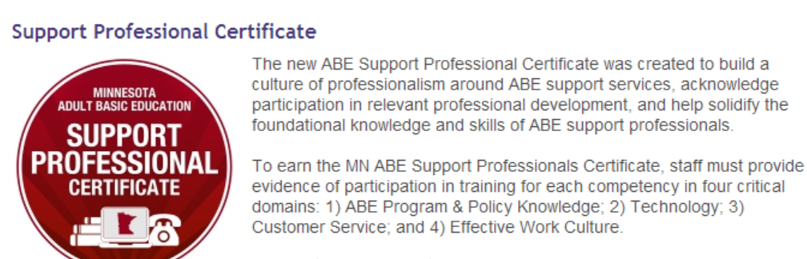
ABE Support Professional Certificate
www.atlasabe.org
Click on Professional Development
Click on Support Services
Notes:
5 Min:

Slide 26

SPARC Plug: Light that fire!
Support Professional Advisory and Resource Committee
Notes:
Becca

Slide 27
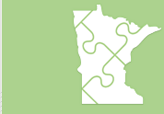

PD Newsletter & calendar
All PD information is now being distributed via the ABE PD E-Newsletter
Get on our distribution list by contacting Cherie.Eichinger@state.mn.us
Info and registration for all PD events can be found on our statewide PD calendar at www.atlasABE.org
Notes:
Todd

Slide 28

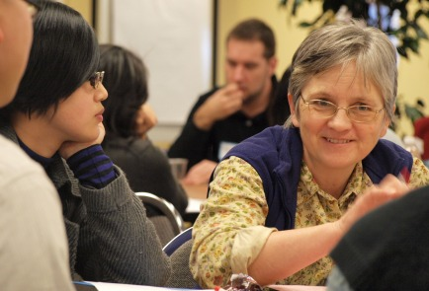
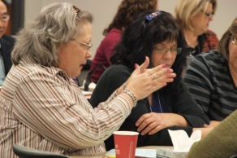
Enjoy the conference!
Use your action plan to mark down great ideas you want to try when after the conference!
Notes:
Becca

Slide 29
Break

