Slide 1
Welcome!
We would like to know who attends the training today so please sign in via chat:
Name
Email address
Your ABE role
In order for us to be able to verify your attendance at today’s training, we need the above information. You will then be able to request an attendance certificate.
If you are having difficulty with the program, please chat to:
Marty Olsen
Materials for today’s training:
Training Handout with Links
CASAS Skill Level Descriptors for Listening
CASAS IT PPT for today’s training:
M

Slide 2
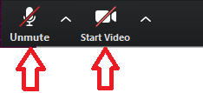
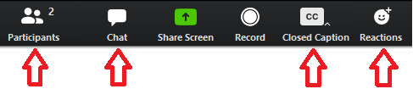
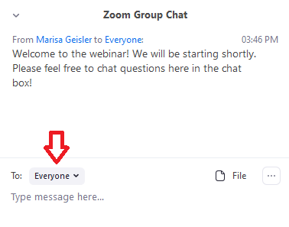
For tech help, private chat to Marty Olsen
At the bottom (hover your mouse to reveal)
Keep mic and video off (looks like this – red line)

Slide 3
Administering the casas listening test
Marty Olsen – martha.olsen@gmail.com

Slide 4
Agenda
CASAS Overview
NRS-approved CASAS tests for ESL and ABE learners
Review – Standardized Testing Process
Listening Test Administration
CASAS Listening Content Standards
Resources
CASAS eTests
Questions
S

Slide 5
About CASAS
Comprehensive Adult Student Assessment System
Non-profit organization started in 1980 to develop basic skills assessments for adult education programs
National leader in adult basic education and adult ESL assessment
Approved by the U.S. Department of Education for NRS Reporting for ABE and ESL
Used in 36 states and internationally

Slide 6

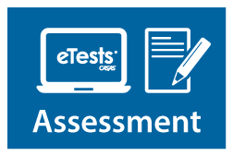


Integrated System Approach
Basic Skills Content Standards and
CASAS Competencies
Reading, Listening, Math Assessments
Paper or computer-based testing (eTests)
QuickSearch Online – free resource to find instructional material titles
TOPSpro Enterprise (TE) – data accountability software to score and track student test scores and generate reports

Slide 7

Tests Overview
M – Sign in reminder

Slide 8




How the System Works
Use CASAS Locator or Appraisal to find appropriate pretests and place students in program.
Use CASAS post-tests to measure learning gains and document completion of NRS EFLs.
Use CASAS pretests to place students into NRS Educational Functioning Levels (EFLs) and identify instructional needs.
Use pretest results to guide teaching.
Use QuickSearch Online to find curriculum resources.
Notes:
1. Placement:
The Locator available only for computer-based testing (CASAS eTests).
The locator test takes up to 15 minutes. An Appraisal test is typically 30-40 minutes.
2. Pretest:
Be sure to assess students in the same assessment series for their pretest and subsequent post-tests.
3. Instruct:
CASAS offers an online tool, QuickSearch Online, to locate instructor-recommended resources for classroom teachers.
4. Post-test:
CASAS recommends post-testing students after 70-100 instructional hours (or a minimum of 40 hours).

Slide 9
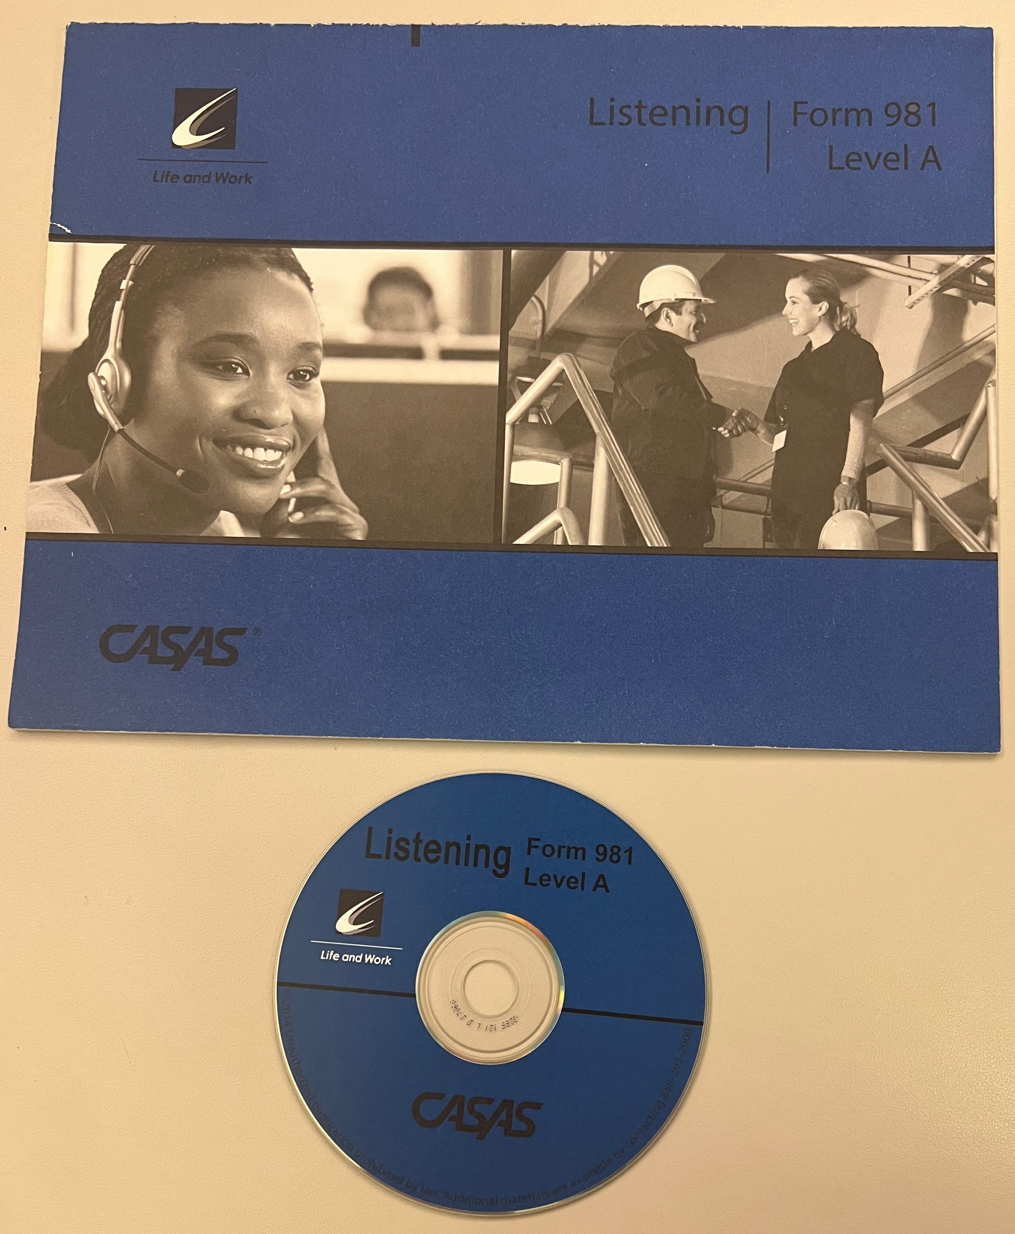
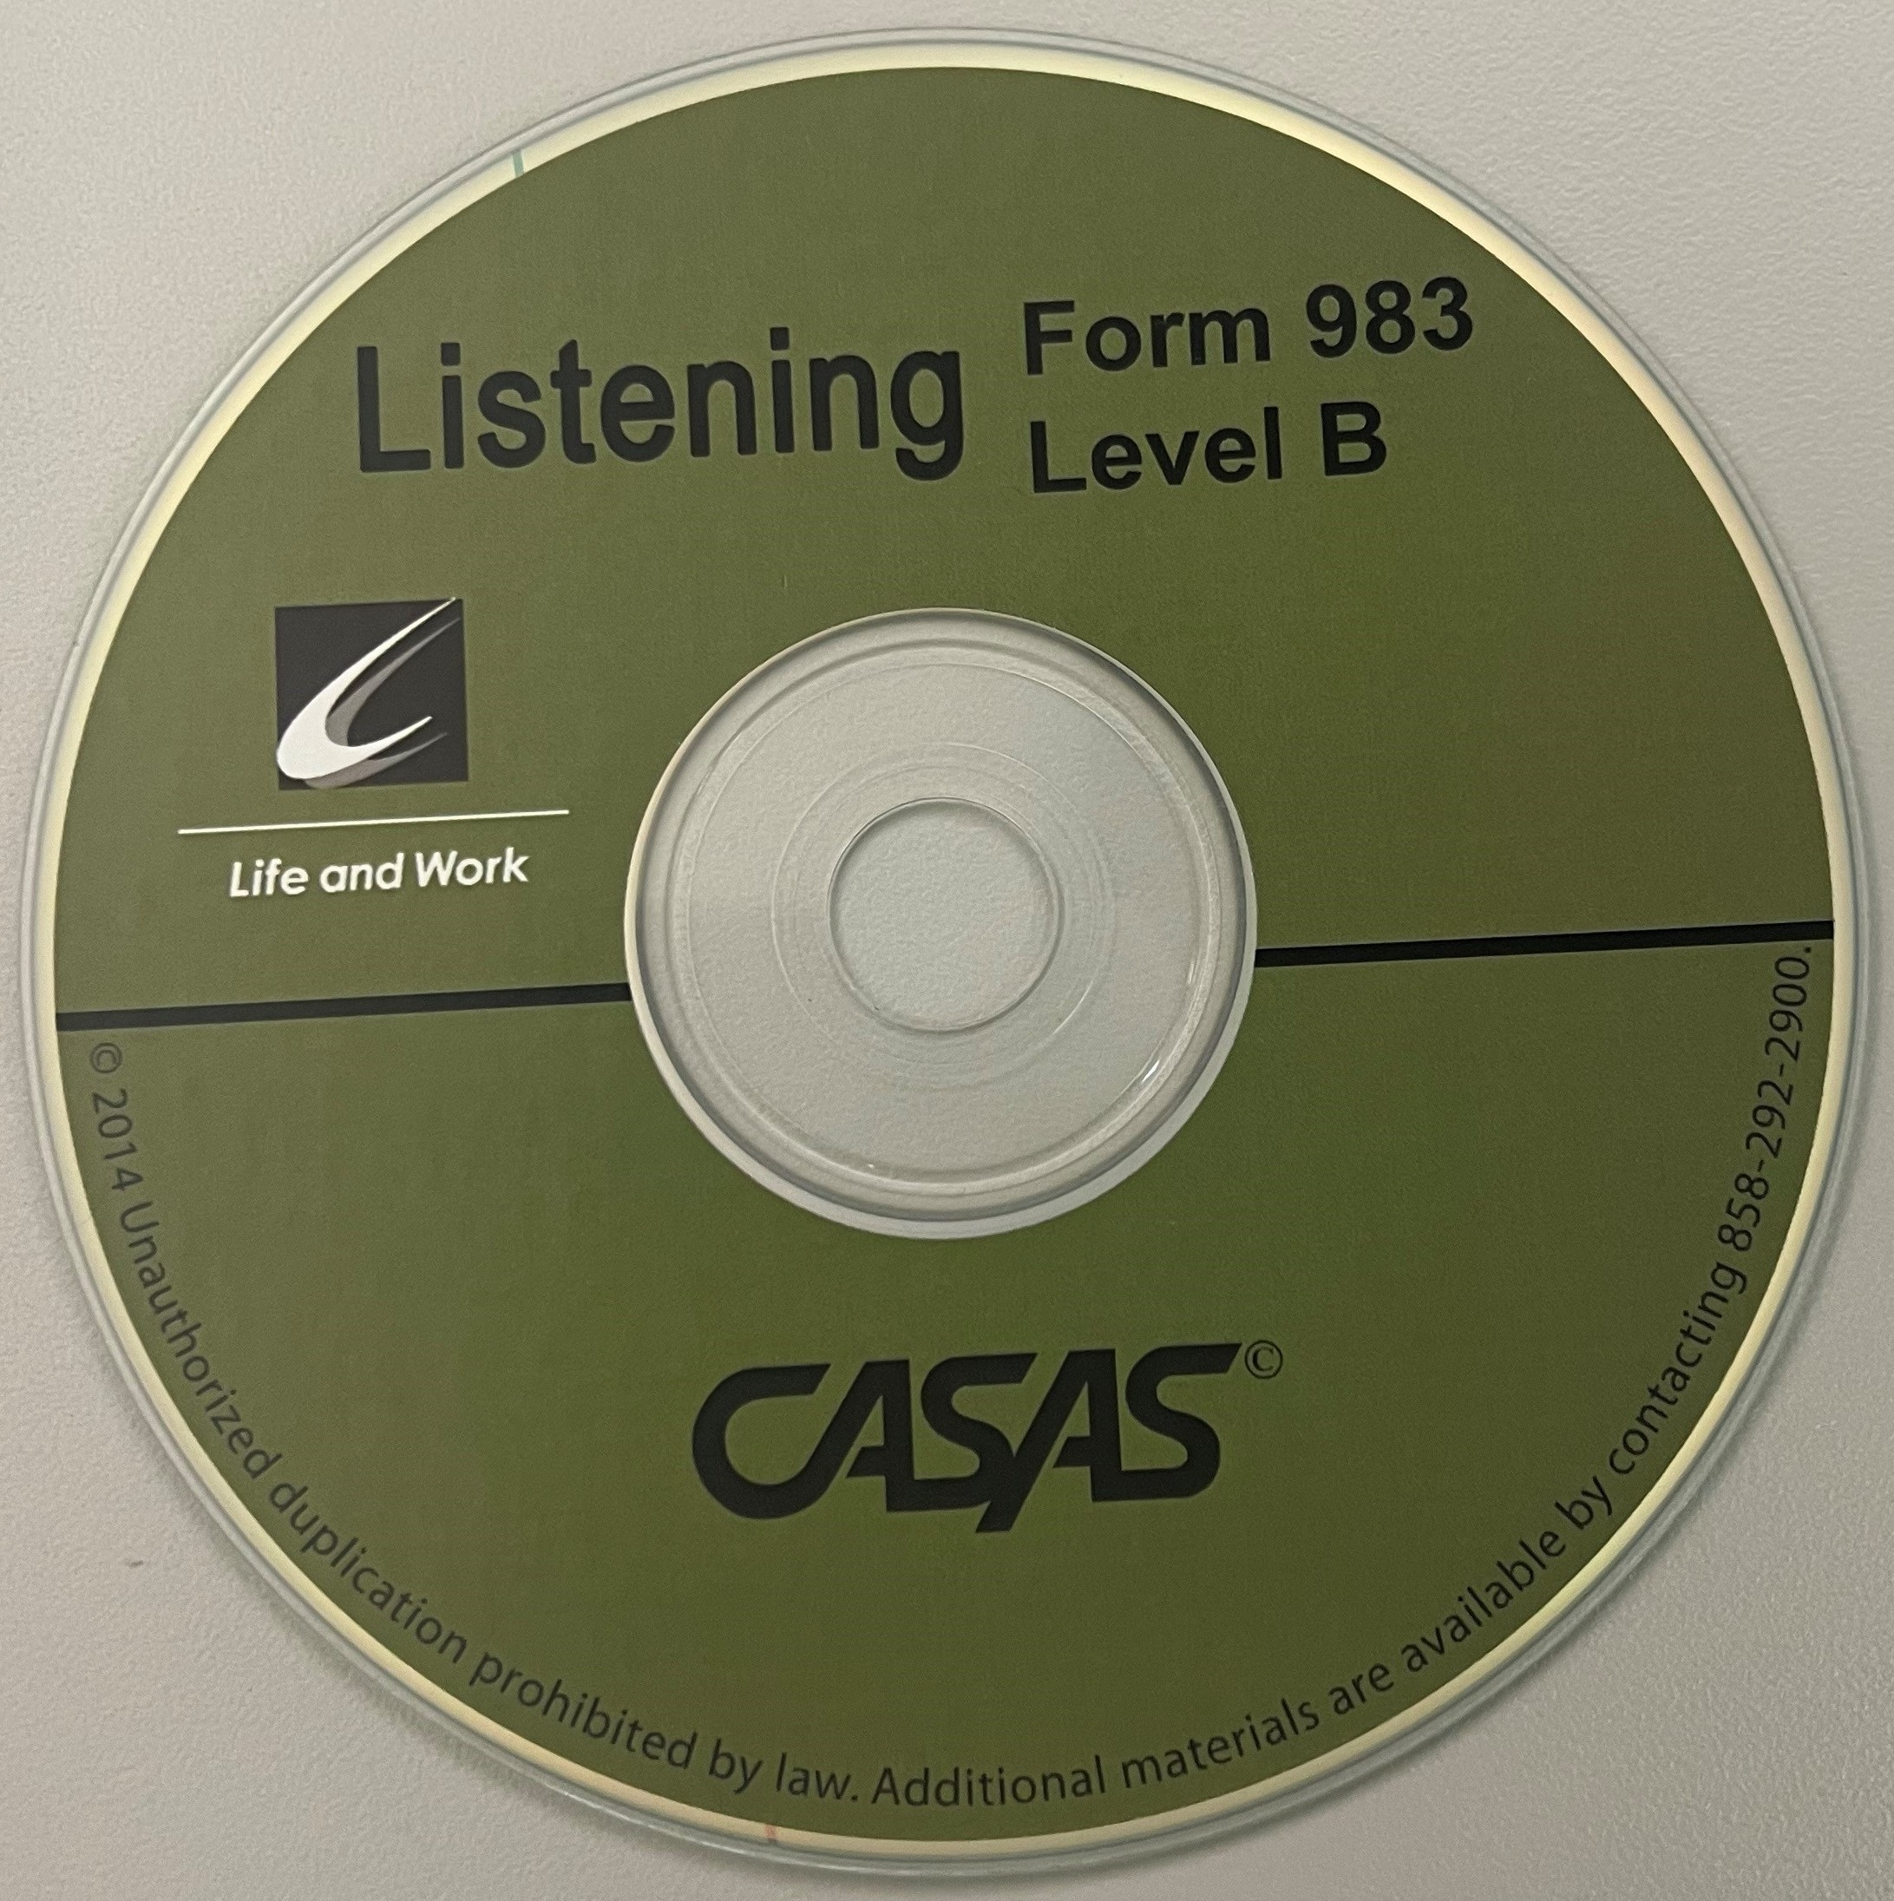
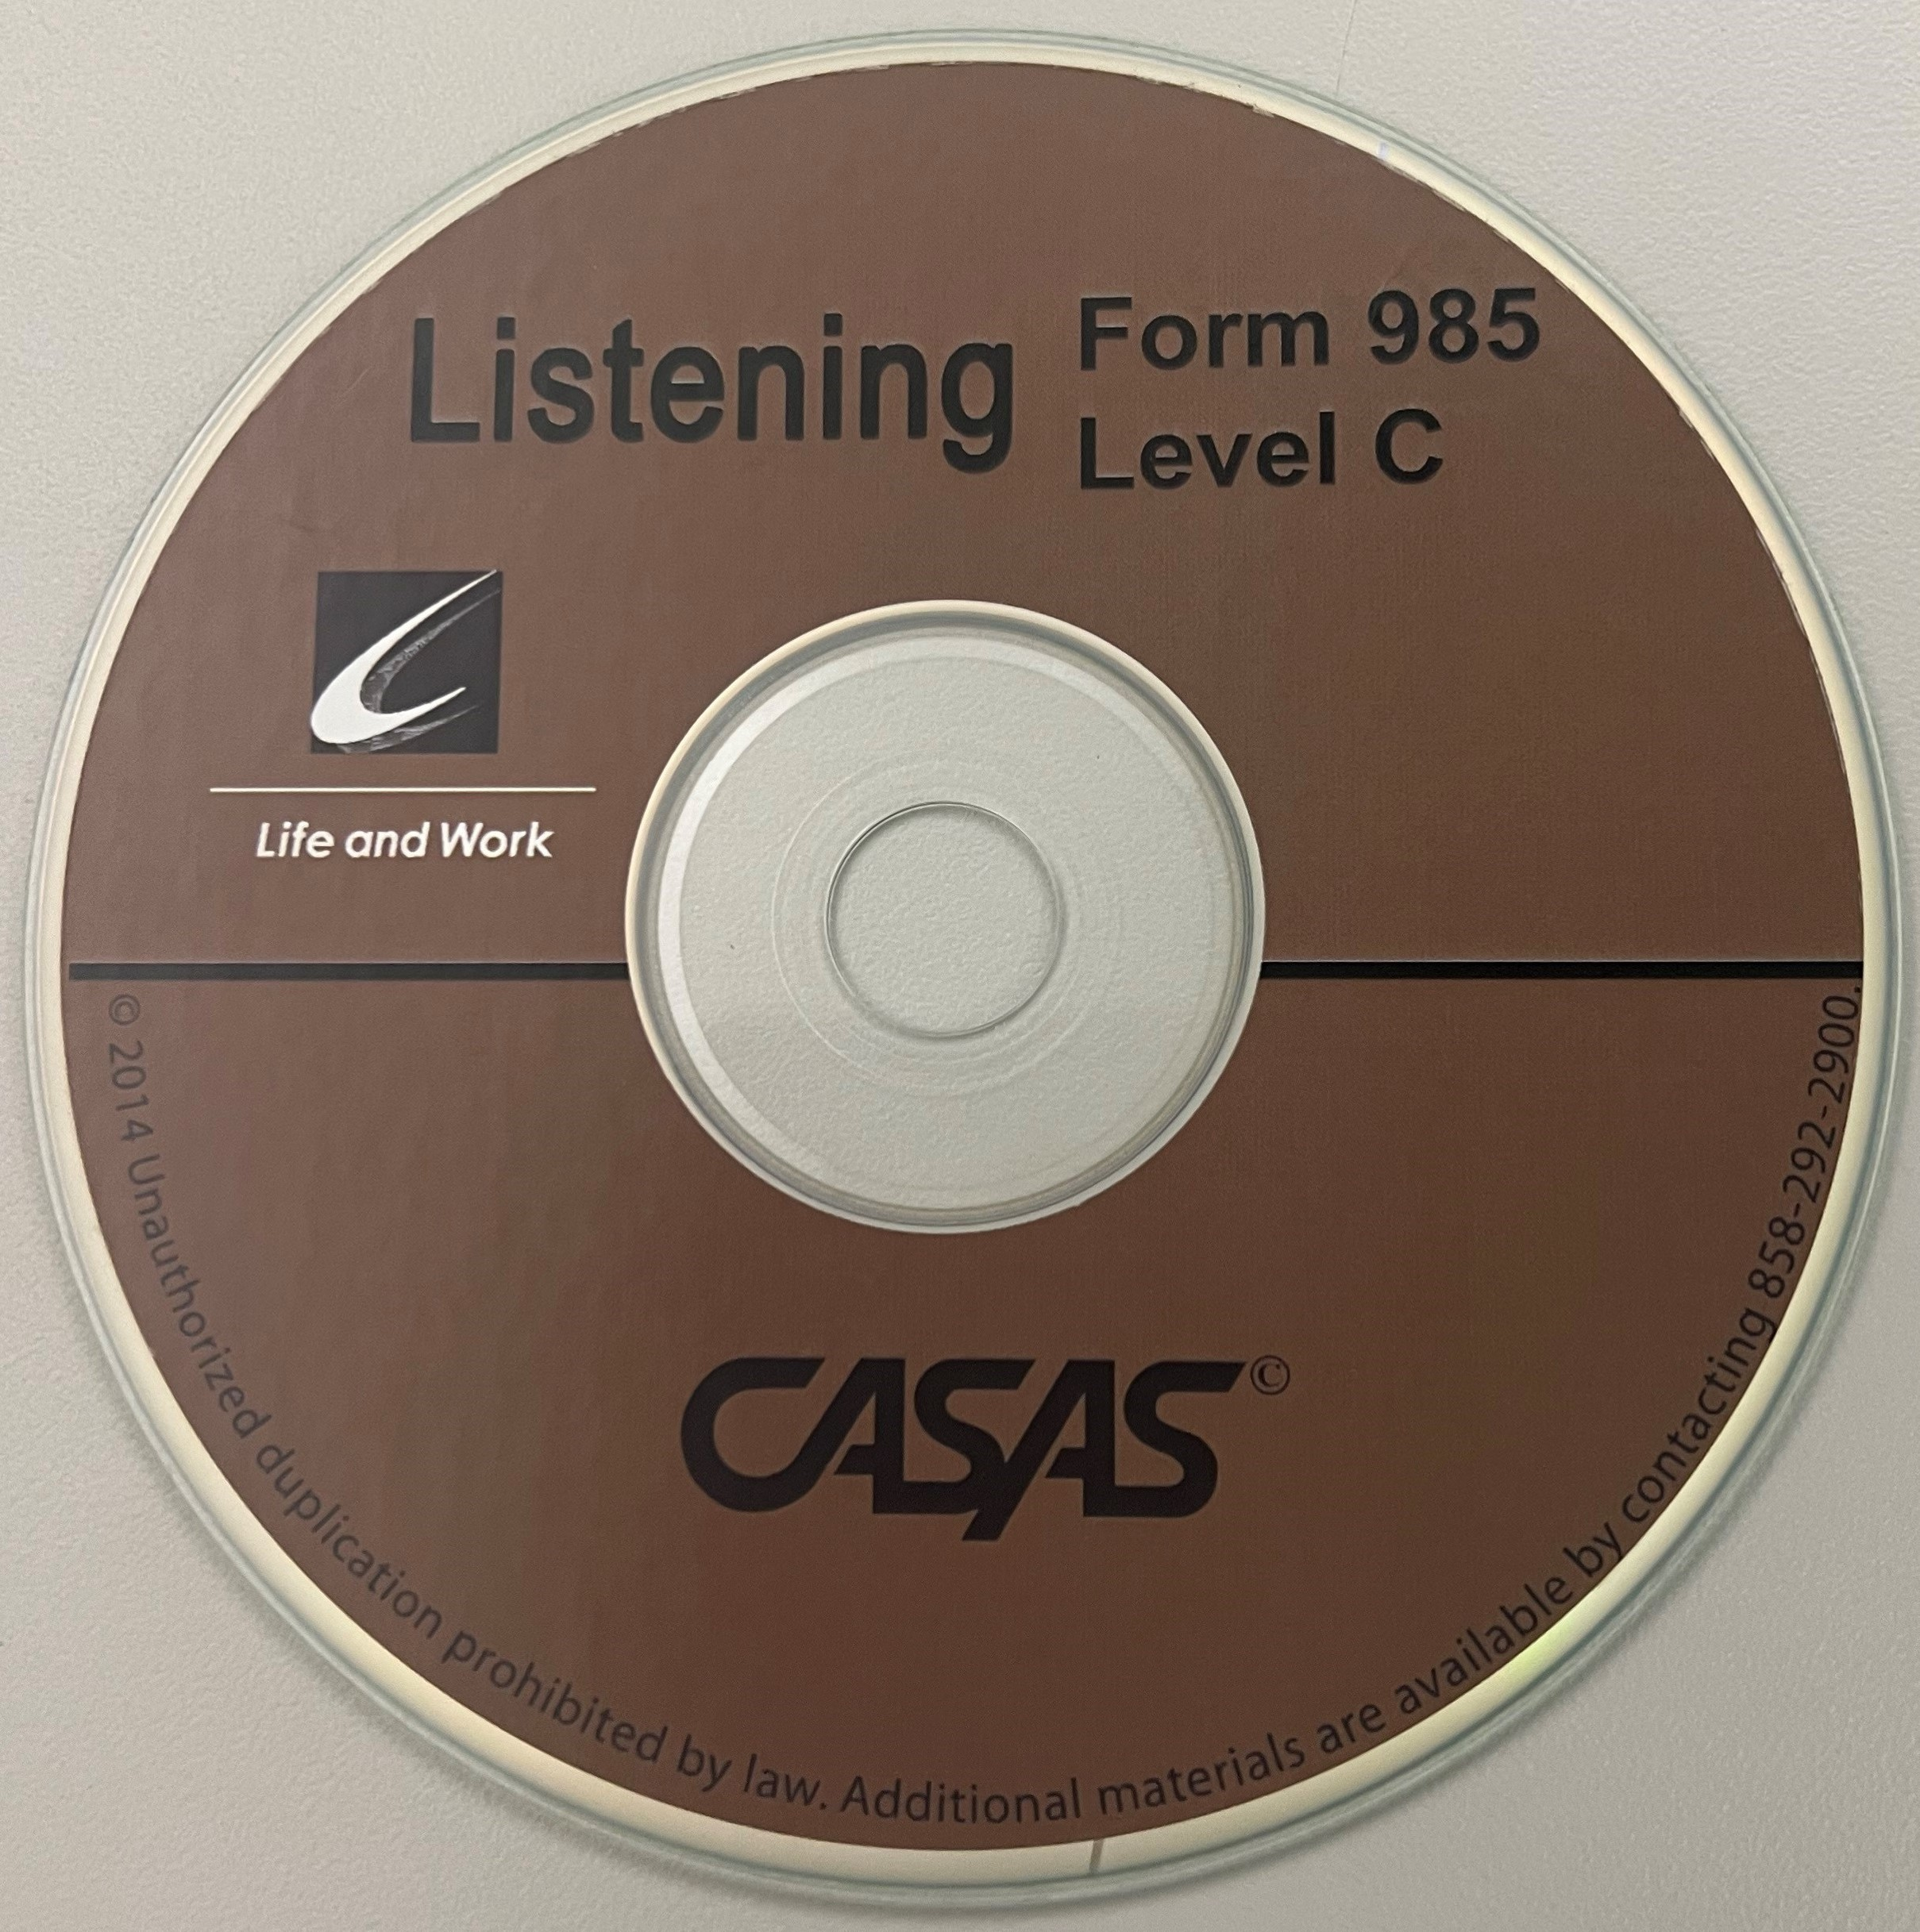
Uses of Listening Test Results
CASAS progress tests (pretests and post-tests) have four principal uses:
  to identify a student’s skill level
  to guide instruction
  to measure learning progress
  for accountability reporting
Level A
Level B
Level C

Slide 10








CASAS Assessments for ESL
**Now approved through June 30, 2023:
Life and Work Reading (80 Series)
Beginning Literacy (Forms 27 and 28)
Life and Work Listening (980 Series)
Reading GOALS and Listening GOALS
Final form studies in progress
To be submitted for NRS approval in 2022

Slide 11

CASAS Assessments for ABE
CASAS Reading GOALS (900 Series) –
  Greater Opportunities for Adult Learning Success
  Approved through May 20, 2026
CASAS Math GOALS –
  **Now approved through June 30, 2023
Strongly aligned with College and Career Readiness Standards
Reading – assesses higher order thinking skills (Depth of Knowledge), complex informational text, and vocabulary, including academic language
Math – math concepts assessed in common life and work applications

Slide 12
ACCOMMODATIONS IN
TEST ADMINISTRATION PROCEDURES
You may provide these accommodations in testing conditions for documented disabilities without contacting CASAS:
  allowing extended time
  giving supervised breaks
  testing in an alternate room
It is not an appropriate accommodation to read a CASAS test or to allow use of a vocabulary pen, dictionaries, calculators or other electronic devices.
Refer to CASAS Assessment Accommodations at CASAS.org for more information
MN Disabilities Website: https://pandamn.org/accommodations/casas-comprehensive-adult-student-assessment-system/ Details specific accommodations that may be used that will not decrease the validity of the test.
Notes:
The latest information CASAS Policies on Accommodations is posted on the CASAS website.
There are many different types of accommodations. If the information you need on the accommodations is not on the website, contact CASAS.
Point out that the MN Disabilities website has specific details about accommodations.

Slide 13
CASAS TESTS ARE STANDARDIZED TESTS.
WHAT DOES THAT MEAN?
A standardized test is a test that is administered, scored, and interpreted in the same way for all test-takers.
Each student that takes the test should receive the same instructions
Each time a student takes the test, they should receive the same instructions.

Slide 14
STANDARDIZED TESTING GUIDELINES
Ask students to turn off and put away their cell phones.
All personal items must be off the tables.
Tell students not to talk or get help from other students during the test.
Scratch paper is allowed for math tests, but not for reading or listening tests. All scratch paper must be collected and shredded after the test.
No cell phones, dictionaries, translators, or any other items allowed.
Allow adequate space between students.
Notes:
Ask participants – What do you remember about taking standardized tests in school?
Remind them that CASAS tests are standardized, government approved with strict testing policies.

Slide 15

Standardized Test Administration Guidelines
Appropriate
Inappropriate
Reviewing practice questions together
Providing start and end times on the board
Providing a relaxed, unhurried atmosphere.
Providing scratch paper (for math tests only) and pencils
Reading questions to students
Translation devices
Allowing cell phones

Slide 16
CASAS Listening Test Assessment Process

Slide 17
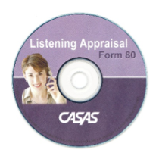

ADMINISTERING THE LISTENING APPRAISAL
Life & Work Listening Form 80L
Paper-based
ESL only
30 minutes
Life & Work Listening 89L
Computer-based
10-14 minutes
Leads seamlessly into the appropriate pretest

Slide 18
ADMINISTER THE LISTENING APPRAISAL
Testing materials needed
  Answer sheets (purchased or school-made)
  CD and CD player
  Number 2 pencils with erasers
Before Testing
  Locate START and PAUSE buttons on CD player. If necessary to briefly pause CD, use the PAUSE button, not the STOP button. (The STOP button will reset CD back to the beginning.)
  NOTE: You can only pause the CD when you hear a BEEP. The purpose for pausing at the beep is to check for understanding and make sure that everyone is in the right place.
  DO NOT replay any test question on the CD or read the scripts instead of playing the CD.

Slide 19
Administer the LISTENING Appraisal
There are no test booklets for the Listening Form 80 appraisal.
Point out the location of the box on the answer sheet for answering the practice items.
Take the time to have everyone answer the practice items, then discuss and help as needed.
Advise students to do their best and keep up with item numbers.
  Don’t guess.
  Stop when you can’t answer any more questions.
  Walk around the room to check students’ work.
As you proctor, note that students are on the correct item.
Notes:
Ask participants “Why?” to most of these instructions – don’t assume they know or understand the importance of each

Slide 20
ADMINISTER THE FORM 80 LISTENING APPRAISAL
Giving the Test
  Start the CD. Every time you hear a beep, pause (not stop) the CD.
  Part 1, questions 1-11 – All items will be repeated twice
  Part 2, questions 12-26 – All items will be said only 1 time.
Sample Item from Part 1 (This in not printed for the student, only said aloud on CD.)
  How many children does the man have?
    (Woman): How many children do you have?
    (Man): Three. . .two boys and one girl.
  How many children does the man have?
    A. One
    B. Two
    C. Three

Slide 21
Scoring the Appraisal
and
Determining the Pretest
(Using Next Assigned Test Charts)
M
Notes:
Paper-based tests

Slide 22
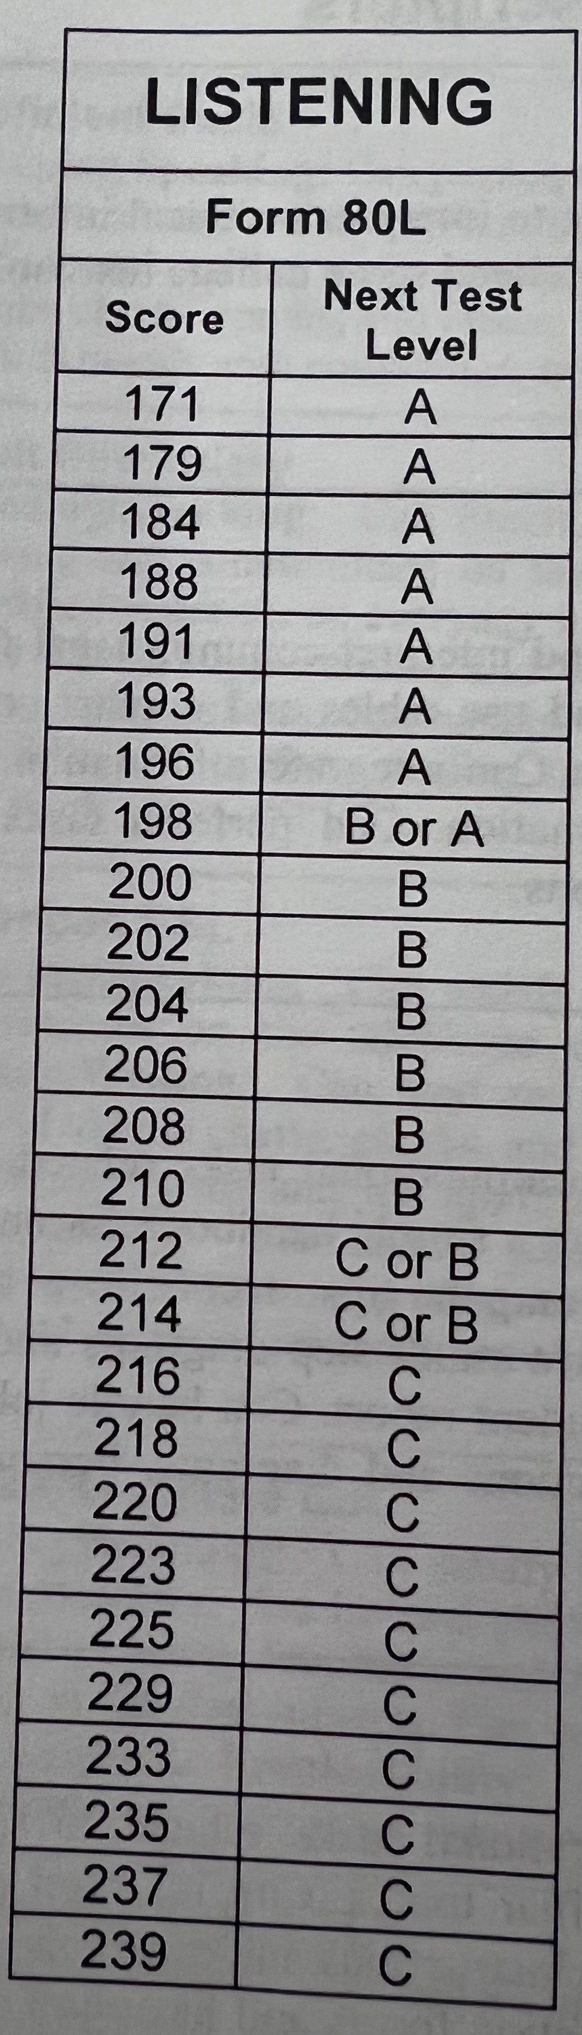
After the Listening appraisal
Pick up all answer sheets
Check to ensure that names are complete and answers are clearly marked
Score the tests
Use the “Next Assigned Test” charts to determine appropriate pre-test to administer

Slide 23
Administering the Form 980 Listening Pretest
Level A – Forms 981 and 982
49 minutes
Part 1 – has a test booklet with colorful pictures
Parts 2 and 3 – no booklet, only listen
All items are repeated twice

Slide 24
Administering the form 980 Listening Pretest
Level B – Forms 983 and 984
52 minutes
No booklets, only listening
Parts 1 and 2 – items are repeated twice
Part 3 – items are said only one time

Slide 25
Administering the form 980 Listening Pretest
Level C – Forms 985 and 986
51 minutes
No booklets, only listening
All 3 Parts – items are said only one time

Slide 26

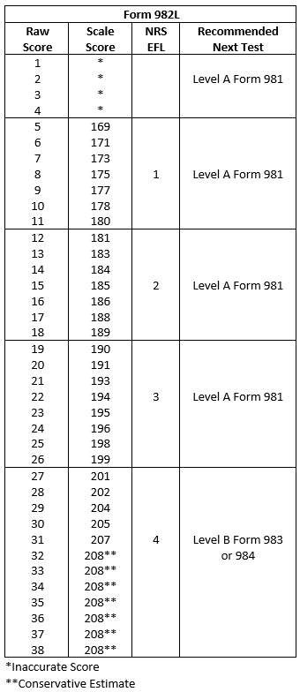
Is it a Valid score?
(*) Inaccurate Score – no score, redo with a lower test form
Mid-range scores (no stars) – valid
(**) Conservative Estimate – cannot be reported in SiD

Slide 27
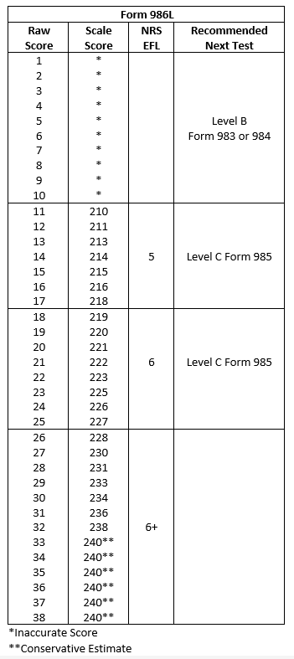
What Do You Need to Know About Post-testing?
Only after 40 or more hours of instruction.
Use the Next Assigned Test chart found in the Test Administration Manual (TAM) to determine the appropriate post-test.
  You must always give a different form than the previous test administered (even if it’s been years).
Ask “Can the learner get a level gain with the same level test as the pretest?”
  If not, it is best to administer a test from the next higher level
Once a student scores >227 on a posttest
  Student will be marked as “Completed ESL” in listening
  No more listening testing needed

Slide 28
CASAS Listening Test Results
Instructional Considerations
M

Slide 29
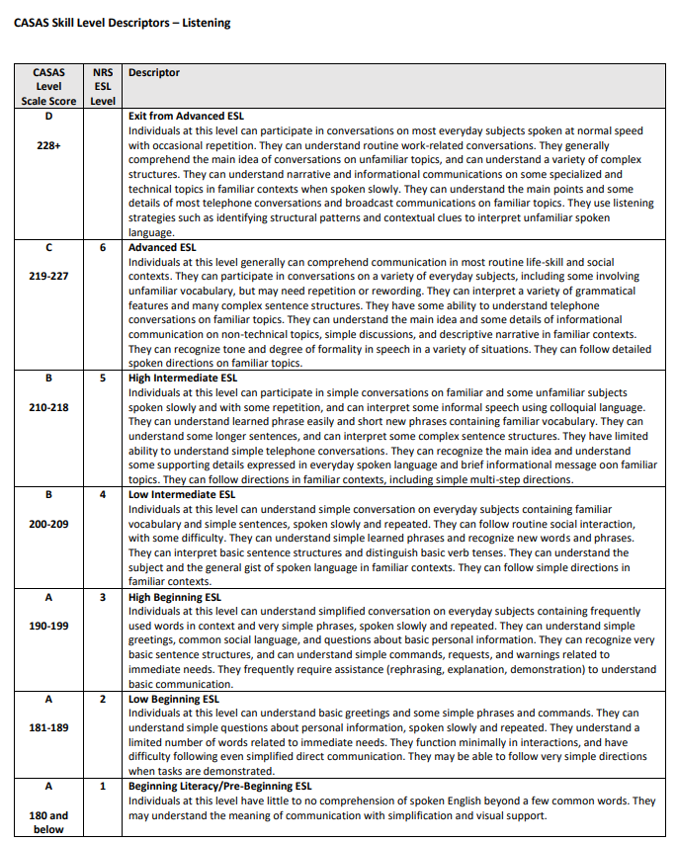
CASAS Skill level descriptors - Listening

Slide 30
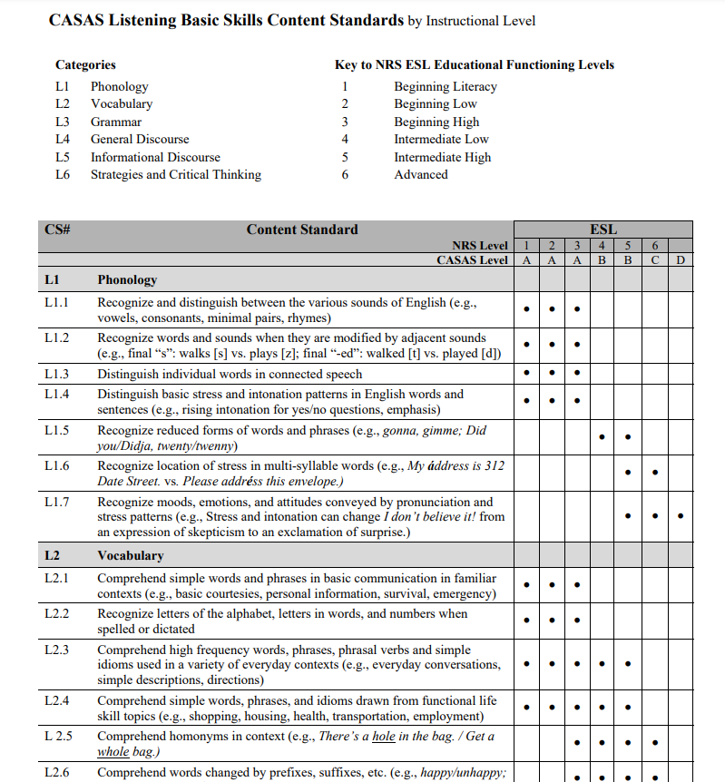
CASAS Listening Basic skills content standards
https://www.casas.org/docs/research/listening-content-standards.pdf?sfvrsn=b2d02338_3?Status=Master

Slide 31
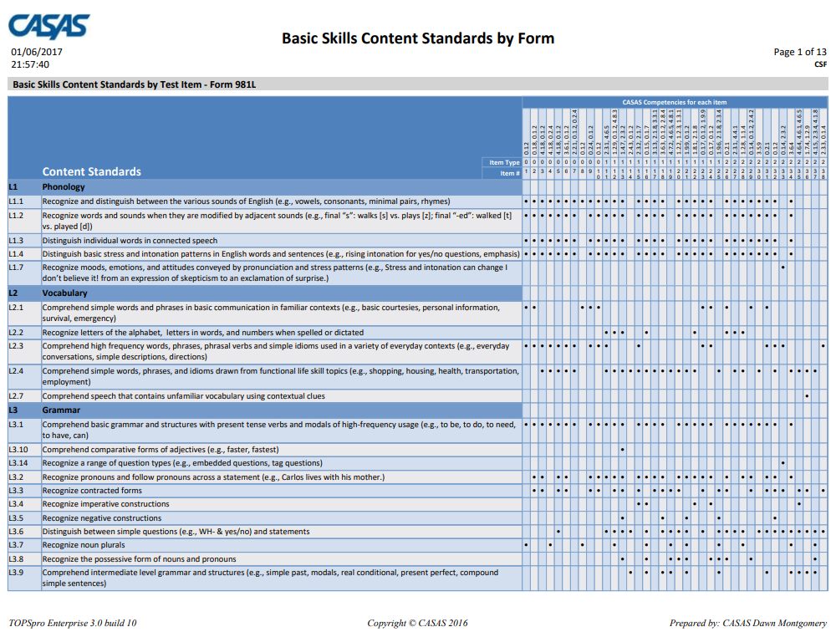
BASic skills content standards https://www.casas.org/docs/default-source/pagecontents/life-and-work-listening-980-series---basic-skills-content-standards-by-form.pdf?sfvrsn=339f8a70_12?status=master
CASAS Competencies
Test Item #

Slide 32
Life and work listening sample test items https://www.casas.org/product-overviews/curriculum-management-instruction/sample-test-items/life-and-work-listening
CASAS Competencies
Use Sample Test Items to:
Familiarize students with CASAS items
Give students practice in taking a CASAS test
Make future testing go more smoothly
Help reduce student test-taking anxiety
Sample Test Booklets
Level A
Level B
Level C
ETest Sampler
https://casasportal.org/eTests

Slide 33
listening Skills practice
ESOL Listening Practice Tests (by level)
  https://www.seminolestate.edu/els/pett/listening
Listening and Dictation Project
  https://www.seminolestate.edu/els/listening-and-dictation
10 Awesome Activities to Improve Intermediate ESL Students’ Listening
  https://www.fluentu.com/blog/educator-english/esl-listening-activities-intermediate/
Randall’s ESL Cyber Listening Lab
  https://www.esl-lab.com/
ESL Listening Activities, Games, Worksheets, and Lesson Plans
  https://www.eslactivity.org/english-listening-tip/

Slide 34

Going live! Checklist
First Steps
M

Slide 35
“Going Live” Checklist
Prior to beginning online CASAS testing, you must complete the checklist found at:
  https://www.casas.org/product-overviews/software/casas-etests/-going-live-checklist

Slide 36
Getting Started with casas eTests
Online, interactive training provided by Elizabeth Scheib, CASAS
Tuesday, February 8, 1:00-3:00 p.m.
Via ZOOM - https://zoom.us/j/93744226770?pwd=TUh6NCtHa0ZJQWFJZHRaOEhZRlZvUT09

Slide 37
Questions?

