Slide 1
Tools to Aid Instruction – Beginning Literacy ESL
Marty Olsen
February 5, 2011
martha.olsen@gmail.com
www.mnabeassessment.com

Slide 2
Objectives
Discuss characteristics of a Beginning Literacy ESL learner
Discuss specific skills that should be addressed at Beginning Literacy ESL level
Review tools CASAS provides to aid teachers in lesson-planning
View sites online that provide lesson plans or other tools that can be used to address specific CASAS competencies
View sites online that students can use to build the skills they need for the CASAS tests

Slide 3
Diverse Adult Learner Profiles
Rosa is a young mother in an ESL class in a family literacy program. She has three small children, whom she brings to the child care program. Rosa has been in the country for one year. Her ESL class has been running for a month, and the students are progressing slowly. Rosa wants to learn, but she attends class infrequently. She does not drive and so depends on family members for a ride, and she often is not able to bring one or more of the children because of illness. She understands no English, and another student translates for her. She has mentioned several times that she has no time to do any of the exercises outside of class.
Mohammed is 17 years old and has been in the country for six months. He is not enrolled in high school, because he needs to help his mother support their family of five, and he has two jobs. He finished elementary school in Iraq and can read and write in his native Arabic. He is learning to understand and speak a little English on the job, but he can read next to nothing in English.
Ibrahim is 60 years old and has come to the United States from Somalia, where he was a businessman and a tribal leader. He can read and write in his native language and in Italian. His refugee benefits have run out, and he has to work to help support his family. He is embarrassed about being in a beginning-level class, and he does not like to work in groups with women. When he speaks, he wants the teacher to correct everything he says.
Source: Practitioner Toolkit: Working With Adult Language Learners

Slide 4
Q: What do Beginning Literacy ESL Level Students have in common?
A: CASAS test scores below 180
Q: What variables do we see in Literacy Level Students?
A: Some cannot speak or understand English, or understand only isolated words or phrases
A: May speak some English, but have limited reading and writing skills in English
A: May have no or minimal reading or writing skills in any language – may have little or no comprehension of how print corresponds to spoken language – may have difficulty using a writing instrument
A: May have education in first language, but no previous instruction in English

Slide 5
Levels of Literacy
Pre-Literate
Oral tradition, first language not written
Holding a pen or opening a book are new exercises
Teaching: focus on oral skills, then transition into reading and writing
Non-Literate
Written language in home country but the student has little or no exposure to literacy in their first or second language
Teaching: emphasize the connection between spoken and written language
Semi-Literate
Limited schooling in their own language
Teaching: help students become confident in their literacy skills
Non-Roman Alphabet Literate
Speak and are literate in a language that is written with a different script.
Can transfer skills from one language to another even if the script is completely different.
Roman Alphabet Language Literate
Are literate in a language written in a Roman alphabet script
Read from left to right and recognize letter shapes and font

Slide 6
Different Strategies for Different Learners
Literate Learners | Non-literate Learners
Learn from print | Learn by doing or watching
Tend to be visually-oriented | Tend to be aurally-oriented
Make lists to remember | Repeat to remember
Spend years learning to read | Have limited time for learning to read
Know they can learn | Lack confidence in their learning ability
Learn best when content is relevant to their lives | Learn best when content is relevant to their lives
Can distinguish between important and less important print | May accept all content as being of equal value

Slide 7
Strategies: A Beginning
Needs Assessment – Can students. . .
Hold a pen?
Write names in English?
Make letter sounds?
Identify basic sight words?
Copy simple sentences?
Read simple sentences?
Begin with listening and speaking
Start with real words (meaningful to students)
Teach word-attack skills (phonics)
*“A Taxonomy of Strategies for Adult Non-literate Learners”, Alysan Croydon

Slide 8
Review of CASAS Tools
Class Profile by Competency
Test Review
QuickSearch
Linking Document (Links competencies in tests to lessons online)
Sample Test Items – Level A (for use when transitioning from Forms 27/28 to 81/82)

Slide 9
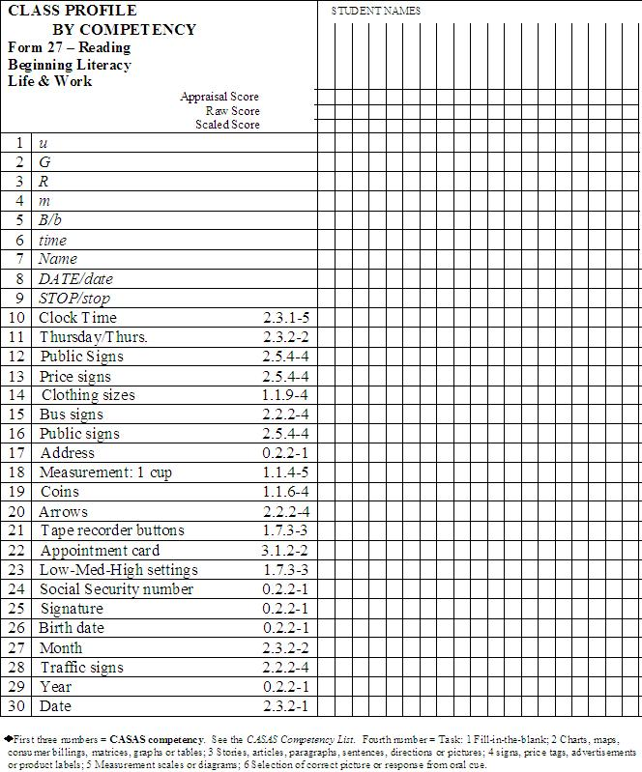
Review of CASAS Tools
Class Profile by Competency
Test Review
QuickSearch
Linking Document (Links competencies in tests to lessons online)
Sample Test Items – Level A (for use when transitioning from Forms 27/28 to 81/82)

Slide 10
Review of CASAS Tools
Class Profile by Competency
Test Review
QuickSearch
Linking Document (Links competencies in tests to lessons online)
Sample Test Items – Level A (for use when transitioning from Forms 27/28 to 81/82)

Slide 11
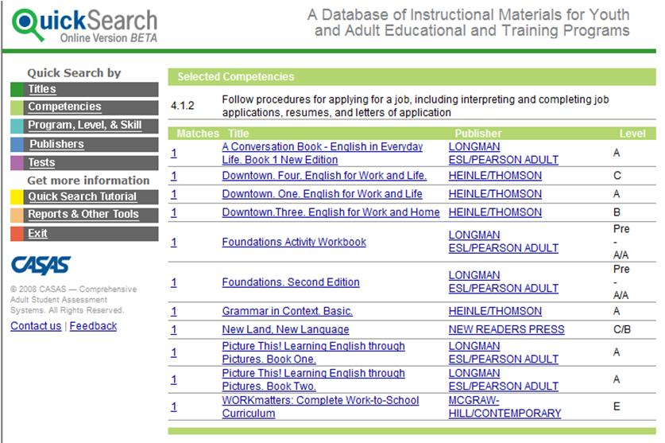
Review of CASAS Tools
Class Profile by Competency
Test Review
QuickSearch
Linking Document (Links competencies in tests to lessons online)
Sample Test Items – Level A (for use when transitioning from Forms 27/28 to 81/82)
www.casas.org >> Products and Services >> QuickSearch

Slide 12
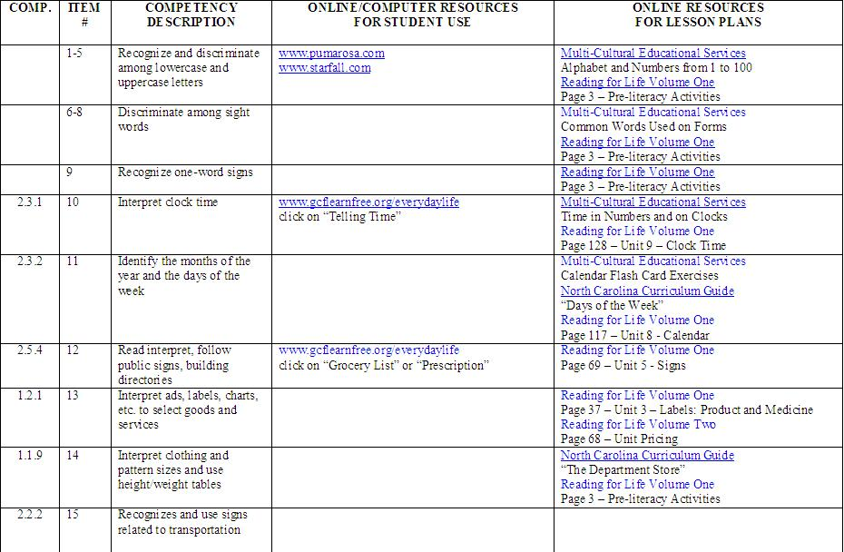
Review of CASAS Tools
Class Profile by Competency
Test Review
QuickSearch
Linking Document (Links competencies in tests to lessons online)
Sample Test Items – Level A (for use when transitioning from Forms 27/28 to 81/82)
http://www.mnabeassessment.com/competency_links.html

Slide 13
Review of CASAS Tools
Class Profile by Competency
Test Review
QuickSearch
Linking Document (Links competencies in tests to lessons online)
Sample Test Items – Level A (for use when transitioning from Forms 27/28 to 81/82)
https://www.casas.org/home/index.cfm?fuseaction=home.showContent&MapID=3229

Slide 14
Alphabet/Phonics – Free Printables
Lanternfish ESL ABCs
http://bogglesworldesl.com/abcs.htm
CVC Words Flashcards
http://bogglesworldesl.com/phonics/cvc_wordcards.htm
Flashcards of High Frequency Words
http://www.emteconline.com/rliteracy/alphabet/highFrequency/Yr1-2FlashComplete.pdf
Phonics – We All Can Read
http://www.weallcanread.com/English_as_a_Second_Language_Phonics_Instruction.html

Slide 15
Vocabulary-Building Activities
Vocabulary knowledge has been found to have a strong effect on reading comprehension
Teach vocabulary that learners will need to use often (high-frequency vocabulary).
Teach key sight words that learners will need, such as emergency, 911, last name, first name, especially when learners are at beginning literacy levels.
Provide multiple opportunities for learners to read and use specific words in different texts and activities that are thematically related, such as the following:
o Brainstorm vocabulary on a specific topic, such as food shopping.
o Practice food vocabulary with flash cards.
o Practice dialogues in which food vocabulary is used (e.g. “I am going shopping.” “What do you need?” “I need bread, beans, and chicken.”)
o Make a shopping list of items they need to buy.
o For homework, copy food words from packages.

Slide 16
Teaching Resources
Adult ESL Training Videos
http://www.newamericanhorizons.org/training-videos
“Making It Real: Teaching Pre-literate Adult Students”
http://literacynow.info/page.aspx?hid=152
“Pre-literate Curriculum” (available on CD) http://www.themlc.org/techgrants
“Listening and Speaking Activities for Adult Learners”
http://www.cde.state.co.us/cdeadult/download/pdf/ListeningSpeakingCorrelatedBESTPlusCASAS.pdf
“Practitioner Toolkit: Working with Adult English Language Learners” http://www.cal.org/CAELA/tools/program_development/CombinedFiles1.pdf

Slide 17
Developing Communication Skills
Following vocabulary instruction, students can be encouraged to recognize and practice vocabulary through the use of pictures depicting familiar activities/vocabulary.
Listening and speaking skills can be developed by asking and answering questions.
On the next slide are examples of questions generated for different communication levels:

Slide 18
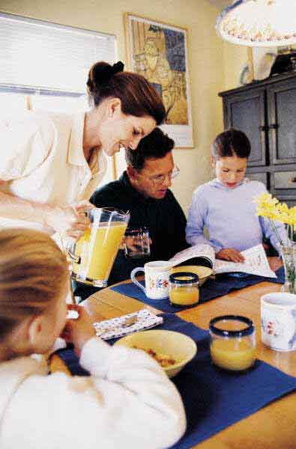
Is this the mother?
Is the father sitting or standing?
In your house, who does the cooking?
Is the mother eating?
Where was the mother before?
What do you eat for breakfast?
Are they in the kitchen or in the living room?
Where do you like to eat?
What is on the table?
Who likes orange juice?
Is there food on the table?
What questions does this picture generate?
Which questions are the easiest to answer?
How does the father feel?
Is there a spoon on the table?
Who is cooking, the mom or the dad?
How many people are in your family?
What is on the table?

Slide 19
Yes/No Questions – The easiest to answer
Is this the mother?
Is the juice on the table?
Is there a glass on the table?
Is it morning?

Slide 20
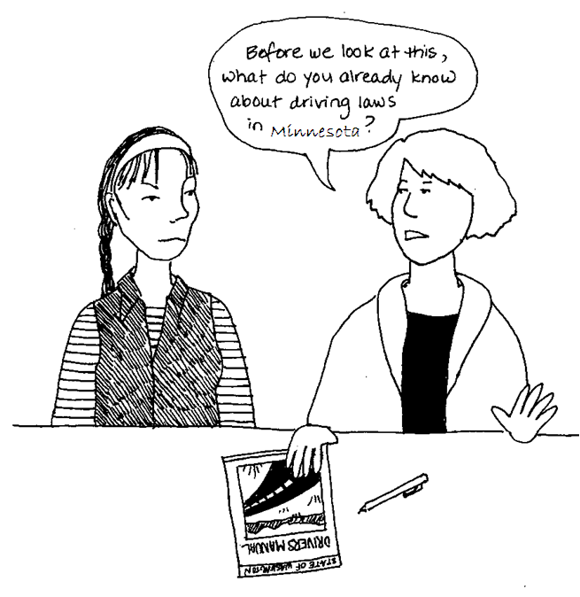
Why?
Often, English Language Learners understand more language than they can produce.
So, the easiest questions are those that require the least language response.

Slide 21
The Question Hierarchy
Can guide your choices when working with adults learning English
YES/NO QUESTIONS
EASIER
EITHER/OR QUESTIONS
WH– QUESTIONS
PERSONAL QUESTIONS
HARDER
OPEN ENDED QUESTIONS

Slide 22
We’ve already seen examples of yes/no questions from the visual, now let’s look at other levels.

Slide 23
Either/or – Choice Questions
Are they in the kitchen or in the bedroom?
Who is cooking, the mother or the father?
Does the mother have long or short hair?
Is the father sitting or standing?

Slide 24
Wh-Questions – For getting factual information
What is on the table?
Who is drinking orange juice?
How many people are in the kitchen?

Slide 25
Personal Questions
How many people are in your family?
In your house, who does the cooking?
Who works in your family?
Where do you study?

Slide 26
Open-ended, interpretative questions – The most difficult to answer
Where was the mother before?
How does the mother feel?
What is going to happen next?

Slide 27
Meaningful interaction and natural communication in the target language are necessary for successful language acquisition.
Learners need to use the language, not simply talk about it.
Give learners opportunities and purposes for communication that reflect or relate to their lives.
Use authentic materials in activities whenever possible
*“Beginning to Work with Adult English Language Learners: Some Considerations” – Mary Ann Cunningham Florez and Miriam Burt, National Center for ESL Literacy Education

Slide 28
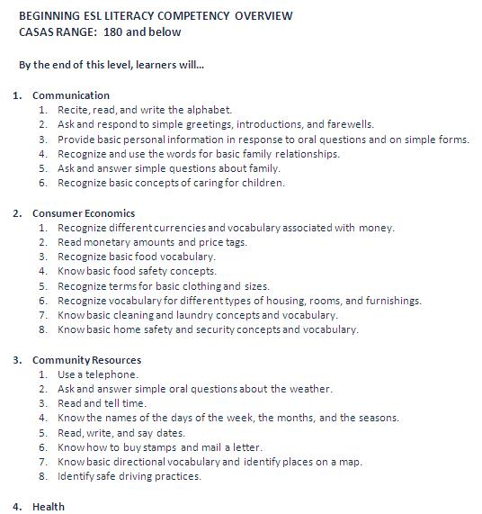
Suggested Instructional Themes http://www.marshalladulteducation.org/scope-a-sequence

Slide 29
Skills that should be addressed at the Beginning ESL Literacy Level
“Picture Literacy”
Ability to recognize pictures is taken for granted
Assumption that non-verbal visual images are a universal language
The viewer must know certain conventions
We can help our students by following a systematic approach

Slide 30
Picture Literacy
Realistic drawing of an orange
Stylized color drawing
Black and white stylized drawing
Photo of real orange

Slide 31
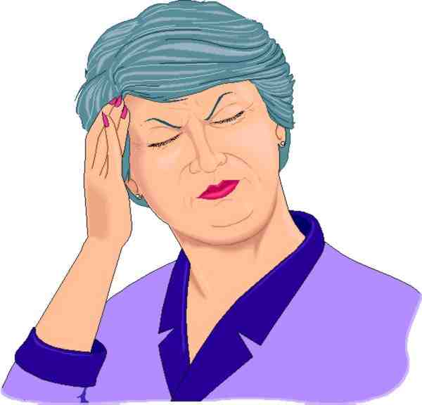
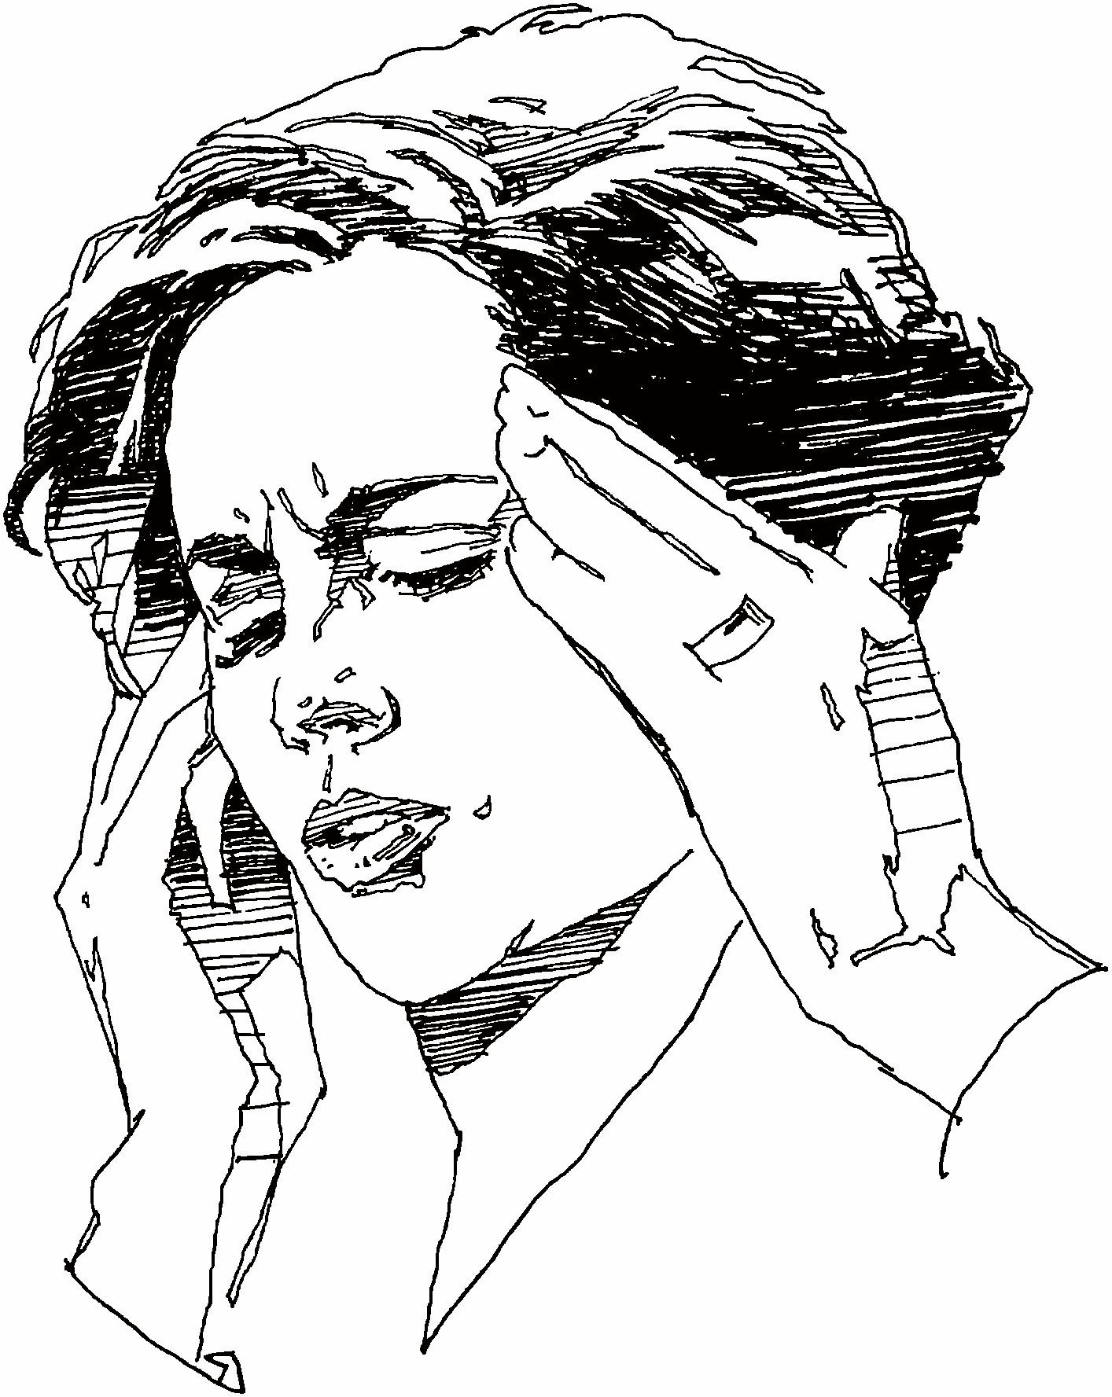
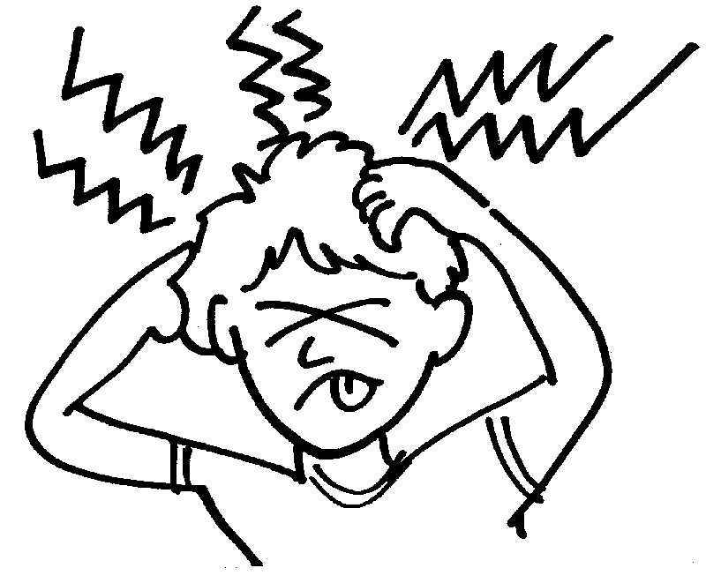
Picture Literacy
Photo of person with a headache
Color drawing of a person with a headache
(Do her eyes hurt?)
Black and white drawing of a person with a headache (What’s wrong with her hands?)
Stylized drawing of a person with a headache (Discuss the meaning of the strange squiggly lines.)

Slide 32
Resources Linked to Forms 27 and 28
Reading for Life – Volume One http://www.mnliteracy.org/sites/default/files/reading_for_life_volume_one.pdf
Unit 1: Pre Literacy Activities
Unit 5: Signs
Unit 8: Calendar
Unit 9: Clock Time
Reading for Life – Volume Two http://www.mnliteracy.org/sites/default/files/reading_for_life_volume_two.pdf
Unit 13: Coins and Currency
Page 68: Unit pricing
Page 49: Measurement

Slide 33
Resources linked to Forms 27 and 28
Multi-Cultural Educational Services http://www.mcedservices.com/PDFs.html
Alphabet and Number Flashcard Exercises
Calendar Exercises
Phonics Exercises
North Carolina Curriculum Guide http://www.nc-net.info/ESL/guide.php
Unit: Time
Unit: The Calendar
Unit: Buying Clothing
EL/Civics Education http://www.nc-net.info/ESL/Caldwell/year1.php
Address
Count and Use Currency
Date of Birth
Name
Phone Numbers

Slide 34
Targeted Online Activities for Student Use
Starfall http://www.starfall.com/
Minneapolis ABE – ELL 0 Activities (http://ell-level0.themlc.org/)
johnmh.com (http://johnmh.com/ILA/28ILA.doc)
Marshall Adult Education – Student Lessons (http://www.marshalladulteducation.org/student-lessons)
Adult and Family Education (http://www.web-esl.com/)
English-On-The-Web (www.english-on-the-web.yolasite.com)

Slide 35
Presentation Resources
“A Taxonomy of Strategies for Adult Non-Literate Learners” – Alyson Croydon of TESOL http://www.schooloftesl.com/publications/Alyson_WAESOL10.pdf
“Beginning to Work with Adult English Language Learners: Some Considerations” – Mary Ann Cunningham Florez and Miriam Burt, National Center for ESL Literacy Education http://resources.marshalladulteducation.org/pdf/briefs/Beginning%20to%20Work%20with%20Adult%20English%20Language%20Learners.pdf
Literacy Network of Washington
http://literacynow.info/Page.aspx?nid=58
Practitioner Toolkit: Working With Adult Language Learners
http://www.cal.org/CAELA/tools/program_development/CombinedFiles1.pdf

