Slide 1
Tools to Aid Instruction – Advanced ESL
Marty Olsen
February 5, 2011
martha.olsen@gmail.com
www.mnabeassessment.com

Slide 2
Objectives
Review tools CASAS provides to aid in instruction
Discuss research-based suggestions for teaching reading to advanced ESL learners
Review online resources for teachers
View online activities targeted to assist students in preparing for the CASAS test

Slide 3
Quick review of CASAS tools
Class Profile by Competency
CASAS QuickSearch
CASAS Content Standards
Look at the test items
Competency Linking Document
Sample Test Items – Level C
Form 187 (Level D)

Slide 4
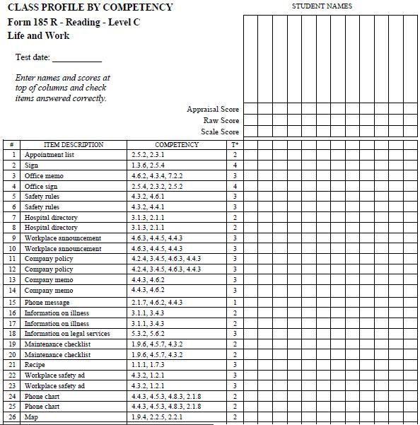
Quick review of CASAS tools
Class Profile by Competency
CASAS QuickSearch
CASAS Content Standards
Look at the test items
Competency Linking Document
Sample Test Items – Level C
Form 187 (Level D)

Slide 5
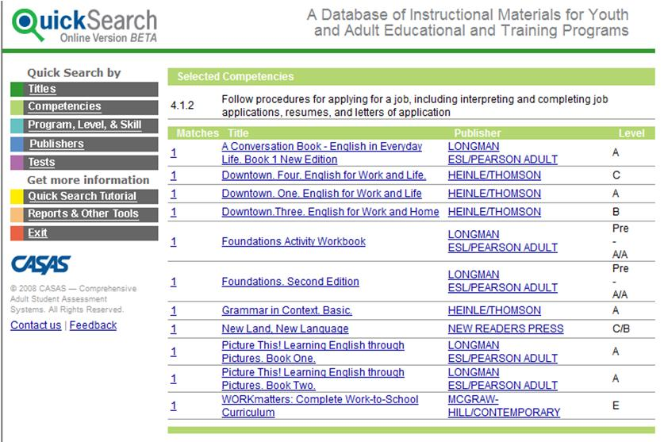
Quick review of CASAS tools
Class Profile by Competency
CASAS QuickSearch
CASAS Content Standards
Look at the test items
Competency Linking Document
Sample Test Items – Level C
Form 187 (Level D)
www.casas.org >> Products and Services >> QuickSearch

Slide 6
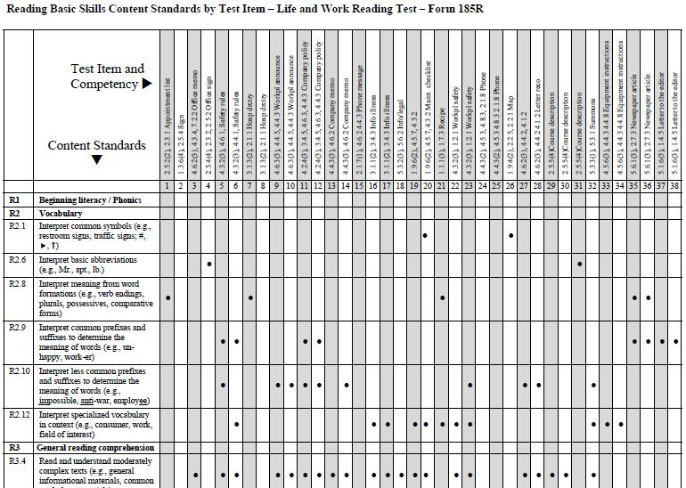
Quick review of CASAS tools
Class Profile by Competency
CASAS QuickSearch
CASAS Content Standards
Look at the test items
Competency Linking Document
Sample Test Items – Level C
Form 187 (Level D)
www.casas.org >> Research and Reports >> Content Correlations >> Basic Skills Content Standards

Slide 7
Quick review of CASAS tools
Class Profile by Competency
CASAS QuickSearch
CASAS Content Standards
Look at the test items
Competency Linking Document
Sample Test Items – Level C
Form 187 (Level D)

Slide 8
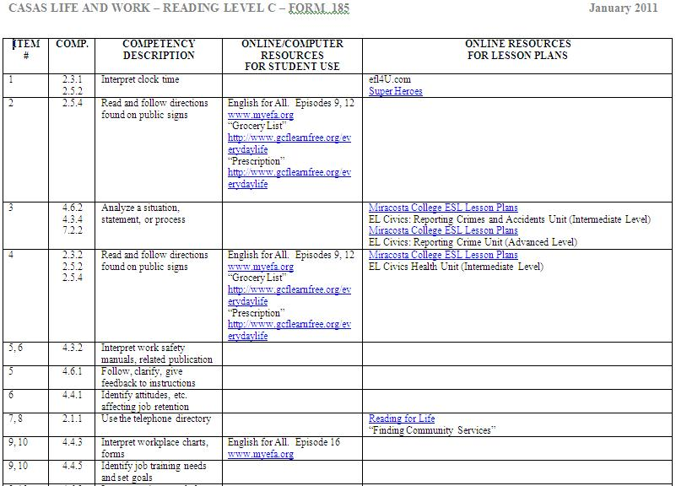
Quick review of CASAS tools
Class Profile by Competency
CASAS QuickSearch
CASAS Content Standards
Look at the test items
Competency Linking Document
Sample Test Items – Level C
Form 187 (Level D)
www.mnabeassessment.com/competency_links.html

Slide 9
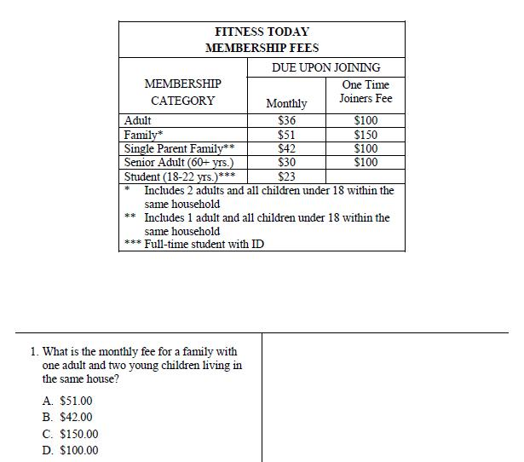
Quick review of CASAS tools
Class Profile by Competency
CASAS QuickSearch
CASAS Content Standards
Look at the test items
Competency Linking Document
Sample Test Items – Level C
Form 187 (Level D)
www.casas.org >> Products and Services >> Sample Test Items >> Life and Work Reading Sample Test Items

Slide 10
Quick review of CASAS tools
Class Profile by Competency
CASAS QuickSearch
CASAS Content Standards
Look at the test items
Competency Linking Document
Sample Test Items – Level C/Level D
Form 187 (Level D) – a suggestion!

Slide 11
How Should Adult ESL Reading Instruction Differ from ABE Reading Instruction? Miriam Burt, Joy Kreeft Peyton, and Carol Van Duzer Center for Adult English Language Acquisition
Vocabulary – ESL Learners have:
Difficulty learning in semantic sets (colors, foods, furniture, days of the week)
Difficulty getting meaning from context
Instruction should:
• Limit the number of vocabulary items that must be pre-taught, select reading passages that are only slightly above what learners can read independently.
• Provide learners with multiple exposures to specific words in multiple contexts.
• Encourage learners to use both monolingual and bilingual dictionaries.
• Encourage learners to use word cards – notes cards with the English words on one side and the translation on the back – and to study them frequently.
• Encourage vocabulary learning through regular tests where students can prove receptive knowledge of words through matching words to definitions or multiple choice exercises.
• After reading, have students write sentences in which they use specific words and grammatical forms.

Slide 12
Direct Vocabulary Teaching: Does it Work With Advanced ESL Students? Rita Ray – Eagan
“What happens to vocabulary scores of advanced ESL learners when I provide direct vocabulary instruction?”
Process:
1-1/2 hours a week for six weeks
Provided instruction in base words and affixes
Results: Scores on CASAS tests increased by an average of 8 points. Vocabulary test scores increased.

Slide 13
How Should Adult ESL Reading Instruction Differ from ABE Reading Instruction? Miriam Burt, Joy Kreeft Peyton, and Carol Van Duzer Center for Adult English Language Acquisition
Reading Comprehension – for ESL Learners
Cultural issues may impede understanding
Ability to summarize what was read difficult if understanding is limited
Instructor should:
• Find out what students know, need to know, and want to know and then build on ideas and concepts from learners’ cultures and experiences whenever possible. Select readings on topics they may be most familiar with.
• Pre-teach vocabulary and preview unfamiliar ideas, actions, vocabulary, and settings as well as titles, pictures, graphics, text structure, and discourse markers (e.g., words such as “first” or “next”).
• Use visual aids and physical objects to help learners build background knowledge.
• Assess learner comprehension through short answers, cloze exercises, and summary writing only after pre-teaching vocabulary, previewing cultural contexts, and discussing the text.

Slide 14
“Sustained Silent Reading and Comprehension” Liv Musel-Staloch – Mankato ABE
“What happens to reading comprehension and the ability to independently incorporate successful methods when I teach comprehension skills and provide daily sustained silent reading using materials in contexts that are learner-driven?”
Process: (Advanced class, January to May, 4 days a week)
Instruction in reading comprehension strategies – making inferences and predictions, posing content questions (who, what, where, when, why, how), identifying main idea, subject matter, supporting details, clarifying, drawing conclusions, vocabulary) – 45 minutes
Sustained silent reading (students’ choice) – 30 to 45 minutes
Journal writing – reflecting on reading – 20 minutes
Findings:
Completed group (avg 91.8 hrs) – avg 19.6 point gain in CASAS scores
Early Exit group (avg 74 hrs) – avg 6.8 point gain in CASAS scores

Slide 15
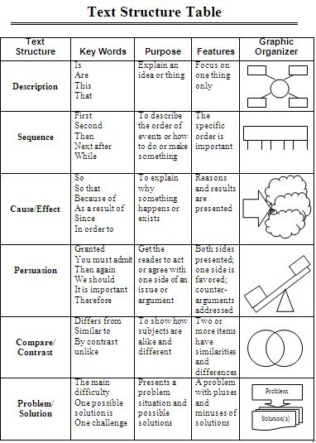
Graphic Organizers

Slide 16
Sites for Reading Resources
Breaking News English
http://www.breakingnewsenglish.com/
Heads Up English
http://www.headsupenglish.com/
Learning Resources (A project of Literacyworks)
http://www.literacynet.org/cnnsf/
Reading Skills for Today’s Adults
http://www.marshalladulteducation.org/reading-skills-for-todays-adult
100 free Short English Stories for ESL Learners
http://www.rong-chang.com/qa2/

Slide 17
Reading Comprehension: Do they understand the questions? By Patricia Schafer, ESL Instructor
“What happens to ELL’s reading comprehension when I teach different question types and strategies for answering them?”
Reading Comprehension problems:
Learners’ lack of vocabulary knowledge led to not recognizing paraphrases of the reading in the answers, even when the question was literal and factual.
They didn’t recognize definitions of terms in the text, and thus missed questions about vocabulary in context.
They didn’t recognize reasons that were not directly stated with a “because”.
They didn’t understand the point of some questions, especially longer, more linguistically complicated ones.

Slide 18
Strategies and Materials:
Taught the English grammar used in questions – used a chapter on questions from Fundamentals of English Grammar 2nd edition (1992) by Betty Azar.
Taught about English sentence structure and which part of the sentence answers the question (for example, the subject answers who or what; prepositional phrases usually answer when, where, or how, etc.)
Explained questions from the reading text before students did the homework, helping them understand the key words and what kind of answer was appropriate.
Second half of semester – re-wrote the reading text’s comprehension questions as multiple-choice quizzes – included some additional questions on main ideas and vocabulary and gave the quizzes at the end of each lesson – spent time going over these quizzes, talking about strategies for finding the right answers and eliminating the wrong ones.
Results:
Average 2 point gain on CASAS by the end of the semester
30% average gain in teacher-made comprehension quiz

Slide 19
How Should Adult ESL Reading Instruction Differ from ABE Reading Instruction? Miriam Burt, Joy Kreeft Peyton, and Carol Van Duzer Center for Adult English Language Acquisition
Fluency
Limit choral reading
Encourage listening to reading, prior to reading alone
Instructional suggestions:
When choral readings are used, select short segments that emphasize English stress and intonation.
When involving learners in oral and choral reading of texts, be certain that they first hear a native-speaker-like model of the reading.

Slide 20
Using “Reading Skills for Today’s Adults” to Help Build Fluency and Comprehension with ESL Students by Celeste Mazur – Lincoln Adult Center, Minneapolis
“What happens to reading comprehension in intermediate level adult ESL students as measured by TABE and fluency measured in words correct per minute when students receive supplemental reading practice that includes fluency instruction?”
Process –
Pre-Reading questions
Silent Reading
Initial timing while reading aloud
Read text three times while listening to it being read
Practice reading text aloud
Answer comprehension questions
Final timing
Graph initial and final WCPM

Slide 21
Findings – after 10 hours of instruction
<1.5% gain on CASAS test
9% gain on TABE test
Finding 1: Reading practice with focused fluency instruction may lead to increased academic reading skills comprehension
Finding 2: Standardized reading scores from tests that assess “life skills” and tests that assess more “academic skills” can vary greatly in adult ESL learners.
Finding 3: Focused fluency instruction on repeated reading and listening while reading can improve reading fluency of adult ESL learners.
What worked? Experimental group said charting, listening-while-reading, reading aloud, and individual pronunciation assistance were helpful.

Slide 22
Effective Ways to Use Authentic Materials with ESL/EFL Students Charles Kelly, Lawrence Kelly, Mark Offner and Bruce Vorland Aichi Institute of Technology, Toyota, Japan
The suggested process:
Students work in pairs
Hand out the “realia” to be examined
Hand out a list of questions to be answered
What types of “realia” are useful?
menus, maps, newspaper inserts, store advertisements, travel brochures, catalogs, phone books, real estate pamphlets, various pamphlets of sightseeing and tourist information, recipes, instructions

Slide 23
Constructing the Questions
Tour Questions
Easy multiple choice or fill-in-the-blank questions to assist students in “touring” the material
Personal Choice Questions
Require students to choose items from the materials based on personal preferences – encourage discussion to defend choices
Challenging Questions
May involve “reading the fine print”, be especially detailed, or involve deductive reasoning – critical thinking questions

Slide 24
Engage the Students with an Author
Make contact with author, prior to reading a selection – make arrangements for author to respond to students via email.
“A Gravestone Made of Wheat”
By Will Weaver
www.willweaverbooks.com
“Sweet Land” (movie of the above story)

Slide 25
Targeted Online Activities for Student Use
ABEWeb – Minneapolis ABE Level 5 https://abeweb.mpls.k12.mn.us/Search.aspx?who=English-Level-5
ABEWeb – Minneapolis ABE Level 6 https://abeweb.mpls.k12.mn.us/Search.aspx?who=English-Level-6
Marshall Adult Education http://www.marshalladulteducation.org/reading-skills-for-todays-adult
johnmh. com – Narrative practice http://johnmh.com/narratives/narratives34.htm
johnmh.com – Form 185/186 Practice http://johnmh.com/ILA/ila185.html
Learning Line www.rmpbs.org/resources/files/education/learningline
California Distance Learning Project http://www.cdlponline.org
GCFLearnFree www.gcflearnfree.org
English-On-The-Web www.english-on-the-web.yolasite.com

Slide 26
Presentation Resources
“Direct Vocabulary Teaching: Does it Work With Advanced ESL Students?”; Rita Ray
http://ltn.themlc.org/sites/bc54ff14-a7d2-4a25-b839-1a392b6d24e4/uploads/Rita_Direct_Vocabulary_Teaching.pdf
“Reading Comprehension: Do they understand the questions?”; Patricia Schafer
http://www.hamline.edu/education/adult/atlas/practitioner_research/Schafer_Patricia-FY0.pdf
“Sustained Silent Reading and Comprehension”; Liv Musel-Staloch
http://ltn.themlc.org/sites/bc54ff14-a7d2-4a25-b839-1a392b6d24e4/uploads/Liv_Musel-Stalochdoc2.pdf
“Using ‘Reading Skills for Today’s Adults’ to Help Build Fluency and Comprehension with ESL Students”; Celeste Mazur
http://ltn.themlc.org/sites/bc54ff14-a7d2-4a25-b839-1a392b6d24e4/uploads/CelesteMazur.pdf
“Effective Ways to Use Authentic Materials with ESL/EFL Students”; Charles Kelly, Lawrence Kelly, Mark Offner and Bruce Vorland
http://iteslj.org/Techniques/Kelly-Authentic.html
“How Should Adult ESL Reading Instruction Differ from ABE Reading Instruction?” Miriam Burt, Joy Kreeft Peyton, and Carol Van Duzer
http://www.marshalladulteducation.org/pdf/briefs2/How_Should_Adult_ESL_Reading_Instruction_Differ_from%20_ABE_Reading_Instruction.pdf

