Slide 1
CASAS Tools to Aid Instruction – Low Beginning Esl
Marty Olsen
June 11, 2010
martha.olsen@gmail.com
www.mnabeassessment.com

Slide 2
Objectives
Review tools CASAS provides to aid teachers in lesson-planning
Discuss specific skills that should be addressed at Low Beginning ESL level
View sites online that provide lesson plans or other tools that can be used to address specific CASAS competencies
View sites online that students can use to build the skills they need for the CASAS tests

Slide 3
How do you prepare your students to take a CASAS test?
Discuss with others around you
Share best practices with entire group

Slide 4
What tools does CASAS provide to assist teachers in preparing their students for a CASAS post-test?

Slide 5
CASAS Competencies
What is a competency?
A competency is a measurable learning objective in a functional life skills context.
Examples:
Interpret medicine labels
Check sales receipts
Competency Content Areas
0. Basic Communication
1. Consumer Economics
2. Community Resources
3. Health
4. Employment
5. Government and Law
6. Math
7. Learning and Thinking Skills
8. Independent Living
Note new Content Area titles.
Download the CASAS Competencies at <www.casas.org>.
Notes:
Note the new Content Area titles for six and seven.

Slide 6
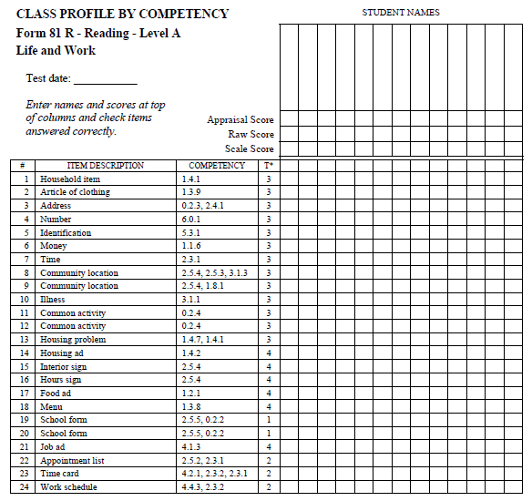
Class Profile by Competency (forms found in your Test Administration Manual)

Slide 7
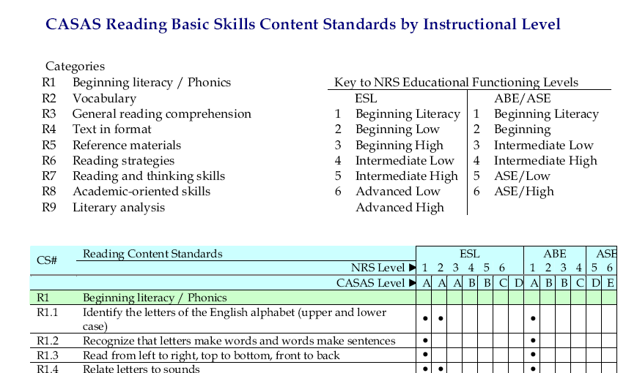
Reading Content Standards
Notes:
Review categories
Review levels and labels
Note that the dot indicates that this skill should be taught at this level
Note similarities between early levels of ESL and ABE

Slide 8
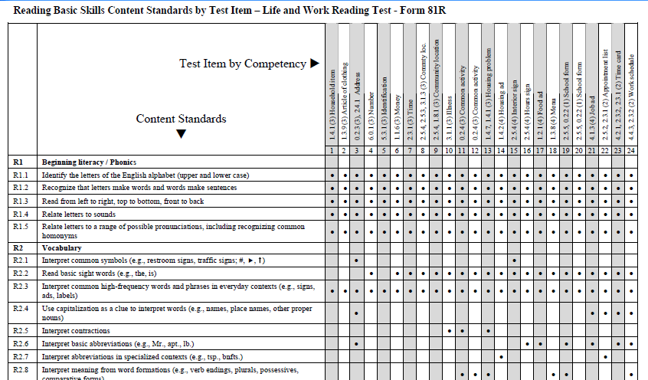
Basic Skills Content Standards by Test Item Correlations

Slide 9
Relationship Between Content Standards and CASAS Competencies

Slide 10
Test Items: Task Areas
Reading Task Areas
Forms
Charts, maps, consumer billings, matrices, graphs, or tables
Stories, articles, paragraphs, sentences, directions, or pictures
Signs, price tags, ads, or product labels
Measurement scales and diagrams
Notes:
Review the purpose of the fourth digit in the competency numbering system. Explain that this item indicates the task area.
Task areas are listed in the Test Administration Manuals and on the bottom of TOPSpro Reports.
Point out that test items can be presented according to a variety of task types
These task areas help to identify additional skills that need to be addressed during instruction
For example: a student may comprehend the language on a test item but not understand the item display, such as a bar chart, graph, or pie chart.
Complete Activity 7.

Slide 11
CASAS Sample Test Items
An instructional tool to:
Familiarize students and teachers with CASAS item types
Practice taking a CASAS test
Practice marking the answer sheet (Can use TOPSpro Test Record)
Sample Reading and Listening test items at Levels A, B, C and D
Five to six test items per level for each skill area
Not a predictor of performance
Download at no cost from www.casas.org
Click on Products and Services >> Test Support Materials >> Sample Test Items for Classroom Use
PowerPoint presentations available for use in the classroom at www.casas.org
Notes:
11
Other sample test items are in development. Check the CASAS Website for updates.

Slide 12
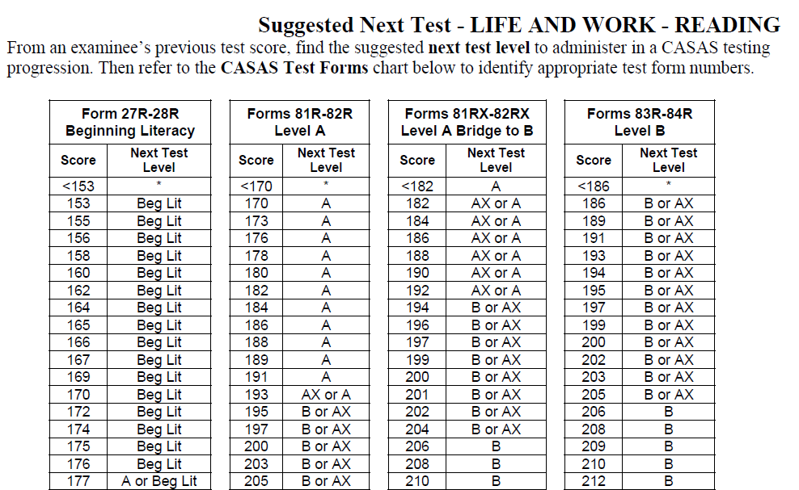
Suggested Next Test Charts

Slide 13
Other Curricula Suggestions
Curriculum adopted by your program (linked to CASAS competencies)
Scope and Sequence (found on www.marshalladulteducation.org website)

Slide 14
CASAS Competency items assessed in Forms 81R and 82R and found in Scope and Sequence
Household item
Article of clothing
Address
Document
Number
Month
Identification
Money
Time
Community location
Illness
Common activity
Housing problem
Housing ad
Interior sign
Hours sign
Traffic sign
Food ad
Menu
School form
Job ad
Appointment list
Time sheet/time card
Work schedule

Slide 15
What skills should be addressed at the Beginning ESL Literacy and Low Beg ESL Levels?

Slide 16
Skills that should be addressed at the Beginning ESL Literacy and Low Beg ESL Levels
“Picture Literacy”
Ability to recognize pictures is taken for granted
Assumption that non-verbal visual images are a universal language
The viewer must know certain conventions
We can help our students by following a systematic approach

Slide 17
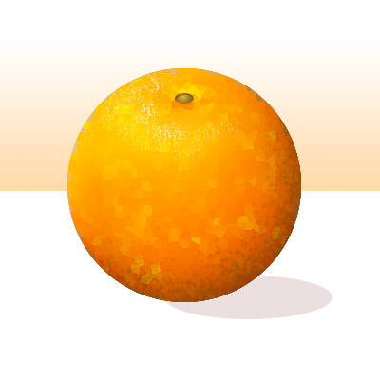
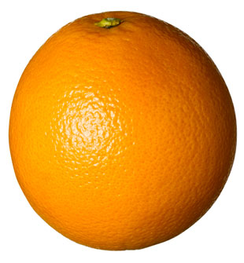
Picture Literacy
Realistic drawing of an orange
Stylized color drawing
Black and white stylized drawing
Photo of real orange

Slide 18
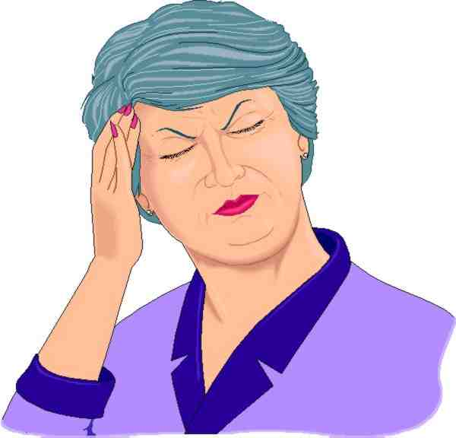
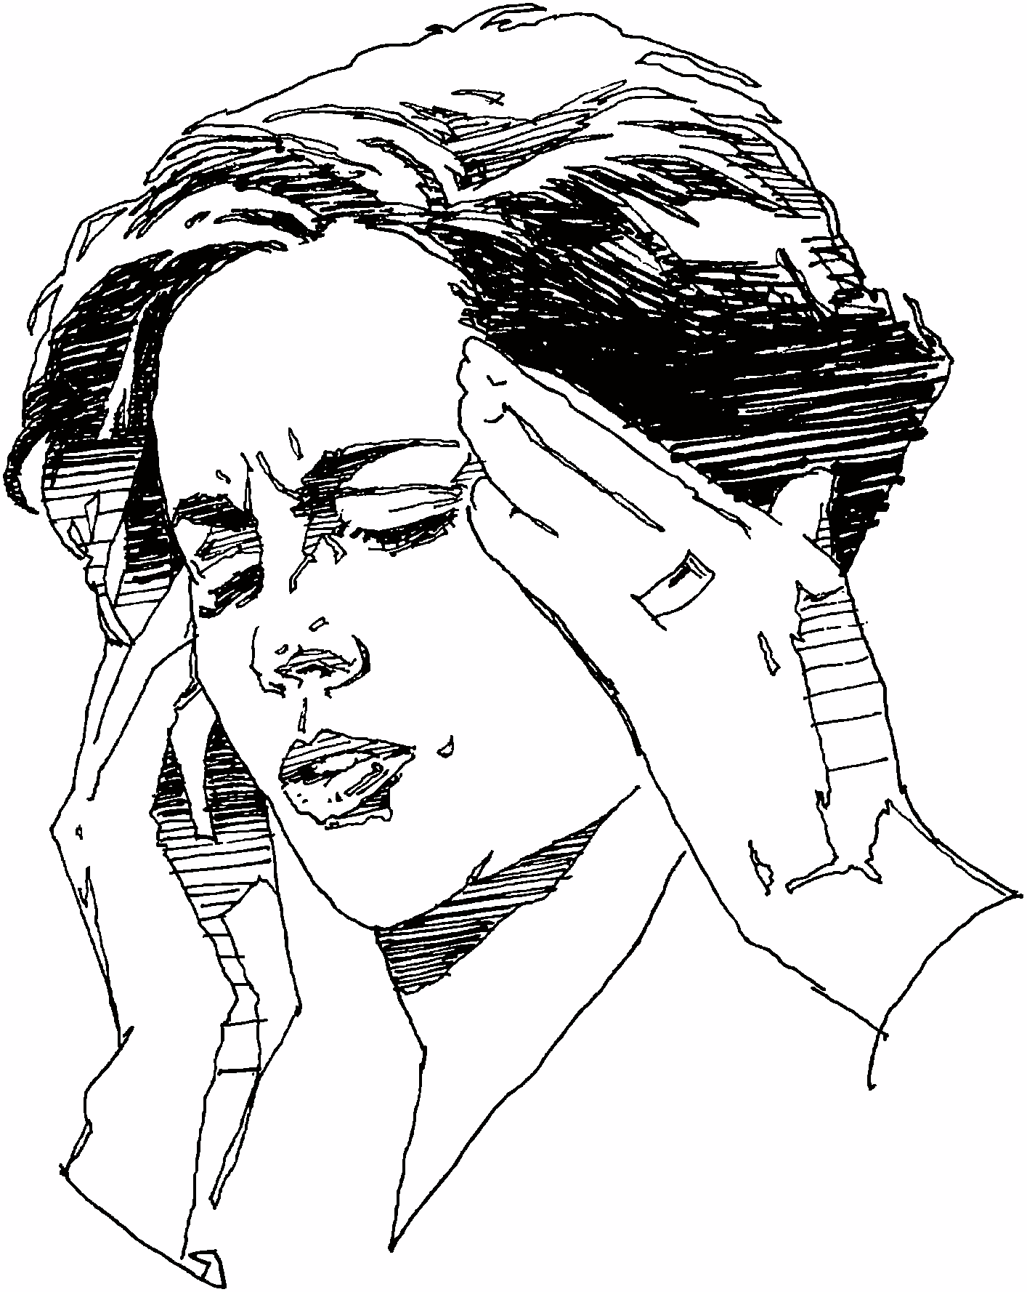
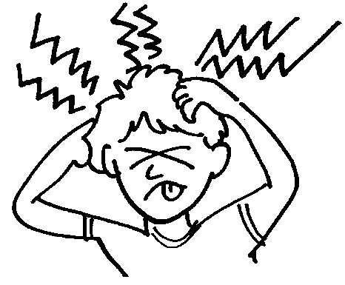
Picture Literacy
Photo of person with a headache
Color drawing of a person with a headache
(Do her eyes hurt?)
Black and white drawing of a person with a headache (What’s wrong with her hands?)
Stylized drawing of a person with a headache (Discuss the meaning of the strange squiggly lines.)

Slide 19
Who? What? Where? How?
How much?
What time?
What can you do?
What can you get?
What’s wrong?
What is she doing?
What’s the problem?
How much?
Which way?
How do you?
Who?
How many?
Where?
What does?
What kind?

Slide 20
Materials Online for Teacher Use
Videos demonstrating best practices in teaching low level ESL learners (http://www.newamericanhorizons.org/training-videos)
Lesson plans linked to competencies (www.mnabeassessment.com/competency_links.html)
CASAS Life & Work – Forms 81R and 82R – Linking documents (www.mnabeassessment.com/competency_links.html)

Slide 21
Materials Online for Teacher Use
Reading For Life (http://www.mnliteracy.org/tools/reading-for-life)
HUBBS EL Civics “Introductions” Unit (http://www.hubbs.spps.org/Introductions_Unit.html)
HUBBS EL Civics “Healthy Living” Unit (http://www.hubbs.spps.org/Healthy_Living.html)

Slide 22
Targeted Online Activities for Student Use
Minneapolis ABE (https://abeweb.mpls.k12.mn.us/)
Marshall Adult Education (http://www.marshalladulteducation.org/student-lessons)
Adult and Family Education (http://www.web-esl.com/)
johnmh.com (http://www.johnmh.com/ILA/ila81r.html)
johnmh.com (http://www.johnmh.com/ILA/ila81rx.html)
Learning Line (www.rmpbs.org/resources/files/education/learningline)
GCFLearnFree (www.gcflearnfree.org)
English-On-The-Web (www.english-on-the-web.yolasite.com)

Slide 23
Lesson Suggestion
For vocabulary practice (after learning vocab)
vocabulary words/pictures on a card.
Divide the room into stations for each category that the vocabulary might be tied to
have the students place themselves in the correct category (e.g. – furniture items place themselves in the correct room; food items place themselves in the correct category on the food pyramid).

Slide 24
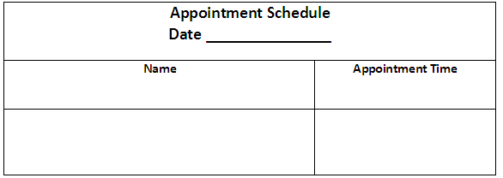
Activity Suggestion
Help students to understand this form by having them schedule appointments with each other for class pair activities.
Language to teach:
“Can you meet at 12:45?
“Yes I can.”
“No, I’m busy. How about 1:00?

Slide 25
Questions?

