Slide 1
Tools to Aid Instruction – CASAS Post-test Prep
Marty Olsen
martha.olsen@gmail.com
February 22, 2014
Marshall ABE

Slide 2
What do you teach?

Slide 3
What do you do to prepare your students to take a CASAS post-test?
Turn to your neighbor and tell them your best ideas!
Share best practices with the group.

Slide 4
Reminder! CASAS is a Standardized Test
Do not review test questions before beginning the testing session.
Students may not use dictionaries or calculators.
Teacher may not read questions to students.
Do not review correct test answers with examinees.
Test materials must be kept in a secure location.
CASAS tests may not be copied, scanned, or duplicated.
Displays, questions, or answers from any CASAS test may not be used to create materials to help students answer CASAS test items.
Proctors must remain in the testing room at all times during the testing event.
Only students taking math tests are allowed to have scratch paper during administration of the assessment. The scratch paper must be collected at the end of test administration and destroyed.
Timing – Pre- and post-tests – no more than one hour

Slide 5
Our task today. . .
Brief overview/review of general instructional practices and websites that you can use to help students succeed
Determine areas that students need to work on, based on previous test results
Find or create lessons that will help your students be better prepared to take a CASAS post-test

Slide 6
Meaningful interaction and natural communication in the target language are necessary for successful language acquisition.
Learners need to use the language, not simply talk about it.
Give learners opportunities and purposes for communication that reflect or relate to their lives.
Use authentic materials in activities whenever possible
*“Beginning to Work with Adult English Language Learners: Some Considerations” – Mary Ann Cunningham Florez and Miriam Burt, National Center for ESL Literacy Education

Slide 7
Beginning Literacy ESL

Slide 8
Skills that should be addressed at the Beginning ESL Literacy Level
“Picture Literacy”
Ability to recognize pictures is taken for granted
Assumption that non-verbal visual images are a universal language
The viewer must know certain conventions
We can help our students by following a systematic approach

Slide 9
Picture Literacy
Realistic drawing of an orange
Stylized color drawing
Black and white stylized drawing
Photo of real orange

Slide 10
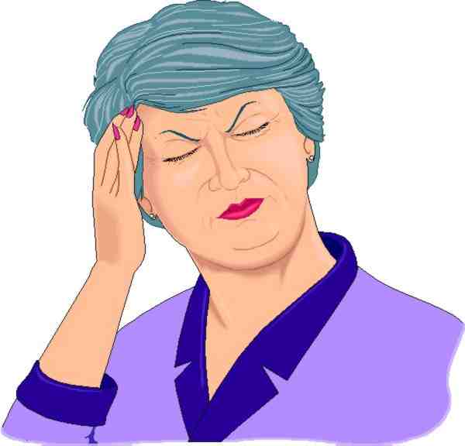
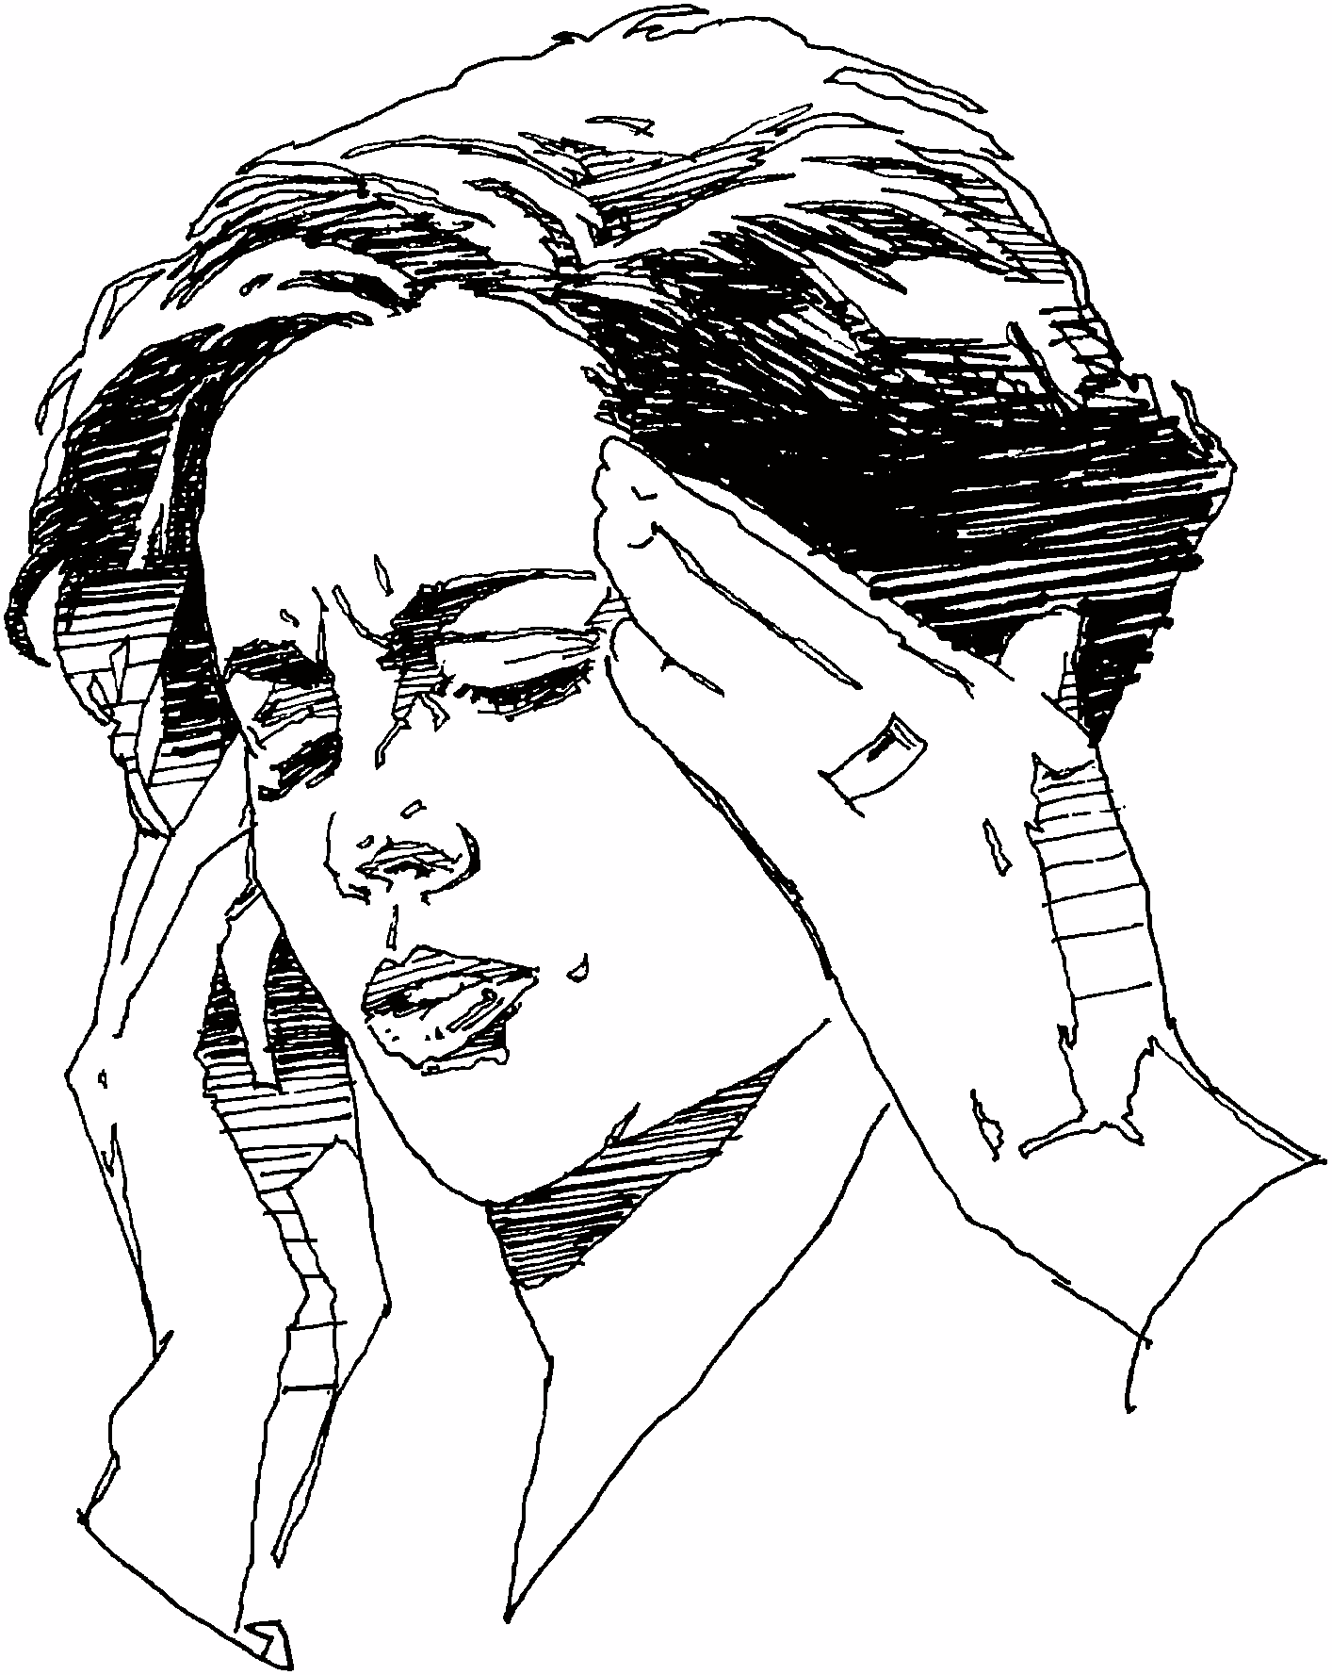
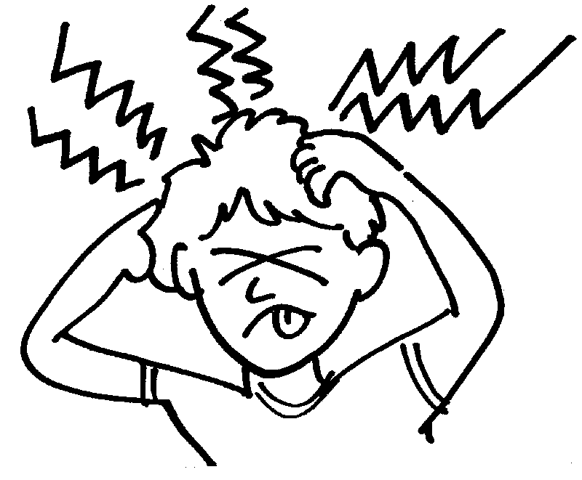
Picture Literacy
Photo of person with a headache
Color drawing of a person with a headache
(Do her eyes hurt?)
Black and white drawing of a person with a headache (What’s wrong with her hands?)
Stylized drawing of a person with a headache (Discuss the meaning of the strange squiggly lines.)

Slide 11
Resources Linked to Forms 27 and 28
Reading for Life – Volume One http://www.mnliteracy.org/sites/default/files/reading_for_life_volume_one.pdf
Unit 1: Pre Literacy Activities
Unit 5: Signs
Unit 8: Calendar
Unit 9: Clock Time
Reading for Life – Volume Two http://www.mnliteracy.org/sites/default/files/reading_for_life_volume_two.pdf
Unit 13: Coins and Currency
Page 68: Unit pricing
Page 49: Measurement

Slide 12
Resources linked to Forms 27 and 28
Multi-Cultural Educational Services http://www.mcedservices.com/PDFs.html
Alphabet and Number Flashcard Exercises
Calendar Exercises
Phonics Exercises
North Carolina Curriculum Guide http://www.nc-net.info/ESL/guide.php
Unit: Time
Unit: The Calendar
Unit: Buying Clothing
EL/Civics Education http://www.nc-net.info/ESL/Caldwell/year1.php
Address
Count and Use Currency
Date of Birth
Name
Phone Numbers

Slide 13
Targeted Online Activities for Student Use
Starfall
http://www.starfall.com/
Minneapolis ABE – ELL 0 Activities https://abeweb.mpls.k12.mn.us/Search.aspx?who=English-Level-0
johnmh.com
http://johnmh.com/ILA/28ILA.doc
Marshall Adult Education – Student Lessons http://www.marshalladulteducation.org/student-lessons
Adult and Family Education http://www.web-esl.com/
English-On-The-Web www.english-on-the-web.yolasite.com
ELL 0 Activities http://mndigital.dreamhosters.com/cdgLevel0/index.html

Slide 14
Low Beginning ESL

Slide 15
See a teacher in action!
Videos demonstrating best practices in teaching low level ESL learners (http://www.newamericanhorizons.org/training-videos)

Slide 16
Materials Online for Teacher Use
Reading For Life http://www.mnliteracy.org/tools/reading-for-life
HUBBS EL Civics “Introductions” Unit http://www.hubbs.spps.org/Introductions_Unit.html)
HUBBS EL Civics “Healthy Living” Unit http://www.hubbs.spps.org/Healthy_Living.html

Slide 17
Targeted Online Activities for Student Use
Minneapolis ABE https://abeweb.mpls.k12.mn.us/
Marshall Adult Education http://www.marshalladulteducation.org/student-lessons
Adult and Family Education http://www.web-esl.com/
johnmh.com http://www.johnmh.com/ILA/ila81r.html
johnmh.com http://www.johnmh.com/ILA/ila81rx.html
GCFLearnFree www.gcflearnfree.org
English-On-The-Web www.english-on-the-web.yolasite.com

Slide 18
Low Intermediate ESL

Slide 19
Questions for discussion:
How are the 83R/84R level tests different from the previous tests (81R, 82R, 81RX, 82RX)?
What does this mean for your instructional plans?

Slide 20
Incorporating Graphic Organizers
Freeology - http://freeology.com/graphicorgs/
Oracle ThinkQuest - http://library.thinkquest.org/J001156/writing%20process/writingprocess.htm
“Google” graphic organizers for many more choices

Slide 21
Sites for Reading Samples
Reading Skills for Today’s Adults http://www.marshalladulteducation.org/reading-skills-for-todays-adult
100 free Short English Stories for ESL Learners
http://www.rong-chang.com/qa2/index.html
EL Civics “Print & Go ESL Reading Worksheets”
http://www.elcivics.com/esl-ebooks-free.html

Slide 22
Materials Online for Teacher Use
Reading For Life http://www.mnliteracy.org/tools/reading-for-life
HUBBS EL Civics – “Food Safety” http://www.hubbs.spps.org/Food_Safety2.html
HUBBS EL Civics – “Construction” http://www.hubbs.spps.org/Construction_Skills.html

Slide 23
Targeted Online Activities for Student Use
Minneapolis ABE https://abeweb.mpls.k12.mn.us/
Marshall Adult Education http://www.marshalladulteducation.org/reading-skills-for-todays-adult
Adult and Family Education http://ww.web-esl.com/
johnmh.com – Form 83 Practice http://www.web-esl.com/ILA/ila83r.html
johnmh.com – Form 185 Practice http://www.web-esl.com/ILA/ila185.html
Learning Line www.rmpbs.org/resources/files/education/learningline
California Distance Learning Project http://www.cdlponline.org
GCFLearnFree www.gcflearnfree.org
English-On-The-Web www.english-on-the-web.yolasite.com

Slide 24
Advanced ESL

Slide 25
Some Strategies
Teach vocabulary
Work on fluency
Develop comprehension

Slide 26
Vocabulary Instruction
Teaching Vocabulary
http://www.thecenterweb.org/alrc/reading-pub.html
Teaching Vocabulary
http://abspd.appstate.edu/vocabulary-lessons
Word Lists for All Levels
http://www.seminolestate.edu/adult-ed/els/web_resources/esol-vocabulary-word-lists/

Slide 27
Fluency
Reading Skills for Today’s Adult
http://www.marshalladulteducation.org/index.php/reading-skills-for-todays-adult

Slide 28
Sites for Reading Comprehension Resources
Breaking News English
http://www.breakingnewsenglish.com/
Heads Up English
http://www.headsupenglish.com/
Learning Resources (A project of Literacyworks)
http://www.literacynet.org/cnnsf/
Reading Skills for Today’s Adults
http://www.marshalladulteducation.org/reading-skills-for-todays-adult
100 free Short English Stories for ESL Learners
http://www.rong-chang.com/qa2/

Slide 29
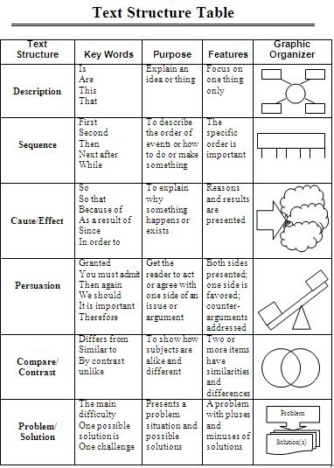
Graphic Organizers

Slide 30
Targeted Online Activities for Student Use
ABEWeb – Minneapolis ABE Level 5 https://abeweb.mpls.k12.mn.us/Search.aspx?who=English-Level-5
ABEWeb – Minneapolis ABE Level 6 https://abeweb.mpls.k12.mn.us/Search.aspx?who=English-Level-6
Marshall Adult Education http://www.marshalladulteducation.org/reading-skills-for-todays-adult
johnmh. com – Narrative practice http://johnmh.com/narratives/narratives34.htm
johnmh.com – Form 185/186 Practice http://johnmh.com/ILA/ila185.html
California Distance Learning Project http://www.cdlponline.org
GCFLearnFree www.gcflearnfree.org
English-On-The-Web www.english-on-the-web.yolasite.com

Slide 31
ABE/GED

Slide 32
Online Resources for Students
GED Test Prep Review
www.testprepreview.com/ged_practice.htm
Varsity Tutors
www.varsitytutors.com/practice-tests
GED On The Web
http://ged-on-the-web.yolasite.com
AAA Math
www.aaamath.com/B/lmpg.htm
Aplus Math
http://aplusmath.com
Simple Fractions
www.sosmath.com/algebra/fraction/frac3/frac3.html
Math Worksheets Land
www.mathworksheetsland.com
Math Goodies
http://mathgoodies.com
Khan Academy Dashboard
https://www.khanacademy.org/exercisedashboard
Khan Academy
https://www.khanacademy.org

Slide 33
Questions?

Slide 34
Review of CASAS Tools
Class Profile by Competency
Test Review
Sample Test Items –https://www.casas.org/product-overviews/curriculum-management-instruction/sample-test-items
Linking Documents
http://www.mnabeassessment.com/competency_links.html

Slide 35
CASAS Test Prep Sites
CASAS Test Prep Activities
http://www.milpitaschat.com/2010/04/casas-test-prep-activities-for-reading.html
CASAS Test Prep Websites & Docs (HUBBS)
http://hubbs.spps.org/casas_test_practice_websites.html
Minneapolis ABE
http://abe.mpls.k12.mn.us/goto.html?source=abeweb.mpls.k12.mn.us/
Test-Taking Practice: CASAS
http://www.seminolestate.edu/adult-ed/els/web_resources/test-taking
Adult and Family Education – CASAS Competency Links
http://www.web-esl.com/pages/ila.html

Slide 36
Your Assignment
Look at your “Class Profile by Competency” forms
Determine target competencies that need to be addressed
Go to http://www.mnabeassessment.com/competency_links.html

Slide 37
Two Options. . .
Search for lesson plans by competency
Search for lesson plans tied closely to the specific test item identified
Go to website

Slide 38
How to Develop a Competency-Based Lesson Plan (WIPPEA)
WIPPEA – Warm-up/Introduction
Presentation
Practice
Evaluation
Application
Warm-Up/Introduction:
Review of previously learned material. Prepare for new lesson. Establish purpose of lesson.

Slide 39
WIPPEA (continued)
Presentation:
Introduce new information and skills using a variety of activities and techniques. Use a variety of strategies: visuals, realia, lecture, demonstration.
Practice:
Provide the learners with the opportunity to practice the new information and skills by integrating the new information in a controlled context. Include Guided Practice (pair work, dictation, worksheets) and Communicative Practice (role play, team work, info exchange and problem-solving) when appropriate. During the practice, monitor learners and provide feedback.

Slide 40
WIPPEA (continued)
Evaluation/Assessment:
Assess the learners and provide feedback.
Application:
Learners apply new skills and knowledge in a functional context.

Slide 41
Link to Presentation
http://www.mnabeassessment.com/competency_links.html

Slide 42
Sharing

